Slide 1
business
Reporter：XXX

Slide 2
1
Work
2
Teaching
3
Plans
4
Opinion

Slide 3
Recent work
recent work
The recent work is the most important task

Slide 4
Recent work
Recent work
Plan A
topic1
topic2
topic3
topic4
Recent work
Plan B
topic1
topic2
topic3
topic4

Slide 5
Recent work
Topic A
The recentwork is the most important task
Topic B
The recentwork is the most important task
Topic C
The recentwork is the most important task

Slide 6
Teaching
Inspiration of Experience Learning Theory on Mathematic Activity Experience Teaching
Teaching
Inspiration of Experience Learning Theory

Slide 7
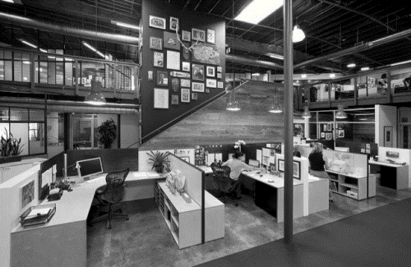
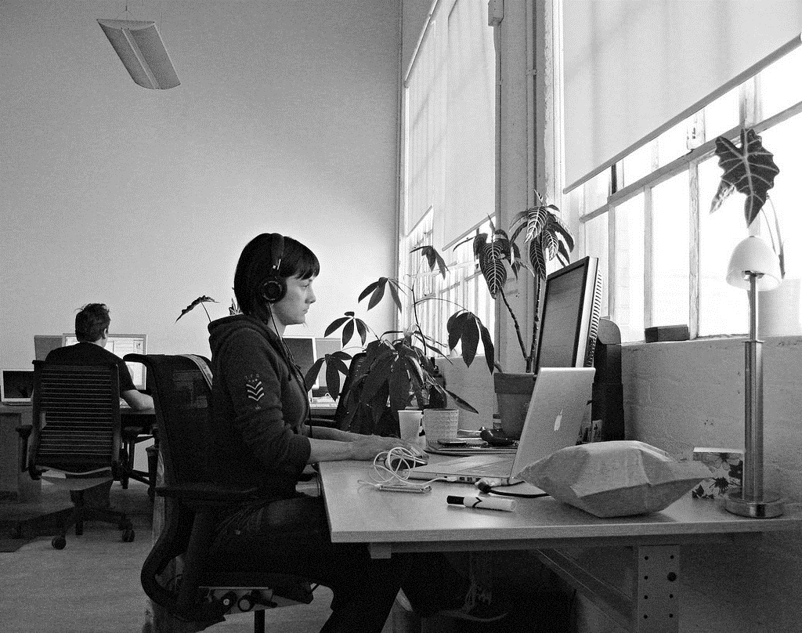
Teaching
Inspiration of Experience Learning Theory on Mathematic Activity Experience Teaching
Teaching
Teaching
Now the optimal way
Of the management of way thus wo can
Now the optimal way
Of the management of way thus wo can
Teaching
Teaching
Now the optimal way
Of the management of way thus wo can
Now the optimal way
Of the management of way thus wo can

Slide 8
Teaching
Inspiration of Experience Learning Theory on Mathematic Activity Experience Teaching
1.Now theoptimalway Of the management of way thus wo can
2.Now theoptimalway Of the management of way thus wo can
48%
65%
3.Now theoptimalway Of the management of way thus wo can
27%
12%

Slide 9
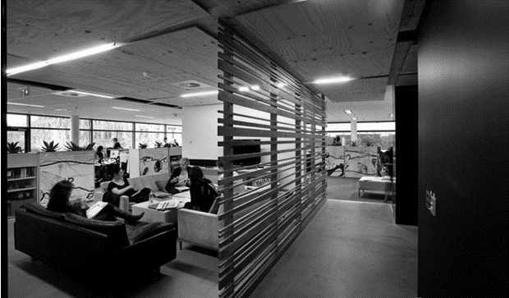
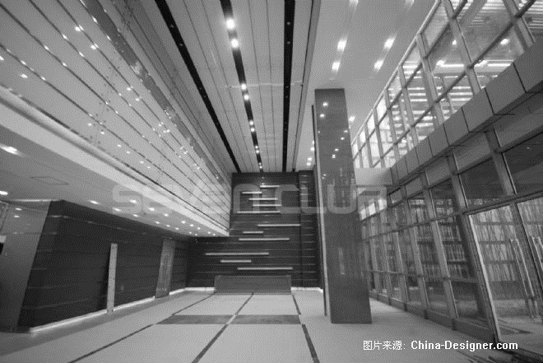
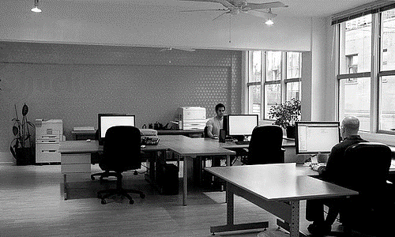
Stage plan
To enhance learning, and strive to improve their own quality

Slide 10
Stage Plan
Inspiration of Experience Learning Theory on Mathematic Activity Experience Teaching
E
D
C
B
A
0
2012
2013
2014
2015
2016
State Plan
To enhance learning, and strive to improve their own quality. According to the needs of the work, study hard safety in production of the relevant laws

Slide 11
Stage Plan
Inspiration of Experience Learning Theory on Mathematic Activity Experience Teaching
Lots of people
Wo can all do lots of things and thus the company will be bet and more.
Few people
Wo can all do lots of things and thus the company will.
63%

Slide 12
opinions
Personal recommendations are often very work to the development of our company

Slide 13
Opinion
Inspiration of Experience Learning Theory on Mathematic Activity Experience Teaching
Opinion
Opinion
Wo can all do lots of things .
Wo can all do lots of things and thus the company will be bet and more
Opinion
Wo can all do lots
Opinion
Wo can all do a lot of things thus a lot
Opinion
Wo can all do lots of things
Opinion

Slide 14
Opinion
Inspiration of Experience Learning Theory on Mathematic Activity Experience Teaching
For male Wo can all do lots of things and thus the company will be bet and more
For female Wo can all do lots of things and thus the company will be bet and more
48%
52%

Slide 15
thankyou

Slide 16
Best PPT templates for free download
https://www.freeppt7.com

