Slide 1







简洁少女心PPT模板
When a cigarette falls in love with a match,it is destined to be hurt.
When a cigarette falls in love with a match,it is destined to be hurt.

Slide 2
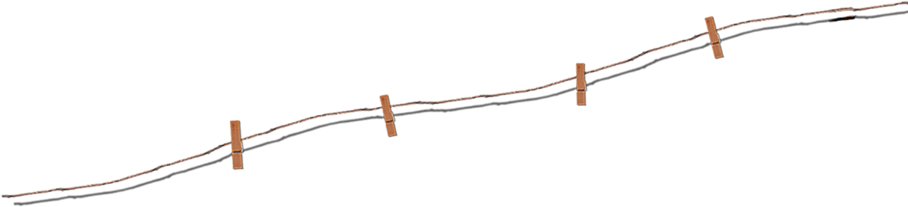
目 录
Contents
单击此处输入标题文本
Click here to add your title
单击此处输入标题文本
Click here to add your title
单击此处输入标题文本
Click here to add your title
单击此处输入标题文本
Click here to add your title

Slide 3
01
单击此处输入标题文本

Slide 4
单击此处输入
标题文本
单击此处输入标题
If they throw stones at you, don’t throw back, use them to build your own foundation instead.
单击此处输入标题
单击此处输入标题
If they throw stones at you, don’t throw back, use them to build your own foundation instead.
If they throw stones at you, don’t throw back, use them to build your own foundation instead.
单击此处输入标题
单击此处输入标题
If they throw stones at you, don’t throw back, use them to build your own foundation instead.
If they throw stones at you, don’t throw back, use them to build your own foundation instead.

Slide 5
单击此处输入
标题文本
单击此处输入标题
No one indebted for others,while many people don't know how to cherish others.
输入
标题
单击此处输入标题
单击此处输入
标题
输入
标题
No one indebted for others,while many people don't know how to cherish others.
单击此处输入标题
单击此处输入标题
No one indebted for others,while many people don't know how to cherish others.
单击此处输入标题
No one indebted for others,while many people don't know how to cherish others.

Slide 6
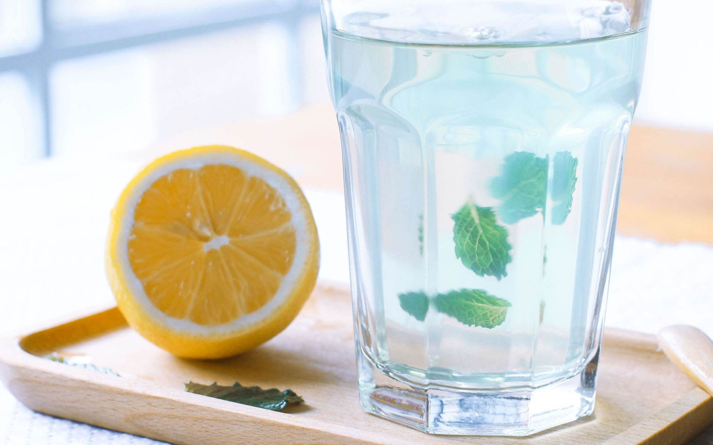

单击此处输入
标题文本
单击此处输入标题
If they throw stones at you, don’t throw back, use them to build your own foundation instead.If they throw stones at you, don’t throw back, use them to build your own foundation instead.
单击此处输入标题
If they throw stones at you, don’t throw back, use them to build your own foundation instead.If they throw stones at you, don’t throw back, use them to build your own foundation instead.

Slide 7
单击此处输入
标题文本
单击此处输入标题
单击此处输入标题
单击此处输入标题
If they throw stones at you, don’t throw back, use them to build your own foundation instead.If they throw stones at you, don’t throw back, use them to build your own foundation instead.
If they throw stones at you, don’t throw back, use them to build your own foundation instead.If they throw stones at you, don’t throw back, use them to build your own foundation instead.
If they throw stones at you, don’t throw back, use them to build your own foundation instead.If they throw stones at you, don’t throw back, use them to build your own foundation instead.

Slide 8
02
单击此处输入标题文本

Slide 9
单击此处输入
标题文本
单击此处输入标题
If they throw stones at you, don’t throw back, use them to build your own foundation instead.
单击此处输入标题
If they throw stones at you, don’t throw back, use them to build your own foundation instead.
单击此处输入标题
If they throw stones at you, don’t throw back, use them to build your own foundation instead.
单击此处输入标题
If they throw stones at you, don’t throw back, use them to build your own foundation instead.

Slide 10



单击此处输入
标题文本
单击此处输入标题
单击此处输入标题
单击此处输入标题
No one indebted for others,while many people don't know how to cherish others.
No one indebted for others,while many people don't know how to cherish others.
No one indebted for others,while many people don't know how to cherish others.

Slide 11
单击此处输入
标题文本
If they throw stones at you, don’t throw back, use them to build your own foundation instead.
If they throw stones at you, don’t throw back, use them to build your own foundation instead.
单击此处输入标题
单击此处输入标题
单击此处输入标题
单击此处输入标题
If they throw stones at you, don’t throw back, use them to build your own foundation instead.
If they throw stones at you, don’t throw back, use them to build your own foundation instead.

Slide 12




单击此处输入
标题文本
单击此处输入标题
单击此处输入标题
单击此处输入标题
单击此处输入标题
No one indebted for others,while many people don't know how to cherish others.
No one indebted for others,while many people don't know how to cherish others.
No one indebted for others,while many people don't know how to cherish others.
No one indebted for others,while many people don't know how to cherish others.

Slide 13
单击此处输入
标题文本
单击此处输入标题
单击此处输入标题
单击此处输入标题
单击此处输入标题
No one indebted for others,while many people don't know how to cherish others.
单击此处输入标题
No one indebted for others,while many people don't know how to cherish others.
No one indebted for others,while many people don't know how to cherish others.
No one indebted for others,while many people don't know how to cherish others.
No one indebted for others,while many people don't know how to cherish others.

Slide 14
03
单击此处输入标题文本

Slide 15
单击此处输入
标题文本
单击此处输入标题
单击此处输入标题
单击此处输入标题
No one indebted for others,while many people don't know how to cherish others.
No one indebted for others,while many people don't know how to cherish others.
No one indebted for others,while many people don't know how to cherish others.
单击此处输入标题
单击此处输入标题
单击此处输入标题
No one indebted for others,while many people don't know how to cherish others.
No one indebted for others,while many people don't know how to cherish others.
No one indebted for others,while many people don't know how to cherish others.

Slide 16



单击此处输入
标题文本
单击此处输入标题
No one indebted for others,while many people don't know how to cherish others.No one indebted for others,while many people don't know how to cherish others.
单击此处输入标题
No one indebted for others,while many people don't know how to cherish others.No one indebted for others,while many people don't know how to cherish others.

Slide 17
单击此处输入
标题文本
单击此处输入标题
No one indebted for others,while many people don't know how to cherish others.
单击此处输入标题
No one indebted for others,while many people don't know how to cherish others.
单击此处输入标题
No one indebted for others,while many people don't know how to cherish others.
单击此处输入标题
No one indebted for others,while many people don't know how to cherish others.
单击此处输入标题
No one indebted for others,while many people don't know how to cherish others.

Slide 18




单击此处输入
标题文本
No one indebted for others,while many people don't know how to cherish others.
单击此处输入标题
No one indebted for others,while many people don't know how to cherish others.

Slide 19
单击此处输入
标题文本
单击此处输入标题
No one indebted for others,while many people don't know how to cherish others.
单击此处输入标题
No one indebted for others,while many people don't know how to cherish others.
单击此处输入标题
No one indebted for others,while many people don't know how to cherish others.
01
02
单击此处输入标题
03
No one indebted for others,while many people don't know how to cherish others.
04
05
单击此处输入标题
No one indebted for others,while many people don't know how to cherish others.

Slide 20
04
单击此处输入标题文本

Slide 21
单击此处输入
标题文本
No one indebted for others,while many people don't know how to cherish others.
No one indebted for others,while many people don't know how to cherish others.
No one indebted for others,while many people don't know how to cherish others.
输入标题
输入标题
输入标题
输入标题
输入标题
No one indebted for others,while many people don't know how to cherish others.
No one indebted for others,while many people don't know how to cherish others.

Slide 22
单击此处输入
标题文本
80%
75%
90%
60%
单击此处输入标题
单击此处输入标题
单击此处输入标题
单击此处输入标题
No one indebted for others,while many people don't know how to cherish others.
No one indebted for others,while many people don't know how to cherish others.
No one indebted for others,while many people don't know how to cherish others.
No one indebted for others,while many people don't know how to cherish others.

Slide 23

单击此处输入
标题文本
单击此处输入标题
Remember what should be remembered, and forget what should be forgotten.Alter what is changeable, and accept what is unchangeable.
When a cigarette falls in love with a match,it is destined to be hurt.
When a cigarette falls in love with a match,it is destined to be hurt.
When a cigarette falls in love with a match,it is destined to be hurt.
When a cigarette falls in love with a match,it is destined to be hurt.

Slide 24
单击此处输入
标题文本
单击此处输入标题
单击此处输入标题
If they throw stones at you, don’t throw back, use them to build your own foundation instead.
If they throw stones at you, don’t throw back, use them to build your own foundation instead.
单击此处输入标题
单击此处输入标题
If they throw stones at you, don’t throw back, use them to build your own foundation instead.
If they throw stones at you, don’t throw back, use them to build your own foundation instead.

Slide 25
展示完毕 感谢欣赏
When a cigarette falls in love with a match,it is destined to be hurt.
When a cigarette falls in love with a match,it is destined to be hurt.

Slide 26

Best PPT templates for free download
https://www.freeppt7.com

