Slide 1
Elegant pattern simple Wind PPT Template
When the a cigarette falls in love with a match,it was destined to be hurt.
When the a cigarette falls in love with a match,it was destined to be hurt.
Click here to enter your company name

Slide 2
01
Click here to enter title text
Directory
02
Click here to enter title text
Contents
03
Click here to enter title text
04
Click here to enter title text

Slide 3
01
Click here to enter title text
Click here to enter descriptive text
Click here to enter descriptive text
Click here to enter descriptive text

Slide 4
Click here to enterTitle text
Click here to enter a title
When the a cigarette falls in love with a match,it was destined to be hurt.
Click here to enter a title
When the a cigarette falls in love with a match,it was destined to be hurt.
Click here to enter a title
When the a cigarette falls in love with a match,it was destined to be hurt.
Click here to enter a title
When the a cigarette falls in love with a match,it was destined to be hurt.
Click here to enter a title
When the a cigarette falls in love with a match,it was destined to be hurt.

Slide 5
Click here to enterTitle text
Click here to enter a title
When the a cigarette falls in love with a match,it was destined to be hurt.
Click here to enter a title
When the a cigarette falls in love with a match,it was destined to be hurt.
Click here to enter a title
When the a cigarette falls in love with a match,it was destined to be hurt.
Click here to enter a title
When the a cigarette falls in love with a match,it was destined to be hurt.
Click here to enter a title
When the a cigarette falls in love with a match,it was destined to be hurt.
Click here to enter a title
When the a cigarette falls in love with a match,it was destined to be hurt.

Slide 6
Click here to enterTitle text
01
02
03
04
Click here to enter a title
Click here to enter a title
Click here to enter a title
Click here to enter a title
When the a cigarette falls in love with a match,it was destined to be hurt.
When the a cigarette falls in love with a match,it was destined to be hurt.
When the a cigarette falls in love with a match,it was destined to be hurt.
When the a cigarette falls in love with a match,it was destined to be hurt.

Slide 7
Click here to enterTitle text
Click here to enter a title
When the a cigarette falls in love with a match,it was destined to be hurt.
Click here to enter a title
Click here to enter a title
When the a cigarette falls in love with a match,it was destined to be hurt.
When the a cigarette falls in love with a match,it was destined to be hurt.
Click here to enter a title
Click here to enter a title
When the a cigarette falls in love with a match,it was destined to be hurt.
When the a cigarette falls in love with a match,it was destined to be hurt.

Slide 8
02
Click here to enter title text
Click here to enter descriptive text
Click here to enter descriptive text
Click here to enter descriptive text

Slide 9
Click here to enterTitle text
Click here to enter a title
When the a cigarette falls in love with a match,it was destined to be hurt.
Click here to enter a title
When the a cigarette falls in love with a match,it was destined to be hurt.
Click here to enter a title
When the a cigarette falls in love with a match,it was destined to be hurt.
1
3
5
2
4
Click here to enter a title
When the a cigarette falls in love with a match,it was destined to be hurt.
Click here to enter a title
When the a cigarette falls in love with a match,it was destined to be hurt.

Slide 10
Click here to enterTitle text
If They throw stones at your, don ' t throw back, use them to build your own foundation instead.
If They throw stones at your, don ' t throw back, use them to build your own foundation instead.
If They throw stones at your, don ' t throw back, use them to build your own foundation instead.
Click here
Enter title
Click here
Enter title
Click here
Enter title

Slide 11
Click here to enterTitle text
Click here to enter a title
Click here to enter a title
Click here to enter a title
Click here to enter a title
If They throw stones at your, don ' t throw back, use them to build your own foundation instead.
If They throw stones at your, don ' t throw back, use them to build your own foundation instead.
If They throw stones at your, don ' t throw back, use them to build your own foundation instead.
If They throw stones at your, don ' t throw back, use them to build your own foundation instead.

Slide 12
Click here to enterTitle text
If They throw stones at your, don ' t throw back, use them to build your own foundation instead. If They throw stones at your, don ' t throw back, use them to build your own foundation instead. If They throw stones at your, don ' t throw back, use them to build your own foundation instead. If They throw stones at your, don ' t throw back, use them to build your own foundation instead.
Click here to enter a title
If They throw stones at your, don ' t throw back, use them to build your own foundation instead. If They throw stones at your, don ' t throw back, use them to build your own foundation instead. If They throw stones at your, don ' t throw back, use them to build your own foundation instead.

Slide 13
Click here to enterTitle text
Click here to enter a title
When the a cigarette falls in love with a match,it was destined to be hurt.
Click here to enter a title
When the a cigarette falls in love with a match,it was destined to be hurt.
Click here to enter a title
Click here to enter a title
When the a cigarette falls in love with a match,it was destined to be hurt.

Slide 14
03
Click here to enter title text
Click here to enter descriptive text
Click here to enter descriptive text
Click here to enter descriptive text

Slide 15
Click here to enterTitle text
Click here to enter a title
When the a cigarette falls in love with a match,it was destined to be hurt.
Click here to enter a title
When the a cigarette falls in love with a match,it was destined to be hurt.
Click here to enter a title
When the a cigarette falls in love with a match,it was destined to be hurt.
.
Click here to enter a title
When the a cigarette falls in love with a match,it was destined to be hurt.
Click here to enter a title
When the a cigarette falls in love with a match,it was destined to be hurt.
Click here to enter a title
When the a cigarette falls in love with a match,it was destined to be hurt.

Slide 16
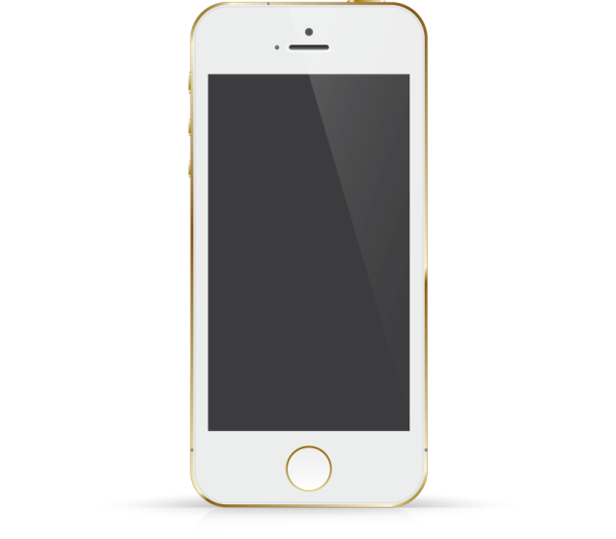
Click here to enterTitle text
Enter text
Click here to enter a title
When the a cigarette falls in love with a match,it was destined to be hurt.
Enter text
Click here to enter a title
When the a cigarette falls in love with a match,it was destined to be hurt.
Enter text
When the a cigarette falls in love with a match,it was destined to be hurt.
When the a cigarette falls in love with a match,it was destined to be hurt.
Enter text

Slide 17
Click here to enterTitle text
When the a cigarette falls in love with a match,it was destined to be hurt.
When the a cigarette falls in love with a match,it was destined to be hurt.
When the a cigarette falls in love with a match,it was destined to be hurt.
When the a cigarette falls in love with a match,it was destined to be hurt.
Click here to enter a title
When the a cigarette falls in love with a match,it was destined to be hurt.
Click here to enter a title
When the a cigarette falls in love with a match,it was destined to be hurt.
Click here to enter a title
When the a cigarette falls in love with a match,it was destined to be hurt.
Click here to enter a title
When the a cigarette falls in love with a match,it was destined to be hurt.

Slide 18
Click here to enterTitle text
“
”
If They throw stones at your, don ' t throw back, use them to build your own foundation instead.
If They throw stones at your, don ' t throw back, use them to build your own foundation instead.
Click here to enter a title
If They throw stones at your, don ' t throw back, use them to build your own foundation instead.

Slide 19
Click here to enterTitle text
Click here to enter a title
If They throw stones at your, don ' t throw back, use them to build your own foundation instead.
Click here to enter a title
If They throw stones at your, don ' t throw back, use them to build your own foundation instead.
Click here to enter a title
If They throw stones at your, don ' t throw back, use them to build your own foundation instead.
Click here to enter a title
If They throw stones at your, don ' t throw back, use them to build your own foundation instead.
Click here to enter a title
If They throw stones at your, don ' t throw back, use them to build your own foundation instead.
Click here to enter a title
If They throw stones at your, don ' t throw back, use them to build your own foundation instead.
Click here to enter a title
If They throw stones at your, don ' t throw back, use them to build your own foundation instead.
Click here to enter a title
If They throw stones at your, don ' t throw back, use them to build your own foundation instead.

Slide 20
04
Click here to enter title text
Click here to enter descriptive text
Click here to enter descriptive text
Click here to enter descriptive text

Slide 21
Click here to enterTitle text
If They throw stones at your, don ' t throw back, use them to build your own foundation instead.
If They throw stones at your, don ' t throw back, use them to build your own foundation instead.
Click here to enter a title
Click here to enter a title
Click here to enter a title
If They throw stones at your, don ' t throw back, use them to build your own foundation instead.
Click here to enter a title
If They throw stones at your, don ' t throw back, use them to build your own foundation instead.

Slide 22
Click here to enterTitle text
“
Click here to enter a title
When the a cigarette falls in love with a match,it was destined to be hurt.
If They throw stones at your, don ' t throw back, use them to build your own foundation instead.
If They throw stones at your, don ' t throw back, use them to build your own foundation instead.
If They throw stones at your, don ' t throw back, use them to build your own foundation instead.
If They throw stones at your, don ' t throw back, use them to build your own foundation instead.

Slide 23
Click here to enterTitle text
Click here to enter a title
When the a cigarette falls in love with a match,it was destined to be hurt.
S
W
Click here to enter a title
When the a cigarette falls in love with a match,it was destined to be hurt.
O
T
Click here to enter a title
When the a cigarette falls in love with a match,it was destined to be hurt.
Click here to enter a title
When the a cigarette falls in love with a match,it was destined to be hurt.

Slide 24
Click here to enterTitle text
Click here to enter a title
Click here to enter a title
If They throw stones at your, don ' t throw back, use them to build your own foundation instead.
If They throw stones at your, don ' t throw back, use them to build your own foundation instead.
Click here to enter a title
Click here to enter a title
Click here to enter a title
If They throw stones at your, don ' t throw back, use them to build your own foundation instead.
If They throw stones at your, don ' t throw back, use them to build your own foundation instead.

Slide 25
THANK
When the a cigarette falls in love with a match,it was destined to be hurt. When the a cigarette falls in love with a match,it was destined to be hurt.

Slide 26
Best PPT templates for free download
Https://www.freeppt7.com

