Slide 1

Business Office and food enjoyment
Business and Entertainment

Slide 2
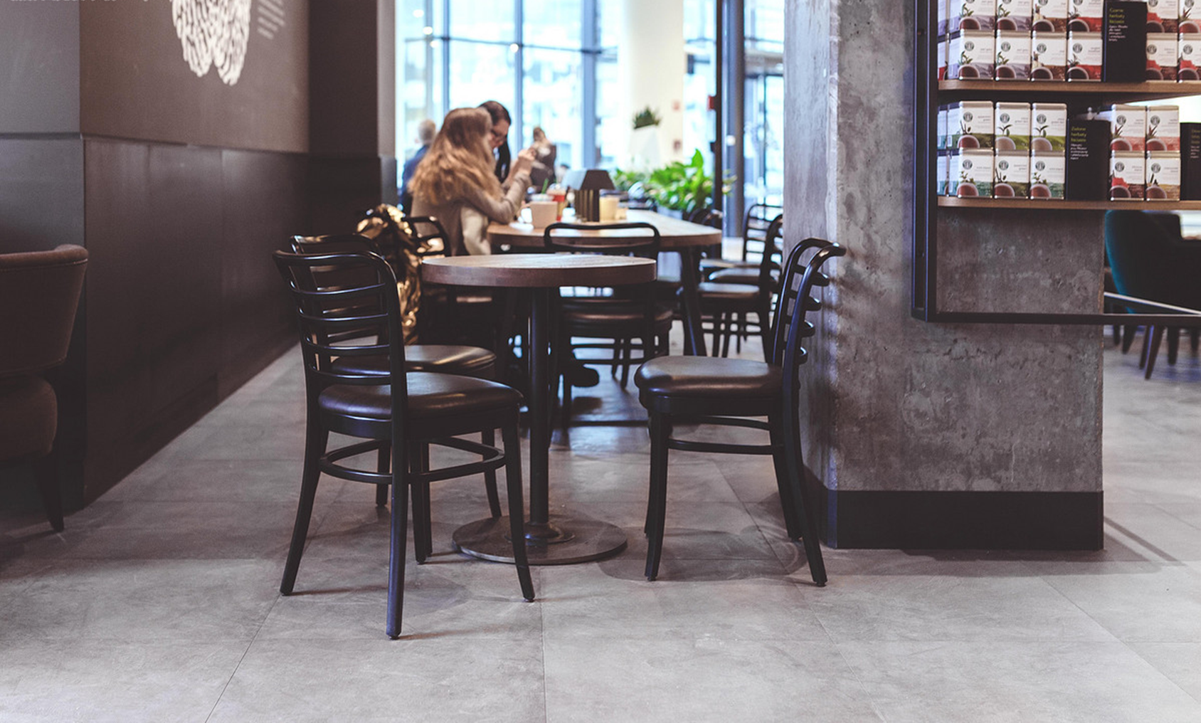
WELCOME
Start a wonderful journey with me
When we are working happily, we don't forget the pleasure that food brings to me.。
When we are working happily, we do not forget the happiness that food brings to me, we have been imagining that this work can bring us surprises, joy and happiness. Sometimes when we in the blink of an eye the beautiful things are no longer, we can only with food, when we in a hurry to enjoy the pleasure of food, perhaps all the troubles will vanish, we began to learn to embrace a better future.

Slide 3

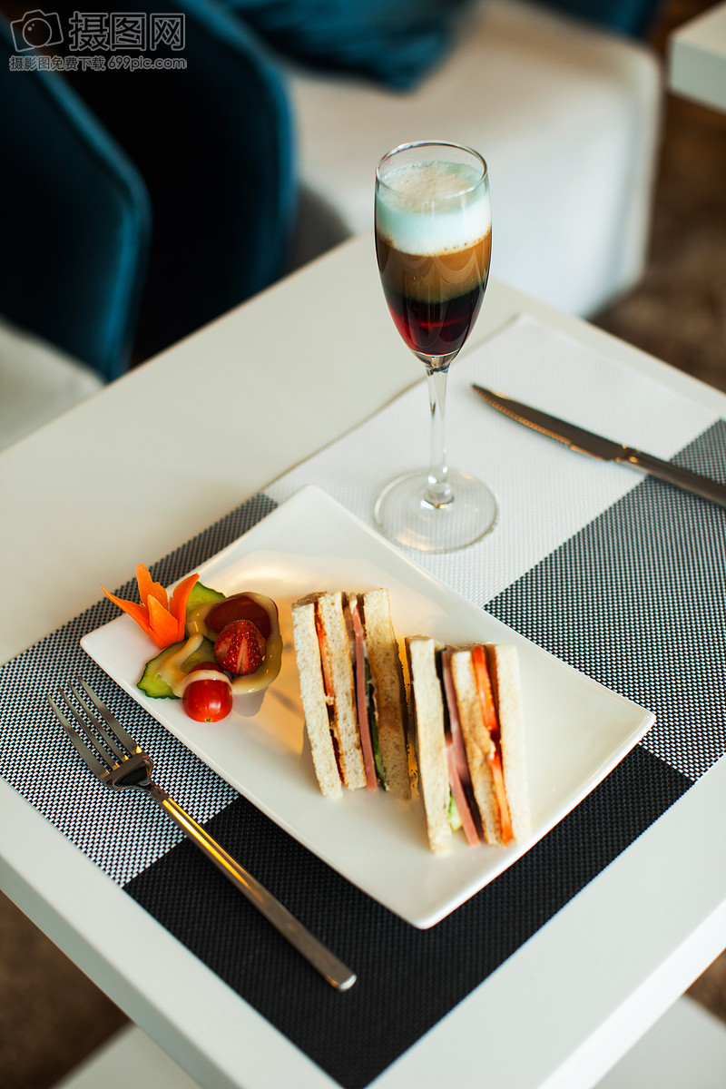
What you type here
What you type here
What you type here
When we are working happily, we don't forget the pleasure that food brings to me.
When we are working happily, we don't forget the pleasure that food brings to me.
When we are working happily, we don't forget the pleasure that food brings to me.

Slide 4
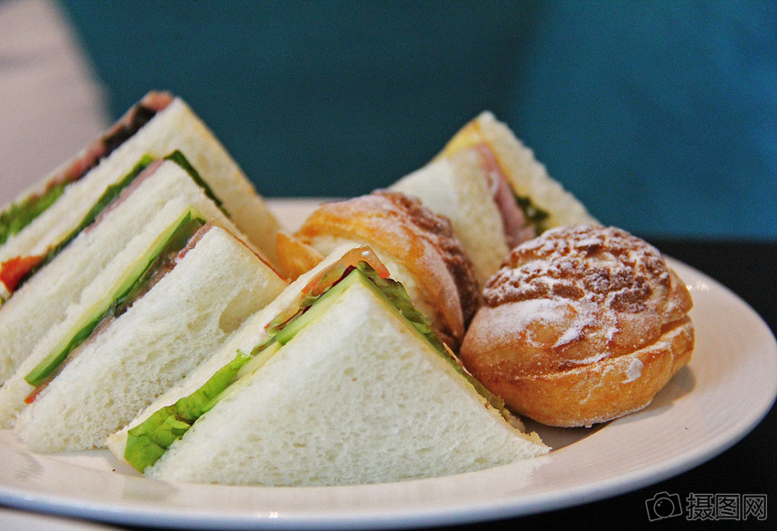
Business Office and food enjoyment
TYPE the CAPTION
You want to EXPRESS
When we are working happily, we do not forget the happiness that food brings to me, we have been imagining that this work can bring us surprises, joy and happiness. Sometimes when we in the blink of an eye the beautiful things are no longer, we can only with food, when we in a hurry to enjoy the pleasure of food, perhaps all the troubles will vanish, we began to learn to embrace a better future.

Slide 5

TYPE the CAPTION
You want to EXPRESS
What you type here
When we are in the happy work, do not forget the food to bring me happiness, we have been imagining that this work can bring us surprises, joy and happiness.
When we are working happily, we don't forget the pleasure that food brings to me.
Type here to type here what you type here
Type here to type here what you type here

Slide 6
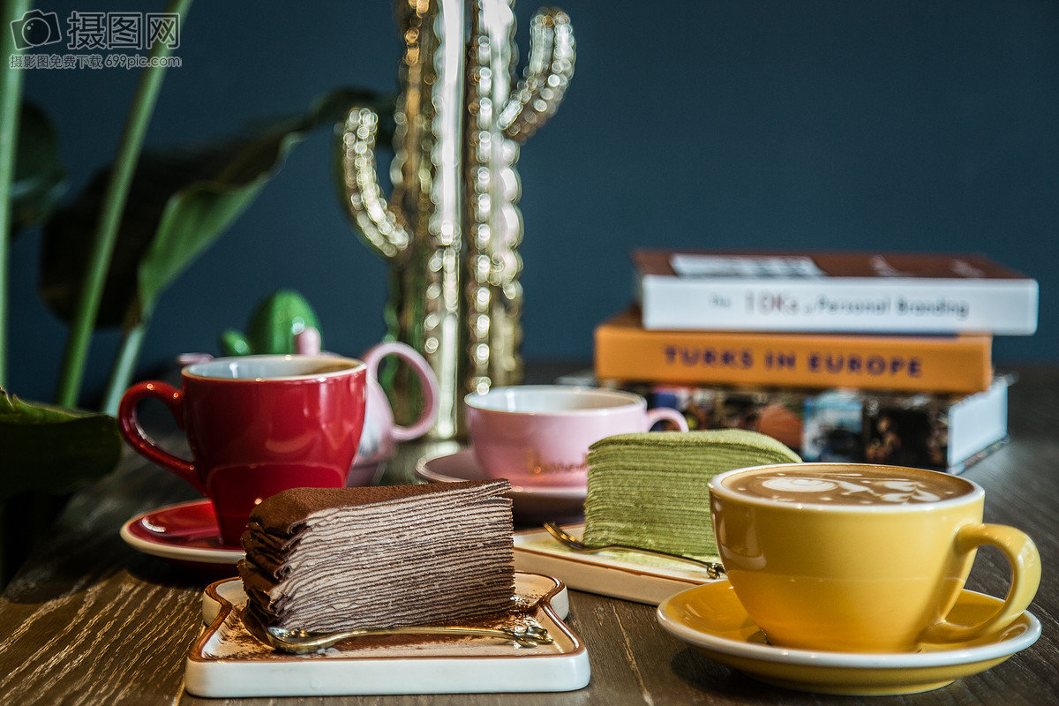
Business Office and food enjoyment
TYPE the CAPTION
You want to EXPRESS
When we are working happily, we don't forget the pleasure that food brings to me.
When we are working happily, we don't forget the pleasure that food brings to me.
When we are working happily, we don't forget the pleasure that food brings to me.
When we were working happily,
Happy cooperation
Happy Learning

Slide 7
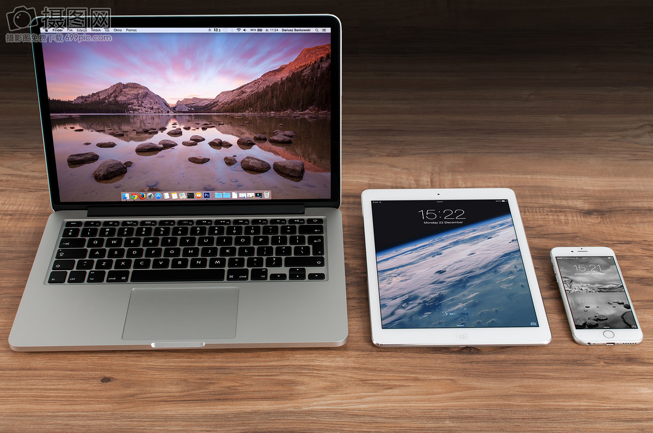
Business Office and food enjoyment
Business and Entertainment
Business Office and food enjoyment
Business Office and food enjoyment
When we are working happily, we do not forget the happiness that food brings to me, we have been imagining that this work can bring us surprises, joy and happiness.
When we are working happily, we do not forget the happiness that food brings to me, we have been imagining that this work can bring us surprises, joy and happiness.
Business Office and food enjoyment
Business Office and food enjoyment
When we are working happily, we do not forget the happiness that food brings to me, we have been imagining that this work can bring us surprises, joy and happiness.
When we are working happily, we do not forget the happiness that food brings to me, we have been imagining that this work can bring us surprises, joy and happiness.

Slide 8
TYPE the CAPTION
You want to EXPRESS
When we are working happily, we don't forget the pleasure that food brings to me.
When we are working happily, we don't forget the pleasure that food brings to me.
When we are working happily, we don't forget the pleasure that food brings to me.
Type here to type here what you type here
When we are in the happy work, do not forget the food to bring me happiness, we have been imagining that this work can bring us surprises, joy and happiness.
When we are in the happy work, do not forget the food to bring me happiness, we have been imagining that this work can bring us surprises, joy and happiness.

Slide 9
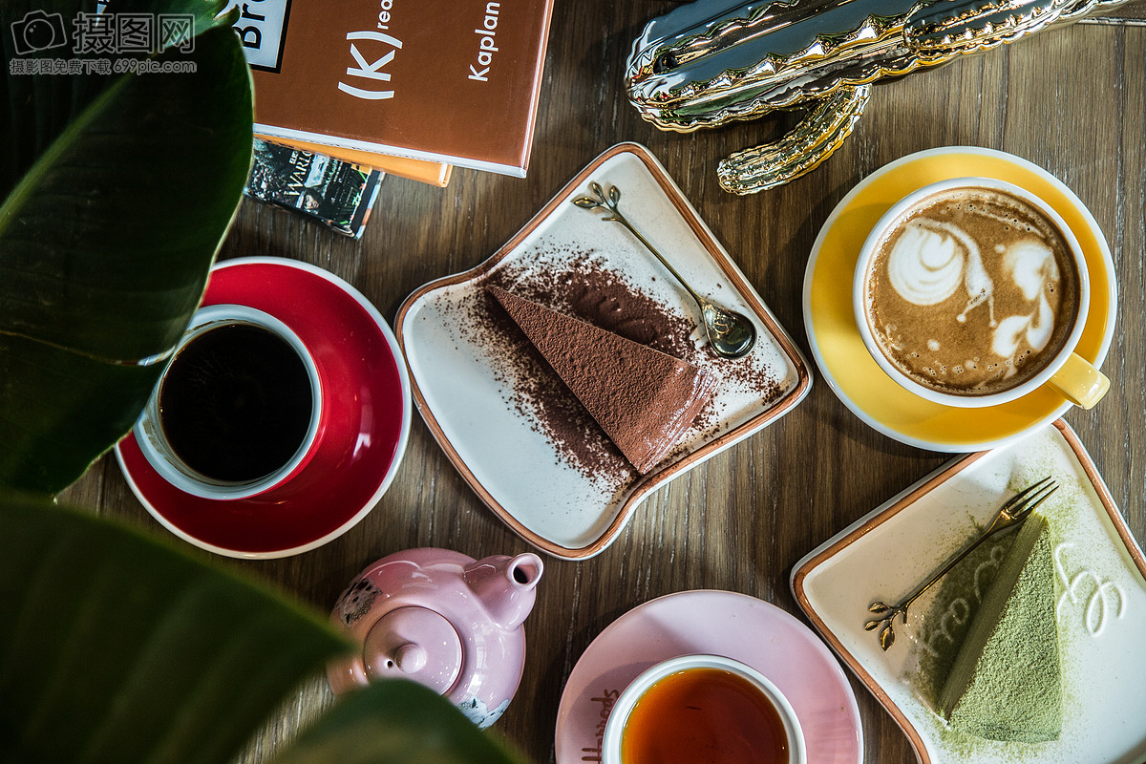
Business Office and food enjoyment
TYPE the CAPTION
You want To EXPRESS
Type here to type here what you type here
Type here to type here what you type here
Type here to type here what you type here
Type here to type here what you type here
Type in your content

Slide 10
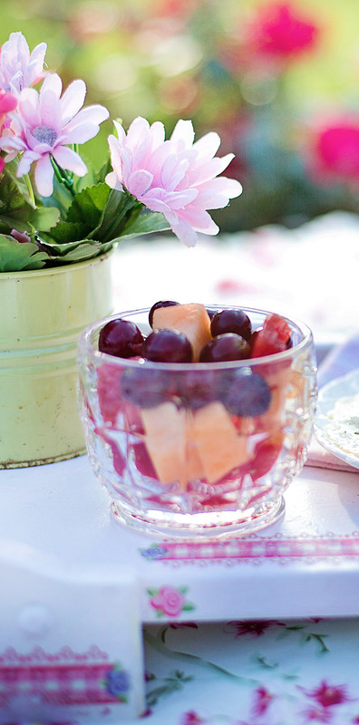
Business Office and food enjoyment
When we are working happily,
I do not forget the joy of food to bring me.
When we are working happily,
I do not forget the joy of food to bring me.
When we are working happily,
I do not forget the joy of food to bring me.

Slide 11
Business Office and food enjoyment
Business Office and food enjoyment
When we are working happily, we don't forget the pleasure that food brings to me.
When we are working happily, we don't forget the pleasure that food brings to me.
When we are working happily, we don't forget the pleasure that food brings to me.
Business Office and food enjoyment
When we are working happily, we don't forget the pleasure that food brings to me.
When we are working happily, we don't forget the pleasure that food brings to me.
When we are working happily, we don't forget the pleasure that food brings to me.

Slide 12

Food and enjoy
Food and enjoy
Food and enjoy
Food and enjoy
When we are working happily.
When we are working happily.
When we are working happily.
When we are working happily.
When we are working happily.
When we are working happily.
When we are working happily.
When we are working happily.
When we are working happily.
When we are working happily.
When we are working happily.
When we are working happily.

Slide 13
Business Office and food enjoyment
TYPE the CAPTION
You want to EXPRESS
TYPE the CAPTION
You want to EXPRESS
TYPE the CAPTION
You want to EXPRESS
01
02
03
Food and enjoy
Food and enjoy
Food and enjoy
When we are working happily.
When we are working happily.
When we are working happily.
When we are working happily.
When we are working happily.
When we are working happily.
When we are working happily.
When we are working happily.
When we are working happily.

Slide 14
Business Office and food enjoyment
01
TYPE the CAPTION
You want to EXPRESS
Food and enjoy
When we are working happily.
When we are working happily.
When we are working happily.
02
TYPE the CAPTION
You want to EXPRESS
TYPE the CAPTION
You want to EXPRESS
03
Food and enjoy
Food and enjoy
When we are working happily.
When we are working happily.
When we are working happily.
When we are working happily.
When we are working happily.
When we are working happily.

Slide 15

Business Office and food enjoyment
Business
Food
Office
TYPE the CAPTION
You want to EXPRESS
Food and enjoy
When we are working happily.
When we are working happily.
When we are working happily.

Slide 16
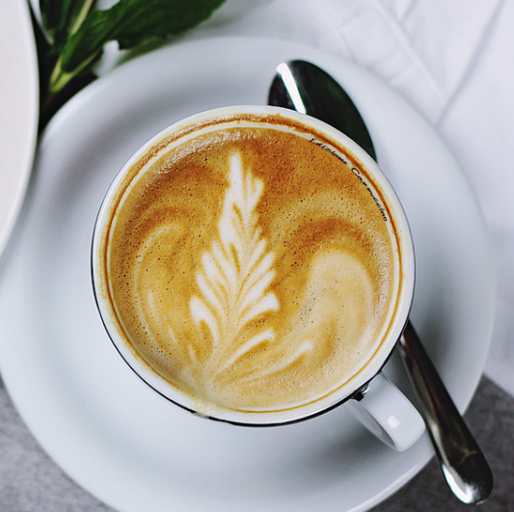
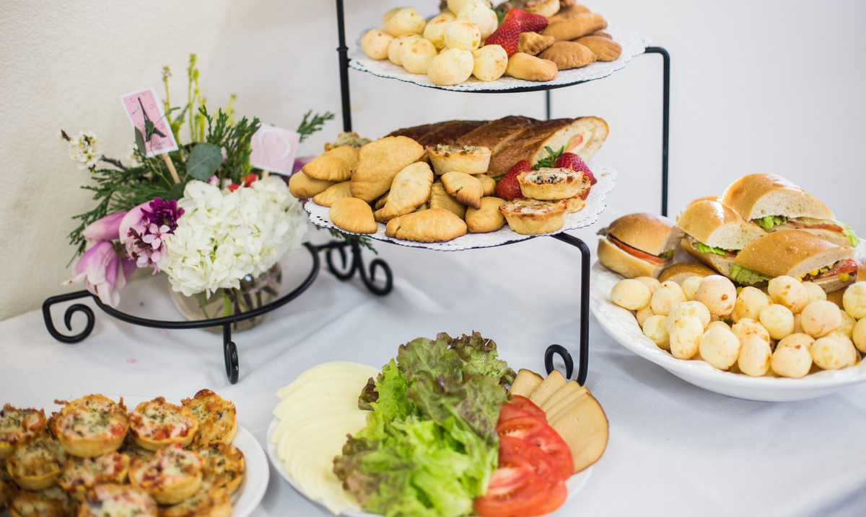
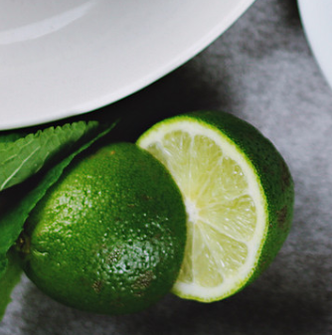
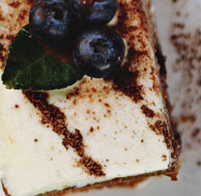
Business Office and food enjoyment
Food and enjoy
When we are working happily.
When we are working happily.
When we are working happily.
Food and enjoy
When we are working happily.
When we are working happily.
When we are working happily.
Food and enjoy
TYPE the CAPTION
You want to EXPRESS
Food and enjoy
When we are working happily.
When we are working happily.
When we are working happily.
When we are working happily.
When we are working happily.
When we are working happily.

Slide 17
Business Office and food enjoyment
TYPE the CAPTION
You want to EXPRESS
TYPE the CAPTION
You want to EXPRESS
Food and enjoy
Food and enjoy
01
When we are working happily.
When we are working happily.
When we are working happily.
When we are working happily.
When we are working happily.
When we are working happily.
02
03
TYPE the CAPTION
You want to EXPRESS
Food and enjoy
04
TYPE the CAPTION
You want to EXPRESS
Food and enjoy
When we are working happily.
When we are working happily.
When we are working happily.
When we are working happily.
When we are working happily.
When we are working happily.

Slide 18
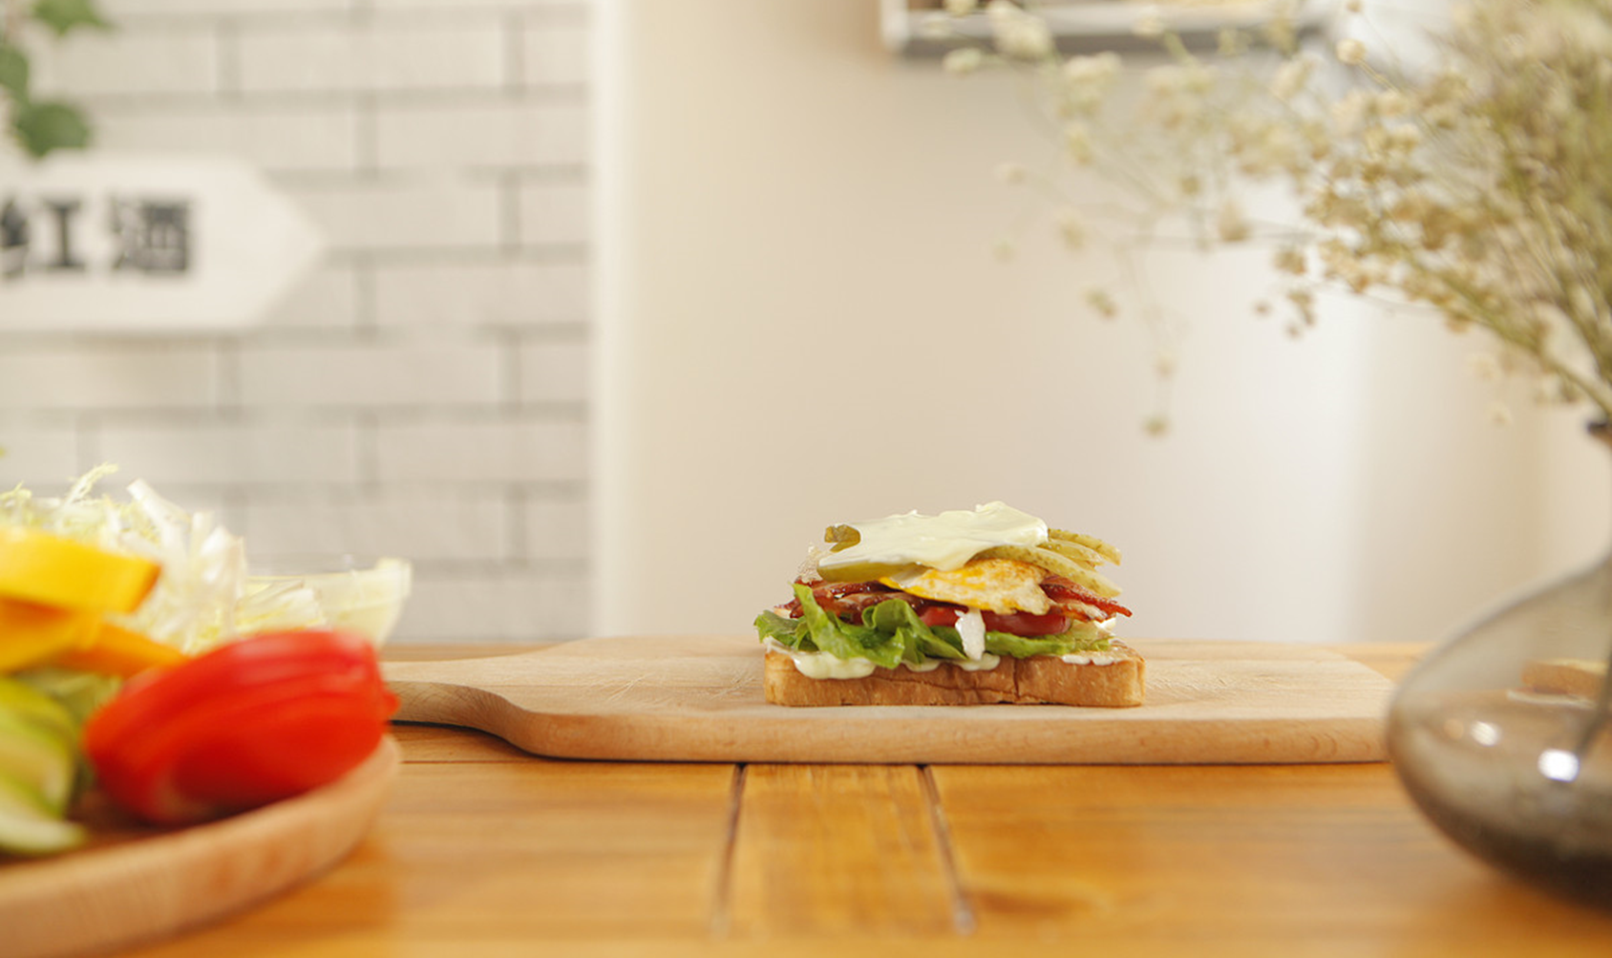
WELCOME
Start a wonderful journey with me
When we are working happily, we don't forget the pleasure that food brings to me.

Slide 19

TYPE the CAPTION
You want to EXPRESS
Food and enjoy
When we are working happily.
When we are working happily.
When we are working happily.
办公
商务
休闲
享受
美食

Slide 20
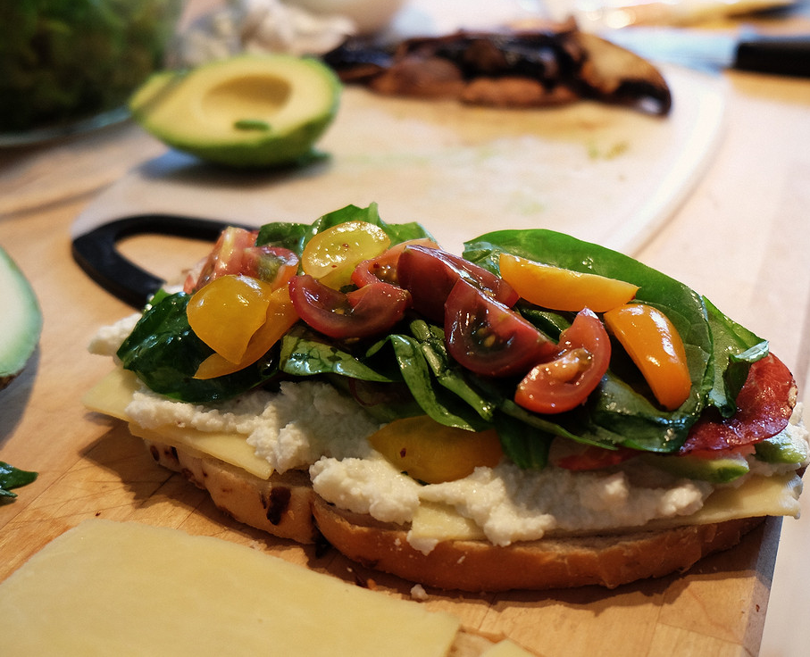
Business Office and food enjoyment
TYPE the CAPTION
You want to EXPRESS
When we are working happily. When we are working happily. When we are working happily. When we are working happily. When we are working happily. When we are working happily.

Slide 21
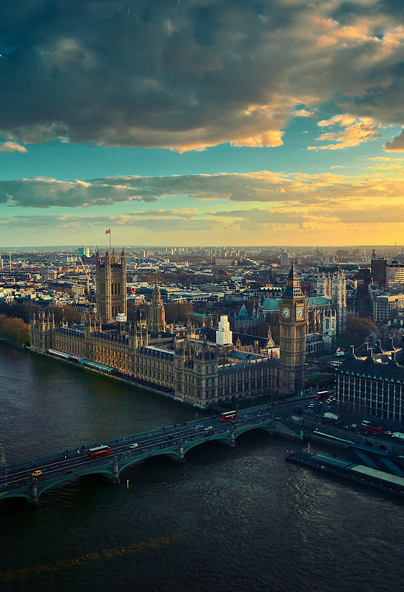
TYPE the CAPTION
You want to EXPRESS
Food and enjoy
When we are working happily.
When we are working happily.
When we are working happily.
TYPE the CAPTION
You want to EXPRESS
Food and enjoy
When we are working happily.
When we are working happily.
When we are working happily.

Slide 22
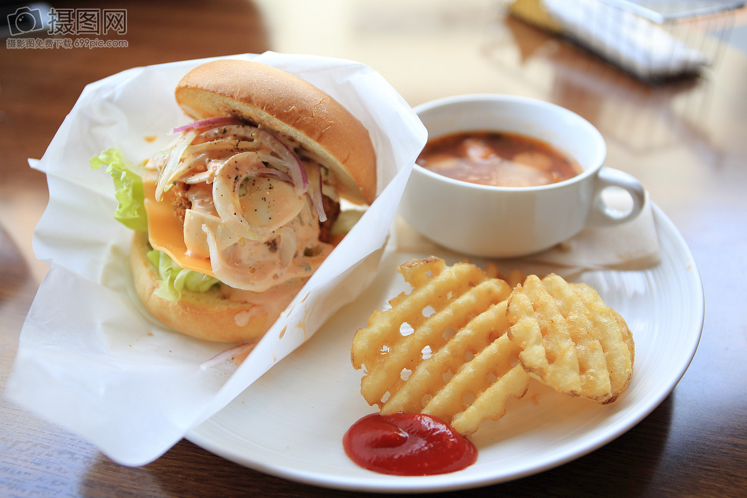
Business Office and food enjoyment
Business Office and food enjoyment
When we are working happily.
When we are working happily.
When we are working happily.

Slide 23

Business Office and food enjoyment
Business Office and food enjoyment
When we are working happily.
When we are working happily.
When we are working happily.
When we are working happily. When we are working happily. When we are working happily. When we are working happily. When we are working happily. When we are working happily.

Slide 24
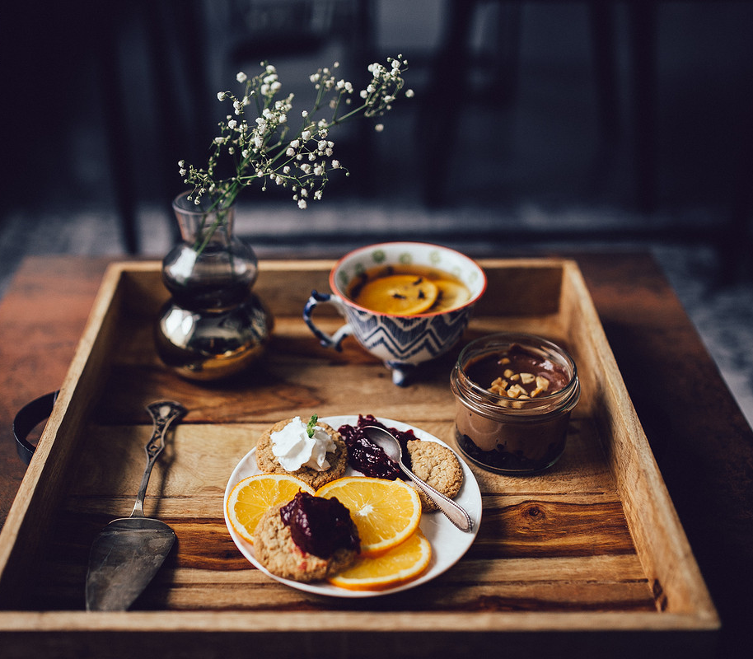
Business Office and food enjoyment
Business Office and food enjoyment
When we are working happily.
When we are working happily.
When we are working happily.

Slide 25
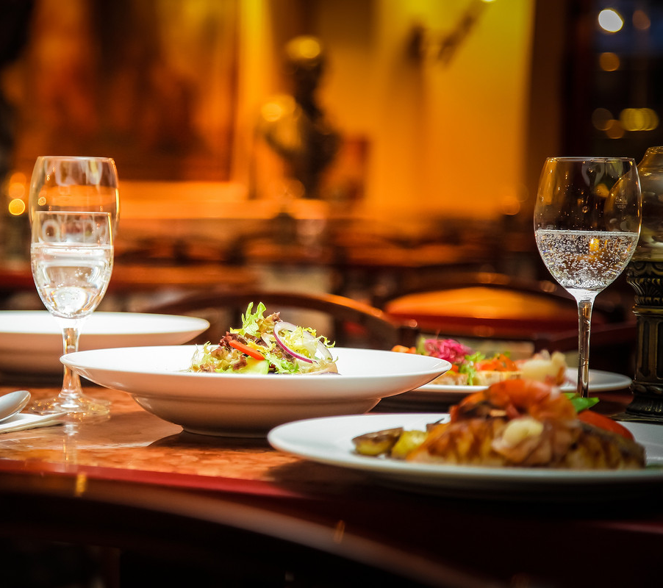
Business Office and food enjoyment
Business Office and food enjoyment
When we are working happily.
When we are working happily.
When we are working happily.

Slide 26

Business Office and food enjoyment
Business Office and food enjoyment
Thank you for listening

Slide 27

Best PPT templates for free download
https://www.freeppt7.com

