Slide 1

PowerPoint Template

Slide 2




CONTEXT
about
about
about
about
Add your title
Add your title
Add your title
Add your title

Slide 3

Part 1
about

Slide 4
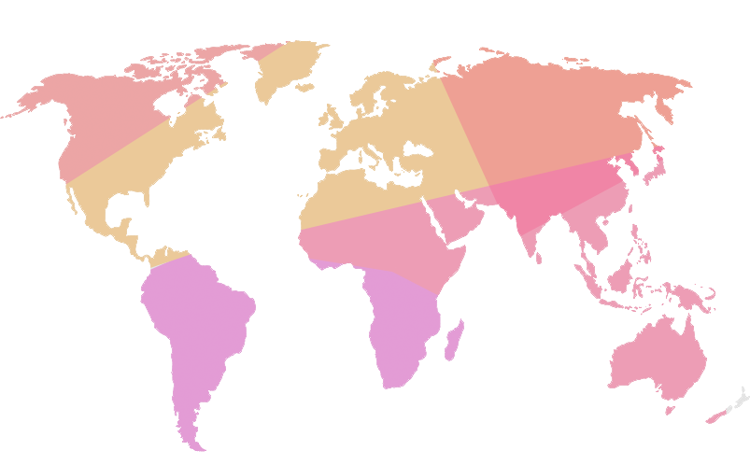
输入你的标题
Add your title
Add your title
Know a lot of sense, but still had bad in this life
Add your title
Know a lot of sense, but still had bad in this life
Add your title
Know a lot of sense, but still had bad in this life

Slide 5
输入你的标题
Add your title
Add your title
Know a lot of sense, but still had bad in this life
Add your title
Add your title
Know a lot of sense, but still had bad in this life
Know a lot of sense, but still had bad in this life

Slide 6


输入你的标题
Add your title
Add your title
Add your title
Add your title
Know a lot of sense, but still had bad in this life
Know a lot of sense, but still had bad in this life
Know a lot of sense, but still had bad in this life

Slide 7

输入你的标题
Add your title
Add your keyword here
PowerPoint template
Change your pic

Slide 8

Part 2
about

Slide 9
输入你的标题
Add your title
Add your title
Know a lot of sense, but still had bad in this life
Add your title
Add your title
Know a lot of sense, but still had bad
Add your title
Know a lot of sense, but still had bad in this life
Know a lot of sense, but still had bad
Add your title
Know a lot of sense, but still had bad in this life

Slide 10




输入你的标题
Add your title
Add your title
Know a lot of sense, but still had bad in this life
Add your title
Know a lot of sense, but still had bad in this life
Add your title
Know a lot of sense, but still had bad in this life

Slide 11


输入你的标题
Add your title
Add your title
Know a lot of sense, but still had bad in this life
Add your title
Know a lot of sense, but still had bad in this life
Add your title
Know a lot of sense, but still had bad in this life

Slide 12
输入你的标题
Know a lot of sense, but still had bad in this life
Add your title
Add
your title
Add
your title
Add
your title
Know a lot of sense, but still had bad in this life
Add
your title
Know a lot of sense, but still had bad in this life
Know a lot of sense, but still had bad in this life

Slide 13
Part 3
about

Slide 14




输入你的标题
Add your title
Add your title
Add your title
Know a lot of sense, but still had bad in this life
Know a lot of sense, but still had bad in this life
Add your title
Add your title
Know a lot of sense, but still had bad in this life
Know a lot of sense, but still had bad in this life
Add your title
Add your title
Know a lot of sense, but still had bad in this life
Know a lot of sense, but still had bad in this life

Slide 15

输入你的标题
Add your title
Add your title
Add your title
Add your title
Add your title
Know a lot of sense, but still had bad in this life
Know a lot of sense, but still had bad in this life
Know a lot of sense, but still had bad in this life
Know a lot of sense, but still had bad in this life

Slide 16
输入你的标题
Add your title
Add your title
1、Add your title
Know a lot of sense, but still had bad in this life
4
1
2、Add your title
3
2
Know a lot of sense, but still had bad in this life
3、Add your title
Know a lot of sense, but still had bad in this life
Q1
Q2
Q3
Q4
4、Add your title
Know a lot of sense, but still had bad in this life

Slide 17
输入你的标题
Add your title
7
1
4
6
3
5
8
2
1
2
3
4
5
6
7
8
Add your title
Add your title
Add your title
Know a lot of sense, but still had bad in this life
Know a lot of sense, but still had bad in this life
Know a lot of sense, but still had bad in this life

Slide 18
Part 4
about

Slide 19
输入你的标题
Add your title
Add your title
Know a lot of sense, but still had bad in this life
20%
Add your title
30%
Know a lot of sense, but still had bad in this life
project
Add your title
15%
Know a lot of sense, but still had bad in this life
Add your title
35%
Know a lot of sense, but still had bad in this life

Slide 20
输入你的标题
Add your title
Know a lot of sense, but still had bad in this life
Know a lot of sense, but still had bad in this life
Add your title
Add your title
201X
201X
201X
201X
Add your title
Add your title
Know a lot of sense, but still had bad in this life
Know a lot of sense, but still had bad in this life

Slide 21
输入你的标题
Add your title
Add your title
Add your title
1
4
Know a lot of sense, but still had bad in this life
Know a lot of sense, but still had bad in this life
Add your title
Add your title
2
5
Know a lot of sense, but still had bad in this life
Know a lot of sense, but still had bad in this life
Add your title
Add your title
3
6
Know a lot of sense, but still had bad in this life
Know a lot of sense, but still had bad in this life

Slide 22

输入你的标题
Add your title
Add your title
Know a lot of sense, but still had bad in this life
Know a lot of sense, but still had bad in this life

Slide 23
THANKS

