Slide 1
201X
Reported by ：XXX

Slide 2

Enter text
Live beautifully, dream passionately, love completely.

Slide 3


Enter Text
图标标题
THE CHART TITLE
Enter text
Enter text
Enter text

Slide 4
Enter Text
1
2
Enter text
Enter text
A
Albert Einstein: Logic will get you from A to B. Imagination will take you everywhere.
Albert Einstein: Logic will get you from A to B. Imagination will take you everywhere.
3
4
Enter text
Enter text
Albert Einstein: Logic will get you from A to B. Imagination will take you everywhere.
Albert Einstein: Logic will get you from A to B. Imagination will take you everywhere.

Slide 5

Enter Text
Enter text
Albert Einstein: Logic will get you from A to B. Imagination will take you everywhere.
Live beautifully, dream passionately, love completely.

Slide 6
B
Enter text
Live beautifully, dream passionately, love completely.

Slide 7
Enter Text
图标标题
THE CHART TITLE
¥
Enter text
Enter text

Slide 8
Enter Text
Enter
Text
Enter
Text
Albert Einstein: Logic will get you from A to B. Imagination will take you everywhere.
Albert Einstein: Logic will get you from A to B. Imagination will take you everywhere.
Albert Einstein: Logic will get you from A to B. Imagination will take you everywhere.
Albert Einstein: Logic will get you from A to B. Imagination will take you everywhere.
Enter
Text
Enter
Text

Slide 9
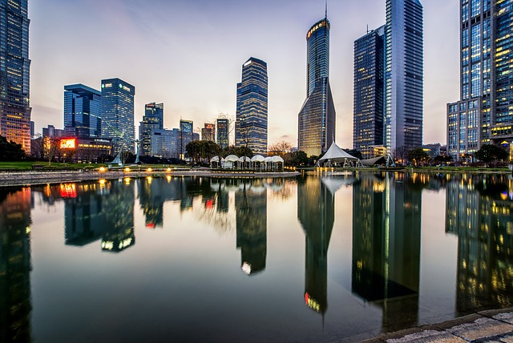
Enter Text
Enter text
Albert Einstein: Logic will get you from A to B. Imagination will take you everywhere.

Slide 10
Enter text
Live beautifully, dream passionately, love completely.

Slide 11
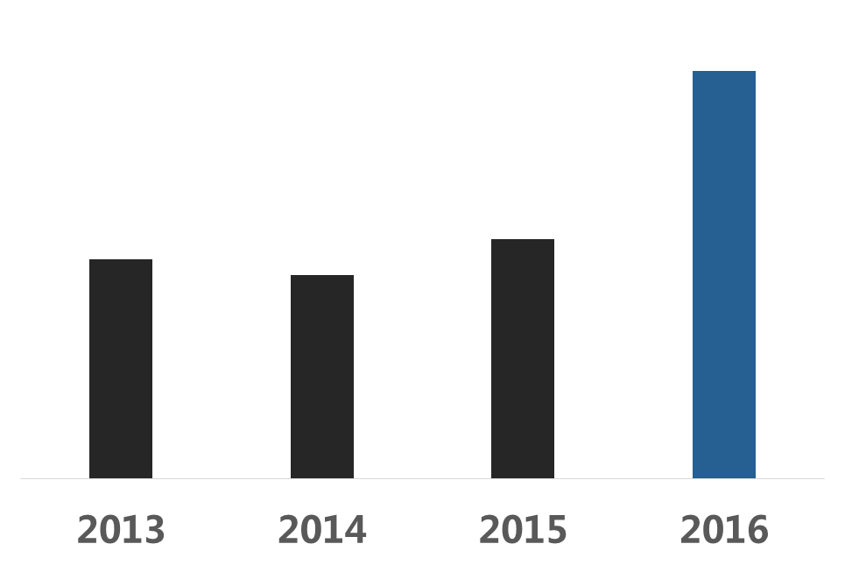
8000
Enter Text
Albert Einstein: Logic will get you from A to B. Imagination will take you everywhere.

Slide 12
Enter Text
Albert Einstein: Logic will get you from A to B. Imagination will take you everywhere.
Enter Text
Enter Text
Albert Einstein: Logic will get you from A to B. Imagination will take you everywhere.

Slide 13
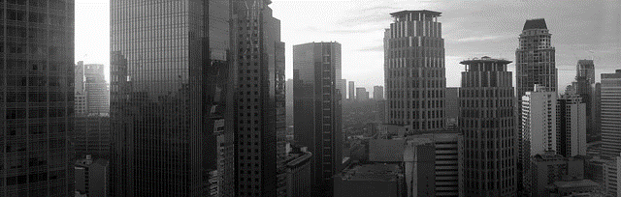
Enter Text
Live beautifully,
dream passionately, love completely.
Enter Text
Enter Text
Albert Einstein: Logic will get you from A to B. Imagination will take you everywhere.
Albert Einstein: Logic will get you from A to B. Imagination will take you everywhere.

Slide 14
Enter text
Live beautifully,dream passionately, love completely.

Slide 15
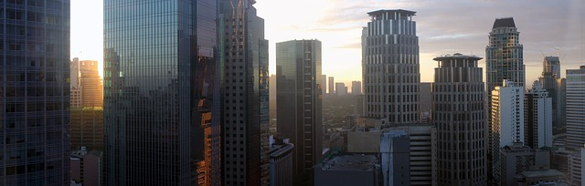
Enter Text
Live beautifully,dream passionately, love completely.
Albert Einstein: Logic will get you from A to B. Imagination will take you everywhere.

Slide 16
Enter Text
Enter Text
Live beautifully,dream passionately, love completely.

Slide 17

Enter Text
Enter Text
Albert Einstein: Logic will get you from A to B. Imagination will take you everywhere.

Slide 18
说明
中文
微软雅黑
英文
aldhabi
图片
Pixabay免费图片

Slide 19

Best PPT templates for free download
https://www.freeppt7.com

