Slide 1

三月烟雨随风潜入轻掩的柴扉
远处故人缓缓归
檐角几枝花藤低垂蝴蝶翩跹飞
小窗映画谁人常依偎
水墨
沉香

Slide 2
目录
CONTENT
壹
叁
Truth is the lifeblood of life, is the foundation of all values
三月烟雨随风潜入轻掩的柴扉
贰
Truth is the lifeblood of life, is the foundation of all values
檐角几枝花藤低垂蝴蝶翩跹飞
肆
Truth is the lifeblood of life, is the foundation of all values
远处故人缓缓归
Truth is the lifeblood of life, is the foundation of all values
小窗映画谁人常依偎

Slide 3
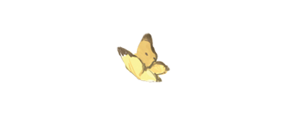
壹
六月·烟雨
Truth is the lifeblood of life, is the foundation of all values

Slide 4

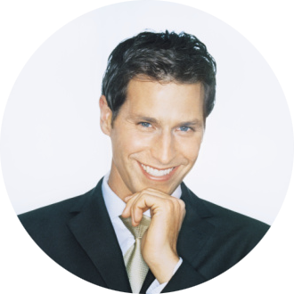


关于·我们
Katherine
Smith
Hamiltion
Truth is the lifeblood of life, is the foundation of all values
Truth is the lifeblood of life, is the foundation of all values
Truth is the lifeblood of life, is the foundation of all values

Slide 5
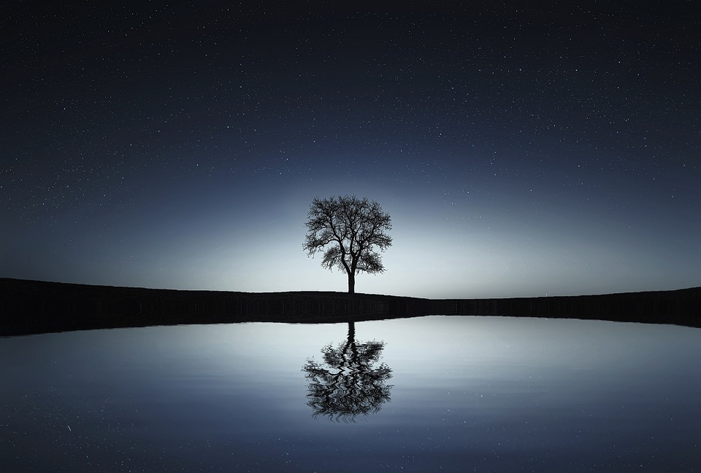
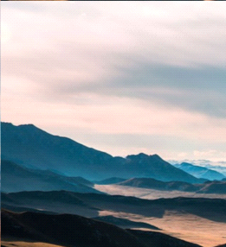
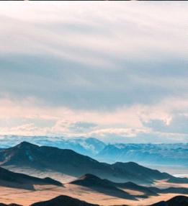
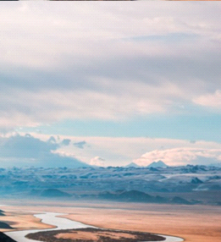
拾色
流莺悄飞近船侧 伴桨声低语浅说
Truth is the lifeblood of life, is the foundation of all values
Truth is the lifeblood of life, is the foundation of all values
Truth is the lifeblood of life, is the foundation of all values
Truth is the lifeblood of life, is the foundation of all values
柳梢沾绿了烟波 绕堤三分春色
Truth is the lifeblood of life, is the foundation of all values

Slide 6
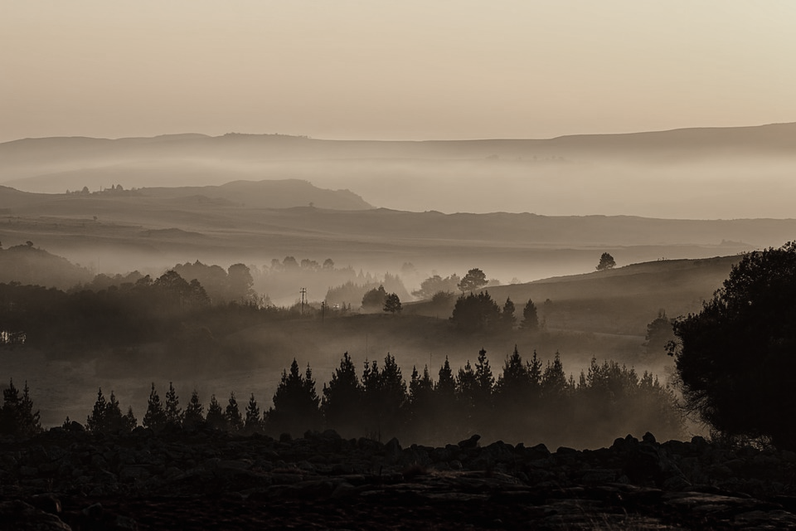
醒
彷徨
Truth is the lifeblood of life, is the foundation of all values
+234,012
Life is the most happy thing is one light naked to the world, finally bare left the world and go. Completely come to think of it, fame and fortune is the physical objects, only as a person's heart, make the benefits of society many people to work for him.
死生契阔，与子成说。执子之手，与子偕老

Slide 7

你
吟诗几阙
他
酿煮一盏
望
Life is the most happy thing is one light naked to the world, finally bare left the world and go. Completely come to think of it, fame and fortune is the physical objects, only as a person's heart, make the benefits of society many people to work for him.
大地

Slide 8
小窗·映画
你
吟诗几阙
他
酿煮一盏
879,33
34,234
%78
Key words
Key words
Key words
445,678
Key words
红妆嫣然
Truth is the lifeblood of life, is the foundation of all values

Slide 9
贰
陌上·花开
Truth is the lifeblood of life, is the foundation of all values

Slide 10
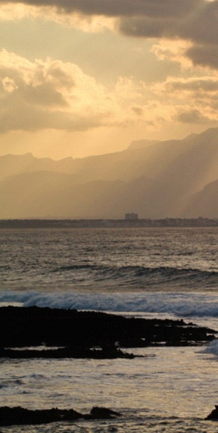
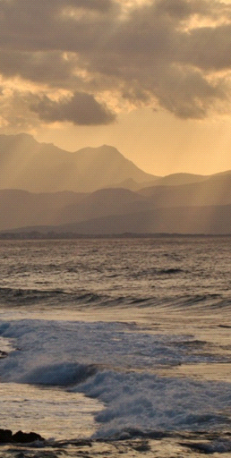
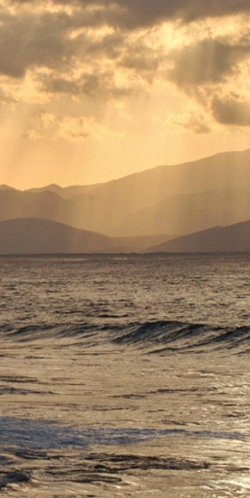

繁华·共赏
57+
Truth is the lifeblood of life, is the foundation of all values
32+
Truth is the lifeblood of life, is the foundation of all values

Slide 11
绘一场 世无双
Truth is the lifeblood of life, is the foundation of all values
563
580
783
念
Truth is the lifeblood of life, is the foundation of all values
Truth is the lifeblood of life, is the foundation of all values
Truth is the lifeblood of life, is the foundation of all values

Slide 12
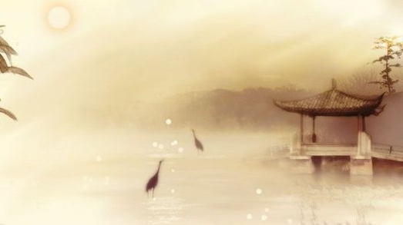
拾
Life is the most happy thing is one light naked to the world, finally bare left the world and go.
春秋
76
绘一场
世无双
Truth is the lifeblood of life, is the foundation of all values

Slide 13
悲
【茶凉·人去】
Life is the most happy thing is one light naked to the world, finally bare left the world and go. Completely come to think of it, fame and fortune is the physical objects, only as a person's heart, make the benefits of society many people to work for him.

Slide 14
叁
铁戟·沉沙
Truth is the lifeblood of life, is the foundation of all values

Slide 15
水墨
沉香

Slide 16
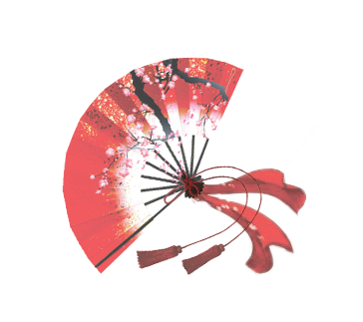
Truth is the lifeblood of life, is the foundation of all values
高山遇流水
醉彷徨 你吟诗几阙 诉情长
Life is the most happy thing is one light naked to the world, finally bare left the world and go. Completely come to think of it, fame and fortune is the physical objects, only as a person's heart, make the benefits of society many people to work for him.
Truth is the lifeblood of life, is the foundation of all values
此生琴瑟想追随

Slide 17
哀
【物是·人非】
Life is the most happy thing is one light naked to the world, finally bare left the world and go. Completely come to think of it, fame and fortune is the physical objects, only as a person's heart, make the benefits of society many people to work for him.

Slide 18
肆
斑驳·岁月
Truth is the lifeblood of life, is the foundation of all values

Slide 19
天阶·流星
Truth is the lifeblood of life, is the foundation of all values

Slide 20
叹
【残败·彷徨】
Life is the most happy thing is one light naked to the world, finally bare left the world and go. Completely come to think of it, fame and fortune is the physical objects, only as a person's heart, make the benefits of society many people to work for him.

Slide 21
终
曲终人不散

