Slide 1
Suitable for work reports/Product Report/Debriefing reports, etc.
Small Fresh flowers PPT Job Reporting Templates
Click here to enter the company name
Reporting Person:XXX
Reporting Time:20XX Years XX Month XX Day

Slide 2
01
Click here to add the title text
Add you title here
02
Click here to add the title text
Add you title here
03
Click here to add the title text
Add you title here
04
Click here to add the title text
Add you title here

Slide 3
Part 01
Click here to add text

Slide 4
Click here to addTitle text
Add you title here
If you leave me, please don t comfort me because and sewing has to meet stinging pain.
If you leave me, please don t comfort me because and sewing has to meet stinging pain.
01
02
If you leave me, please don t comfort me because and sewing has to meet stinging pain.
03
04
If you leave me, please don t comfort me because and sewing has to meet stinging pain.

Slide 5
Click here to addTitle text
Add you title here
If you leave me, please don t comfort me because and sewing has to meet stinging pain.
+
If you leave me, please don t comfort me because and sewing has to meet stinging pain.
+

Slide 6
Click here to addTitle text
Add you title here
Enter a title
1
4
Click here to enter text
Click here to enter text
Click here to enter text
Click here to enter text
Click here to enter text
Click here to enter text
2
3
Click here to enter text
Click here to enter text
Click here to enter text
Click here to enter text
Click here to enter text
Click here to enter text

Slide 7
Click here to addTitle text
Add you title here
3
2
1
If you leave me, please don t comfort me because and sewing has to meet stinging pain.
If you leave me, please don t comfort me because and sewing has to meet stinging pain.
If you leave me, please don t comfort me because and sewing has to meet stinging pain.

Slide 8
Part 02
Click here to add text

Slide 9
Click here to addTitle text
Add you title here
Click here to add text
Click here to add text
If you leave me, please don t comfort me because and sewing has to meet stinging pain.
If you leave me, please don t comfort me because and sewing has to meet stinging pain.
Click here to add text
Click here to add text
If you leave me, please don t comfort me because and sewing has to meet stinging pain.
If you leave me, please don t comfort me because and sewing has to meet stinging pain.

Slide 10
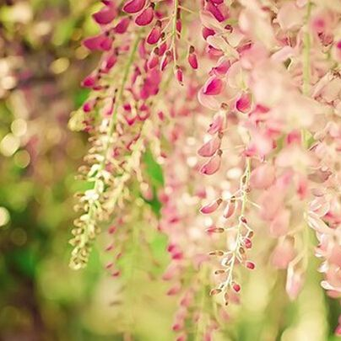
Click here to addTitle text
Add you title here
Click here to add text
Click here to enter text
Click here to enter text
Click here to enter text
Click here to enter text
Click here to enter text
Click here to enter text

Slide 11
Click here to addTitle text
Add you title here
If you leave me, please don t comfort me because and sewing has to meet stinging pain.
If you leave me, please don t comfort me because and sewing has to meet stinging pain.
Input
Title
If you leave me, please don t comfort me because and sewing has to meet stinging pain.
If you leave me, please don t comfort me because and sewing has to meet stinging pain.

Slide 12
Click here to addTitle text
Add you title here
Click here to add text
If you leave me, please don t comfort me because and sewing has to meet stinging pain.
Click here to add text
If you leave me, please don t comfort me because and sewing has to meet stinging pain.
Click here to add text
If you leave me, please don t comfort me because and sewing has to meet stinging pain.

Slide 13
Click here to addTitle text
Add you title here
Why
where
WhatsApp
How
Click here to enter text
Click here to enter text
Click here to enter text
Click here to enter text
Click here to enter text
Click here to enter text
Click here to enter text
Click here to enter text
Click here to enter text
Click here to enter text
Click here to enter text
Click here to enter text
Click here to enter text
Click here to enter text
Click here to enter text
Click here to enter text
Click here to enter text
Click here to enter text
Click here to enter text
Click here to enter text
Click here to enter text
Click here to enter text
Click here to enter text
Click here to enter text

Slide 14
Part 03
Click here to add text

Slide 15
Click here to addTitle text
Add you title here
1
If you leave me, please don t comfort me because and sewing has to meet stinging pain.
2
If you leave me, please don t comfort me because and sewing has to meet stinging pain.
3
If you leave me, please don t comfort me because and sewing has to meet stinging pain.
4
If you leave me, please don t comfort me because and sewing has to meet stinging pain.

Slide 16
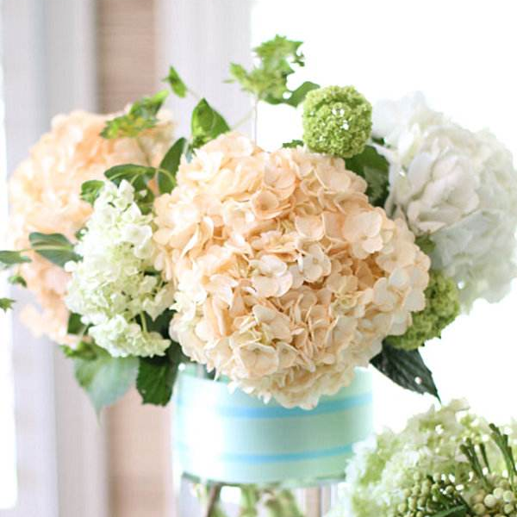
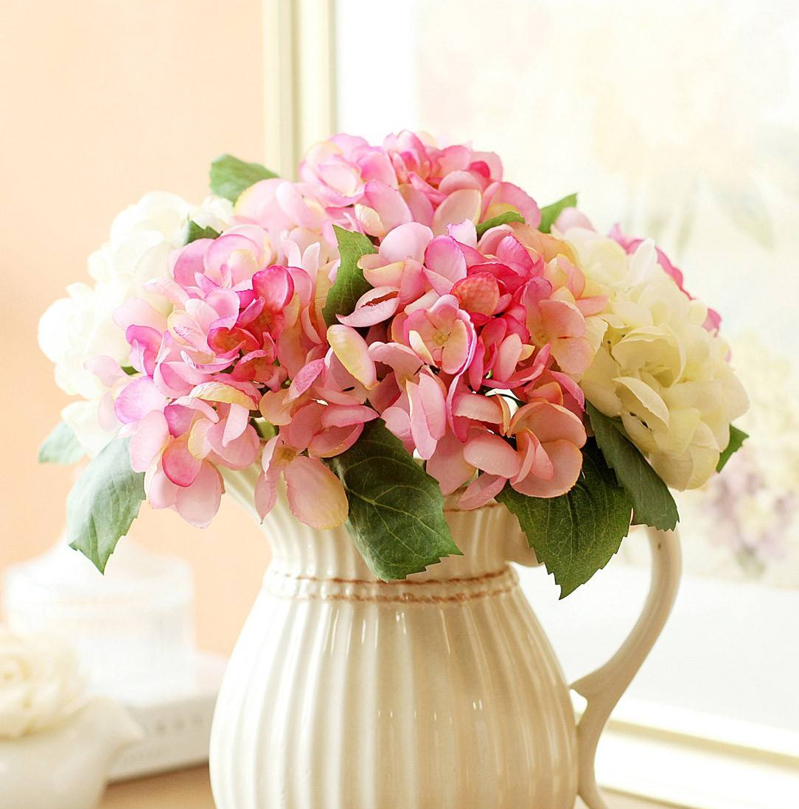
Click here to addTitle text
Add you title here
Click here to add text
If you leave me, please don t comfort me because and sewing has to meet stinging pain.
If you leave me, please don t comfort me because and sewing has to meet stinging pain.
If you leave me, please don t comfort me because and sewing has to meet stinging pain.
If you leave me, please don t comfort me because and sewing has to meet stinging pain.

Slide 17
Click here to addTitle text
Add you title here
Click here to add a title
One needs 3 things to be truly happy-in's world:some thing to does, some one to love, some thing to hope.
Click here to add a title
One needs 3 things to be truly happy-in's world:some thing to does, some one to love, some thing to hope.
PROCESS 01
PROCESS 02
PROCESS 03
PROCESS 04
Click here to add a title
One needs 3 things to be truly happy-in's world:some thing to does, some one to love, some thing to hope.
Click here to add a title
One needs 3 things to be truly happy-in's world:some thing to does, some one to love, some thing to hope.

Slide 18
Click here to addTitle text
Add you title here
Title
Title
Title
One needs 3 things to be truly happy-in's world:some thing to does, some one to love, some thing to hope.
One needs 3 things to be truly happy-in's world:some thing to does, some one to love, some thing to hope.
One needs 3 things to be truly happy-in's world:some thing to does, some one to love, some thing to hope.

Slide 19
Part 04
Click here to add text

Slide 20
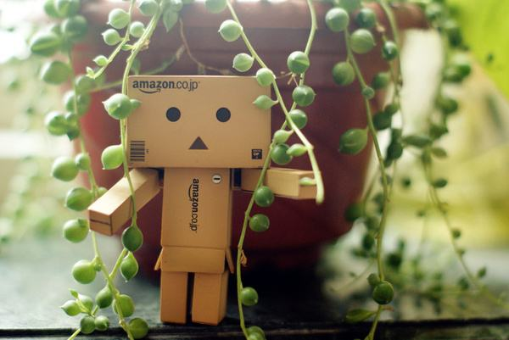
Click here to addTitle text
Add you title here
Click here to add text
One needs 3 things to be truly happy-in's world:some thing to does, some one to love, some thing to hope.
One needs 3 things to be truly happy-in's world:some thing to does, some one to love, some thing to hope.

Slide 21
Click here to addTitle text
Add you title here
Click here to add text
Click here to add text
Click here to add text
Click here to add text
1
2
3
4
One needs 3 things to be truly happy-in's world:some thing to does, some one to love, some thing to hope.
One needs 3 things to be truly happy-in's world:some thing to does, some one to love, some thing to hope.
One needs 3 things to be truly happy-in's world:some thing to does, some one to love, some thing to hope.
One needs 3 things to be truly happy-in's world:some thing to does, some one to love, some thing to hope.

Slide 22
Click here to addTitle text
Add you title here
Click here to add text
Click here to add text
Click here to add text
Click here to add text
5
6
7
8
One needs 3 things to be truly happy-in's world:some thing to does, some one to love, some thing to hope.
One needs 3 things to be truly happy-in's world:some thing to does, some one to love, some thing to hope.
One needs 3 things to be truly happy-in's world:some thing to does, some one to love, some thing to hope.
One needs 3 things to be truly happy-in's world:some thing to does, some one to love, some thing to hope.

Slide 23
Click here to addTitle text
Add you title here
Click here to add the title text
Click here to add the title text
One needs 3 things to be truly happy-in's world:some thing to does, some one to love, some thing to hope.
One needs 3 things to be truly happy-in's world:some thing to does, some one to love, some thing to hope.
Click here to add text
Click here to add the title text
Click here to add the title text
One needs 3 things to be truly happy-in's world:some thing to does, some one to love, some thing to hope.
One needs 3 things to be truly happy-in's world:some thing to does, some one to love, some thing to hope.

Slide 24
Click here to addTitle text
Add you title here
One needs 3 things to be truly happy-in's world:some thing to does, some one to love, some thing to hope.
One needs 3 things to be truly happy-in's world:some thing to does, some one to love, some thing to hope.
Click here to add text
One needs 3 things to be truly happy-in's world:some thing to does, some one to love, some thing to hope.
Click here to add text
One needs 3 things to be truly happy-in's world:some thing to does, some one to love, some thing to hope.

