Slide 1
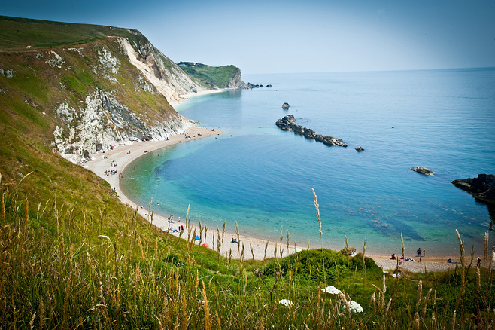
Flattened Universal PowerPoint Template

Slide 2
ABOUT US
Last sunday, Mr.Lee got up very early to go fishing. He spent the whole day sitting beside the river but got nothing at the end of the day. that he had to go home by dinner time. Lee thought that his wife might be mad at him for bringing nothing back. So he bought a big fish at the market before he got home. At least, he was happy finally for what he could bring home.

Slide 3
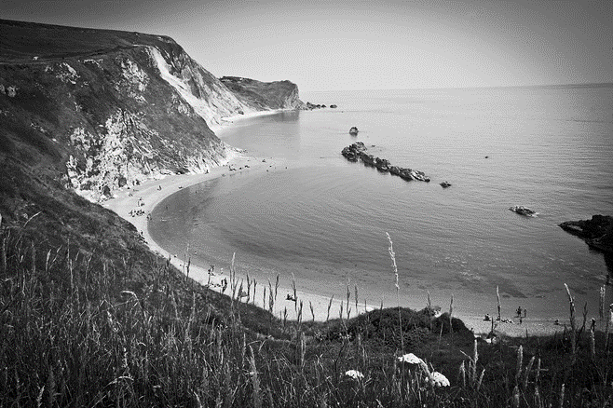
ABOUT US
WHAT THE FUCK BOY
WHAT THE FUCK BOY
go home by dinner time. Lee thought that his wife might be mad at him for bringing nothing back. So he bought a big fish at the market before he got home.

Slide 4

LIFE
IS SO LONG
Last sunday, Mr.Lee got up very early to go fishing. He spent the whole day sitting beside the river but got nothing at the end of the day. that he had to

Slide 5
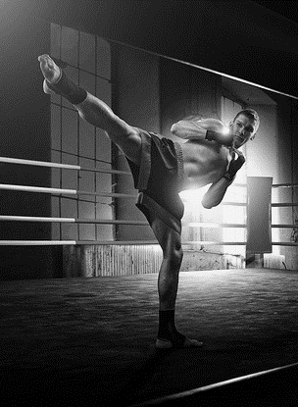
WHAT A
BAD BOY BOY!
YES,YOU ARE GOOD
Last sunday, Mr.Lee got up very early to go fishing. He spent the whole day sitting beside the river but got nothing at the end of the day
PLEASE ANSWER YES
Therefore, Mr.Lee was very dissapointed due to that he had to go home by dinner time. On his way home, Lee thought that his wife might be mad at him for bringing nothing back.
YES,OF COURSE
So he bought a big fish at the market before he got home.. At least, he was happy finally for what he could bring home.

Slide 6
COPY
BY DS
PLEASE ANSWER YES
Therefore, Mr.Lee was very dissapointed due to that he had to go home by dinner time. On his way home, Lee thought that his wife might be mad at him for bringing nothing back.
go home by dinner time. Lee thought that his wife might be mad at him for bringing nothing back. So he bought a big fish at the market before he got home.
So he bought a big fish at the market before he got home.. At least, he was happy finally for what he could bring home.
YES,YOU ARE GOOD
Last sunday, Mr.Lee got up very early to
go fishing. He spent the whole day sitting beside the

Slide 7


24
You are a old girl
WHAT THE
FUCK FUCK BOY!
12
You are a young girl
YES,YOU ARE GOOD
Last sunday, Mr.Lee got up very early to go fishing. He spent the whole day sitting beside the river but got nothing at the end of the day
Therefore, Mr.Lee was very dissapointed due to that he had to go home by dinner time. On his way home, Lee thought that his wife might be mad at him for bringing nothing back.
36
You are a elegent woman
TOP.
TOP.

Slide 8
WHAT THE
FUCK FUCK BOY!
YES,YOU ARE GOOD
Last sunday, Mr.Lee got up very early to go fishing. He spent the whole day sitting beside the river but got nothing at the end of the day
PLEASE ANSWER YES
Therefore, Mr.Lee was very dissapointed due to that he had to go home by dinner time. On his way home, Lee thought that his wife might be mad at him for bringing nothing back.
YES,OF COURSE
So he bought a big fish at the market before he got home.. At least, he was happy finally for what he could bring home.
YES,YOU ARE GOOD
Last sunday, Mr.Lee got up very early to go fishing. He spent the whole day sitting beside the

Slide 9
WHAT THE
FUCK BOY!
YES,YOU ARE GOOD
Last sunday, Mr.Lee got up very early to go fishing. He spent the whole day sitting beside the river but got nothing at the end of the day
Therefore, Mr.Lee was very dissapointed due to that he had to go home by dinner time. On his way home, Lee thought that his wife might be mad at him for bringing nothing back.

Slide 10
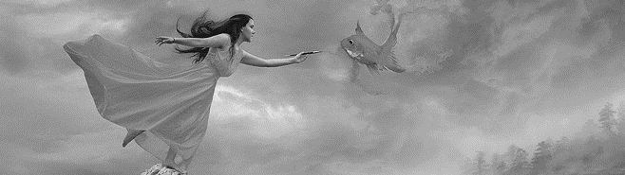




01.
02.
03.
YES,YOU ARE GOOD
PLEASE ANSWER YES
YES,OF COURSE
Last sunday, Mr.Lee got up very early to go fishing. He spent the whole day sitting beside the river but got nothing at the end of the day
Therefore, Mr.Lee was very dissapointed due to that he had to go home by dinner time. On his way home, Lee thought that his wife might be mad at him for bringing nothing back.
So he bought a big fish at the market before he got home.. At least, he was happy finally for what he could bring home.
120
888
666
550

Slide 11


WHAT INFINITY?
THIS IS A COLORFUL WORLD
JUST DO IT
YES,YOU ARE GOOD
Last sunday, Mr.Lee got up very early to go fishing. He spent the whole day sitting beside the river but got nothing at the end of the day
PLEASE ANSWER YES
Therefore, Mr.Lee was very dissapointed due to that he had to go home by dinner time. On his way home, Lee thought that his wife might be mad at him for bringing nothing back.
YES,OF COURSE
So he bought a big fish at the market before he got home.. At least, he was happy finally for what he could bring home.
DENG SHUANG
DENG SHUANG
DENG SHUANG

Slide 12



WHAT INFINITY?
THIS IS A COLORFUL WORLD
JUST DO IT
ast sunday, Mr.Lee got up very early to go fishing. He spent the whole day sitting beside the river but got nothing at the end of the day.
PLEASE ANSWER YES
Therefore, Mr.Lee was very dissapointed due to that he had to go home by dinner time. On his way home,
888
666
123
YES,OF COURSE
So he bought a big fish at the market before he got home.. At least, he was happy finally for what he could bring home. YES,YOU ARE GOOD
the
Everyday
Twice
A week
Once
A week

Slide 13
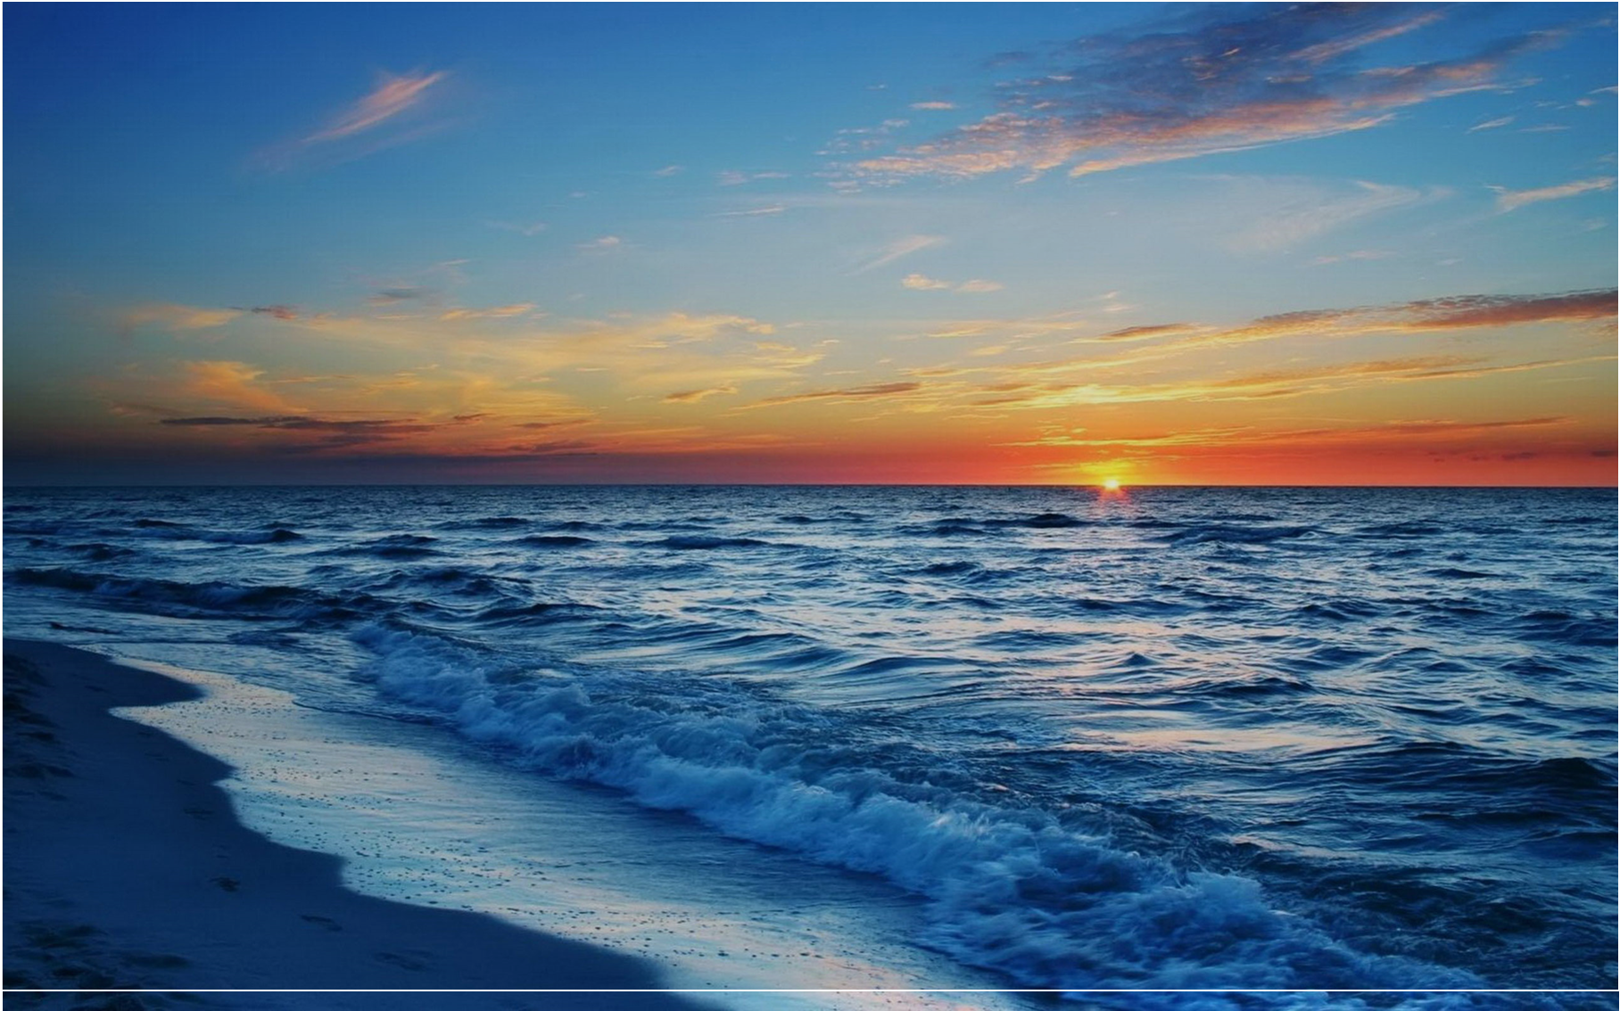

THERE IS SOME GOOD
IN THIS WORLD,AND
IT IS WORTH FIGHTING FOR.
ast sunday, Mr.Lee got up very early to go fishing. He spent the whole day sitting beside the river but got nothing at the end of the day. river but got nothing at the end of river but got nothing at the end of
YOU CAN WRITE HERE
123456
GOOD IDEA
So he bought a big fish at the market before he got home..
CLICK ME

Slide 14


WHAT THE
INFINITY?
ast sunday, Mr.Lee got up very early to go fishing. He spent the whole day sitting beside the river but got nothing at the end of the day. river but got nothing at the end of river but got nothing at the end of
“
So he bought a big fish at the market before he got home.. At least, he was happy finally for what he could bring home.
”

Slide 15


WHAT INFINITY?
THIS IS A COLORFUL WORLD
JUST DO IT
“Therefore, Mr.Lee was very dissapointed due to that he had to go home by dinner time. On his way home, Lee thought that his wife might be mad at him for bringing nothing back.
”

Slide 16
WHAT INFINITY?
THIS IS A COLORFUL WORLD
JUST DO IT
THIS IS A
COLORFUL WORLD
ast sunday, Mr.Lee got up very early to go fishing. He spent the whole day sitting beside the river but got nothing at the end of the day. river but got nothing at the end of river but got nothing at the end of
Mary
Jenny
Susan
She is a nice man,
please support her
She is a nice man,
please support her
She is a nice man,
please support her

Slide 17
COPY
BY DS

