Slide 1
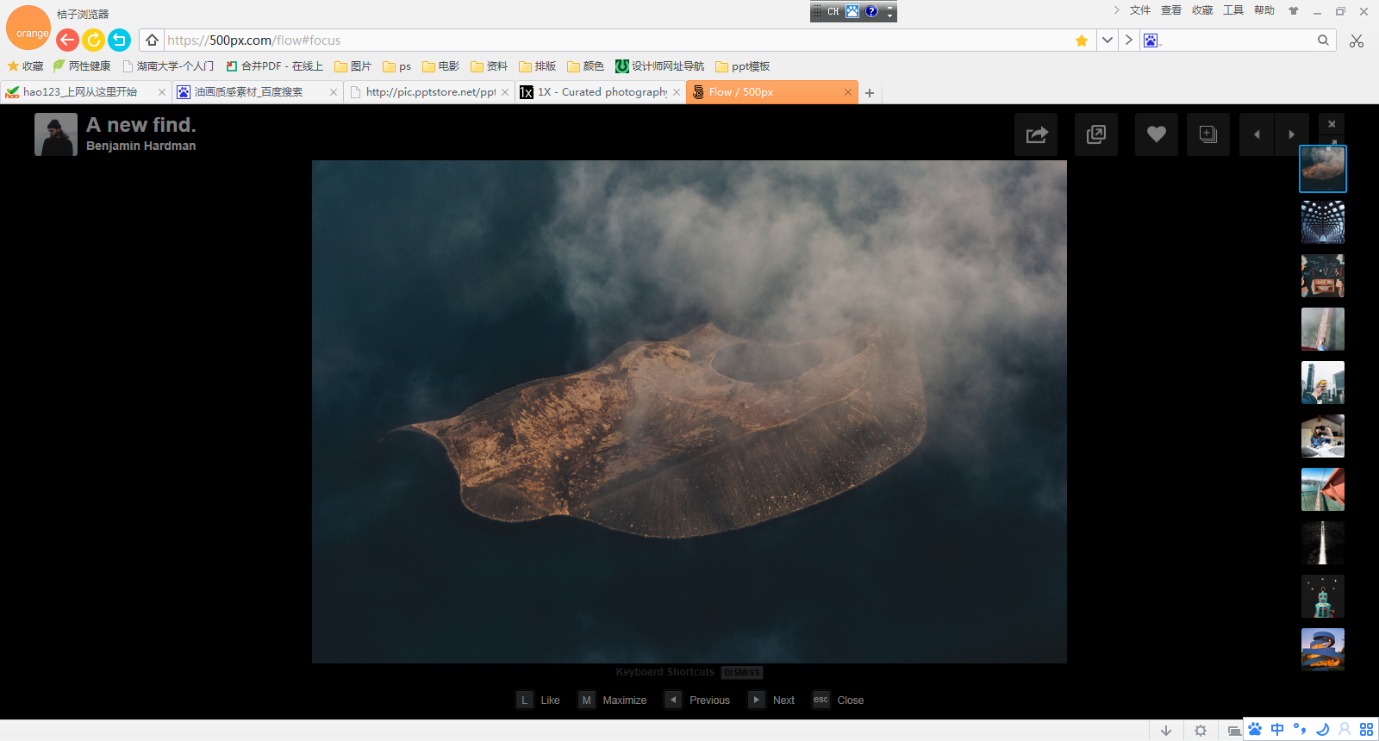
Add a title
Giant squid remain one of the most enigmatic large animals on the planet.

Slide 2
Directory
Contents
01Brief introduction
02Brief introduction
03Brief introduction
Large animals on the planet.
Large animals on the planet.
Large animals on the planet.

Slide 3
01
Brief introduction
Large animals on the planet.

Slide 4
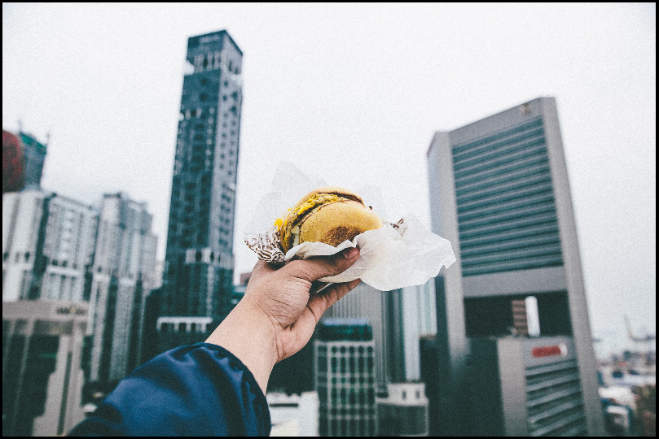
01Brief introduction
Brief introduction
Type what you want here, type what you want here, type what you want here, type what you want here.

Slide 5
01Brief introduction
Creative One
Type the text here and type the text here to type the text here
Creativity II
Type the text here and type the text here to type the text here
Creativity Three
Type the text here and type the text here to type the text here
Creative Four
Type the text here and type the text here to type the text here

Slide 6
01Brief introduction
Type what you want here, type what you want here, type what you want here, type what you want here.
Type what you want here, type what you want here, type what you want here, type what you want here.
Type what you want here, type what you want here, type what you want here, type what you want here.
01
02
03
Features one
Features two
Features three

Slide 7
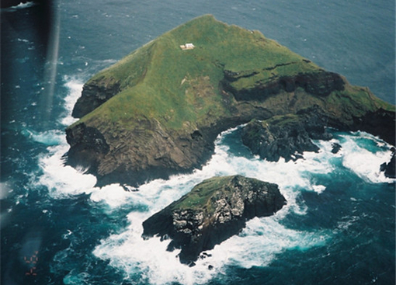
01Brief introduction
Title
Type the content here to type what you typed here and type what you typed here to type the content here and type what you typed here.
Brief Introduction

Slide 8
02
Brief introduction
Large animals on the planet.

Slide 9
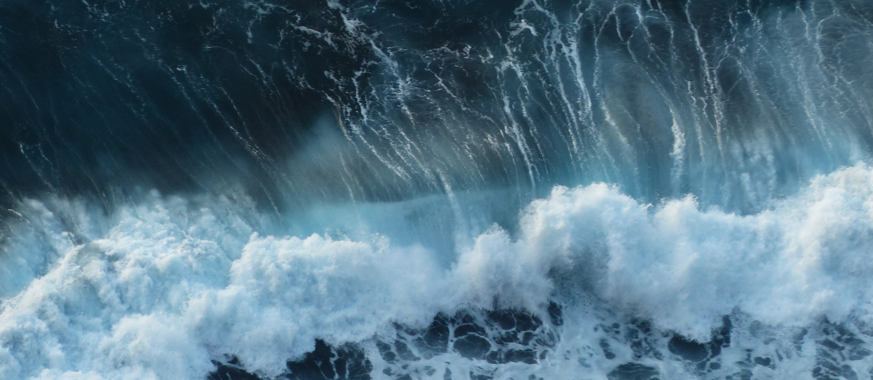
02Brief introduction
Type the content here to type what you typed here and type what you typed here to type the content here and type the content here to type what you typed here typing

Slide 10
02Brief introduction
Type the content here to type what you typed here, type what you typed here, type the content here, and type the content here.
01
Type the content here to type what you typed here, type what you typed here, type the content here, and type the content here.
02
Type the content here to type what you typed here, type what you typed here, type the content here, and type the content here.
03
Type the content here to type what you typed here, type what you typed here, type the content here, and type the content here.
04

Slide 11
02Brief introduction
Type the content here to type what you typed here and type what you typed here to type the appropriate content here
Type the content here to type what you typed here and type what you typed here to type the appropriate content here
Type the content here to type what you typed here and type what you typed here to type the appropriate content here

Slide 12
02Brief introduction
Advantages One
Type the content here to type what you typed here and type what you typed here to type the appropriate content here
Advantage Analysis
Advantage Two
Type the content here to type what you typed here and type what you typed here to type the appropriate content here
Advantages of three
Type the content here to type what you typed here and type what you typed here to type the appropriate content here

Slide 13
03
Brief introduction
Large animals on the planet.

Slide 14
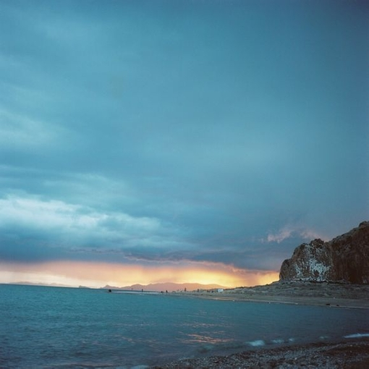
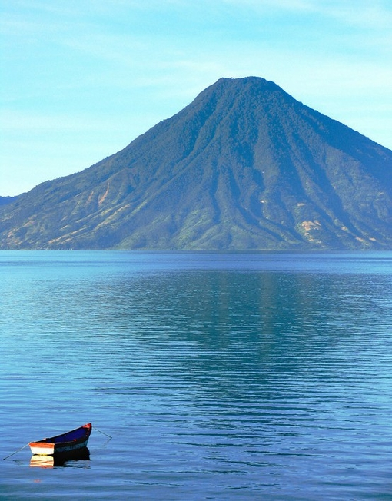
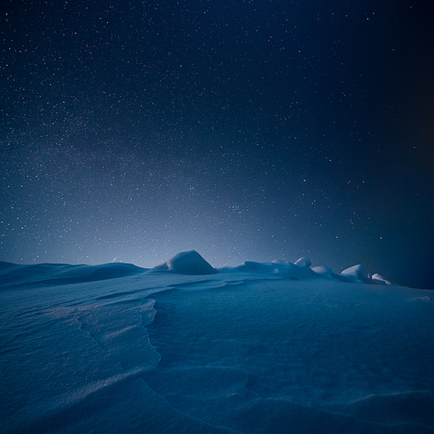
03Brief introduction
Type the content here to type what you typed here
Type the content here to type what you typed here
Type the content here to type what you typed here

Slide 15

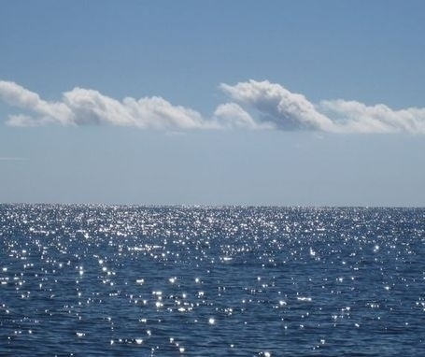

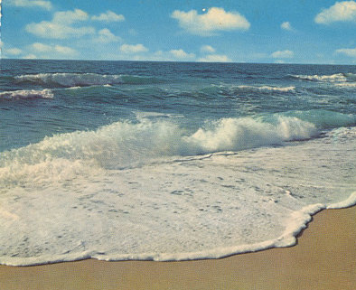
03Brief introduction
Type the appropriate content here to type here
Type the appropriate content here to type here
Type the appropriate content here to type here
Type the appropriate content here to type here
Type the content here to type what you typed here
Type the content here to type what you typed here
Type the content here to type what you typed here
Type the content here to type what you typed here

Slide 16
THANKS FOR WATCHING

Slide 17

Best PPT templates for free download
Https://www.freeppt7.com

