Slide 1
Literary refreshing template
THIS ARE A ART TEMPLATE, THANK YOU WATCHING THIS ONE. THIS IS A ART TEMPLATE,

Slide 2
CONTENT
01
02
03
04
ADD TITTLE HERE
ADD TITTLE HERE
ADD TITTLE HERE
ADD TITTLE HERE

Slide 3
0 1
ADD YOUR TITTLE HERE
THIS ARE A ART TEMPLATE, THANK YOU WATCHING THIS ONE.

Slide 4
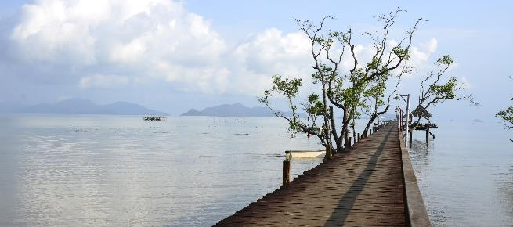
ADD YOUR TITTLE HERE
Just for today I would try to live through this day only and not tackle his whole life problem at once. Only and not tackle I whole life problem at once.
Just for today I would try to live through this day only and not tackle I whole life problem at once Just for today I Try to live. Through this day only and not tackle I whole life

Slide 5
ADD YOUR TITTLE HERE
Just for today I would try to live through this day only and not tackle his whole life problem at once. I can

Slide 6
STAGE ONE
STAGE
Hours the S Just for today I would try to live through this
Hours the S Just for today I would try to live through this
STAGE THREE
STAGE FOUR
Hours the S Just for today I would try to live through this
A Hours the S Just for today I would try to live through this

Slide 7
ADD YOUR TITTLE HERE

01
Hours s Just for today I would try to live through this day only and not tackle my whole life problem at once.

02
Just for today I would try to live through this day only and not tackle his whole life problem at once. I can
Hours s Just for today I would try to live through this day only and not tackle my whole life problem at once.

03
Hours s Just for today I would try to live through this day only and not tackle my whole life problem at once.

Slide 8
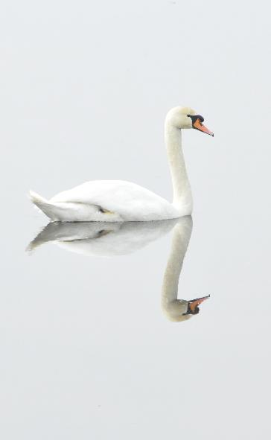
ADD YOUR TITTLE HERE
Just for today I would try to live through this day only and not tackle his whole life problem at once. I can
0 1
Just for today I would try to live through this day only and not tackle his whole life problem at once
0 2
Just for today I would try to live through this day only and not tackle his whole life problem at once
0 3
Just for today I would try to live through this day only and not tackle his whole life problem at once

Slide 9
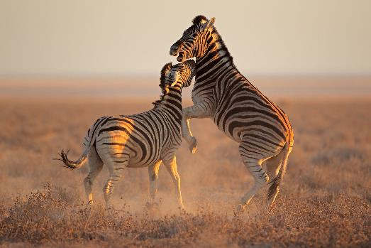
0 1
Just for today I would try to live through this day only and not tackle his whole life problem at once
0 2
Just for today I would try to live through this day only and not tackle his whole life problem at once
03
Just for today I would try to live through this day only and not tackle his whole life problem at once

Slide 10
0 2
ADD YOUR TITTLE HERE
THIS ARE A ART TEMPLATE, THANK YOU WATCHING THIS ONE.

Slide 11
ADD YOUR TITTLE HERE
Just for today I would try to live through this day only and not tackle his whole life problem at once. I can

Slide 12
ADD YOUR TITTLE HERE
Just for today I would try to live through this day only and not tackle his whole life problem at once
01
02
03
03
Just for today I would try to live through this
Just for today I would try to live through this
Just for today I would try to live through this
Just for today I would try to live through this

Slide 13
STEP 01
Just for today I would try to live through this day only and not tackle his whole life problem at once
STEP 02
Just for today I would try to live through this day only and not tackle his whole life problem at once
STEP 03
Just for today I would try to live through this day only and not tackle his whole life problem at once

Slide 14
YOUR TITLE HERE
YOUR TITLE HERE
YOUR TITLE HERE
Just for today I would try to live through this day only and not tackle his whole life
Just for today I would try to live through this day only and not tackle his whole life
Just for today I would try to live through this day only and not tackle his whole life

Slide 15
ADD YOUR TITTLE HERE
Just for today I would try to live through this day only and not tackle his whole life problem at once. Hours s Just for today I would try to live through this day only and not tackle my whole life problem at once.

Slide 16
0 3
ADD YOUR TITTLE HERE
THIS ARE A ART TEMPLATE, THANK YOU WATCHING THIS ONE.

Slide 17
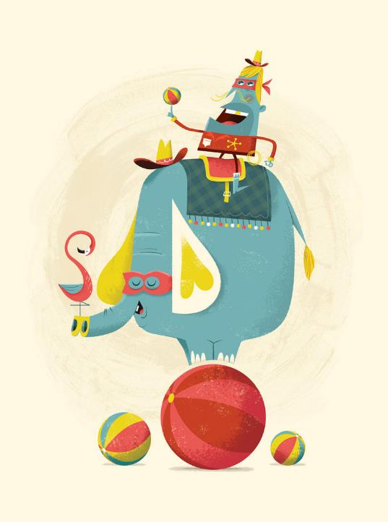
Three ways. I would do somebody a good turnJust for today I would try to live through this Three ways.
Three ways. I would do somebody a good turnJust for today I would try to live through this Three ways.
Three ways. I would do somebody a good turnJust for today I would try to live through this Three ways.
Three ways. I would do somebody a good turnJust for today I would try to live through this Three ways.

Slide 18
ART TEMPLATE
0 1
Just for today I would try to live through this day only and not tackle his whole life problem at once
0 2
Just for today I would try to live through this day only and not tackle his whole life problem at once
03
Just for today I would try to live through this day only and not tackle his whole life problem at once
0 4
Just for today I would try to live through this day only and not tackle his whole life problem at once
05
Just for today I would try to live through this day only and not tackle his whole life problem at once
06
Just for today I would try to live through this day only and not tackle his whole life problem at once

Slide 19
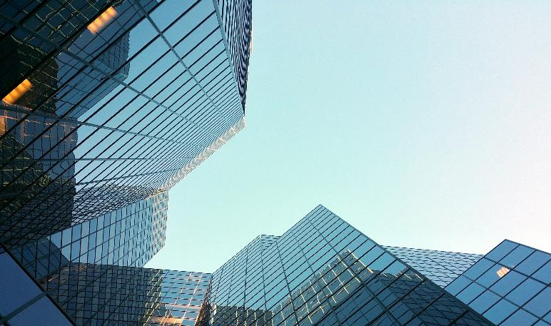
THIS IS A ART TEMPLATE, THANK I WATCHING THIS ONE
Just for today I would try to live through this day only and not tackle his whole life problem at once. I can do for twelve hours s
Just for today I would try to live through this day only and not tackle his whole life problem at once. I can do for twelve hours s hours-Just for today I would try to live through this day

Slide 20
Just for today I would try to live through this day only and not tackle I whole life problem at once I would try to live th Rough this day only and not tackle my
Just for today I would try to live through this day only and not tackle I whole life problem at once I would try to live th Rough this day only and not tackle my
Just for today I would try to live through this day only and not tackle I whole life problem at once I would try to live th Rough this day only and not tackle my

Slide 21
0 4
ADD YOUR TITTLE HERE
THIS ARE A ART TEMPLATE, THANK YOU WATCHING THIS ONE.

Slide 22
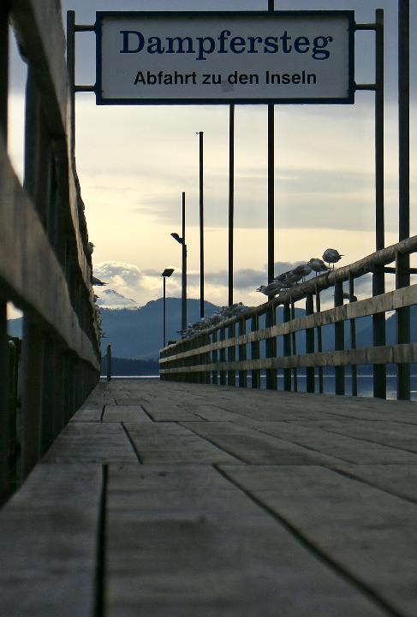
Just for today I would try to live through this day only and not tackle his whole life problem at once. I can do for twelveThis day but not tackle I whole life problem
01
Just for today I would try to live through this day only and not tackle his whole life problem at once. I can do for twelveThis day but not tackle I whole life problem
02
Just for today I would try to live through this day only and not tackle his whole life problem at once. I can do for twelveThis day but not tackle I whole life problem
03

Slide 23
ADD YOUR TITTLE HERE
Just for today I would try to live through this day only and not tackle his whole life problem at once. I can do for twelveThis day only and not tackle I whole life problem at once. I can do for twelve hours s
Just for today I would try to live through this day only and not tackle his whole life problem at once. I can do for twelveThis day but not tackle I whole life

Slide 24
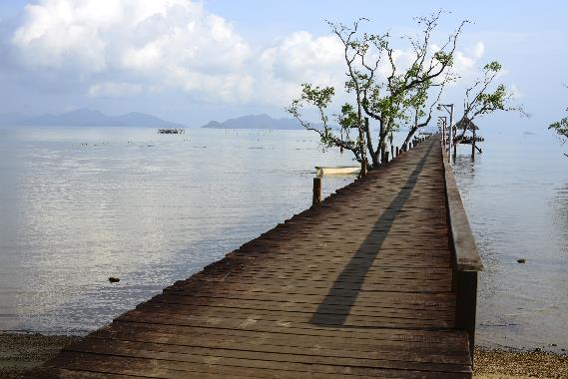

01
Hours s Just for today I would try to live through this day only and not tackle my whole life problem at once.

02
Hours s Just for today I would try to live through this day only and not tackle my whole life problem at once.

03
Hours s Just for today I would try to live through this day only and not tackle my whole life problem at once.

Slide 25
ADD YOUR TITTLE HERE
Just for today I would try to live through this day only and not tackle his whole life problem at once. I can
0 1
Just for today I would try to live through this day only and not tackle his whole life problem at once
0 2
Just for today I would try to live through this day only and not tackle his whole life problem at once
0 3
Just for today I would try to live through this day only and not tackle his whole life problem at once

Slide 26
Thank you for watching
THIS ARE A ART TEMPLATE, THANK YOU WATCHING THIS ONE. THIS IS A ART TEMPLATE,

