Slide 1



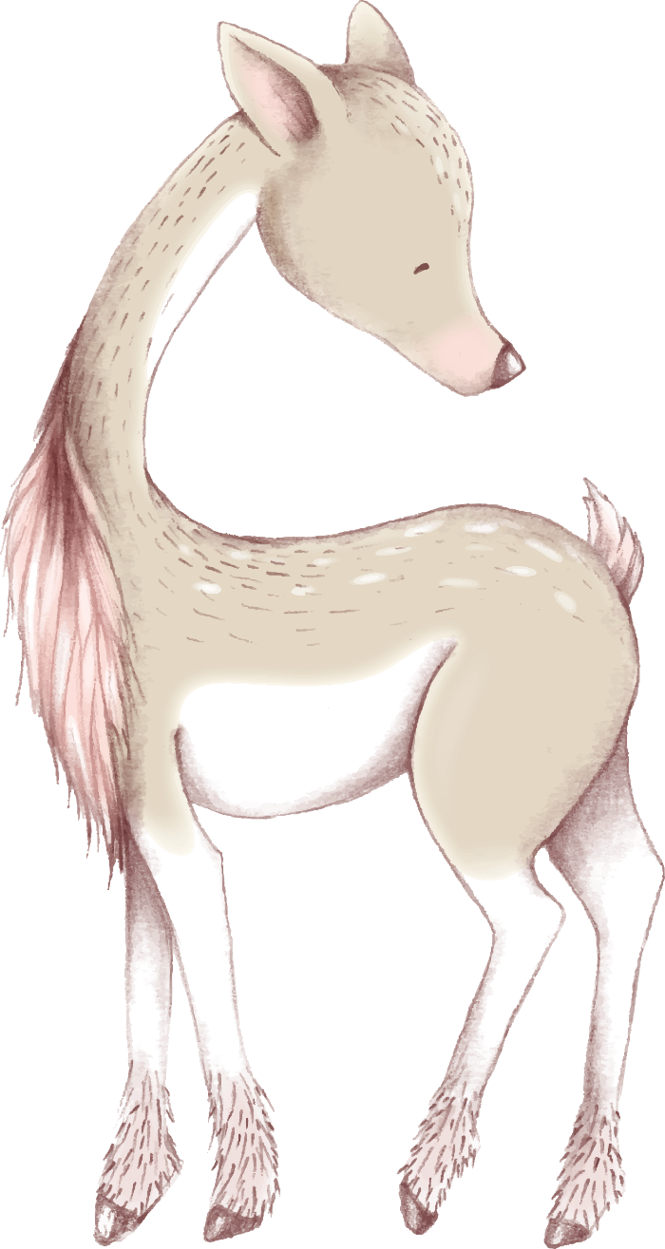







2019
Aesthetic Creative Templates
ADD THE TITLE HERE

Slide 2






Here's your title.
ADD THE TITLE HERE
Here's your title.
ADD THE TITLE HERE
Here's your title.
ADD THE TITLE HERE

Slide 3




01
Here's the title.
Users can present on a projector or computer, or they can print out a presentation and make it into film for application to a wider range of areasMicrosoft Office PowerpointNot only can you create a presentation, the user can

Slide 4


Here's your title.
ADD THE TITLE HERE
Here's the title.
Here's the title.
Here's the title.
Users can present on a projector or computer or print out a presentation to create
film for application to a wider range of
domain, take advantage of not only creating presentations
Users can present on a projector or computer, or they can print out a presentation and make it into film for application to a wider range of areas
Users can present on a projector or computer or print out a presentation to create
film for application to a wider range of
domain, take advantage of not only creating presentations
Users can present on a projector or computer, or they can print out a presentation and make it into film for application to a wider range of areas
Users can present on a projector or computer or print out a presentation to create
film for application to a wider range of
domain, take advantage of not only creating presentations
Users can present on a projector or computer, or they can print out a presentation and make it into film for application to a wider range of areas

Slide 5




Here's your title.
ADD THE TITLE HERE
Here's the title.
Here's the title.
Here's the title.
Here's the title.
Users can present on a projector or computer or print out a presentation to create
Users can present on a projector or computer or print out a presentation to create
Users can present on a projector or computer or print out a presentation to create
Users can present on a projector or computer or print out a presentation to create

Slide 6

Here's your title.
ADD THE TITLE HERE
Here's the title.
Users can present on a projector or computer, or they can print out a presentation and make it into film for application to a wider range of areasMicrosoft Office PowerpointNot only can you create a presentation, which users can present on a projector or computer, or print it out and make it filmed for application to a wider fieldMicrosoft Office PowerpointNot only can you create a presentation that users can present on a projector or computer, but you can also print it out and make it into film for application to a wider range of areasMicrosoft Office PowerpointNot only can you create a presentation

Slide 7


Here's your title.
ADD THE TITLE HERE
Here's the title.
Here's the title.
Users can present on a projector or computer, or they can print out a presentation and make it into film for application to a wider range of areasMicrosoft Office PowerpointNot only can you create a presentation, which users can present on a projector or computer, but you can also print it out and make it into film for a wider range of applications.
Users can present on a projector or computer, or they can print out a presentation and make it into film for application to a wider range of areasMicrosoft Office PowerpointNot only can you create a presentation, which users can present on a projector or computer, but you can also print it out and make it into film for a wider range of applications.

Slide 8


Here's your title.
ADD THE TITLE HERE
Here's the title.
Users can present on a projector or computer, or they can print out a presentation and make it into film for application to a wider range of areasMicrosoft Office PowerpointNot only can you create a presentation, which users can present on a projector or computer, but you can also print it out and make it into film for a wider range of applications.
Here's the title.
Users can present on a projector or computer, or they can print out a presentation and make it into film for application to a wider range of areasMicrosoft Office PowerpointNot only can you create a presentation, which users can present on a projector or computer, but you can also print it out and make it into film for a wider range of applications.

Slide 9
02
Here's the title.
Users can present on a projector or computer, or they can print out a presentation and make it into film for application to a wider range of areasMicrosoft Office PowerpointNot only can you create a presentation, the user can

Slide 10

Here's your title.
ADD THE TITLE HERE
Here's the title.
Users can present on a projector or computer, or they can print out a presentation and make it into film for application to a wider range of areas

Slide 11


Here's your title.
ADD THE TITLE HERE
Here's the title.
Users can present on a projector or computer, or they can print out a presentation and make it into film for application to a wider range of areasMicrosoft Office PowerpointNot only can you create a presentation, which users can present on a projector or computer, but you can also print it out and make it into film for a wider range of applications.
Here's the title.
Users can present on a projector or computer, or they can print out a presentation and make it into film for application to a wider range of areasMicrosoft Office PowerpointNot only can you create a presentation, which users can present on a projector or computer, but you can also print it out and make it into film for a wider range of applications.

Slide 12




Here's your title.
ADD THE TITLE HERE
Here's the title.
Here's the title.
Here's the title.
Here's the title.
Users can present on a projector or computer or print out a presentation and make it into film for wider application
Users can present on a projector or computer or print out a presentation and make it into film for wider application
Users can present on a projector or computer or print out a presentation and make it into film for wider application
Users can present on a projector or computer or print out a presentation and make it into film for wider application

Slide 13




Here's your title.
ADD THE TITLE HERE
Here's the title.
Here's the title.
Users can present on a projector or computer, or they can print out a presentation and make it into film for application to a wider range of areasMicrosoft OPowerpointNot only can you create a presentation, but users can present it on a projector or computer
Users can present on a projector or computer, or they can print out a presentation and make it into film for application to a wider range of areasMicrosoft OPowerpointNot only can you create a presentation, but users can present it on a projector or computer

Slide 14




Here's your title.
ADD THE TITLE HERE
Here's the title.
Users can present on a projector or computer, or they can print out a presentation and make it into film for application to a wider range of areasMicrosoft Office PowerpointNot only
Here's the title.
Users can present on a projector or computer, or they can print out a presentation and make it into film for application to a wider range of areasMicrosoft Office PowerpointNot only
Here's the title.
Users can present on a projector or computer, or they can print out a presentation and make it into film for application to a wider range of areasMicrosoft Office PowerpointNot only

Slide 15
03
Here's the title.
Users can present on a projector or computer, or they can print out a presentation and make it into film for application to a wider range of areasMicrosoft Office PowerpointNot only can you create a presentation, the user can

Slide 16

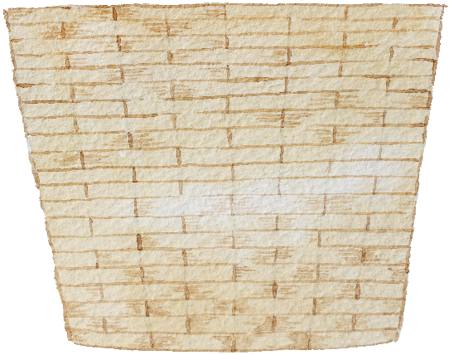


Here's your title.
ADD THE TITLE HERE
Here's the title.
Here's the title.
Here's the title.
Here's the title.
Users can present on a projector or computer, or they can print out a presentation and make it into film for use in a wider field.
Users can present on a projector or computer, or they can print out a presentation and make it into film for use in a wider field.
Users can present on a projector or computer, or they can print out a presentation and make it into film for use in a wider field.
Users can present on a projector or computer, or they can print out a presentation and make it into film for use in a wider field.

Slide 17



Here's your title.
ADD THE TITLE HERE
Here's the title.
Here's the title.
Here's the title.
Users can present on a projector or computer, or they can print out a presentation and make it into film for use in a wider field.
Users can present on a projector or computer, or they can print out a presentation and make it into film for use in a wider field.
Users can present on a projector or computer, or they can print out a presentation and make it into film for use in a wider field.

Slide 18

Here's your title.
ADD THE TITLE HERE
Here's the title.
Users can present on a projector or computer, or they can print out a presentation and make it into film for application to a wider range of areasMicrosoft Office PowerpointNot only can you create a presentation, which users can present on a projector or computer, but you can also print it out and make it into film for a wider range of applications.
Users can use the projector or computer
to present, or to print the presentation into film for wider application
in the general field, the use ofMicrosoft Office PowerpointNot only can you create
Users can use the projector or computer
to present, or to print the presentation into film for wider application
in the general field, the use ofMicrosoft Office PowerpointNot only can you create
Users can use the projector or computer
to present, or to print the presentation into film for wider application
in the general field, the use ofMicrosoft Office PowerpointNot only can you create

Slide 19






Here's your title.
ADD THE TITLE HERE
Here's the title.
Users can present on a projector or computer, or they can print out a presentation and make it into film for application to a wider range of areasMicrosoft Office
Here's the title.
Users can present on a projector or computer, or they can print out a presentation and make it into film for application to a wider range of areasMicrosoft Office
Here's the title.
Users can present on a projector or computer, or they can print out a presentation and make it into film for application to a wider range of areasMicrosoft Office

Slide 20




Here's your title.
ADD THE TITLE HERE
Here's the title.
Users can present on a projector or computer, or they can print out a presentation and make it into film.
Here's the title.
Users can present on a projector or computer, or they can print out a presentation and make it into film.
Here's the title.
Users can present on a projector or computer, or they can print out a presentation and make it into film.
Here's the title.
Users can present on a projector or computer, or they can print out a presentation and make it into film.

Slide 21
04
Here's the title.
Users can present on a projector or computer, or they can print out a presentation and make it into film for application to a wider range of areasMicrosoft Office PowerpointNot only can you create a presentation, the user can

Slide 22






Here's your title.
ADD THE TITLE HERE
Here's the title.
Here's the title.
Users can present on a projector or computer, or they can print out a presentation and make it into film for application to a wider range of areasMicrosoft OPowerpointNot only can you create a presentation, but users can present it on a projector or computer
Users can present on a projector or computer, or they can print out a presentation and make it into film for application to a wider range of areasMicrosoft OPowerpointNot only can you create a presentation, but users can present it on a projector or computer

Slide 23
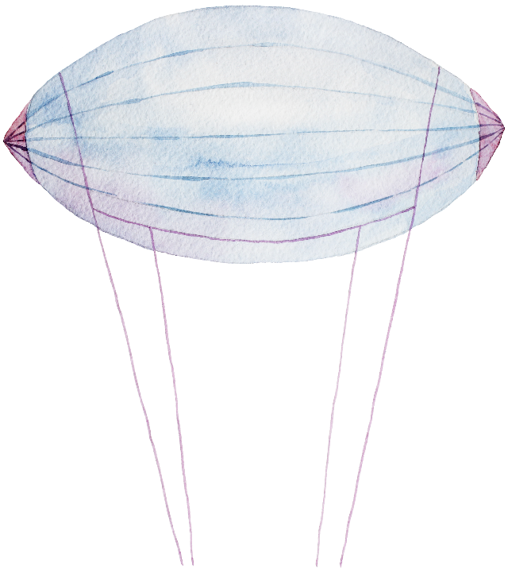

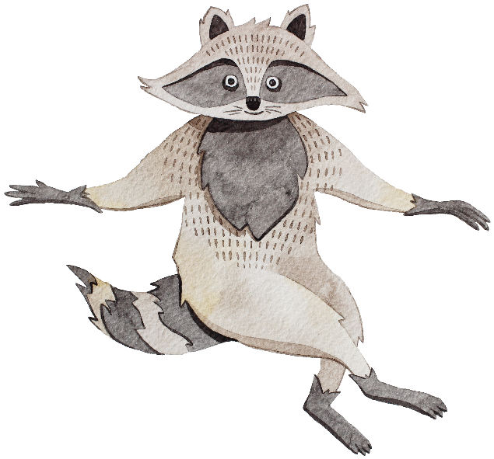

Here's your title.
ADD THE TITLE HERE
Here's the title.
Users can present on a projector or computer, or they can print out a presentation and make it into film for application to a wider range of areasMicrosoft Office PowerpointNot only can you create a presentation, which users can present on a projector or computer, but you can also print it out and make it into film for a wider range of applications.
Here's the title.
Users can present on a projector or computer, or they can print out a presentation and make it into film for application to a wider range of areasMicrosoft Office PowerpointNot only can you create a presentation, which users can present on a projector or computer, but you can also print it out and make it into film for a wider range of applications.
Here's the title.
Users can present on a projector or computer, or they can print out a presentation and make it into film for application to a wider range of areasMicrosoft Office PowerpointNot only can you create a presentation, which users can present on a projector or computer, but you can also print it out and make it into film for a wider range of applications.

Slide 24


Here's your title.
ADD THE TITLE HERE
Here's the title.
Users can present on a projector or computer, or they can print out a presentation and make it into film for application to a wider range of areasMicrosoft Office PowerpointNot only can you create a presentation,
Here's the title.
Users can present on a projector or computer, or they can print out a presentation and make it into film for application to a wider range of areasMicrosoft Office PowerpointNot only can you create a presentation,
Here's the title.
Users can present on a projector or computer, or they can print out a presentation and make it into film for application to a wider range of areasMicrosoft Office PowerpointNot only can you create a presentation,
Here's the title.
Users can present on a projector or computer, or they can print out a presentation and make it into film for application to a wider range of areasMicrosoft Office PowerpointNot only can you create a presentation,

Slide 25



Here's your title.
ADD THE TITLE HERE
Here's the title.
Users can present on a projector or computer, or they can print out a presentation and make it into film for application to a wider range of areas
Here's the title.
Here's the title.
Users can present on a projector or computer, or they can print out a presentation and make it into film for application to a wider range of areas
Users can present on a projector or computer, or they can print out a presentation and make it into film for application to a wider range of areas

Slide 26
Here's your title.
ADD THE TITLE HERE
Here's the title.
Users can present on a projector or computer, or they can print out a presentation and make it into film for application to a wider range of areasMicrosoft Office PowerpointNot only can you create a presentation,
Here's the title.
Users can present on a projector or computer, or they can print out a presentation and make it into film for application to a wider range of areasMicrosoft Office PowerpointNot only can you create a presentation,

Slide 27

Thank you.

