Slide 1
E-COMMERCEP PTT EMPLATE
https://www.freeppt7.com

Slide 2
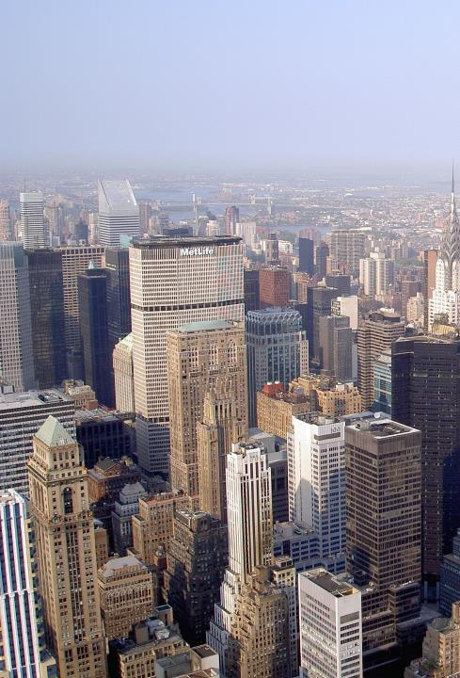
Listings
1
Why talk about trends
2
The history of e-commerce
3
The current state of e-commerce
4
The possible future of e-commerce

Slide 3
One
Why talk about trends

Slide 4
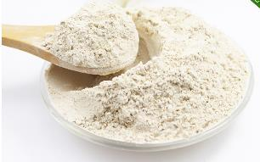
Is the trend related to you??
earned money to sell cabbage.
Heart with white powder

Slide 5
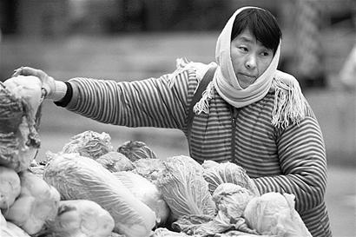
Is the trend related to you??
Beijing
Chinese cabbage
Political
Economic
2002Years
Technology
Culture
So sell cabbage for the rest of your life?

Slide 6
What do you think of trends??
Standing at the mouth of the typhoon,
Pigs can fly!
80Years of sea business
90Age Stocks
00Era Electronics, Real Estate
10AgeITInternet

Slide 7
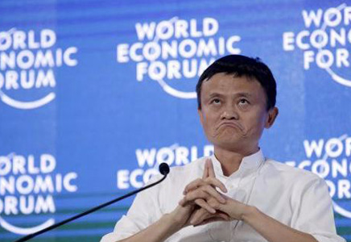
What do you think of trends??
The wind's gone.
It's the pig who fell to his death!
SO WHAT

Slide 8
Our career trends
Managers
Professional elite
Entrepreneurs

Slide 9
Two
The history of e-commerce

Slide 10
E-commerce events
Tmall
Taobao
8848
Ali
Dangdang
EBAY
Amazon
2012
2003
1999
1995
1994

Slide 11
Double11A new festival.
2014Years
571Billion
2012Years
191Billion
2009Years
0.5Billion

Slide 12
The war of e-commerce
The battle for resources
The battle for speed
Price fight
User contention

Slide 13
Recommended learning materials

Slide 14
Three
The current state of e-commerce

Slide 15
Pattern stable double super-strong
2
Pat
Millet
Gome
Online
1Store No.
1
Jingdong
Baidu Rice
When when
Tmall
U.S. Mission
Uber
Suning
Tesco

Slide 16
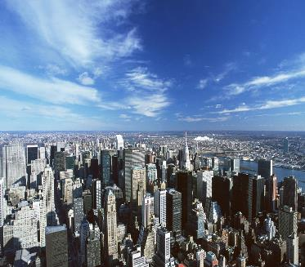
Change strategy: mergers, acquisitions, acquisitions
Interests
There is no eternal enemy.
Drops&Express
58Same city&Catch-up net
U.S. Mission&Public Reviews
Ctrip&Where to
Ali&Youku

Slide 17
Changes brought about in e-commerce
Mobile
Fragmentation
Humanized
Socializing
changed our food and clothing, and......

Slide 18
Four
The possible future of e-commerce

Slide 19
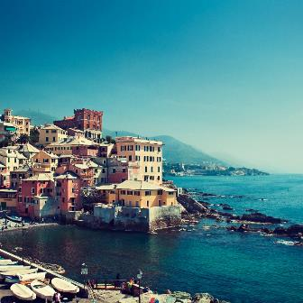
Changes in geographic time and space
Globalization
Urbanization

Slide 20
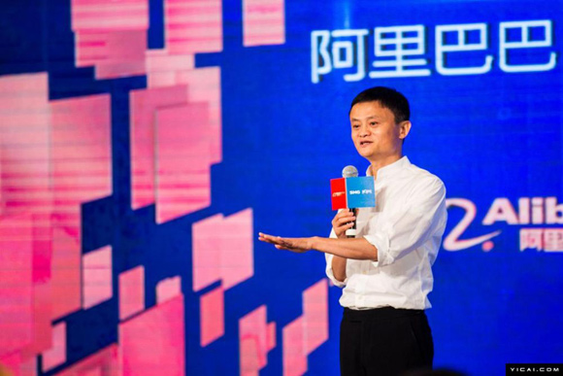
?
Discussion questions
In the future you don't do e-commerce, you will have no business
Enter the title

Slide 21
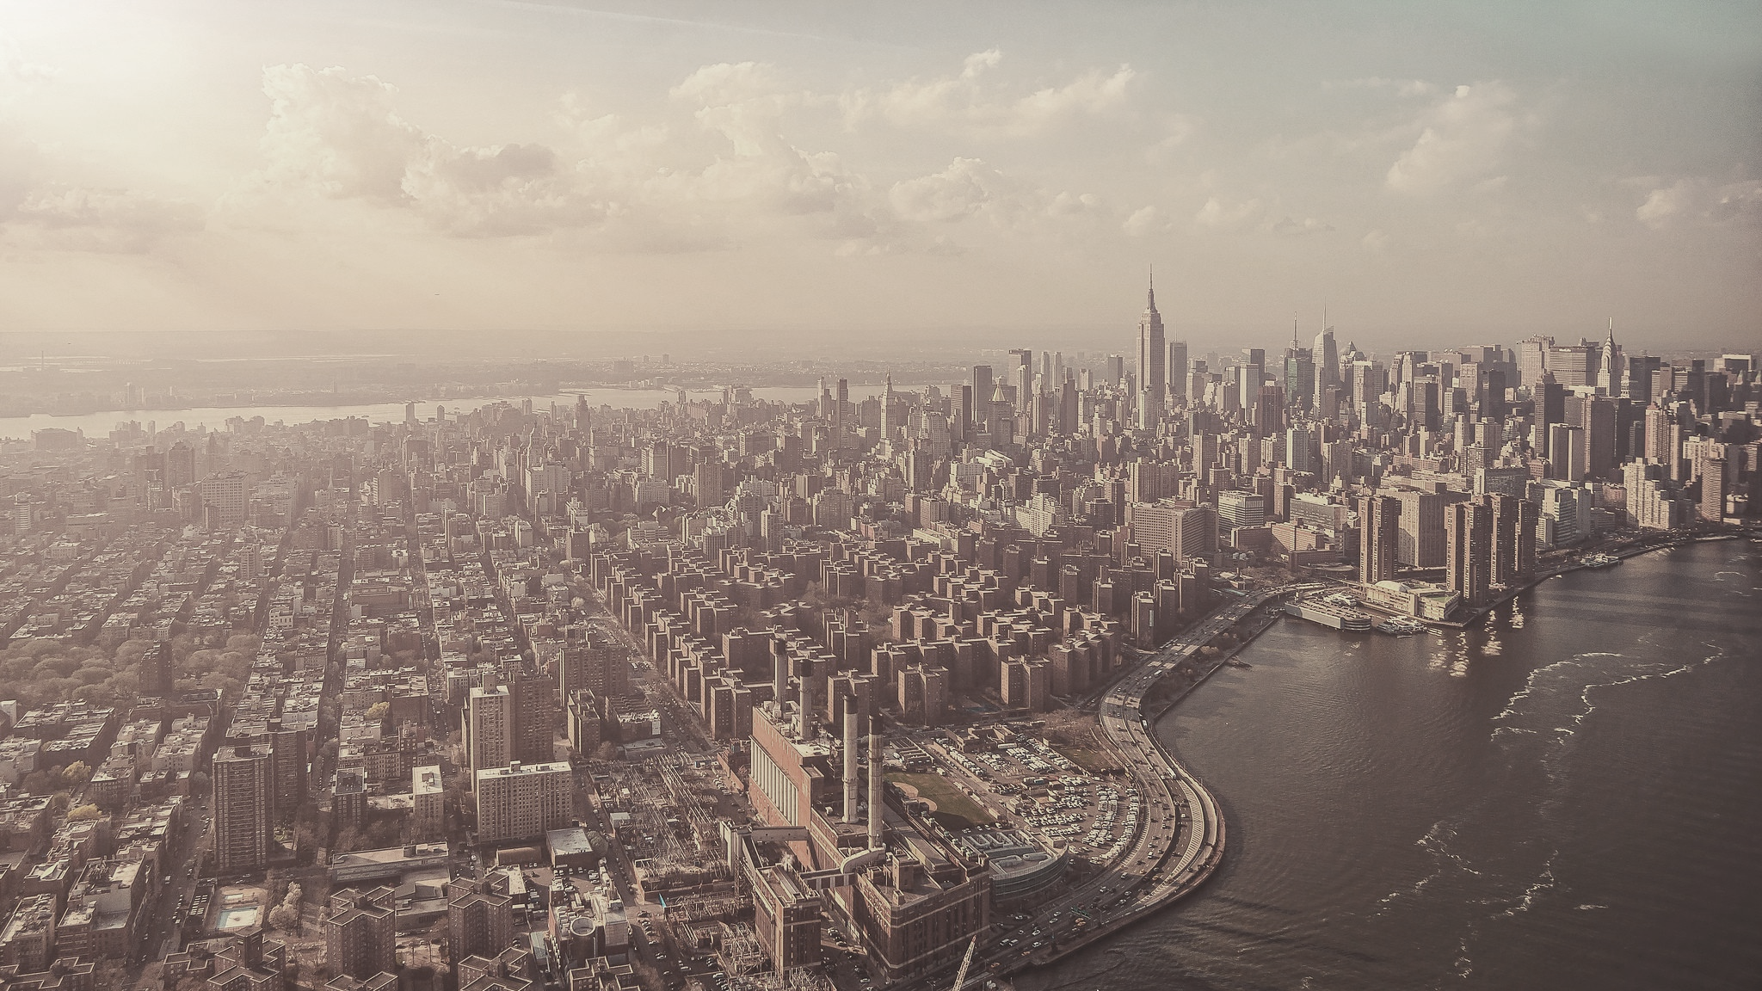
Time-aware for JunJie
The pass changer is Yinghao

