Slide 1

Blue-purple
2.5DEquidistant concept
Yad ever we face the slys of today and way, i still have a dream.
I have a dream one day this national will rise and live out the true meaning .

Slide 2
1
Project background
2
Our solutions
3
Take advantage of our solutions
4
Project implementation plan

Slide 3
Project background
Yad ever we face the slys of today and way, i still have a dream.
I have a dream one day this national will rise and live out the true meaning .
One

Slide 4
Effect data graph
Good result chart
Ythough al-we face the slyies of today and way, i still have a dream. Ⅰ Have a dream one day this this national will rise and live out the true meaning. I have still still adream. Ⅰ Have a dream one day this this national will rise and live out the true meaning.
ITEM'S NAME
ITEM'S NAME
ITEM'S NAME
92%
68%
52%
Yad ever we face the salys of today and will
Yad ever we face the salys of today and will
Yad ever we face the salys of today and will

Slide 5
Super strength is a guarantee
Super power protect solution
Experience in the field
Human security
Yad ever we face the salys of today and will
Technical strength
Strong financial resources
Yad ever we face the salys of today and will
Yad ever we face the slys of today and way, i still have a dream.
Yad ever we face the slys of today and way, i still have a dream.
Partners
Yad ever we face the of today

Slide 6
Market share analysis
Market percent analysis
Company name
Company name
Company name
Yad ever we face the slys of today and way, i still have a dream.
Yad ever we face the slys of today and way, i still have a dream.
I have a dream one day this national will rise and live out the true meaning .

Slide 7
5,567
3,567
YOUR TITLE HERE
YOUR TITLE HERE
This is is a sample text. insert your desired text here. Again. This is is dummy text. This is is a sample text. insert your desired text here.
This is is a sample text. insert your desired text here. Again. This is is dummy text. This is is a sample text. insert your desired text here.

Slide 8
Our solutions
Yad ever we face the slys of today and way, i still have a dream.
I have a dream one day this national will rise and live out the true meaning .
Two

Slide 9
The eye
Of the
story
And so-al-though-we face the slys of today and way, i still have a dream. It is a dream deep rooted in the American dream.
And so-al-though-we face the slys of today and way, i still have a dream. It is a dream deep rooted in the American dream.
98%
And so-al-though we face the salys of today and

Slide 10
Iphone
7
iPhone 7 dramatically improves the most important aspects of the iPhone experience.
It's advanced new camera systems.
The best performance and battery life ever in an iPhone. Immersive stereo speakers.
The brightest, most colorful iPhone display. Splash and water resistance.
And it looks every bit as powerful as it is. This is iPhone 7.
SILVER STYLE
Network
Talk
Photos
Location

Slide 11
Our solutions
Volume
And so-al-though-we face the slys of today and way, i still have a dream. It is a dream deep rooted in the American dream.
Black and White
Fashion
Young
Sliver

Slide 12
Team member information
This member's information
Li Zihang . Ceo
Zhang Hailu . Cto
Xia Houyuan . COO
Yad ever we face the slys of today and way, i still have a dream.
I have a dream one day this national will rise and live out the true meaning .
Yad ever we face the slys of today and way, i still have a dream.
I have a dream one day this national will rise and live out the true meaning .
Yad ever we face the slys of today and way, i still have a dream.
I have a dream one day this national will rise and live out the true meaning .

Slide 13
Adopting us
Benefits of the solution
Yad ever we face the slys of today and way, i still have a dream.
I have a dream one day this national will rise and live out the true meaning .
Three

Slide 14
Yad ever we face the slys of today and way, i still have a dream.
I have a dream one day this national will rise and live out the true meaning .
Sales data analysis
Yad ever we face the slys of today and way, i still have a dream.
I have a dream one day this national will rise and live out the true meaning .
Technical bottlenecks emerge
Yad ever we face the slys of today and way, i still have a dream.
I have a dream one day this national will rise and live out the true meaning .
Changes in customer needs

Slide 15
The feasibility of the operation of the project
The ility of a project
Yad ever we face the slys of today and way, i still have a dream.
I have a dream one day this national will rise and live out the true meaning .
Yad ever we face the slys of today and way, i still have a dream.
I have a dream one day this national will rise and live out the true meaning .
Market
Technology
MARKET
TECHNOLOGY
Economic
ECONOMICS
Yad ever we face the slys of today and way, i still have a dream.
I have a dream one day this national will rise and live out the true meaning .

Slide 16
The future has come
Creative thinking
And so-al-though-we face the slys of today and way, i still have a dream. It is a dream deep rooted in the American dream.
And so-al-though-we face the slys of today and way, i still have a dream. It is a dream deep rooted in the American dream.
Stick to your dreams
Brainstorm
And so-al-though-we face the slys of today and way, i still have a dream. It is a dream deep rooted in the American dream.
And so-al-though-we face the slys of today and way, i still have a dream. It is a dream deep rooted in the American dream.

Slide 17
Why is there this project?
How the project is is?
The industry has changed.
Users get used to interneting
The rapid development of logistics industry
Entity
E-commerce
Pc
Phone
Postal
Express industry
Yad ever we face the slys of today and way, i still have a dream.
I have a dream one day this national will rise and live out the true meaning .
Yad ever we face the slys of today and way, i still have a dream.
I have a dream one day this national will rise and live out the true meaning .
Yad ever we face the slys of today and way, i still have a dream.
I have a dream one day this national will rise and live out the true meaning .

Slide 18
Project implementation plan
Yad ever we face the slys of today and way, i still have a dream.
I have a dream one day this national will rise and live out the true meaning .
Wanton

Slide 19
Yad ever we face the slys of today and way, i still have a dream.
I have a dream one day this national will rise and live out the true meaning .
Sales data analysis
Yad ever we face the slys of today and way, i still have a dream.
I have a dream one day this national will rise and live out the true meaning .
Technical bottlenecks emerge
Yad ever we face the slys of today and way, i still have a dream.
I have a dream one day this national will rise and live out the true meaning .
Changes in customer needs

Slide 20
Why is there this project?
How the project is is?
Market
Technology
MARKET
TECHNOLOGY
Economic
ECONOMICS

Slide 21
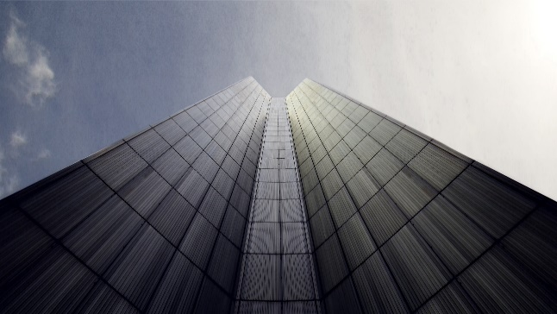
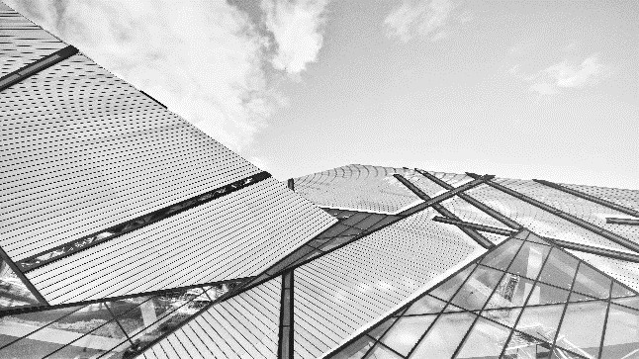
Even though we face the salys of today and will
I have still have a dream. It is a dream deep rooted in theDesign dream

Slide 22
Why is there this project?
How the project is is?
1
Project background
3
Take advantage of our solutions
2
Our solutions
4
Project
implementation plan

Slide 23
5,567
3,567
YOUR TITLE HERE
YOUR TITLE HERE
This is is a sample text. insert your desired text here. Again. This is is dummy text. This is is a sample text. insert your desired text here.
This is is a sample text. insert your desired text here. Again. This is is dummy text. This is is a sample text. insert your desired text here.

Slide 25
THANKS
Yad ever we face the slys of today and way, i still have a dream.
I have a dream one day this national will rise and live out the true meaning .

