Slide 1
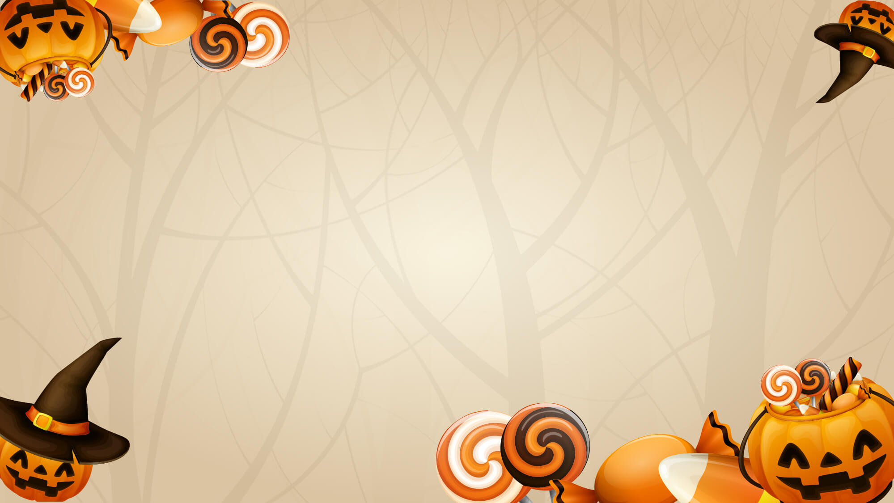
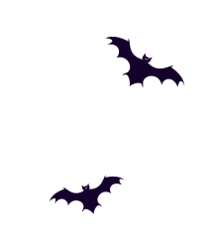
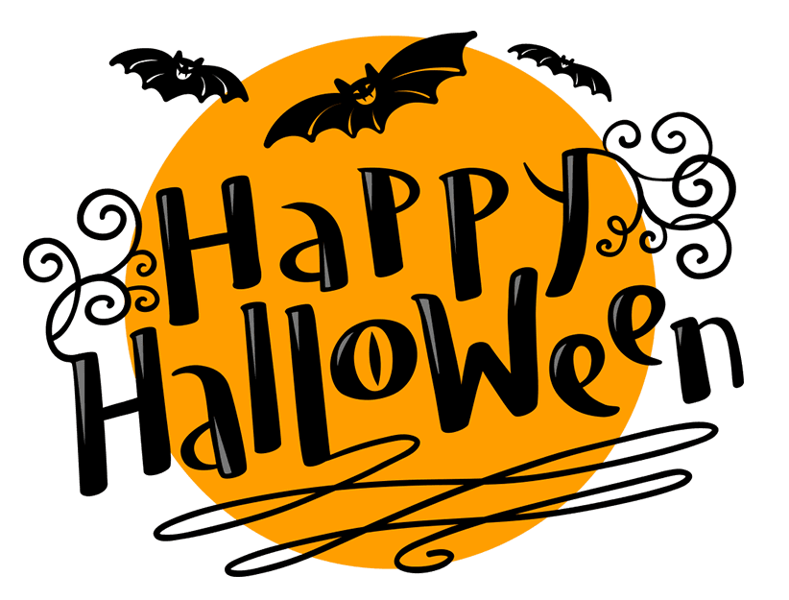
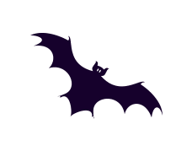
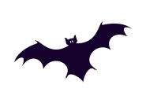
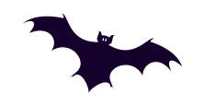
SIMPLE UNIVERSAL HALLOWEEN PPT TEMPLATE

Slide 2
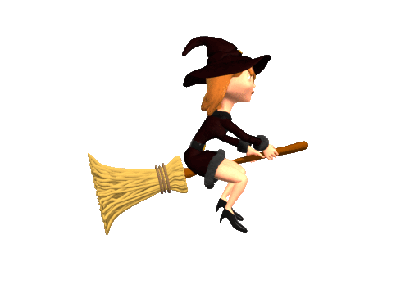











Halloween·Origin
More than two thousand years ago, christianity in europe11month1the day is set as "the day of the world's saints." "HALLOW" that is, the meaning of the saints. Legend has it that the celts who lived in ireland, scotland and other places since 500 BC move this festival forward one day, that is,10month31day. They consider it the official end of summer, the day at the beginning of the new year, the day when the harsh winter begins.
At that time, it was believed that the dead souls of the deceased would return to their homes on this day to find the living in the living, thereby regenerating, and this is the only hope that people can be reborn after death. And the living people are afraid of the soul of the dead to take birth, so people on this day put out the fire, candlelight, so that the soul of the dead can not find the living people, and dressed themselves as demons to scare the souls of the dead away. After that, they will rekindle the fire and the candlelight and start the new year.

Slide 3

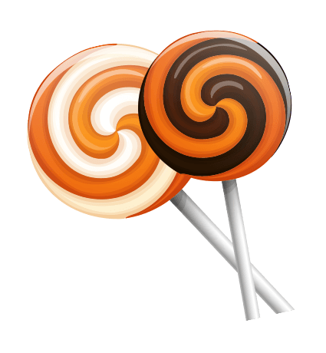
Act 1
It's Halloween."Holy Night"Meaning
But for a variety of reasons Halloween has become one of the most popular and popular festivals of the year.

Slide 4
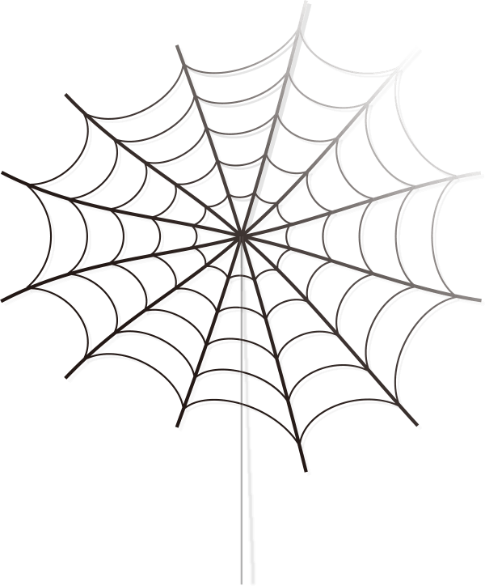

Clothing·Origin
Halloween costumes, millions of people, not just monotony of the big ghost. Make the simplest ghost suit with a white sheet on the head, key two holes to leave the eyes; to play a magician, wear black pants, then wear a black hat, and hide a fluffy rabbit spare between the hat and the head; the child put on white pants, and then tied a flashlight behind the head dressed up as an angel There are also parents who dress their children up as their favorite cartoon characters.

Slide 5
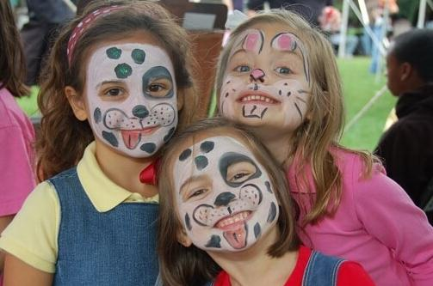
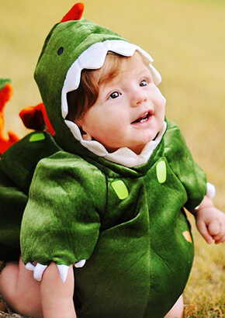
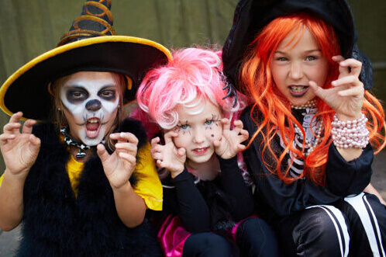

Slide 6
Act II
It's Halloween."Holy Night"Meaning
But for a variety of reasons Halloween has become one of the most popular and popular festivals of the year.

Slide 7

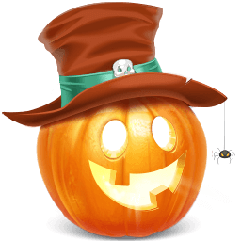
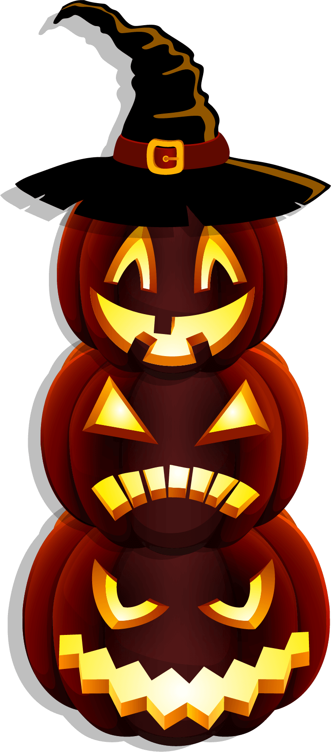

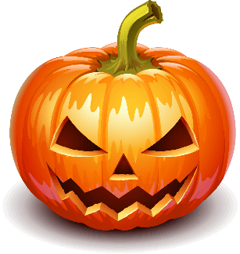
Pumpkin Lights·Origin
Pumpkin lights originated in ancient Ireland. Legend has it that a name isJackA man who is a drunk and loves to play pranks. On Halloween, he set a trap to trap the devil in a tree, and he wouldn't let the devil down until the devil promised never to let him live in hell.JackAfter death, because he did not believe in God, he could not go to heaven, and the devil would not let him into hell, in order to helpJackFind the path back to earth, and the devil gave him a piece of burning charcoal,JackPut the burning charcoal in a lantern he carved into a large carrot, the first one"JackLanterns" helped to find his path back to Ireland, but he never looked for it, so he always took the lanterns to the world.

Slide 8
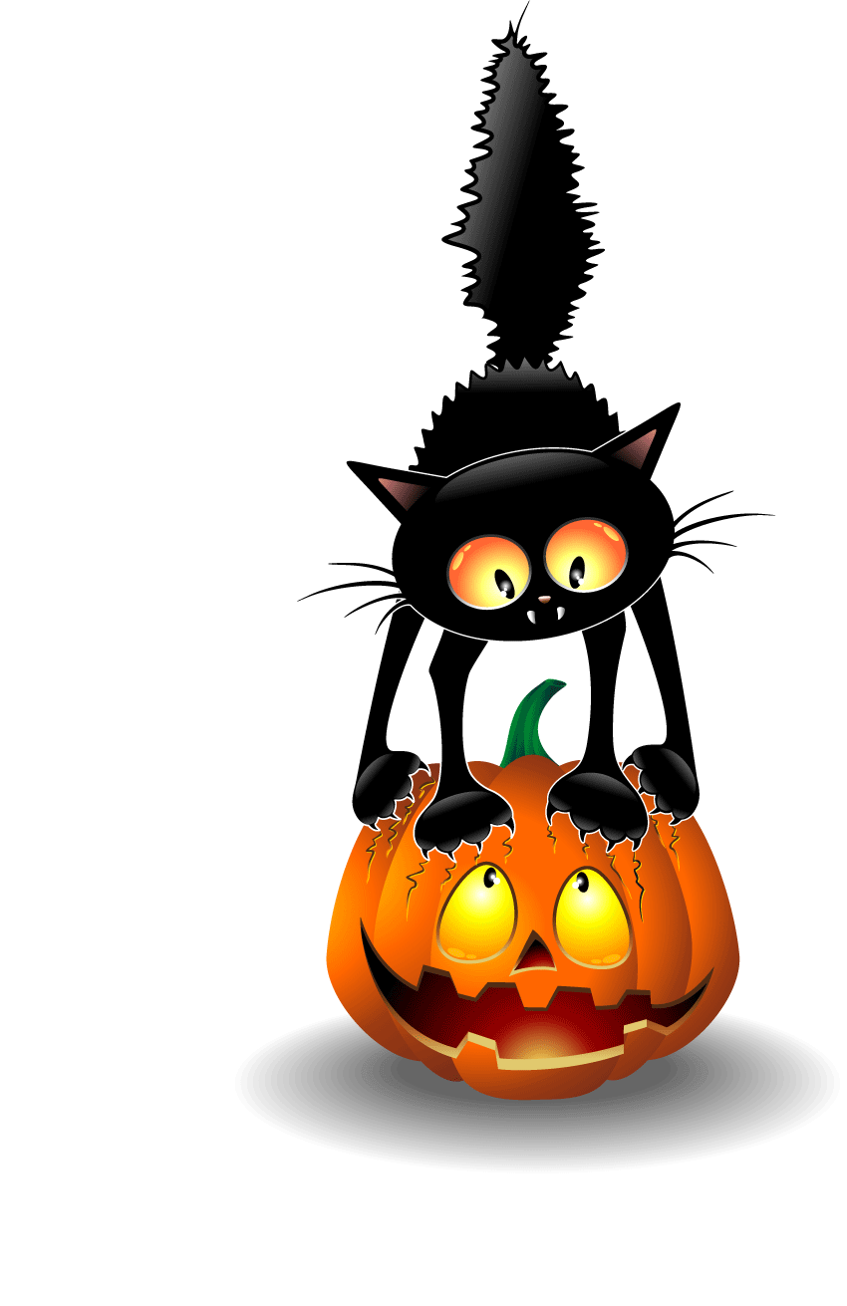
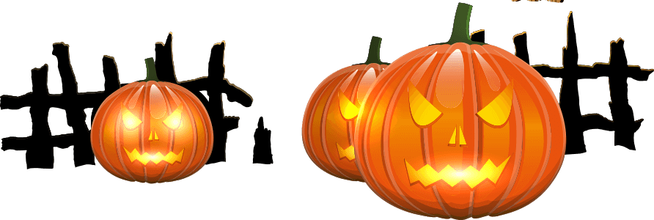
Pumpkin Lights·Origin
China's traditional July Yuan Festival is similar to The West's Halloween, and even many gangsters taboo many things during the ghost festival to avoid obscurity. It can be seen that even in the folk beliefs know that the best thing about elves is to go away. Unfortunately, it is packaged as a carnival, stimulation, laissez-faire festival, in the commercial interests of the incentive to promote the Halloween as in addition to Christmas and Thanksgiving outside the third major festival, each year at this time in the cover of the night to confuse the world, with the dance of death beats worship fear and death.

Slide 9
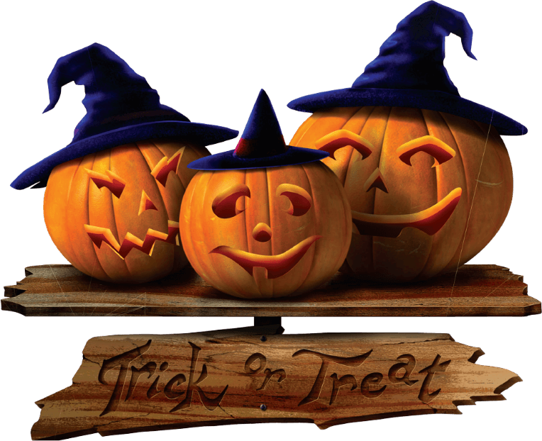
Halloween·Misperception
actually right Halloween for11Month1Day.10Month31The day is the Holy Night (or the Eve of the Holy Ness), which is the equivalent of New Year's Eve and Christmas Eve before Christmas. Thanks to the all-in-one night's mania, and the business hype of its activities, many people are mistakenly guided to think that Halloween is10Month31Day. This needs to be addressed!

Slide 10
Act III
It's Halloween."Holy Night"Meaning
But for a variety of reasons Halloween has become one of the most popular and popular festivals of the year.

Slide 11
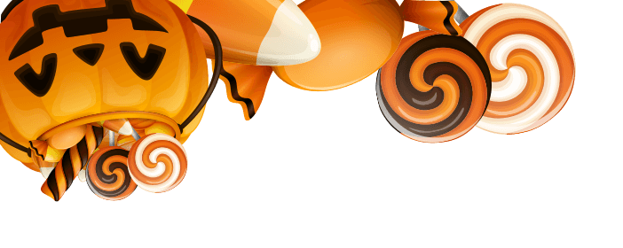
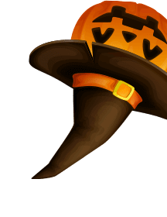
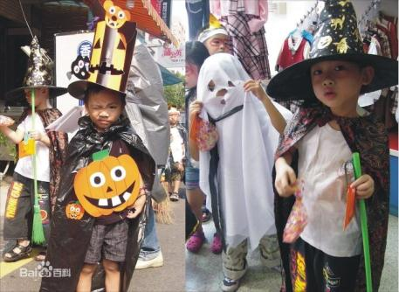
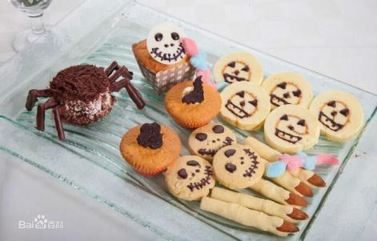
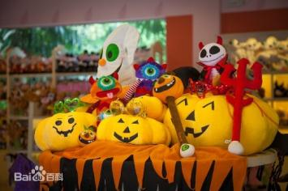
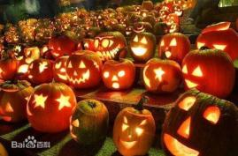
Halloween·Popular
Halloween is popular in the English-speaking world, such as the British Isles and North America, followed by Australia and New Zealand. Now some young people in Asian countries are also inclined to "foreign festival", to Halloween, some large foreign supermarkets will put out special counters selling Halloween toys, small vendors will also sell halloween-related dolls or models to attract the eyes of young people.

Slide 12
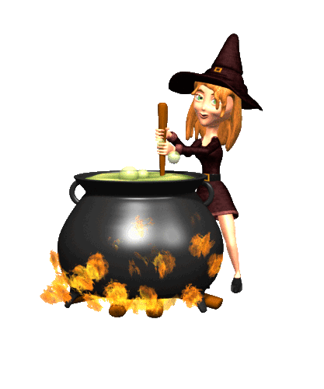

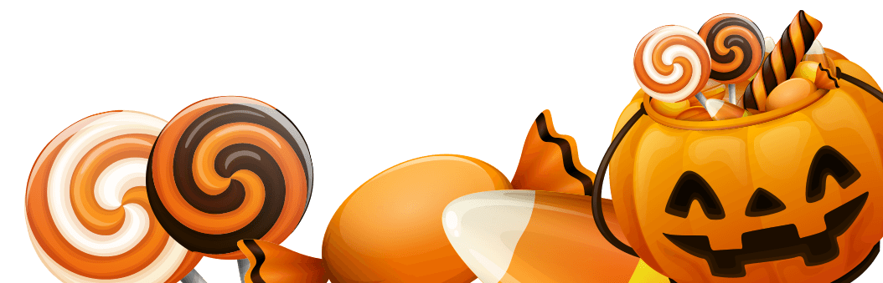
Halloween·Popular
1
2
3
Back home.
I even drank it.
Three bowls of pumpkin soup
Back home.
I even drank it.
Three bowls of pumpkin soup
Back home.
I even drank it.
Three bowls of pumpkin soup

Slide 13
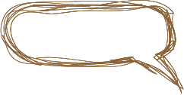
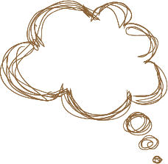
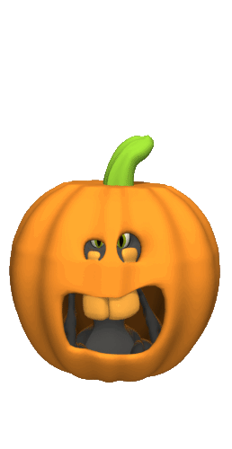
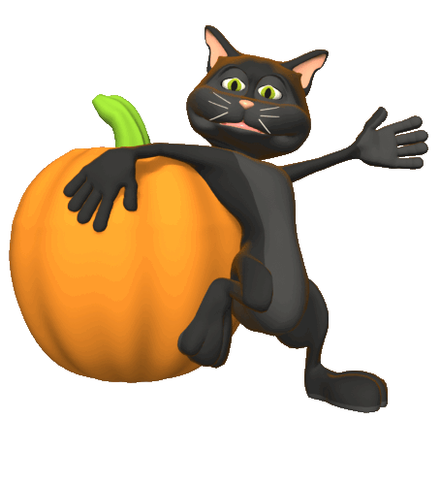
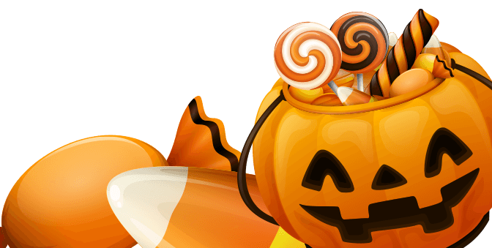
When I got home that night,
I drank three bowls of pumpkin soup.
Back home that night.
I drank three bowls of pumpkin soup.

Slide 14
Act 4
It's Halloween."Holy Night"Meaning
But for a variety of reasons Halloween has become one of the most popular and popular festivals of the year.

Slide 15
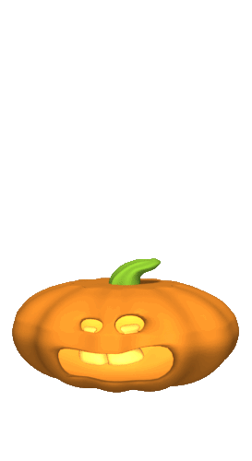
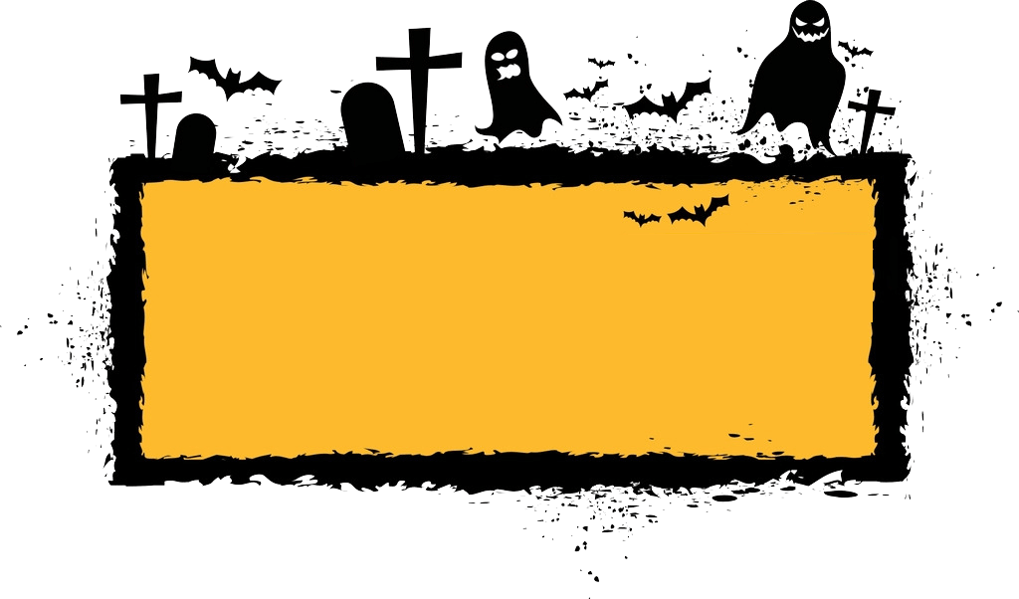
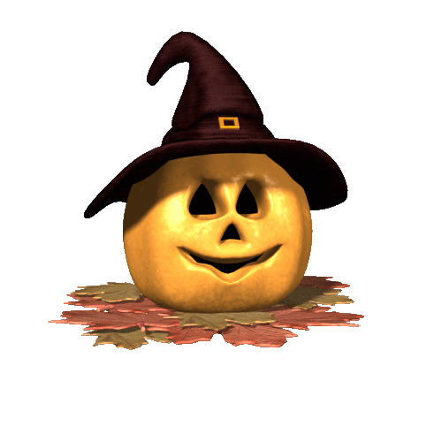
Halloween·Songs
This Is Halloween
"Trick or " The Nightmare before Christmas" aka "This is Halloween"

Slide 16
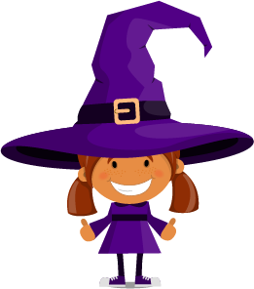
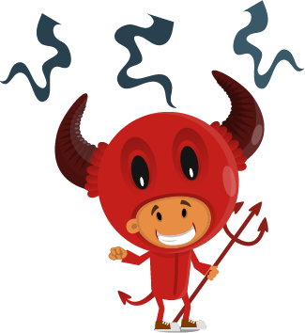
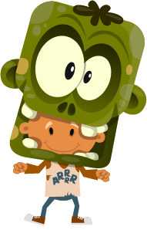
Festivals
Click here to add your text, as concisely as possible. Click here to add your text, as concisely as possible. Click here to add your text, as concisely as possible. Click here to add your text, as concisely as possible.

Slide 17
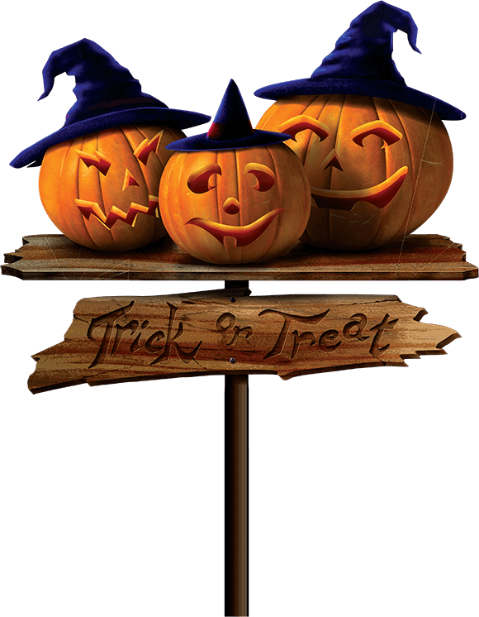
Festivals
Click here to add your text, as concisely as possible. Click here to add your text, as concisely as possible. Click here to add your text, as concisely as possible. Click here to add your text, as concisely as possible.

Slide 19
