Slide 1
Calm wind paper defense template
C
Mentor:Xxx
Professional:Xxx
Respondent:Xxx
Time:Xxx

Slide 2
01
The meaning and purpose of selecting topics
02
Development at home and abroad
05
Project design
03
Key research content
CONTENTS
06
Research findings and applications
04
Analysis of project principles
07
Summarize the recommendations

Slide 3
The First Part
The meaning and purpose of selecting topics
We are sings the best!

Slide 4
The meaning and purpose of selecting topics
We are sings the best!
01
04
Add Your Title
Add Your Title
Remember that happiness is a way of travel, not a destination. Remember that happiness is a way of travel, not a destination.
Remember that happiness is a way of travel, not a destination. Remember that happiness is a way of travel, not a destination.
02
05
Add Your Title
Add Your Title
Remember that happiness is a way of travel, not a destination. Remember that happiness is a way of travel, not a destination.
Remember that happiness is a way of travel, not a destination. Remember that happiness is a way of travel, not a destination.
03
06
Add Your Title
Add Your Title
Remember that happiness is a way of travel, not a destination. Remember that happiness is a way of travel, not a destination.
Remember that happiness is a way of travel, not a destination. Remember that happiness is a way of travel, not a destination.

Slide 5
The meaning and purpose of selecting topics
We are sings the best!
Add The Title Here
Add The Title Here
Add The Title Here
Remember that happiness is a way of travel, not a destination.
Remember that happiness is a way of travel, not a destination.
Remember that happiness is a way of travel, not a destination.
Add The Title Here
Add The Title Here
Add The Title Here
Remember that happiness is a way of travel, not a destination.
Remember that happiness is a way of travel, not a destination.
Remember that happiness is a way of travel, not a destination.
Remember that happiness is a way of travel, not a destination. Times you need to look back, otherwise you will never know what you have lost in way of forever searching. Remember that happiness is a way of travel, not a destination. Times you need to look back, otherwise you will never know what you have lost in way of forever searching.

Slide 6
The Second Part
Development at home and abroad
We are sings the best!

Slide 7
Development at home and abroad
We are sings the best!
Add Your Title
Add Your Title
Remember that happiness is a way of travel, not a destination. Remember that happiness is a way of travel.
Remember that happiness is a way of travel, not a destination. Remember that happiness is a way of travel.
Remember that happiness is a way of travel, not a destination. Remember that happiness is a way of travel.
Remember that happiness is a way of travel, not a destination. Remember that happiness is a way of travel.
Remember that happiness is a way of travel, not a destination.
Remember that happiness is a way of travel, not a destination. Remember that happiness is a way of travel.
Remember that happiness is a way of travel, not a destination. Remember that happiness is a way of travel.
Remember that happiness is a way of travel, not a destination. Remember that happiness is a way of travel.
Remember that happiness is a way of travel, not a destination. Remember that happiness is a way of travel.
Remember that happiness is a way of travel, not a destination.
HOME
ABROAD

Slide 8
The Third Part
Key research content
We are sings the best!

Slide 9
Key research content
We are sings the best!
Add Your Title
Remember that happiness is a way of travel, not a destination. Remember that happiness is a way of travel.
Add Your Title
01
Remember that happiness is a way of travel, not a destination. Remember that happiness is a way of travel.
02
Add Your Title
Add Your Title
Remember that happiness is a way of travel, not a destination. Remember that happiness is a way of travel.
03
Remember that happiness is a way of travel, not a destination. Remember that happiness is a way of travel.
04
Add Your Title
Add Your Title
05
06
Remember that happiness is a way of travel, not a destination. Remember that happiness is a way of travel.
Remember that happiness is a way of travel, not a destination. Remember that happiness is a way of travel.

Slide 10
The Fourth Part
Analysis of project principles
We are sings the best!

Slide 11
Analysis of project principles
We are sings the best!
Add Your Title
Remember that happiness is a way of travel, not a destination. Times you need to look back, otherwise you will never know what you have lost in way of forever searching. Remember that happiness is a way of travel, not a destination. Times you need to look back, otherwise you will never know what you have lost in way of forever searching.
Add Your Title
Remember that happiness is a way of travel, not a destination. Times you need to look back, otherwise you will never know what you have lost in way of forever searching. Remember that happiness is a way of travel, not a destination. Times you need to look back, otherwise you will never know what you have lost in way of forever searching.
Add Your Title
Remember that happiness is a way of travel, not a destination. Times you need to look back, otherwise you will never know what you have lost in way of forever searching. Remember that happiness is a way of travel, not a destination. Times you need to look back, otherwise you will never know what you have lost in way of forever searching.

Slide 12
The Fifth Part
Project design
We are sings the best!

Slide 13
Project design
We are sings the best!
03
01
Add Your Title
Add Your Title
Remember that happiness is a way of travel, not a destination. Remember that happiness is a way of travel.
Remember that happiness is a way of travel, not a destination. Remember that happiness is a way of travel.
04
02
Add Your Title
Add Your Title
Remember that happiness is a way of travel, not a destination. Remember that happiness is a way of travel.
Remember that happiness is a way of travel, not a destination. Remember that happiness is a way of travel.

Slide 14
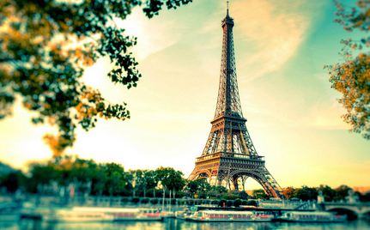
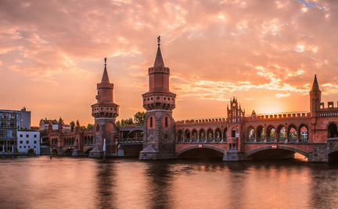
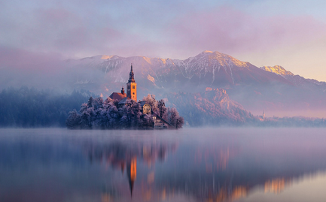
Project design
We are sings the best!
Remember that happiness is a way of travel, not a destination. Remember that happiness is a way of travel.
Add Your Title
Add Your Title
Add Your Title
Remember that happiness is a way of travel, not a destination. Remember that happiness is a way of travel.
Remember that happiness is a way of travel, not a destination. Remember that happiness is a way of travel.
Remember that happiness is a way of travel, not a destination. Remember that happiness is a way of travel.

Slide 15
The Sixth Part
Research findings and applications
We are sings the best!

Slide 16
Research findings and applications
We are sings the best!
ADD THE TITLE HERE
01
03
Remember that happiness is a way of travel, not a destination. Remember that happiness is a way of travel, not a destination.
Remember that happiness is a way of travel, not a destination. Remember that happiness is a way of travel, not a destination.
Remember that happiness is a way of travel, not a destination. Remember that happiness is a way of travel, not a destination.
Remember that happiness is a way of travel, not a destination. Remember that happiness is a way of travel, not a destination.
02
04

Slide 17
Research findings and applications
We are sings the best!
Remember that happiness is a way of travel, not a destination. Remember that happiness is a way of travel.
Add Your Title
Remember that happiness is a way of travel, not a destination. Remember that happiness is a way of travel.
Remember that happiness is a way of travel, not a destination. Remember that happiness is a way of travel.
Add Your Title
Remember that happiness is a way of travel, not a destination. Remember that happiness is a way of travel.
Remember that happiness is a way of travel, not a destination. Remember that happiness is a way of travel.
Add Your Title
Remember that happiness is a way of travel, not a destination. Remember that happiness is a way of travel.
Remember that happiness is a way of travel, not a destination. Remember that happiness is a way of travel.
Remember that happiness is a way of travel, not a destination. Remember that happiness is a way of travel.
Add Your Title

Slide 18
The Seventh Part
Summarize the recommendations
We are sings the best!

Slide 19
Summarize the recommendations
We are sings the best!
Add Your Title
06
01
Add Your Title
Remember that happiness is a way of travel, not a destination. Remember that happiness is a way of travel.
Remember that happiness is a way of travel, not a destination. Remember that happiness is a way of travel.
Add Your Title
05
02
Add Your Title
Remember that happiness is a way of travel, not a destination. Remember that happiness is a way of travel.
Remember that happiness is a way of travel, not a destination. Remember that happiness is a way of travel.
Add Your Title
04
03
Add Your Title
Remember that happiness is a way of travel, not a destination. Remember that happiness is a way of travel.
Remember that happiness is a way of travel, not a destination. Remember that happiness is a way of travel.

Slide 20
Thanks for watching
C
Mentor:Xxx
Professional:Xxx
Respondent:Xxx
Time:Xxx

