Slide 1
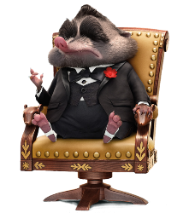
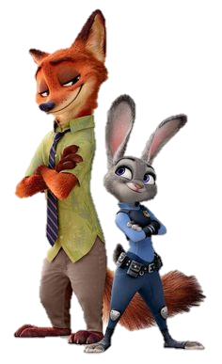
ZOOTOPIA
JOHN DESIGN

Slide 2
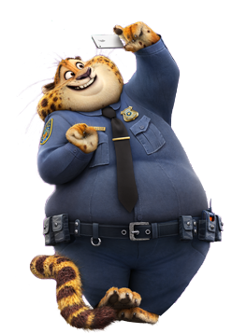
PART THREE
you don't call a rabbit cute.
PART TWO
you don't call a rabbit cute.
PART ONE
you don't call a rabbit cute.
PART FOUR
you don't call a rabbit cute.
CONTENTS

Slide 3
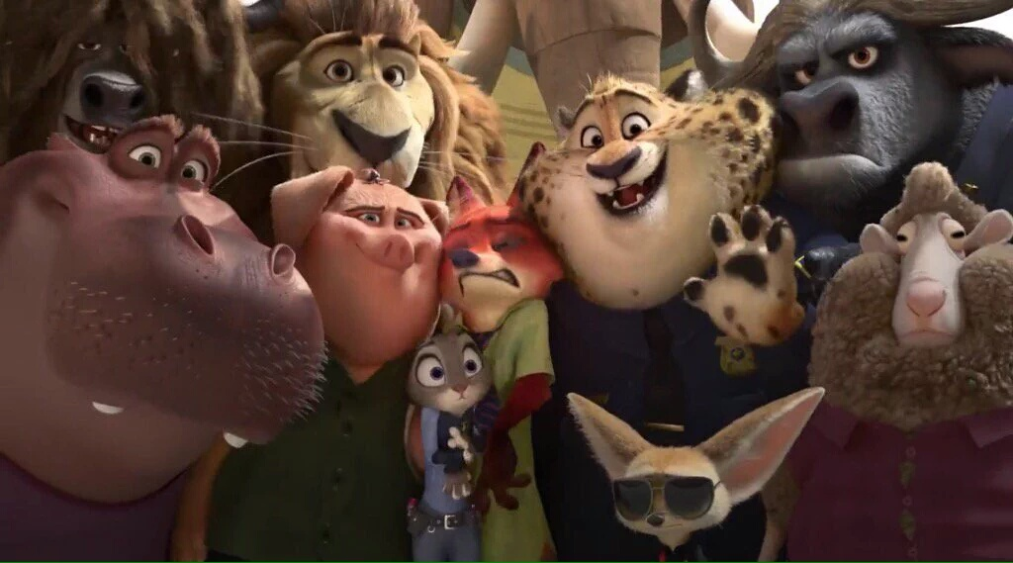
NICK
JUDY
All right, get in here. You bunnies, so emotional.
I really am just a dumb bunny.
I know you'll never forgive me. And I don't blame you. I wouldn't forgive me either. I was ignorant and irresponsible and small-minded. But predators shouldn't suffer because of my mistakes. And after we're done, you can hate me, and that'll be fine, because I was a horrible friend, and I hurt you. And you can walk away knowing you were right all along.

Slide 4
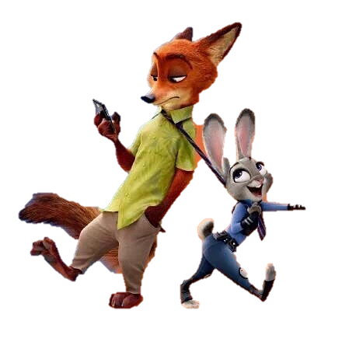
PART
You are a dumb bunny.
01

Slide 5
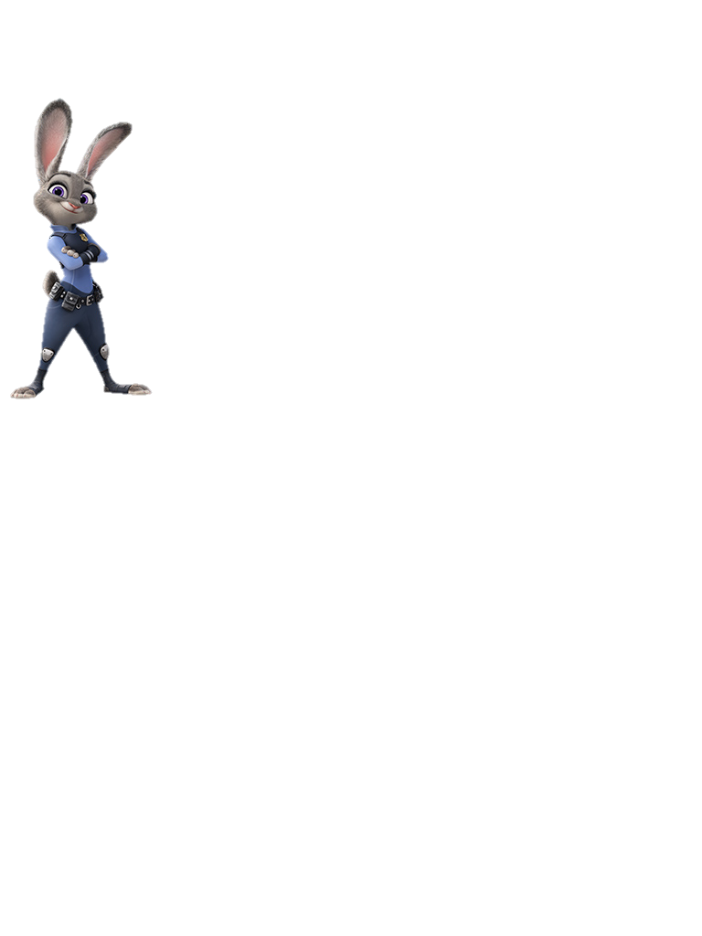
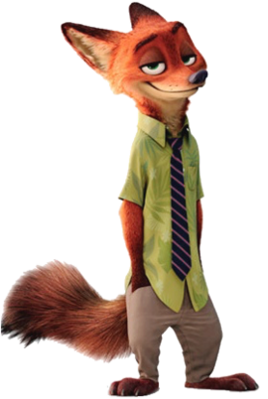
PART
01
Judy hopps
Nick wilde
Officer Judy Hopps is on an exciting case in Zootopia. Her day started out like any other, until she stumbled across a crying elephant who was missing his Jumbo-pop.
As a child residing in Zootopia with his mother, Nick had a dream of joining the local Junior Ranger Scouts, for the goal of receiving genuine acceptance.

Slide 6
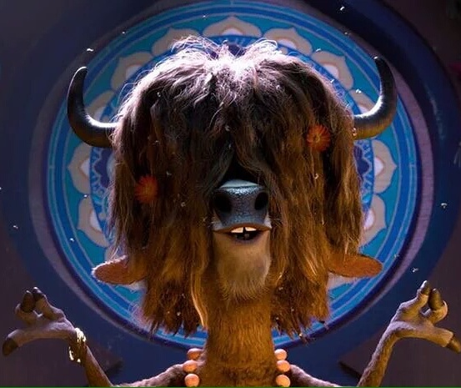
Zootopia Yax
Yax
Yax is a yak, and the owner of a local club in Sahara Square, known as the Mystic Springs Oasis. Yax, like the club itself, is very unique in the city of Zootopia, being that he is a naturist (or naturalist as he calls it).

Slide 7
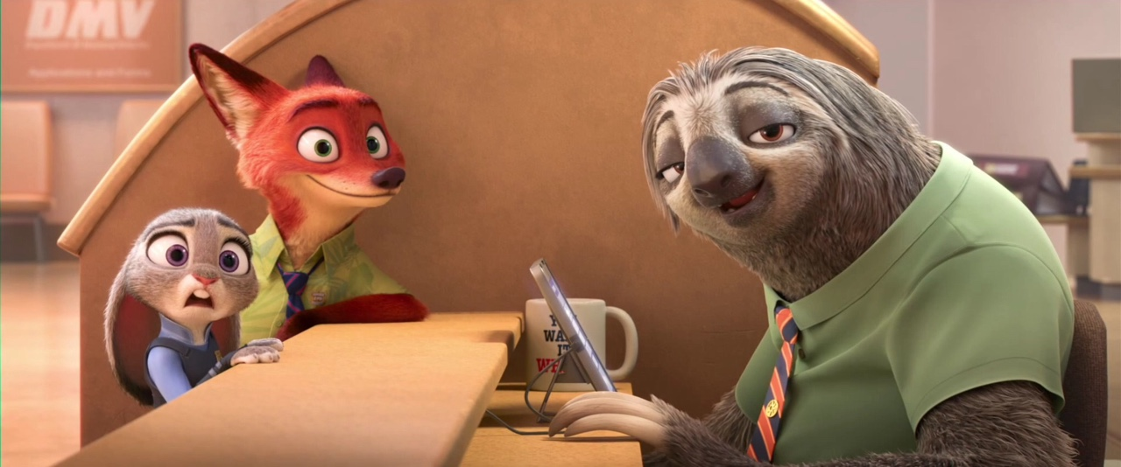
1
2
3
flash
flash
flash
Why does camel have three humps?
Why does camel have three humps?
Why does camel have three humps?
ZOOTOPIA Flash
I know you'll never forgive me. And I don't blame you. I wouldn't forgive me either. I was ignorant and irresponsible and small-minded. But predators shouldn't suffer because of my mistakes.

Slide 8
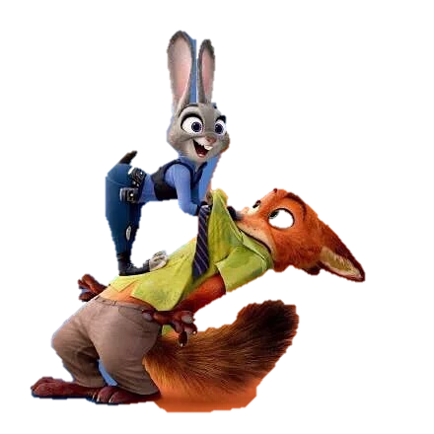
PART
02
You can only be what you are. Sly fox. Dumb bunny. And that is not wet cement.

Slide 9
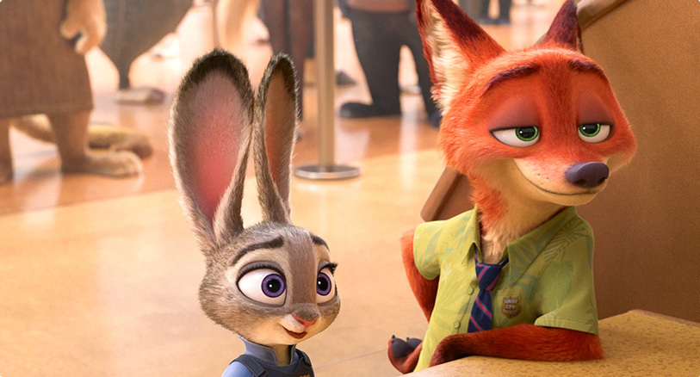
FLASH
All right, get in here. You bunnies, so emotional.
Officer Judy Hopps is on an exciting case in Zootopia. Her day started out like any other, until she stumbled across a crying elephant who was missing his Jumbo-pop.

Slide 10
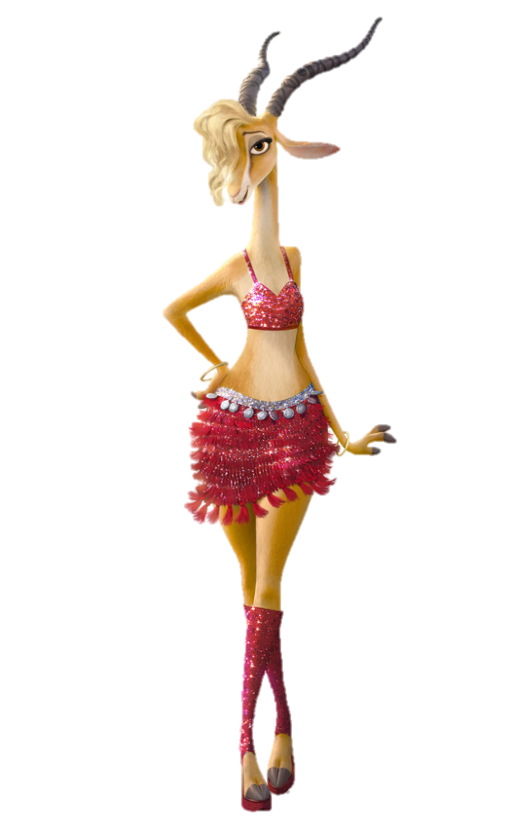
You can only be what you are. Sly fox. Dumb bunny. And that is not wet cement.
PART
02

Slide 11
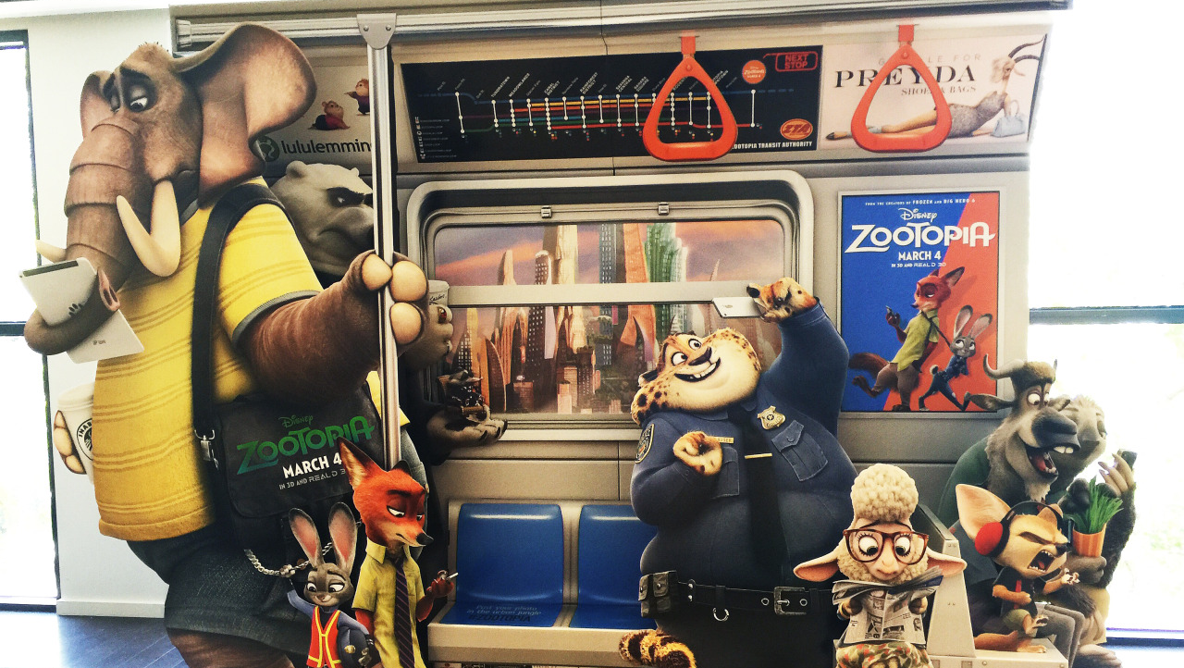
50%
You can only be what you are. Sly fox. Dumb bunny. And that is not wet cement.
You can only be what you are. Sly fox. Dumb bunny.
15%
5%
You can only be what you are. Sly fox. Dumb bunny.
30%
You can only be what you are. Sly fox. Dumb bunny.

Slide 12
PART
You can only be what you are. Sly fox. Dumb bunny. And that is not wet cement.
02
I know you'll never forgive me. And I don't blame you. I wouldn't forgive me either. I was ignorant and irresponsible and small-minded. But predators shouldn't suffer because of my mistakes. And after we're done, you can hate me, and that'll be fine, because I was a horrible friend, and I hurt you. And you can walk away knowing you were right all along.

Slide 13
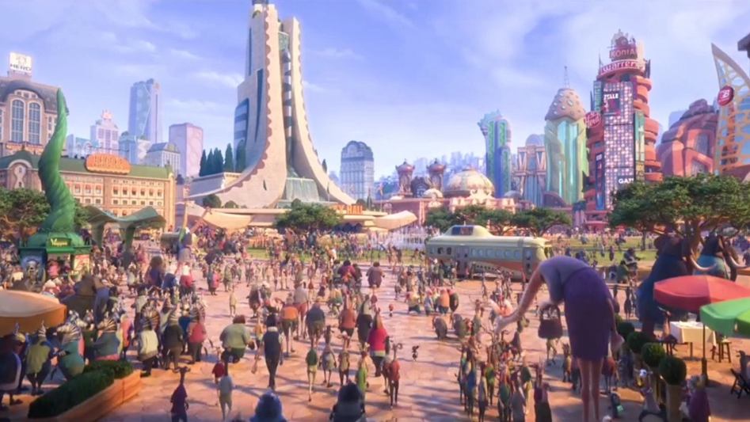
PART
03
You can only be what you are. Sly fox. Dumb bunny. And that is not wet cement.

Slide 14
PART
03
NICK
JUDY
All right, get in here. You bunnies, so emotional.
I really am just a dumb bunny.

Slide 15
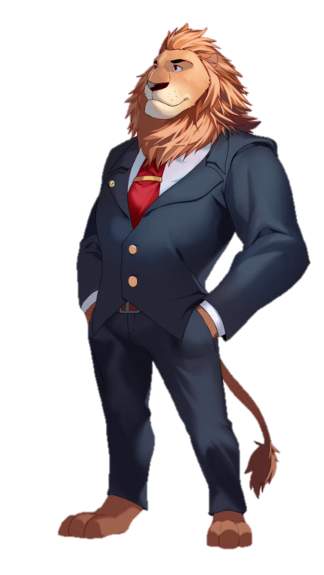
PART
TITLE HERE
03
You can only be what you are. Sly fox. Dumb bunny. And that is not wet cement.
TITLE HERE
You can only be what you are. Sly fox. Dumb bunny. And that is not wet cement.
TITLE HERE
You can only be what you are. Sly fox. Dumb bunny. And that is not wet cement.
TITLE HERE
You can only be what you are. Sly fox. Dumb bunny. And that is not wet cement.

Slide 16
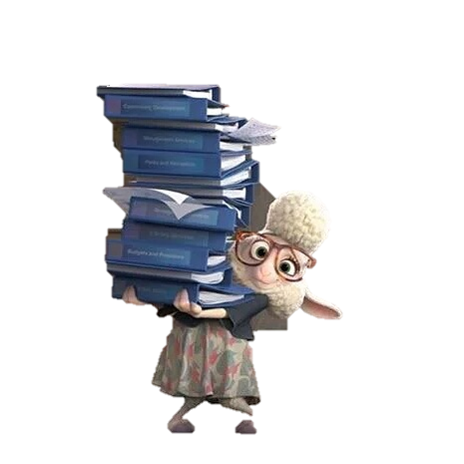
Mayor
All right, get in here. You bunnies, so emotional.
All right, get in here. You bunnies, so emotional.

Slide 17
I know you'll never forgive me. And I don't blame you. I wouldn't forgive me either. I was ignorant and irresponsible and small-minded. But predators shouldn't suffer because of my mistakes.
TITLE HERE
TITLE HERE
TITLE HERE
TITLE HERE
TITLE HERE

Slide 18
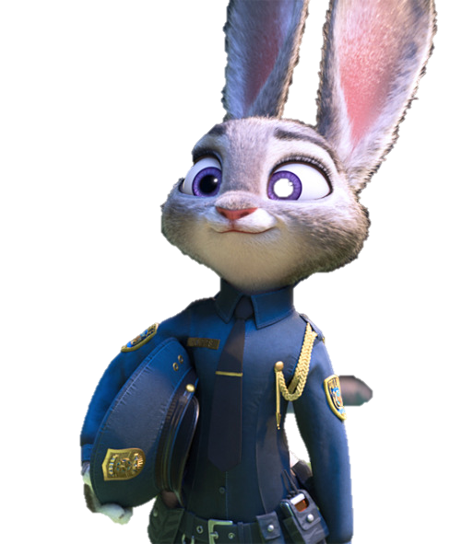
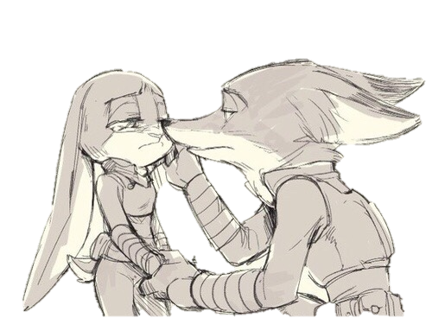
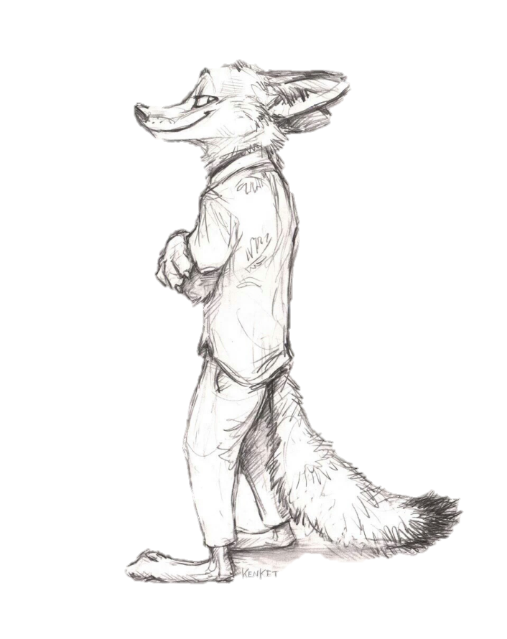
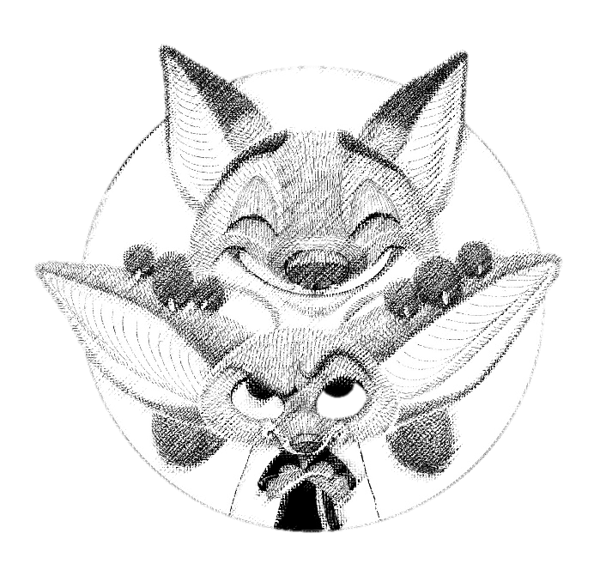
PART
I really am just a dumb bunny.
04

Slide 19
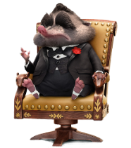
Title here
1
All right, get in here. You bunnies, so emotional.
2
All right, get in here. You bunnies, so emotional.
3
All right, get in here. You bunnies, so emotional.

Slide 20
Title here
Title here
Title here
Title here
All right, get in here. You bunnies, so emotional.
All right, get in here. You bunnies, so emotional.
All right, get in here. You bunnies, so emotional.
All right, get in here. You bunnies, so emotional.

Slide 21
Nick
You bunnies, so emotional.
Nick and
judy
You bunnies, so emotional.
All right, get in here. You bunnies, so emotional.
judy
I really am just a dumb bunny.

Slide 22
ZOOTOPIA
Nick : You know you love me!
Judy : I do ? Yes I do!
Life's a little bit messy. We all make mistakes. No matter what type of animal you are, change starts with you.
Life's a little bit messy. We all make mistakes. No matter what type of animal you are, change starts with you.

Slide 23
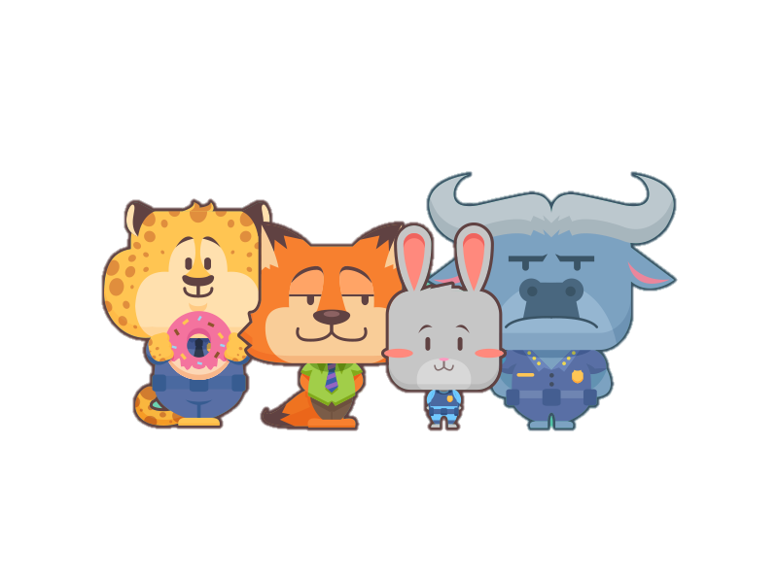
Thank you
JOHN DESIGN, TO SHARE POINT

