Slide 1
SobrietysPlant painting
A cluster of blue elves
CHENYING0907

Slide 2
PurposeRecorded
SobrietysPlant painting
PART 1
Don't want to be folded off the branch and lose your soul.
Can't do tough Walking Dead. Would rather self-destruct to describe the dragonfly, was discarded.
PART 2
Dreams about walking
Many strange places in the dream, let people happy, but do not know where to come.
PART 3
The silence of course
If we can take this as a matter of course silence, it seems that we can be a lover of course.

Slide 3
PART 1
Don't want to be folded off the branch and lose your soul.
Can't do tough Walking Dead. Would rather self-destruct to describe the dragonfly, was discarded.

Slide 4
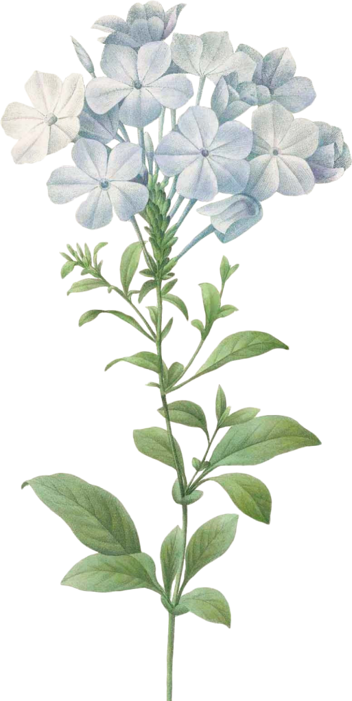
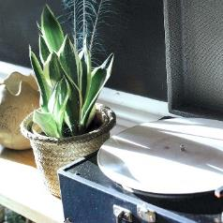
One day, mule.
Bring home a handful of flowers. I don't know how to treat each other. Looking around is a joy, using only water to irrigate. I went to sleep and forgot to take pictures of them with your camera. When I woke up the next morning, I found that all the flowers were dead. The more beautiful you are, the more dismal death will be. Yellow and shrivelled, like waste paper. There can be no delay in a day.

Slide 5
White flowers represent the beginning of summer.
In this way, this short, insatiable beauty goes deep into the bone marrow
It's nostalgic, never to be resonated.
This white flower represents the beginning of summer.
SobrietysPlant painting
This white flower represents the beginning of summer.
Like a woman's elusive personality.
Irreconcilable stoics

Slide 6
Tweezers bring memories of the South
Text content
Text content
Text content
Text content
In the baskets of the old farmers on the street, I saw the white cotton thread strapped up a small handful of flowers.
In the baskets of the old farmers on the street, I saw the white cotton thread strapped up a small handful of flowers.
In the baskets of the old farmers on the street, I saw the white cotton thread strapped up a small handful of flowers.
In the baskets of the old farmers on the street, I saw the white cotton thread strapped up a small handful of flowers.

Slide 7
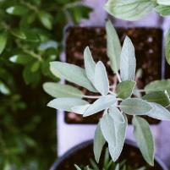
In this way, this short, insatiable beauty goes deep into the bone marrow
It's nostalgic, never to be resonated.
This white flower represents the beginning of summer.
Like a woman's elusive personality.
Irreconcilable stoics
One day, mule.
"Bring home a handful of flowers. I don't know how to treat each other. "

Slide 8
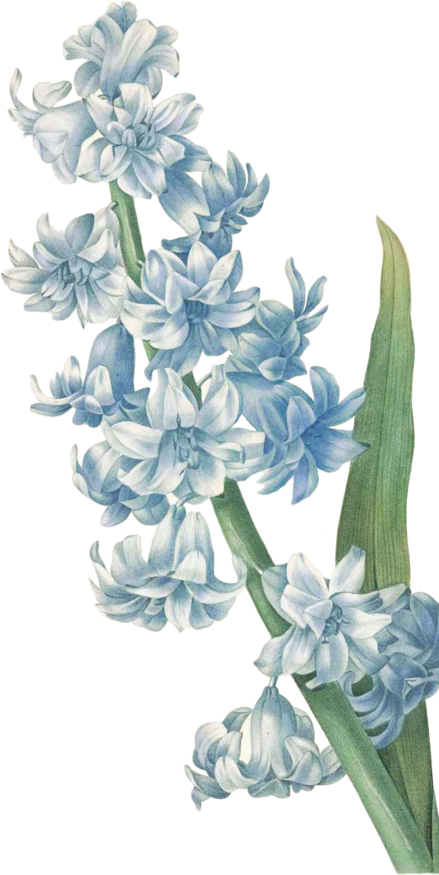
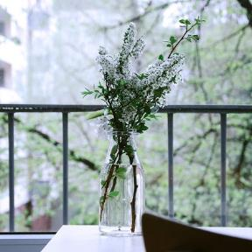
Tweezers bring memories of the South
In this way, this short, insatiable beauty goes deep into the bone marrow
It's nostalgic, never to be resonated.
This white flower represents the beginning of summer.

Slide 9
Short and hopeless beauty
Text content
In the baskets of the old farmers on the street, I saw the white cotton thread strapped up a small handful of flowers.
Text content
In the baskets of the old farmers on the street, I saw the white cotton thread strapped up a small handful of flowers.
Text content
In the baskets of the old farmers on the street, I saw the white cotton thread strapped up a small handful of flowers.

Slide 10
PART 2
Dreams about walking
Many strange places in the dream, let people happy, but do not know where to come.

Slide 11
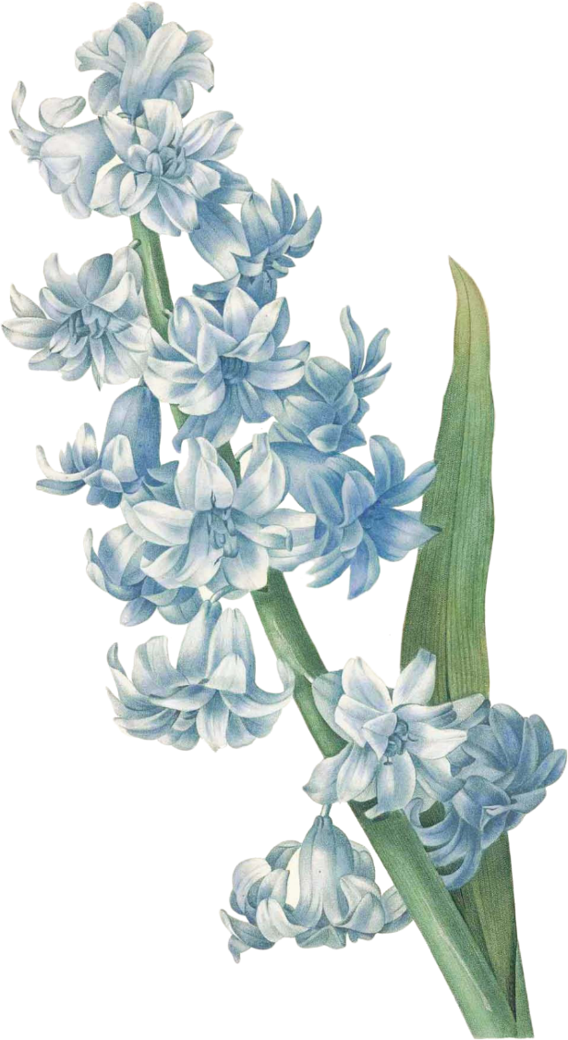
Walk
6One day in the month, I had a dream.
I saw myself go by boat to a strange place. Follow the wide green river up the current. The water waves are rapid, there are huge plants, one plant stands up. The stems are very thick, the leaves are large and grow in the middle of the water. There are large flowers in bloom on the distant peaks, suggesting that more flowers are blooming deep. The green leaves are layered and green.

Slide 12
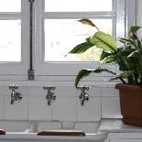
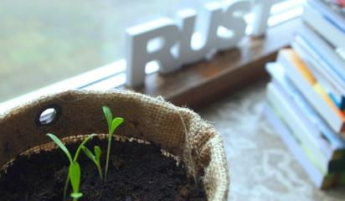
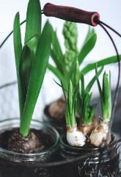
-About Walking-
Pacific Ocean, sweltering ferry, plane gliding in the sky overlooking, Turks, nameless town......Often you will see rivers, rivers, valleys, vivid colors of plants. Unidentified person.
This place, like many strange places that have appeared in dreams, makes people happy, but they don't know where to come.
A lot of dreams are about walking. See yourself by boat or by plane (not known why, usually on these two modes of transport), go to all kinds of strange places, see all kinds of strange people.

Slide 13
Pacific · Sweltering ferry
About Walking
There was a man in that dream.
A white dress.
About Walking
A back, walked outside the door. He seems to be discriminated against.
About Walking
But I think he has a subtle sense of pride. I was impressed with him.
About Walking
My dream will have an extremely gorgeous color, more solid than the oil color.

Slide 14
Pacific · Sweltering ferry
Walk
People will record his own dreams, Jung is a, and so will one of my friends who do rock and roll.
Dream
What happens in a dream is something that cannot be encountered or even imagined in reality. It becomes a continuation of life outside.

Slide 15
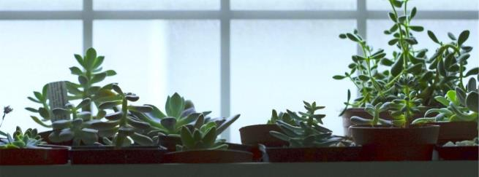
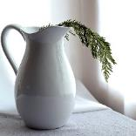
The blue waters and the deep green hills
Remember the shape of the sky, chimneys, column-like smoke, a cross, cross, as clear as watercolor. It seems to be jet-setting. The scene is spectacular.

Slide 16
Typhoon weather in hometown
By boat, you see the blue waters of peacocks and the deep green hills. The texture of that color, as if blood was squirting out of the eyes.
Remember the shape of the sky, chimneys, column-like smoke, a cross, cross, as clear as watercolor. It seems to be jet-setting. The scene is spectacular.
A dream that has been repeated for several years is being chased and running non-stop. Always run in a back-to-back place, corridor, or a door, numerous twists and turns of the laneway. I'm very tired running, but I can't stop.

Slide 17
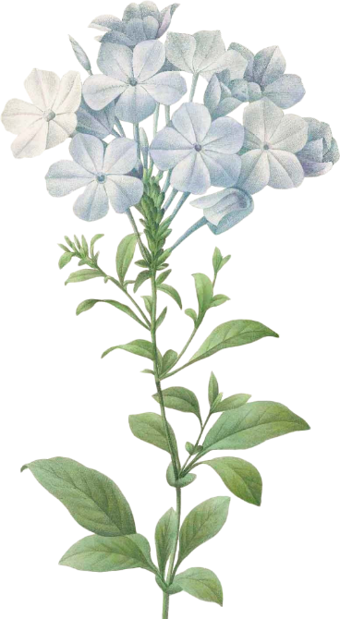
PART 3
The silence of course
If we can take this as a matter of course silence, it seems that we can be a lover of course.

Slide 18
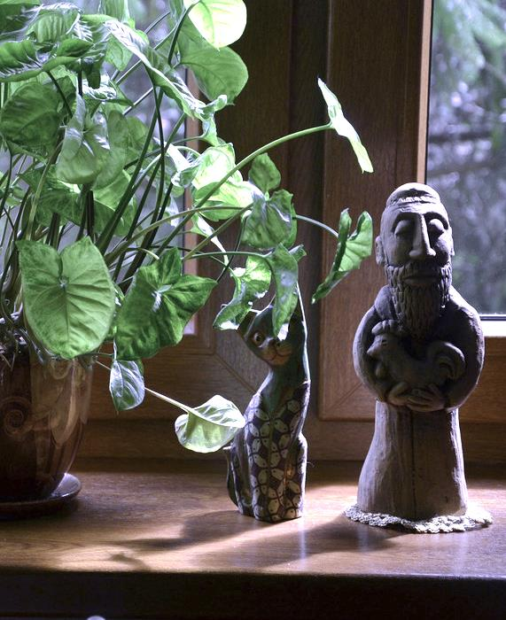
It was on what night. You hug me. We sat together as if we were rotating the pace of the game.
Silence
long silence. After the silence, the glass smoke tank was filled with long, short cigarette butts and scattered soot.
If we can take this as a matter of course silence, it seems that we can be a lover of course.
-About Walking-

Slide 19
Text content
Dream ingresed from the top of the wooden staircase in the yard of my home.
Text content
Text content
He was seen lying out the door at first, then got up and knocked at the door.
It's probably a growing bone growing at a young age.
Text content
Falling and Soul son steam in dreams
Text content
confronted him across the door. know that he is a soul.
And i dreamed of the dead. I can't see the face, I don't know where to come from.

Slide 20
Silence
Smoking too much, so often feel oxygen-deprived dizziness. I wish I could follow you awakely. Show you my picture when I was twenty years old. The contours converge and the eyes are transparent. So thin and clear.
In the back seat of a sweltering car, sit by your side. There is a change in your breathing. Oh. I am such a sensitive woman. So i'm blushing often and i'm sad.

Slide 21
Smoking too much, so often feel oxygen-deprived dizziness. I wish I could follow you awake Show you my 20th-year-old photos. Contour Convergence Eye transparent So thin and clear In the back seat of a sweltering car, sitting next to you There's a change in your breath.
There's always a man who loses first.
ALWAYS.
You turned your face to see me. The air between us became as calm as water. It was as if we were facing each other. But there is always a man who loses first.

Slide 22
Thanks for listening.
https://www.freeppt7.com

