Slide 1
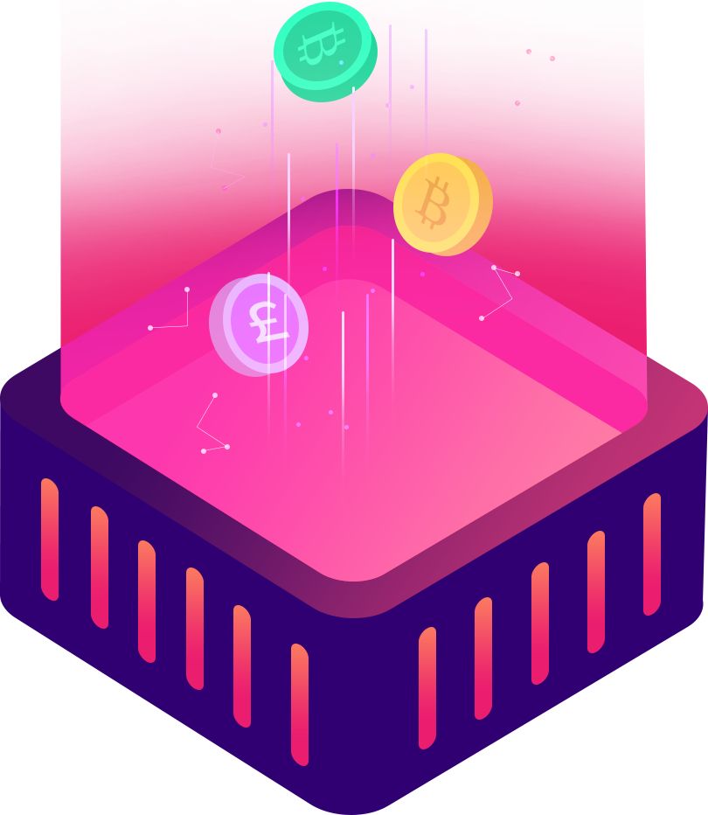
Technology Fashion Blockchain Template
Dream what you want to dream; go where you want to go; be what you want to be, because you have only only only life.
Business Plan · Business Summary · Science and Technology Launch · Blockchain Workshop
Speaker:freeppt7.com

Slide 2
CONTENT
01 | Introduction to blockchain
02 | Blockchain Network
Dream what you want to dream; go where you want to go
Dream what you want to dream; go where you want to go
03 | Data
04 | Core issues
Dream what you want to dream; go where you want to go
Dream what you want to dream; go where you want to go

Slide 3
PART.01
Introduction to blockchain
Dream what you want to dream; go where you want to go; be what you want to be, because you have only only only life.

Slide 4
Introduction to blockchain
Dream what you want to dream; go where you want to go; be what you want to be, because you have only only only life.
Consumers
Traditional payment methods
Record the ledger
Third-party agencies
Almost all trade on the Internet requires the use of trusted third-party credit agencies to process electronic payment information. Such systems are still internally constrained by"Credit-based model"。
Digital signature
Business

Slide 5
Introduction to blockchain
Dream what you want to dream; go where you want to go; be what you want to be, because you have only only only life.
Blockchain payment system
Consumers
Digital signature
Block Chance
Blockchain technology is the basic technology to build the encryption transmission of Bitcoin blockchain network and transaction information. It is based on the principle of cryptography rather than credit, so that any agreed party pays directly, thus eliminating the need for the participation of third-party intermediaries.
Digital signature
Business

Slide 6
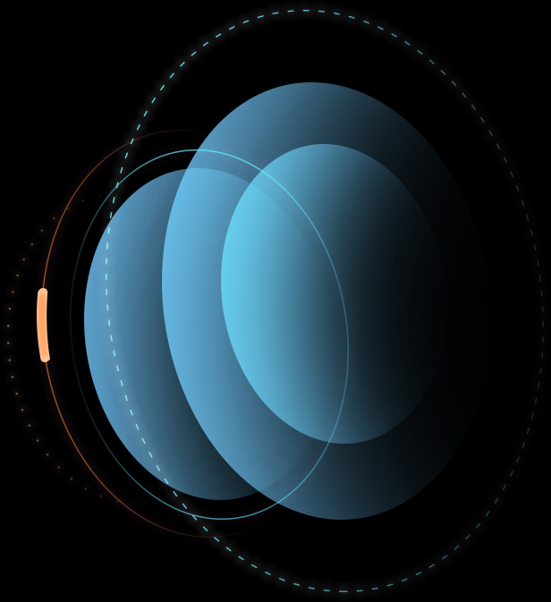
Introduction to blockchain
Dream what you want to dream; go where you want to go; be what you want to be, because you have only only only life.
Blockchain definition
From a data perspective, blockchain is a distributed database that is almost impossible to change. The distribution here is not just a distributed storage of data,Distributed records as data are also reflected(I.e. maintained by system participants)。

Slide 7
Introduction to blockchain
Dream what you want to dream; go where you want to go; be what you want to be, because you have only only only life.
Blockchain features
Open consensus
Anyone can participate in a blockchain network, each device can act as a node, each node allows for a complete copy of the database. Nodes are based on a consensus mechanism that jointly maintains the entire blockchain through competitive computing. Either node fails,The remaining nodes are still functioning.
Go to the center.
The blockchain is composed of many nodes to form an end-to-end network, there is no centralized device and management organization. Data exchange between nodes is verified by digital signature technology without trusting each other, as long as it follows the established rules of the system,There can and cannot be and cannot be spoofed between nodes to other nodes.
Open and transparent
The rules of the open and transparent blockchain are open and transparent, and all data information is public so that every transaction is visible to all nodes.
Non-tamperable traceability
Modifications to a database by a single or even multiple nodes cannot affect the databases of other nodes unless they can control the entire network beyond51%nodes are modified at the same time

Slide 8
PART.02
Blockchain Network
Dream what you want to dream; go where you want to go; be what you want to be, because you have only only only life.

Slide 9
Blockchain Network
Dream what you want to dream; go where you want to go; be what you want to be, because you have only only only life.
Digital signature
Digital signature
Digital signatures involve a hash function, the sender's public key, and the sender's private key. Digital signatures have two effects.,One is to be able to determine that the message was indeed signed by the sender and concurrent. Second, digital signatures can determine the integrity of messages.
How it works
When a message is sent, the sender generates a message summary from the message text using a hash function,, and then encrypt the summary with your own private key,The encrypted summary is sent to the receiver as a digital signature of the message and the message, which first calculates the message summary from the original message received using the same hash function as the sender.

Slide 10
Blockchain Network
Dream what you want to dream; go where you want to go; be what you want to be, because you have only only only life.
SHA256
OneSeed ballsHashEncryption algorithm for values
How it works
Enter any string of data into theSHA256will get a256BitHashValue(Hash value)。 Its characteristics:The same data entry will get the same result. Enter data with only a slight change(Like a1It's become0 )

Slide 11
Blockchain Network
Dream what you want to dream; go where you want to go; be what you want to be, because you have only only only life.
Merkle Tree
A hash binary tree,Use it to quickly verify the integrity of large-scale data. In the Bitcoin Network,MerkleThe tree is used to summarize all transaction information in a block and ultimately generate a uniform hash value for all transaction information in that block,Changes in the information of any transaction in the block will makeMerkleThe tree changed.
Non-leaf nodesvalueThe calculation is to combine all the child nodes of the node ,Then make a combination of resultshashCalculatedhash value。

Slide 12
Blockchain Network
Dream what you want to dream; go where you want to go; be what you want to be, because you have only only only life.
Bitcoin
Bitcoin( BitC oin )The concept was originally wits by Ben Cong in2009Year proposed,Design and release open source software based on Nakamoto's ideas and construct itP2pInternet. Bitcoin is a kind ofP2pThe form of the digital currency. Point-to-point transmission means a decentralized payment system.

Slide 13
PART.03
Data
Dream what you want to dream; go where you want to go; be what you want to be, because you have only only only life.

Slide 14
Data
Dream what you want to dream; go where you want to go; be what you want to be, because you have only only only life.
Blockchain
Blockchain organizes data as blocks. All of the boxer's trading discipline is stored in the only blockchain on the web in the form of a transaction slip

Slide 15
Data
Dream what you want to dream; go where you want to go; be what you want to be, because you have only only only life.
Record transaction information in local memory into a block principal in a block principal
Generate all transaction information in this blockMerkleTree,PutMerkleThe value of the root of the tree is saved in the block head
Put the data of the block header of the previous block just generated throughSHA256Algorithm generates a hash value filled into the parent hash of the current chunk
Save the current time in the timestamp field
The difficulty value field adjusts to the average build time of the chunk over time to cope with the changing overall total calculation of the entire network

Slide 16
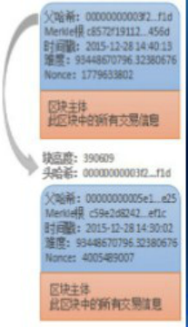
Data
Dream what you want to dream; go where you want to go; be what you want to be, because you have only only only life.
Version No.:Indicate the parent block hash value of the relevant version information of the software and protocol:Referenced in the blockchain
The hash value of the parent block head, through which each block is connected to the beginning and end, forms the blockchain, and this value plays a vital role in the security of the blockchain
MerkleRoot:This value is calculated by the hash value of all transactions in the block body and then two or two hashs in the block body,Primarily used to verify that a transaction exists in this block
Time stamp:Record when the block was generated,Accurate to seconds
Difficulty value:Difficulty objectives for the relevant math problems in this block
Random number(Nonce):Record the value of the answer to decrypt the math question sq. in the block

Slide 17
PART.04
Core issues
Dream what you want to dream; go where you want to go; be what you want to be, because you have only only only life.

Slide 18
Core issues
Dream what you want to dream; go where you want to go; be what you want to be, because you have only only only life.
Proof of workload
The block header contains a random number,Makes the random hash value of the block appear the desired0Number. The node tries repeatedly to find this random number, which builds a:Workload certification mechanism.
The essence of the workload certification mechanism is- CPUone vote, "most"The decision is expressed as the longest chain, because the longest chain contains the maximum amount of work. If most of theCpuFor honest node control, then the chain of honesty will be extended as quickly as possible,and beyond the other competitive chains.

Slide 19
Core issues
Dream what you want to dream; go where you want to go; be what you want to be, because you have only only only life.
More than one node on the network can calculate a random number over the same period of time, i.e. multiple nodes broadcast their respective packaged temporary blocks (all legal) on the network.
Fork
BLOCK4
BLOCK6
BLOCK1
BLOCK2
BLOCK3
BLOCK5
If a node receives multiple subsequent temporary blocks for the same pre-continuation block, the node establishes a branch on the local blockchain, with multiple temporary chunks corresponding to multiple branches. The deadlock will not be broken until the next proof of workload is discovered, and one of the chains is proven to be a longer one, so the nodes working on the other branch chain will switch camps and start working on the longer chain. Other branches will be completely abandoned by the network.

Slide 20
Core issues
Dream what you want to dream; go where you want to go; be what you want to be, because you have only only only life.
Double Flower
Double spend, or double payment, refers to an attacker using the same money for different transactions almost at the same time.
Each time a node attaches a newly received transaction order to a block, it will follow the public key of the originating party of the transaction to check that the currency used in the current transaction actually belongs to the current transaction initiator, which can be traversed to the initial birth point of the currency(that is, the block source that produced it.)。 Although multiple trade orders can be broadcast in any order, they must be in a certain order when they are eventually added to the block. Between blocks withHashThe value acts as a timestamp block, which determines that the source of funds for any transaction can be determined by backtracking.

Slide 21
Core issues
Dream what you want to dream; go where you want to go; be what you want to be, because you have only only only life.
Core issues
Energy consumption
Security
Data inventory space
Air capability to handle large-scale transactions

Slide 22
THANK YOU
Dream what you want to dream; go where you want to go; be what you want to be, because you have only only only life.
Business Plan · Business Summary · Science and Technology Launch · Blockchain Workshop
Speaker:freeppt7.com

