Slide 1
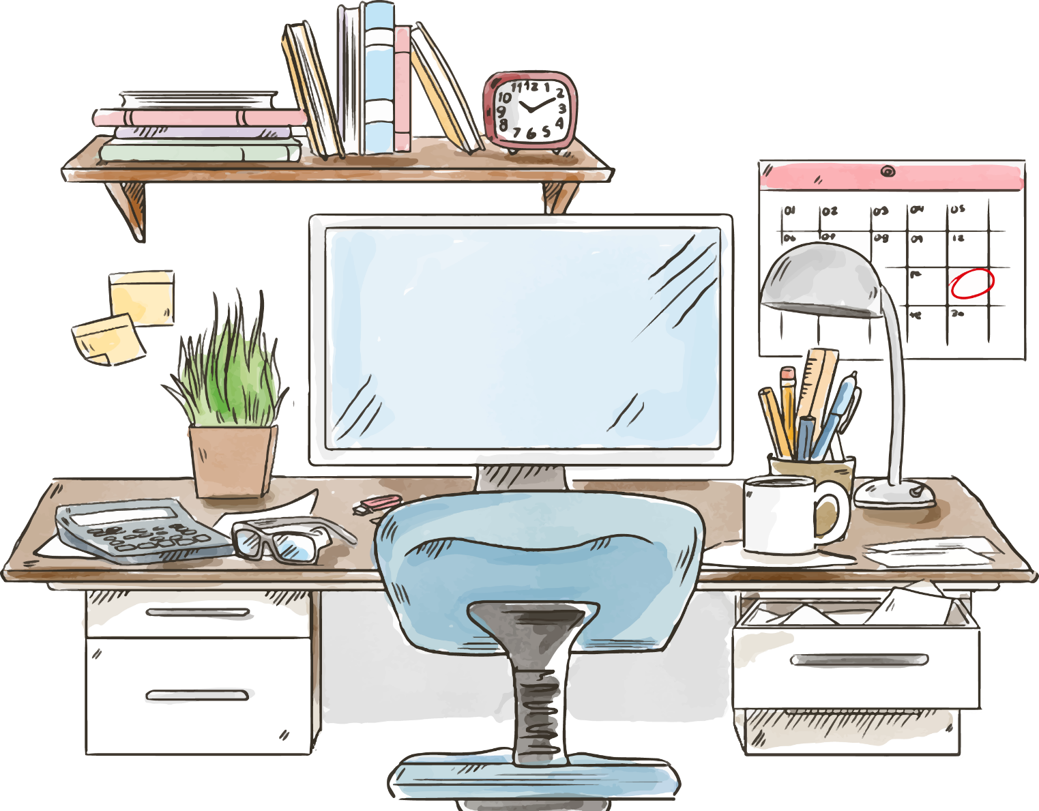
Name:
For personal resume, I look forward to a show themselves, give yourelves a chance! For personal resume, I look forward to a show themselves, give yourelves a chance!
I'm looking forward to a stage for self-presentation
Personal bid resume template

Slide 2
Personal
information
01
02
Biography
Personal information
Personal history
03
Knowledge skills
04
Honors
Knowledge and skills
Income honor
Listings
COMPANY
Self-evaluation
Personal works
05
06
Self-evaluation
personal works

Slide 3
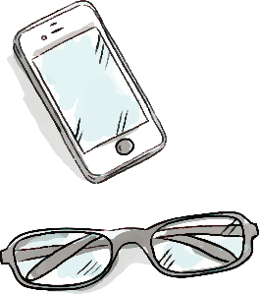
Personal information
Address: Panzhihua City West
Email:fid888888@139.com
Contact:153****4230
Name: Zhao Mei
Age:26Years old
Weight:65kg
Origin: Sichuan Panzhihua
Marriage: Unmarried
Graduation School: Sichuan Normal University
Gender: Female
Name: Han
Height:172cm
Education: College
Major: Marketing
Political Landscape: Party Members
2010Graduated from Sichuan Normal University, studied marketing major, because of the design has a strong design, after graduation to study graphic design and work.

Slide 4
Biography
A
B
C
D
2010.07-2012.05
Sichuan Jiatian Plate Co., Ltd.
Flat production
2012.05-2013.05
Panzhihua City Automotive4SShop
Graphic design
2013.06-2015.07
Panzhihua City Spring and Autumn Advertising
Graphic design
2015.07-So far
Bazhong City Spring and Autumn Advertising
ⅥDesign

Slide 5
Knowledge skills
Adobe Illustrator
C1Driving license
Adobe Photoshop
Good at planning publicity
CorelDRAW
Microsoft Office

Slide 6
Honors
2008Years10Month15Day
Access to school scholarships
2009Years12Month25Day
He was awarded an outstanding member of the Academy-level League and joined the Communist Party at the end of the month.
2009Years11Month02Day
National Computer Level LEVEL Level II Certificate (CLanguage), proficiencyOfficeOffice software.
2010Years5Month17Day
Obtaining outstanding graduates at the academic level

Slide 7
Self-evaluation
I am a cheerful personality to accept new things, very much like graphic design industry,Although not to study this profession, because like to graduate to the relevant company internship and get your advice, so that I love more, through their own day after day to study hard, master masterOfficeOffice/Photoshop/Illustrator/CorelDRAWgraphic design software, good atPpt, advertising, graphic design,Have a certain ability to manage planning,Several years of experience in advertising agency, let me be good atPptDesign, typography, production brochures,ⅥDesign, advertising design, etc.
I love the design industry now, and constantly absorb the trend of information, so that their insight with the times, so that they shine in this industry.

