Slide 1
CHRISTMAS EVENT PLANNING PPT TEMPLATE
https://www.freeppt7.com

Slide 2
1.Introduction to the event
2.Christmas background
CONTENTS
3.Implementation of the event
4.Surprises keep coming.
5.The meaning of the event

Slide 3
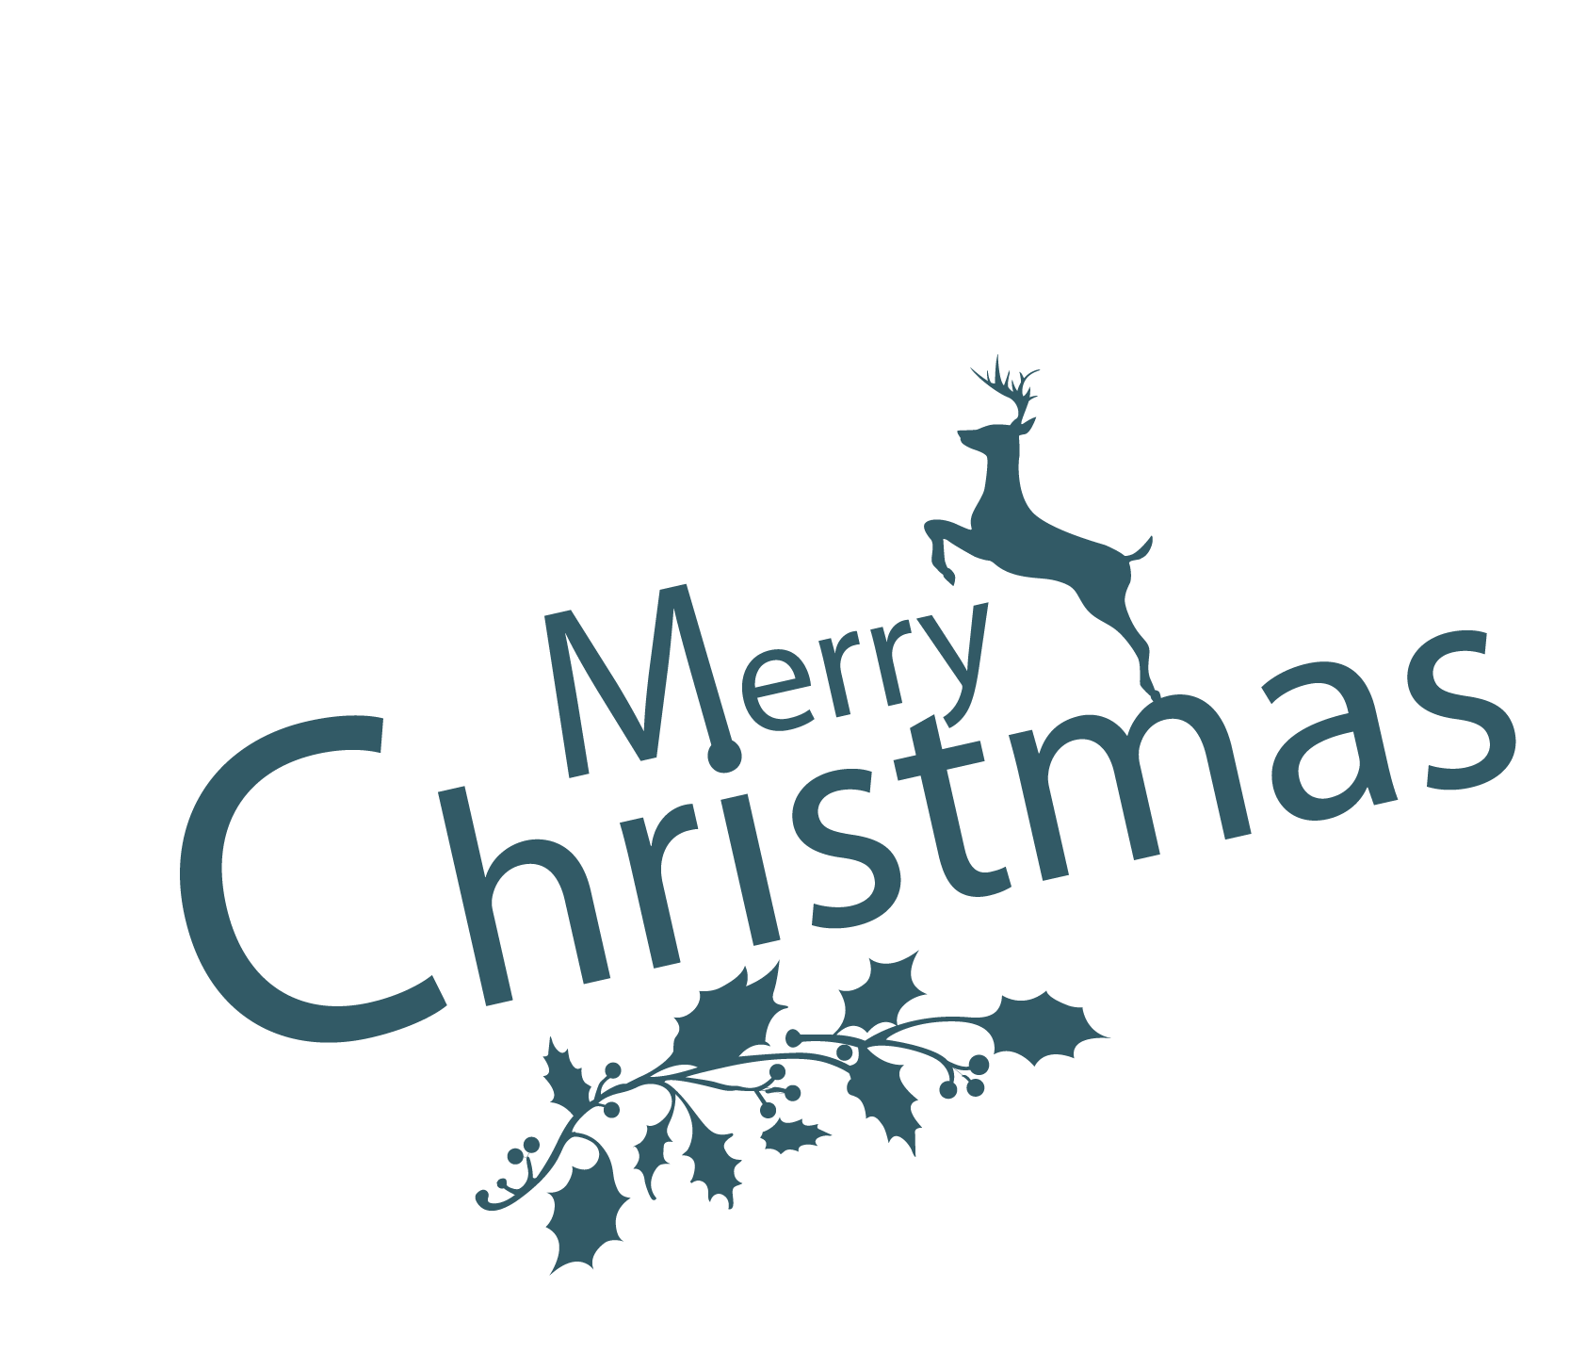
Introduction to the event

Slide 4
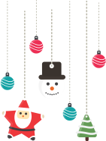
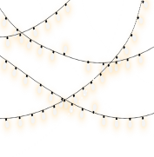
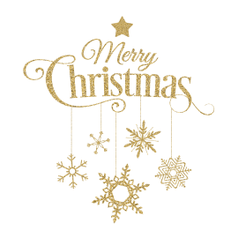
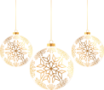
1.Activities
Christmas activities to food, games, carnivals, children and other brands that coincide with the project industry as the main object of cooperation to negotiate, integration of resources. Free or small paid venue use rights, rich outdoor advertising space, as well as huge media publicity efforts and investment as selling points, to attract partners who match the target customers to co-host.

Slide 5
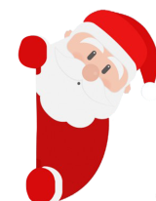
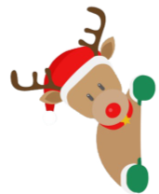
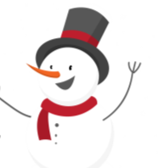
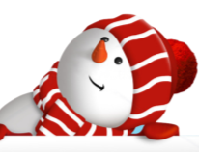
2.Purpose of the event
To gather the popularity of the project, promote the project visibility, the role of saving customers. It is expected that through the use of the site, advertising site requisition, event cooperation and other means to maximize the cost of the implementation of the event compression.

Slide 6
Christmas background

Slide 7
1. The origin of the festival
The name of Christmas is "Christ's Sat."
the abbreviation of . Christmas for a long time
The date is not determined until
In the mid-3rd century, Christianity in Rome
After legalization, the Roman Master of 354
The Church designated the Julian calendar as Jesus on December 25th.
Birth Day. In 440 A.D., the Romanchurch
Tin-d-Tin-d'T. 25 thon Christmas Day. World
Most Christians in the world are on December 25
The day is Christmas. 19th century, St.
The popularity of the birthday card, the out of Santa Claus
Now, Christmas is becoming popular.

Slide 8
2. Christmas customs
Westerners in red, green, white for Christmas, Christmas
To come to the temporary household to decorate with Christmas color. Red
There are Christmas flowers and Christmas candles. The green one is the Christmas tree.
It is the main decoration of Christmas. There's a face hanging from it.
Six-color lanterns, gifts. Western children go to bed on Christmas Eve
Before, put socks in front of the fireplace or by the pillow
Waiting for Santa to put gifts in their socks after they fall asleep
inside. It's also a traditional custom to play Santa Claus during the holidays.

Slide 9
3.Santa
The legend of Santa Claus in Scandina thousands of years ago
The peninsula is in the emergence of. Wisdom, Art in Nordic Myths
Poems, The God of Odin of War, in the Cold Winter, Ride On His Eight
Foot horses ride the ends of the world , punish evil and promote good , and distribute gifts
Meanwhile, his son, Ray, dressed in red, armed with lightning and ice
The snow gods fought a vicious battle in the dark, finally overcoming the cold
According to pagan legend, Santa Claus is a descendant of Odin. This
Some stories mostly carry forward the spirit of Christ, Christmas old
People are always in the spiritual world of people.

Slide 10
Implementation of the event

Slide 11
1.Event time
Click here to add event time content
Click here to add event time content
Click here to add event time content

Slide 12
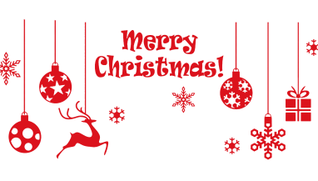
2.Venue layout
Click here to add content
Click here to add content
Click here to add content
Click here to add content
Click here to add content
Click here to add content

Slide 13
Click here to add content
Click here to add content
Click here to add content
Click here to add content
Click here to add content
Click here to add content
3.Staffing
Title
Title
Title

Slide 14
4.What's in the event
Click here to add event content
Click here to add event content
Click here to add event content
Click here to add event content
Click here to add event content
Click here to add event content

Slide 15
Game InteractionClick here to add content
Move
Live
5
Singing songsClick here to add content
Shun
2
Dance PerformancesClick here to add content
Order
1
3
4
The Book of Poems RecitesClick here to add content

Slide 16
Surprises keep coming.

Slide 17
1.Distribute gifts
It's also an annual holiday party, a group of Santa Claus lined up in small lines, red, green, have ... But the green old man is a little miserable, green, not festive, the leader assigned him to the countryside to send gifts!

Slide 18
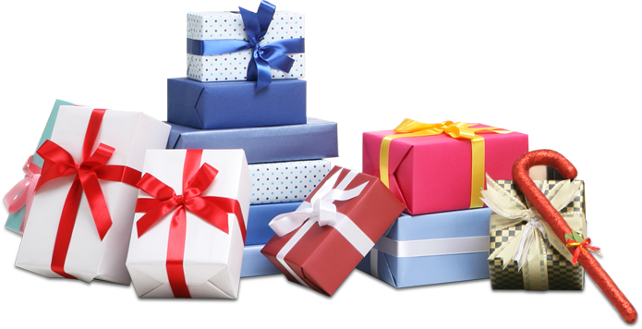
2Lucky Draw
Participate in live interactive games
link, there's a chance to get
Take the lucky prize Oh, festival.
Day surprise, wait for you to get

Slide 19
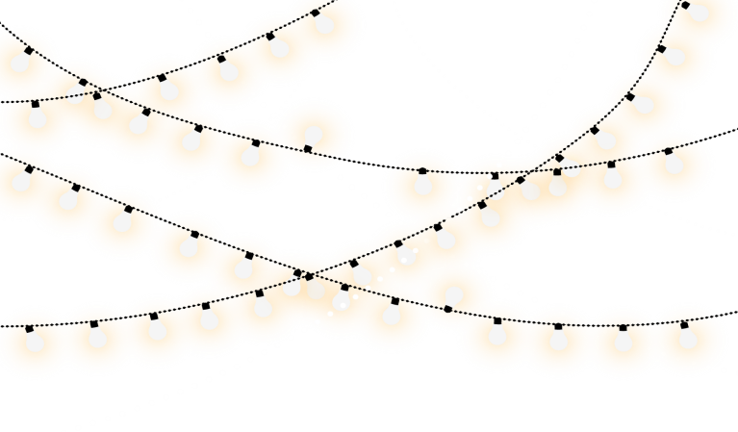
3.Winners
Friends at the scene welcome everyone with warm
Applause and the acceptance of the award-winning people on stage to receive the award

Slide 20
The meaning of the event

Slide 21
1.The feeling of getting together
Click here to add contentPoint
Click to add content here
Add content here Click here
click here to add content

Slide 22
2.Holiday Blessings
Merry Christmas!
Auspicious reindeer running
Ping An's silver bell is jingling
Happy snowflakes are flying
The kind old man is smiling
Christmas gifts are on delivery

Slide 23
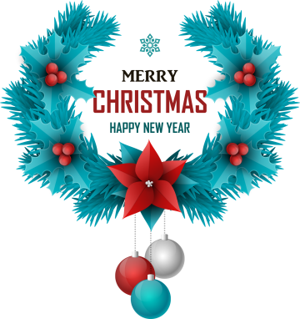
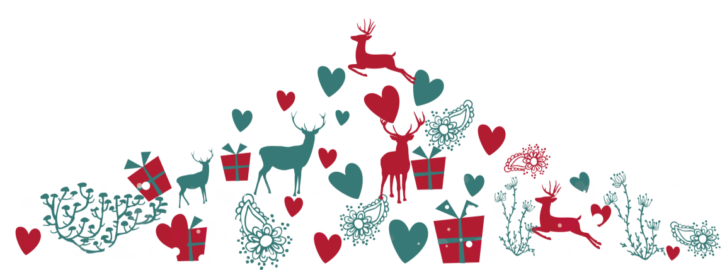
3.Giving back to events
Click here to add contentClick here
add content click here to add in
please click here to add content Click here

Slide 24
Thanks

Slide 25
Best PPT templates for free download
https://www.freeppt7.com

