Slide 1
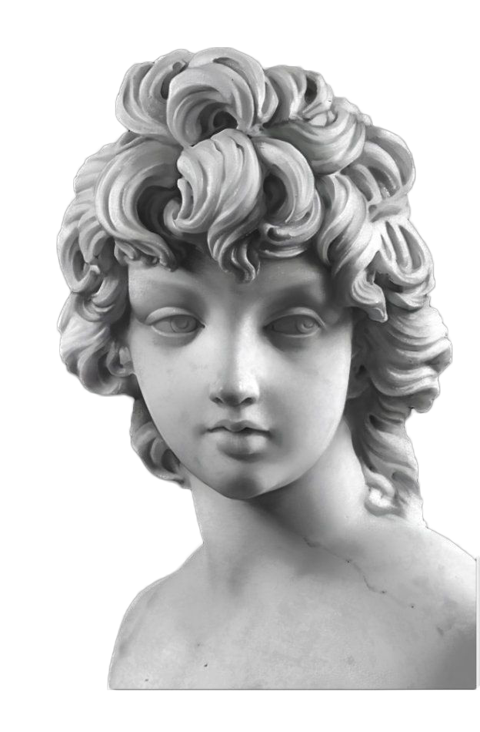
Steam Wave Style
High-end gradient fashion atmosphere, you deserve to have!
HELLO!

Slide 2
CONTENTS
Directory
Company Name
01. / The introduction
The quick, brown fox
More
02. / Project Overview
03. / Details and Process
04. / Soft launch

Slide 3
PART ONE
Introduction
COMPANY GREETING
The quick, brown fox jumps over a lazy dog. DJs flock by-time MTV ax quiz prog. Junk MTV quiz graceby by fox whelps. Bawds jog, flick quartz, vex nymphs. Waltz, bad nymph, for quick jigs vex! Fox nymphs grab quick-jived waltz.

Slide 4
You text here
About Our Company
The quick, brown fox jumps over a lazy dog. DJs flock by-time MTV ax quiz prog. Junk MTV quiz graceby by fox whelps. Bawds jog, flick quartz, vex nymphs. Waltz, bad nymph, for quick jigs vex! Fox nymphs grab quick-jived waltz. Brick quiz whangs jumpy veldt fox. Bright vixens jump; Dozy fowl quack. Quick wafting zephyrs vex bold Jim.
4
Page
You text here
You text here
You text here
30 plus
2400
800 plus
Read More
Copyright © 2017 YOUR COMPANY NAME

Slide 5
01
The quick, brown fox Jumps over a lazy dog. DJs flock by-time MTV ax quiz prog. Junk MTV quiz graced.
You text here
Single
Image Layout
02
The quick, brown fox Jumps over a lazy dog. DJs flock by-time MTV ax quiz prog. Junk MTV quiz graceby by fox whelps. Bawds jog, flick quartz, vex nymphs. Waltz, bad nymph, for quick jigs vex! Fox nymphs grabquick-jived waltz. Brick quiz whangs jumpy veldt fox. Bright vixens jump; Dozy fowl quack.
The quick, brown fox Jumps over a lazy dog. DJs flock by-time MTV ax quiz prog. Junk MTV quiz graced.
03
The quick, brown fox Jumps over a lazy dog. DJs flock by-time MTV ax quiz prog. Junk MTV quiz graced.

Slide 6
You text here
Special
Feature Slide
The quick, brown Fox jumps over a lazy dog. DJs flock by-time MTV ax quiz prog. Junk MTV quiz graceby by fox whelps. Bawds jog, flick quartz, vex nymphs. Waltz, bad nymph, for quick jigs vex.
I Want it!
Read More

Slide 7
You text here
Business Market
Brand New
Design
The quick, brown fox Jumps over a lazy dog. DJs flock by-time MTV ax quiz prog. Junk MTV quiz graced.
",
Nice Colors
Design Everyday
$!
The quick, brown fox Jumps over a lazy dog. DJs flock by-time MTV ax quiz prog. Junk MTV quiz graced.
The quick, brown fox Jumps over a lazy dog. DJs flock by-time MTV ax quiz prog. Junk MTV quiz graced.
The quick, brown fox Jumps over a lazy dog. DJs flock by-time MTV ax quiz prog. Junk MTV quiz graced.
The quick, brown fox Jumps over a lazy dog. DJs flock by-time MTV ax quiz prog. Junk MTV quiz graced.
Project Data
Daily Inspiration
The quick, brown fox Jumps over a lazy dog. DJs flock by-time MTV ax quiz prog. Junk MTV quiz graced.
The quick, brown fox Jumps over a lazy dog. DJs flock by-time MTV ax quiz prog. Junk MTV quiz graced.

Slide 8
Feature number 1
The quick, brown fox Jumps over a lazy dog. DJs flock by-time MTV ax quiz prog. Junk MTV quiz graceby by fox whelps. Bawds jog, flick quartz, vex nymphs. Waltz, bad nymph, for quick jigs vex.
01
IT'S ABOUT
SOMETHING NEW
Feature number 2
The quick, brown fox Jumps over a lazy dog. DJs flock by-time MTV ax quiz prog. Junk MTV quiz graceby by fox whelps. Bawds jog, flick quartz, vex nymphs. Waltz, bad nymph, for quick jigs vex.
02

Slide 9
You text here
Fresh Slide
Ideas
01. / The introduction
02. / Project Overview
03. / Details and Process
2720
300 plus
The quick, brown fox jumps over
The quick, brown fox jumps over
Read More
04. / Soft launch

Slide 10
PART ONE
Project Overview
COMPANY GREETING
The quick, brown fox jumps over a lazy dog. DJs flock by-time MTV ax quiz prog. Junk MTV quiz graceby by fox whelps. Bawds jog, flick quartz, vex nymphs. Waltz, bad nymph, for quick jigs vex! Fox nymphs grab quick-jived waltz.

Slide 11
You text here
An In
Design
Primary
Secondary
Feature number 2
The quick, brown fox Jumps over a lazy dog. DJs flock by-time MTV ax quiz prog. Junk MTV quiz graceby by fox whelps. Bawds jog, flick quartz, vex nymphs. Waltz, bad nymph, for quick jigs vex.
Feature number 1
Feature number 3
The quick, brown fox Jumps over a lazy dog. DJs flock by-time MTV ax quiz prog. Junk MTV quiz graceby by fox whelps. Bawds jog, flick quartz, vex nymphs. Waltz, bad nymph, for quick jigs vex.
The quick, brown fox Jumps over a lazy dog. DJs flock by-time MTV ax quiz prog. Junk MTV quiz graceby by fox whelps. Bawds jog, flick quartz, vex nymphs. Waltz, bad nymph, for quick jigs vex.

Slide 12
The quick, brown fox Jumps over a lazy dog. DJs flock by-time MTV ax quiz prog. Junk MTV quiz graceby by fox whelps. Bawds jog.
Ouranos Desta
"The quick, brown fox jumps
The quick, brown fox Jumps over a lazy dog. DJs flock by-time MTV ax quiz prog. Junk MTV quiz graceby by fox whelps. Bawds jog.
Kire Kamala
"The quick, brown fox jumps

Slide 13
Halsten Magdalena
The quick, brown fox Jumps over a lazy dog. DJs flock by-time MTV ax quiz prog. Junk MTV quiz graceby by fox whelps. Bawds jog, flick quartz, vex nymphs.
GRAPHIC DESIGNER
Design
86%
Photography
55%
Illustration
73%

Slide 14
The quick, brown fox jumps over a lazy dog. DJs flock by-time MTV ax quiz prog.
The quick, brown fox jumps over a lazy dog. DJs flock by-time MTV ax quiz prog. Junk MTV quiz graceby by fox whelps. Bawds jog, flick quartz, vex nymphs. Waltz, bad nymph, for quick jigs vex! Fox nymphs grab quick-jived waltz.
Next
Martin Axchwulz
UI / UX Designer

Slide 15
You text here
Laptop
Mockup Slide
The quick, brown fox Jumps over a lazy dog. DJs flock by-time MTV ax quiz prog. Junk MTV quiz graceby by fox whelps. Bawds jog, flick quartz.
Read More
I got it!
01
02
The quick, brown fox Jumps over a lazy dog. DJs flock by.
The quick, brown fox Jumps over a lazy dog. DJs flock by.

Slide 16
Inspiring
Stories Slide
01.
" The quick, brown fox Jumps over a lazy dog. DJs flock by-time MTV ax quiz prog. Junk MTV quiz graceby by fox whelps. Bawds jog, flick quartz, vex nymphs. Waltz, bad nymph, for quick jigs vex. "
Daisy Doe
The Company, CEO

Slide 17
You text here
Our Great Projects
01
02
03
04
14 May
02 August
24 October
Next project
Project 01
Project 02
Project 03
The quick, brown fox jumps over a lazy dog. DJs flock by-time MTV ax quiz prog.
The quick, brown fox jumps over a lazy dog. DJs flock by-time MTV ax quiz prog.
The quick, brown fox jumps over a lazy dog. DJs flock by-time MTV ax quiz prog.
View more
View more
View more

Slide 18
¥
7.99 7.99
You text here
Clean
Slide Design
Nice looking pot!
The quick, brown fox jumps over a lazy dog. DJs flock by-time MTV ax quiz prog. Junk MTV quiz.
Buy Now
Read More

Slide 19
PART ONE
Details and Process
COMPANY GREETING
The quick, brown fox jumps over a lazy dog. DJs flock by-time MTV ax quiz prog. Junk MTV quiz graceby by fox whelps. Bawds jog, flick quartz, vex nymphs. Waltz, bad nymph, for quick jigs vex! Fox nymphs grab quick-jived waltz.

Slide 20
You text here
The Analisys
Strengths
Imagination
You text here
Photography
88%
Illustration
73%
Design
47%
Strengths
92%

Slide 21
You text here
The Analisys
Weaknesses
Creative
You text here
The quick, brown fox Jumps over a lazy dog. DJs flock by-time MTV ax quiz prog.
40%
70%
You text here
You text here

Slide 22
You text here
The Analisys
Opportunities
Photography
You text here
The quick, brown fox Jumps over a lazy dog. DJs flock by-time MTV ax quiz prog. Junk MTV quiz graceby by fox whelps. Bawds jog, flick quartz, vex nymphs. Waltz, bad nymph, for quick jigs vex.
Read More

Slide 23
You text here
The Analisys
Threats
Creative
You text here
The quick, brown fox Jumps over a lazy dog. DJs flock by-time MTV ax quiz prog. Junk MTV quiz graceby by fox whelps. Bawds jog.
The quick, brown fox jumps.
The quick, brown fox jumps.

Slide 24
You text here
Company Timeline
09 August 2017
It starts from zero
Starting a new project
The quick, brown fox jumps over a lazy dog. DJs flock by-time MTV ax quiz prog. Junk MTV quiz graceby by fox whelps. Bawds jog, flick quartz, vex nymphs.
24 August 2017
And so it begins
Coffee time with team
The quick, brown fox jumps over a lazy dog. DJs flock by-time MTV ax quiz prog. Junk MTV quiz graceby by fox whelps. Bawds jog, flick quartz, vex nymphs.
1,750
2,500

Slide 25
15 September 2017
Fresh Ideas
We've gained more than than
¥1,000,000
The quick, brown fox jumps over a lazy dog. DJs flock by-time MTV ax quiz prog. Junk MTV quiz graceby by fox whelps. Bawds jog, flick quartz, vex nymphs.
The quick, brown fox jumps
03 October 2017
Creative Business
Continuous Projects
The quick, brown fox jumps over a lazy dog. DJs flock by-time MTV ax quiz prog. Junk MTV quiz graceby by fox whelps. Bawds jog, flick quartz, vex nymphs.
Banana Project #1
Banana Project #2
20 October
Company monthly data
The Analisys
83%
-12%
The quick, brown fox jumps over a lazy dog. DJs flock by-time MTV ax quiz prog. Junk MTV quiz graceby by fox whelps. Bawds jog, flick quartz, vex nymphs.
You text
You text

Slide 26
11 November 2017
Two chart doughnut
Simple chart would help
The quick, brown fox jumps over a lazy dog. DJs flock by-time MTV ax quiz prog. Junk MTV quiz graceby by fox whelps. Bawds jog, flick quartz, vex nymphs.
70%
92%
01 December 2017
Experience Customer
love Peoples us
The quick, brown fox jumps over a lazy dog. DJs flock by-time MTV ax quiz prog. Junk MTV quiz graceby by fox whelps. Bawds jog, flick quartz, vex nymphs.
"The quick, brown fox jumps - Kelly Doe
End of the timeline
The quick, brown fox jumps over a lazy dog. DJs flock by-time MTV ax quiz prog. Junk MTV quiz graceby by fox whelps. Bawds jog, flick quartz, vex nymphs.

Slide 27
PART ONE
Soft launch
COMPANY GREETING
The quick, brown fox jumps over a lazy dog. DJs flock by-time MTV ax quiz prog. Junk MTV quiz graceby by fox whelps. Bawds jog, flick quartz, vex nymphs. Waltz, bad nymph, for quick jigs vex! Fox nymphs grab quick-jived waltz.

Slide 28
You text here
Business Lightbulb
Design
Business
The quick, brown fox jumps over a lazy dog. DJs flock by when MTV ax.
The quick, brown fox jumps over a lazy dog. DJs flock by when MTV ax.
Presentation
Imagination
The quick, brown fox jumps over a lazy dog. DJs flock by when MTV ax.
The quick, brown fox jumps over a lazy dog. DJs flock by when MTV ax.

Slide 29
You text here
Business
Funnel Flow
"The quick, brown fox jumps over a lazy dog. DJs flock by when MTV
Creative Business
The quick, brown fox jumps.
The quick, brown fox jumps.
Beautiful Design
Nice Colors
Basic
Strategy
The quick, brown fox jumps.
The quick, brown fox jumps.

Slide 30
You text here
USA
Chart s Map
The quick, brown fox jumps over
First region
1,230,000
790,000
Second region
The quick, brown fox jumps over a lazy dog.
The quick, brown fox jumps over a lazy dog.
8500 plus
¥38.00
The quick, brown fox jumps over a lazy dog.
The quick, brown fox jumps over a lazy dog.
"The quick, brown fox jumps

Slide 31
29
2020 Calendar
December
S
M
T
W
T
F
S
26
27
28
29
30
1
2
FRIDAY
3
4
5
6
7
8
9
10
11
12
13
14
15
16
The quick, brown fox jumps over a lazy dog.
The quick, brown fox jumps over a lazy dog.
17
18
19
20
21
22
23
Schedule #2
The quick, brown fox jumps over a lazy dog.
24
25
26
27
28
29
30
31
1
2
3
4
5
6
5. / Tuesday

