Slide 1

BUSINESS
Hand-drawn business plan
The user-document able on a project or computer
print the presentation and make it into e used in a wilder field
https://www.freeppt7.com

Slide 2
CONTENTS
Title text added
Title text added
The user-document able on a project or computer
print the presentation and make it into e used in a wilder field
The user-document able on a project or computer
print the presentation and make it into e used in a wilder field
Title text added
Title text added
The user-document able on a project or computer
print the presentation and make it into e used in a wilder field
The user-document able on a project or computer
print the presentation and make it into e used in a wilder field

Slide 3
PART 01
Title text added here
The user-document can on a project or or computer, or print the presentation and make it into a film to let a edd er field

Slide 4
Title text added
Title text added
Users can present on a projector or computer Or they can print out a presentation On a projector or computer Users can present on a projector or computer Or they can print out a presentation On a projector or computer Or they can print out a presentation on a projector or computer.

Slide 5
Title text added
1
2
3
Title text added
Title text added
Title text added
Users can present on a projector or computer or print out a presentation To make a presentation On a projector or computer Or they can present a presentation on a projector or computer
Users can present on a projector or computer or print out a presentation To make a presentation On a projector or computer Or they can present a presentation on a projector or computer
Users can present on a projector or computer or print out a presentation To make a presentation On a projector or computer Or they can present a presentation on a projector or computer

Slide 6
Title text added
Title text added
Users can present on a projector or computer or print out a presentation to make
Title text added
Users can present on a projector or computer or print out a presentation to make
Title text added
Users can present on a projector or computer or print out a presentation to make

Slide 7
Title text added
Title text added
Title text added
Users can present on a projector or computer or make
Users can present on a projector or computer or make
Title text added
Title text added
Users can present on a projector or computer or make
Users can present on a projector or computer or make

Slide 8
Title text added
Title text added
Title text added
Users can present on a projector or computer or print out a presentation To make a presentation Users can present on a projector or computer Or they can print the presentation to make a presentation
Users can present on a projector or computer or print out a presentation To make a presentation Users can present on a projector or computer Or they can print the presentation to make a presentation

Slide 9
PART 02
Title text added here
The user-document can on a project or or computer, or print the presentation and make it into a film to let a edd er field

Slide 10
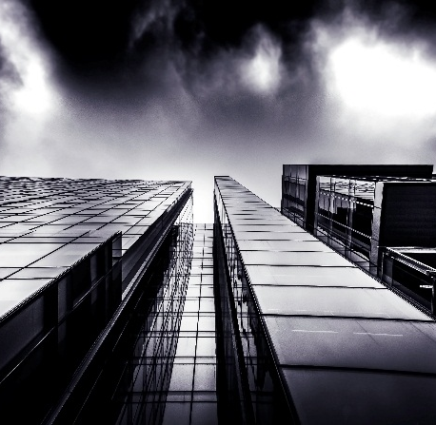
Title text added
Title text added
Title text added
Users can present on a projector or computer or print out a presentation to make
Users can present on a projector or computer or print out a presentation to make
Title text added
Title text added
Users can present on a projector or computer or print out a presentation to make
Users can present on a projector or computer or print out a presentation to make

Slide 11
Title text added
Text add
Text add
Text add
Users can present on a projector or computer or print a presentation
Users can present on a projector or computer or print a presentation
Users can present on a projector or computer or print a presentation

Slide 12
Title text added
Title text added
Users can present on a projector or computer or print out a presentation to make
Title text added
Users can present on a projector or computer or print out a presentation to make
Title text added
Users can present on a projector or computer or print out a presentation to make

Slide 13
Title text added
Title text added
Users can present on a projector or computer or print out a presentation to make
Title text added
Title text added
Users can present on a projector or computer or print out a presentation to make
Users can present on a projector or computer or print out a presentation to make

Slide 14
PART 03
Title text added here
The user-document can on a project or or computer, or print the presentation and make it into a film to let a edd er field

Slide 15
Title text added
Title text added
Users can present on a projector or computer Or they can print out a presentation On a projector or computer Users can present on a projector or computer Or they can print out a presentation On a projector or computer Or they can print out a presentation on a projector or computer.

Slide 16
Title text added
Title text added
Users can present on a projector or computer or print out a presentation.
Title text added
Users can present on a projector or computer or print out a presentation.
Title text added
Users can present on a projector or computer or print out a presentation.

Slide 17
Title text added
Title text added
Users can present on a projector or computer or print out a presentation to make
Title text added
Users can present on a projector or computer or print out a presentation to make
Title text added
Users can present on a projector or computer or print out a presentation to make
Title text added
Users can present on a projector or computer or print out a presentation to make

Slide 18
Title text added
Title text added
Users can present on a projector or computer or print out a presentation Can make a presentation On the projector or computer Users can also print out the presentation Can make the presentation The user can make the projector
Title text added
Users can present on a projector or computer or print out a presentation Can make a presentation On the projector or computer Users can also print out the presentation Can make the presentation The user can make the projector

Slide 19
PART 04
Title text added here
The user-document can on a project or or computer, or print the presentation and make it into a film to let a edd er field

Slide 20

Title text added
Title text added
Title text added
Users can present on a projector or computer or print out a presentation to make
Users can present on a projector or computer or print out a presentation to make
Title text added
Title text added
Users can present on a projector or computer or print out a presentation to make
Users can present on a projector or computer or print out a presentation to make

Slide 21
Title text added
Title text added
Title text added
Users can present on a projector or computer or print out a presentation to make
Users can present on a projector or computer or print out a presentation to make
Title text added
Users can present on a projector or computer or print out a presentation to make

Slide 22
Title text added
Title text added
Users can present on a projector or computer or print out a presentation to make
Title text added
Title text added
Users can present on a projector or computer or print out a presentation to make
Users can present on a projector or computer or print out a presentation to make

Slide 23

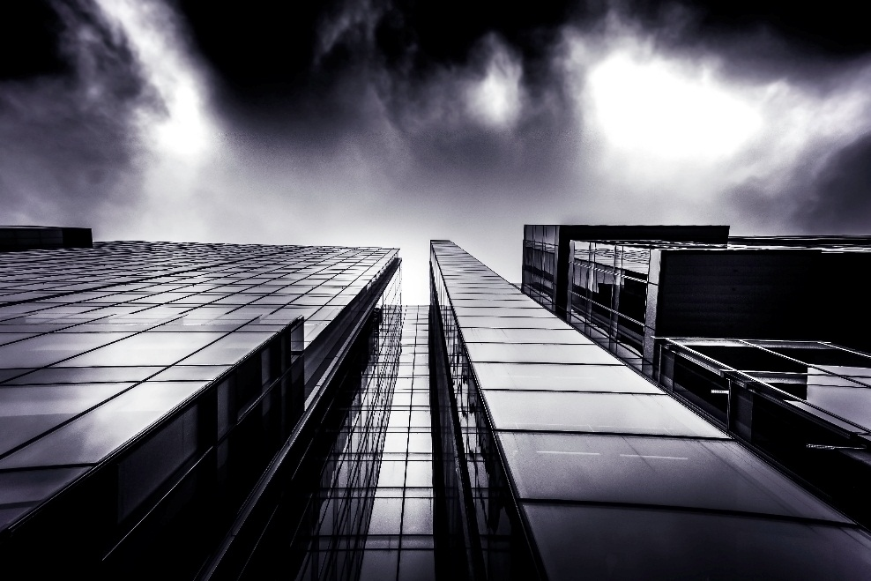
Title text added
Title text added
Title text added
Users can present on a projector or computer or print out a presentation to make
Users can present on a projector or computer or print out a presentation to make

Slide 24
Title text added
Title text added
Title text added
Users can present on a projector or computer or print out a presentation to make
Users can present on a projector or computer or print out a presentation to make
Title text added
Title text added
Users can present on a projector or computer or print out a presentation to make
Users can present on a projector or computer or print out a presentation to make

Slide 25
THANK YOU
The user-document able on a project or computer
print the presentation and make it into e used in a wilder field
https://www.freeppt7.com

