Slide 1

BUSINESS
templates
The user can thersprint The presentation and make it into e used in a wilder field field

Slide 2
CONTENTS
01
02
03
04
Title text added
Title text added
Title text added
Title text added

Slide 3
01
The user-document able on a project or computer
print the presentation and make it into e used in a wilder field
Title text added

Slide 4
Title text added
Title text added
Title text added
Title text added
Users can present on a projector or computer or print out a presentation to make
Users can present on a projector or computer or print out a presentation to make
Users can present on a projector or computer or print out a presentation to make

Slide 5
Title text added
Title text added
Title text added
Title text added
Users can make a presentation on a projector or computer or print out a presentation to make
Users can make a presentation on a projector or computer or print out a presentation to make
Users can make a presentation on a projector or computer or print out a presentation to make

Slide 6
Title text added
Title text added
Users can present on a projector or computer or print out a presentation to make
Title text added
Users can present on a projector or computer or print out a presentation to make
Title text added
Users can present on a projector or computer or print out a presentation to make

Slide 7
Title text added
Title text added
Title text added
Users can present on a projector or computer or print out a presentation to make
Users can present on a projector or computer or print out a presentation to create a
Title text added
Users can present on a projector or computer or print out a presentation to make

Slide 8
Title text added
Title text added
Users can present on a projector or computer or print out a presentation to make
Title text added
Users can present on a projector or computer or print out a presentation to make
Title text added
Users can present on a projector or computer or print out a presentation to make

Slide 9
02
The user-document able on a project or computer
print the presentation and make it into e used in a wilder field
Title text added

Slide 10
Title text added
Title text added
Users can present on a projector or computer or print out a presentation to make
Title text added
Users can present on a projector or computer or print out a presentation to make

Slide 11
Title text added
Title text added
Users can present on a projector or computer or present a presentation
Title text added
Users can present on a projector or computer or present a presentation
Title text added
Users can present on a projector or computer or present a presentation

Slide 12
Title text added
Users can present on a projector or computer or print out a presentation to make
Users can present on a projector or computer or print out a presentation to make
Users can present on a projector or computer or print out a presentation to make
Users can present on a projector or computer or print out a presentation to make
Users can present on a projector or computer or print out a presentation to make
Users can present on a projector or computer or print out a presentation to make

Slide 13
Title text added
Title text added
Title text added
Users can present on a projector or computer or print out a presentation to make
Users can present on a projector or computer or print out a presentation to make

Slide 14
03
The user-document able on a project or computer
print the presentation and make it into e used in a wilder field
Title text added

Slide 15
Title text added
Title text added
Users can present on a projector or computer or present a presentation
Title text added
Users can present on a projector or computer or present a presentation
Title text added
Users can present on a projector or computer or present a presentation
Title text added
Users can present on a projector or computer or present a presentation
Title text added
Users can present on a projector or computer or present a presentation

Slide 16
Title text added
Title text added
Title text added
Users can present on a projector or computer or print out a presentation to make
Users can present on a projector or computer or print out a presentation to make
Title text added
Title text added
Users can present on a projector or computer or print out a presentation to make
Users can present on a projector or computer or print out a presentation to make
Title text added
Title text added
Users can present on a projector or computer or print out a presentation to make
Users can present on a projector or computer or print out a presentation to make

Slide 17
Title text added
Title text added
Title text added
01
02
Users can present on a projector or computer or print out a presentation to make
Users can present on a projector or computer or print out a presentation to make
Title text added
Title text added
03
04
Users can present on a projector or computer or print out a presentation to make
Users can present on a projector or computer or print out a presentation to make

Slide 18
Title text added
Title text added
Title text added
Users can present on a projector or computer or print out a presentation to make
Users can present on a projector or computer or print out a presentation to make
Title text added
Title text added
Users can present on a projector or computer or print out a presentation to make
Users can present on a projector or computer or print out a presentation to make

Slide 19
Title text added
Title text added
Title text added
Title text added
Users can present on a projector or computer or print out a presentation To make a presentation Users can present on a projector or computer Or they can print the presentation to make a presentation
Users can present on a projector or computer or print out a presentation To make a presentation Users can present on a projector or computer Or they can print the presentation to make a presentation
Users can present on a projector or computer or print out a presentation To make a presentation Users can present on a projector or computer Or they can print the presentation to make a presentation

Slide 20
04
The user-document able on a project or computer
print the presentation and make it into e used in a wilder field
Title text added

Slide 21




Title text added

Slide 22
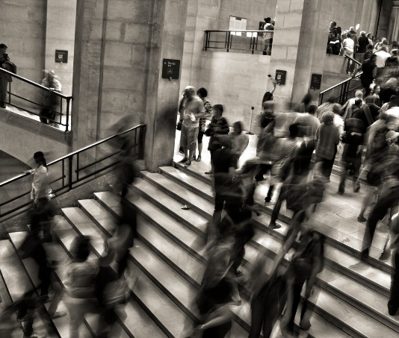
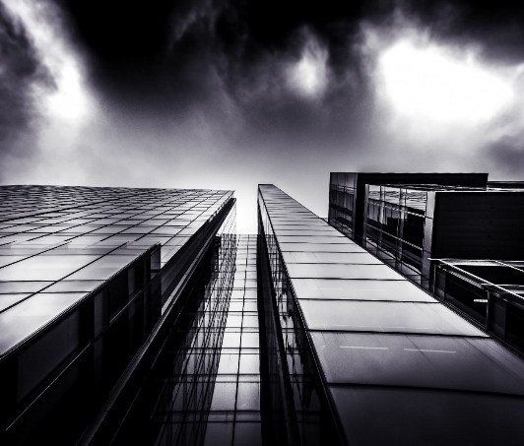


Title text added
Title text added
Title text added
Title text added
Title text added
Users can make a presentation on a projector or computer or print out a presentation to make
Users can make a presentation on a projector or computer or print out a presentation to make
Users can make a presentation on a projector or computer or print out a presentation to make
Users can make a presentation on a projector or computer or print out a presentation to make

Slide 23



Title text added
Title text added
Title text added
Title text added
Users can make a presentation on a projector or computer or print out a presentation to make
Users can make a presentation on a projector or computer or print out a presentation to make
Users can make a presentation on a projector or computer or print out a presentation to make

Slide 24


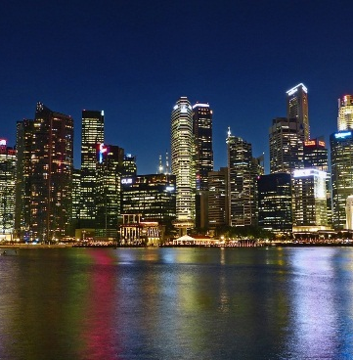



Title text added
Text add
Text add
Text add
Users can present on a projector or computer or print out a presentation to make
Users can present on a projector or computer or print out a presentation to make
Users can present on a projector or computer or print out a presentation to make
Text add
Text add
Text add
Users can present on a projector or computer or print out a presentation to make
Users can present on a projector or computer or print out a presentation to make
Users can present on a projector or computer or print out a presentation to make

Slide 25
THANK YOU

