Slide 1
YOUR LOGO HERE
Enterprise publicity with high-end atmospheric common template
Introduction
Production
Market
BY DBLPPT
Notes:
The template title uses Huakang Jin-black font, has been embedded in this template, objectively can download and install the font.

Slide 2
00
Company Logo
Write the company's external propaganda slogan here
ABOVE ALL
Abour Compay
01
YOUR TITLE
02
YOUR TITLE
03
YOUR TITLE
Type your coverage
Type your coverage
Type your coverage

Slide 3
SECTION ONE
DBLPPT
→

Slide 4
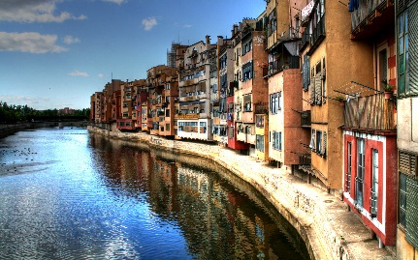
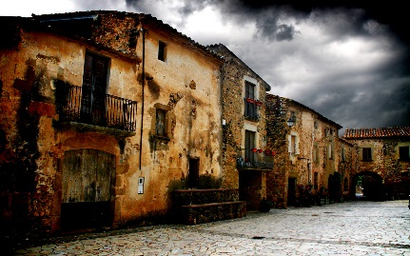
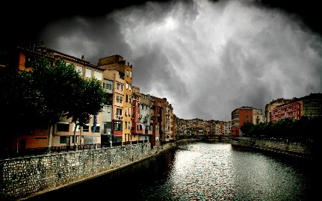
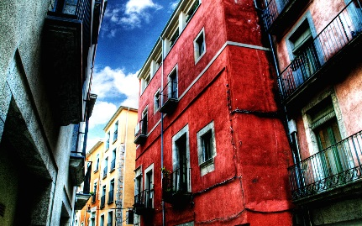
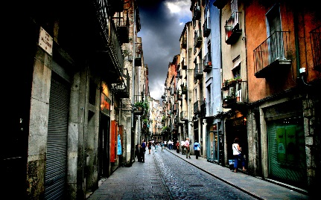
01
PART ONE
PICTURES
Picture number
Picture number
Picture number
Picture number
Picture number
Picture number

Slide 5
01
PART ONE
PICTURES
Type your coverage
Type your coverage
Type your coverage

Slide 6
01
PART ONE
THETROY HIS
THE MAIN MARKET
THE FUTURE
I looked ed in my sister's eyes and i made a decision not to go with her just yet. That I y here day and complete my journey.
I also made made the matter, i willn't just just live any life. I will life life that t i absolutely LOVE and not let less.
In-time, the clarity that descended around me was like a light shining in a dark room for the first time. As if the earth's plates hadshifted ddydd my fydy and everything suddenly looked real for the first time.

Slide 7
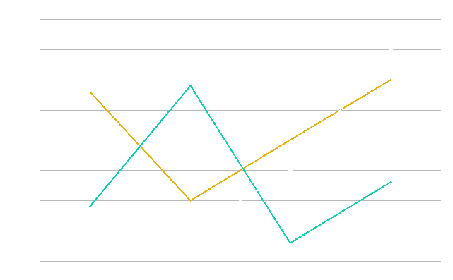
01
PART ONE
THETROY HIS
THE MAIN MARKET
THE FUTURE
I looked ed in my sister's eyes and i made a decision not to go with her just yet. That I y here day and complete my journey.

Slide 8
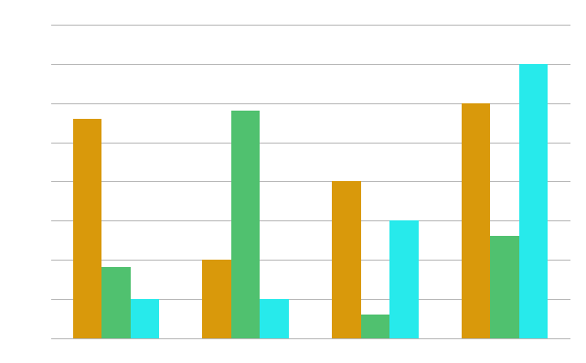
01
PART ONE
THETROY HIS
THE MAIN MARKET
THE FUTURE
I looked ed in my sister's eyes and i made a decision not to go with her just yet. That I y here day and complete my journey.

Slide 9
SECTION TWO
DBLPPT
→

Slide 10
02
PART TWO
YOUR KEY POINT
YOUR KEY POINT
YOUR KEY POINT
YOUR KEY POINT
I realised hen t-t i hadi a choice. I can choose to end my life or i can choose to live it.
I realised hen t-t i hadi a choice. I can choose to end my life or i can choose to live it.
I realised hen t-t i hadi a choice. I can choose to end my life or i can choose to live it.
I realised hen t-t i hadi a choice. I can choose to end my life or i can choose to live it.
YOUR LOGO HERE

Slide 11
02
PART TWO
35%
23%
I realised hen t-t i hadi a choice. I can choose to end my life or i can choose to live it.
I realised hen t-t i hadi a choice. I can choose to end my life or i can choose to live it.
54%
29%
I realised hen t-t i hadi a choice. I can choose to end my life or i can choose to live it.
I realised hen t-t i hadi a choice. I can choose to end my life or i can choose to live it.
YOUR LOGO HERE

Slide 12
02
PART TWO
YOUR KEY POINT
YOUR KEY POINT
I realised hen t-t i hadi a choice. I can choose to end my life or i can choose to live it.
I realised hen t-t i hadi a choice. I can choose to end my life or i can choose to live it.
YOUR KEY POINT
YOUR KEY POINT
I realised hen t-t i hadi a choice. I can choose to end my life or i can choose to live it.
I realised hen t-t i hadi a choice. I can choose to end my life or i can choose to live it.
YOUR LOGO HERE

Slide 13
02
PART TWO
YOUR KEY POINT
I realised hen t-t i hadi a choice. I can choose to end my life or i can choose to live it.
YOUR KEY POINT
I realised hen t-t i hadi a choice. I can choose to end my life or i can choose to live it.
YOUR KEY POINT
I realised hen t-t i hadi a choice. I can choose to end my life or i can choose to live it.
YOUR KEY POINT
I realised hen t-t i hadi a choice. I can choose to end my life or i can choose to live it.
YOUR KEY POINT
I realised hen t-t i hadi a choice. I can choose to end my life or i can choose to live it.
ADD YOUR TITLE
YOUR LOGO HERE

Slide 14
02
PART TWO
YOUR TITLE
ADD YOUR KEY POINT HERE
I realised hen t-t i hadi a choice. I can choose to end my life or i can choose to live it.
YOUR TITLE
ADD YOUR KEY POINT HERE
I realised hen t-t i hadi a choice. I can choose to end my life or i can choose to live it.
YOUR TITLE
ADD YOUR KEY POINT HERE
I realised hen t-t i hadi a choice. I can choose to end my life or i can choose to live it.
YOUR TITLE
ADD YOUR KEY POINT HERE
I realised hen t-t i hadi a choice. I can choose to end my life or i can choose to live it.
YOUR LOGO HERE

Slide 15
02
PART TWO
2017
2018
2019
2020
YOUR KEY POINT
YOUR KEY POINT
YOUR KEY POINT
YOUR KEY POINT
I realised hen t-t i hadi a choice. I can choose to end my life or i can choose to live it.
I realised hen t-t i hadi a choice. I can choose to end my life or i can choose to live it.
I realised hen t-t i hadi a choice. I can choose to end my life or i can choose to live it.
I realised hen t-t i hadi a choice. I can choose to end my life or i can choose to live it.
YOUR LOGO HERE

Slide 16
02
PART TWO
I realised hen t-t i hadi a choice. I can choose to end my life or i can choose to live it.
20%
I realised hen t-t i hadi a choice. I can choose to end my life or i can choose to live it.
60%
20%
I realised hen t-t i hadi a choice. I can choose to end my life or i can choose to live it.
YOUR LOGO HERE

Slide 17
THANKS FOR YOUR ATTENTION
DBLPPT

