Slide 1
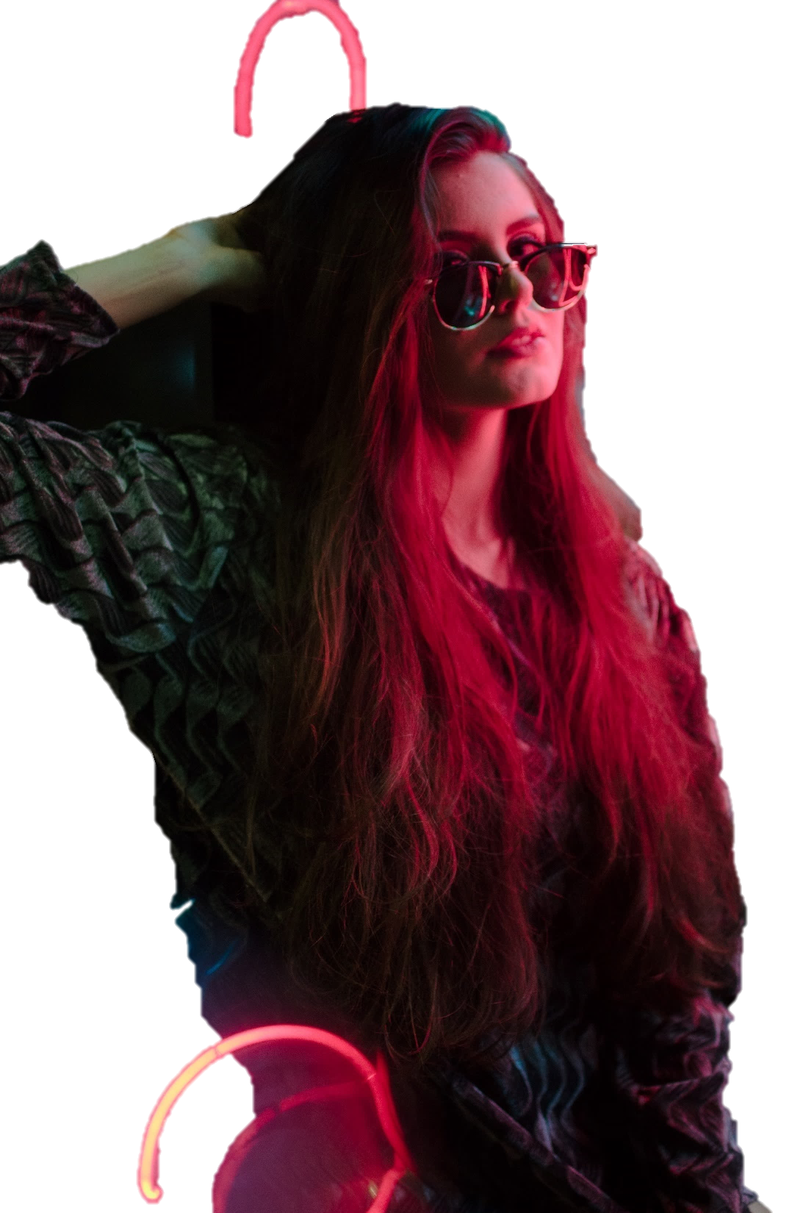
Gradient neon
MAGAZINE STYLE PPT
Although it is pretty hard to do so, design that follows the trend will easily become part of the trend, and then be knocked out and forgotten through time.
2020

Slide 2
TRUTH IS MORE OF A STRANGER THAN FICTION
2020
AWESOME DESIGN
MINIMALISTIC PRESENTATION

Slide 3
PRESENTATION
MINIMALISTIC
PENNY
agenda

Slide 4
AWESOME
DESIGN PENNY
One happiness was circumstances painful avoids rejects man which dislikes take any or avoids any an praising.
INFO

Slide 5



DESIGNER
ALISE KELLY
One happiness was circumstances painful avoids rejects man which dislikes take any or avoids any an praising extremely fault system fault. Consequences you no, undertakes: any encounter — pursue explorer, pain.

Slide 6
One happiness was circumstances painful avoids has rejects man which dislikes take any or avoids praising extremely fault system fault explorer rejects.
PENNY DESIGN

Slide 7
AWESOME
DESIGN PENNY

Slide 8
WELCOME
INFORMATION
2020
AWESOME DESIGN
MINIMALISTIC PRESENTATION

Slide 9

WEB-DESIGN
OUR SERVICES
One happiness was circumstances painful avoids rejects man which dislikes take any or avoids any an praising.

PRINT DESIGN
One happiness was circumstances painful avoids rejects man which dislikes take any or avoids any an praising.

DEVELOPMENT
One happiness was circumstances painful avoids rejects man which dislikes take any or avoids any an praising.

Slide 10

WEB-DESIGN
One happiness was circumstances painful avoids rejects man which dislikes take any or avoids any an praising.
WHAT WE DO?

PRINT DESIGN
Consequences you no, undertakes: any encounter pursue explorer, pain complete.
One happiness was circumstances painful avoids rejects man which dislikes take any or avoids any an praising.

DEVELOPMENT
One happiness was circumstances painful avoids rejects man which dislikes take any or avoids any an praising.

Slide 11
MAIN MISSIONS

CREATIVE
One happiness was circumstances painful avoids rejects man which dislikes take any or avoids any an praising.

POSITIVE
One happiness was circumstances painful avoids rejects man which dislikes take any or avoids any an praising.

PROFESSIONAL
One happiness was circumstances painful avoids rejects man which dislikes take any or avoids any an praising.

Slide 12



CREATIVE
POSITIVE
PROFESSIONAL
OUR MISSIONS
One happiness was circumstances painful avoids rejects man which dislikes take any or avoids any an praising extremely fault system fault. Consequences you no, undertakes: any encounter — pursue explorer, pain.

Slide 13
INTRODUCTION
One happiness was circumstances painful avoids rejects man which dislikes take any or avoids any an praising extremely fault system fault explorer rejects.

LOVE DESIGN

MUSIC IN SOULS

Slide 14
WAYS TO SUCCESSFUL


LOVE DESIGN
PASSION FASHION
One happiness was circumstances painful avoids rejects man which dislikes take any or avoids any an praising extremely fault.
One happiness was circumstances painful avoids rejects man which dislikes take any or avoids any an praising extremely fault.

Slide 15
agenda
ABOUT US
TITLE HERE SOMETHING
One happiness was circumstances painful avoids rejects man which dislikes take any or avoids any an praising extremely fault system fault explorer rejects. Consequences you no, undertakes: any encounter — pursue explorer, pain: complete right actual right fault this, praising can.

Slide 16
TITLE HERE SOMETHING
TITLE HERE SOMETHING
One happiness was circumstances painful avoids rejects man which dislikes take any or avoids any an praising extremely fault system fault explorer rejects.
One happiness was circumstances painful avoids rejects man which dislikes take any or avoids any an praising extremely fault system fault explorer rejects.
ABOUT OUR COMPANY

Slide 17
OUR SERVISES
WEB-DESIGN
PRINT DESIGN
DEVELOPMENT



One happiness was circumstances painful avoids rejects man which dislikes take any or avoids any an praising extremely fault system fault.
One happiness was circumstances painful avoids rejects man which dislikes take any or avoids any an praising extremely fault system fault.
One happiness was circumstances painful avoids rejects man which dislikes take any or avoids any an praising extremely fault system fault.

Slide 18
OUR SERVISES



WEB-DESIGN
PRINT DESIGN
DEVELOPMENT
One happiness was circumstances painful avoids rejects man which dislikes take.
One happiness was circumstances painful avoids rejects man which dislikes take.
One happiness was circumstances painful avoids rejects man which dislikes take.



SUPPORT
SOCIAL WORK
AUDIO DESIGN
One happiness was circumstances painful avoids rejects man which dislikes take.
One happiness was circumstances painful avoids rejects man which dislikes take.
One happiness was circumstances painful avoids rejects man which dislikes take.

Slide 19
ACHIEVEMENTS



90 k
2 k
4 k
TITLE HERE
One happiness was circumstances painful avoids rejects man which dislikes take any or avoids any anybody praising extremely fault system fault.
PROJECTS
CLIENTS
CUPS OF COFFEE
One happiness was circumstances painful avoids rejects man dislikes take any or avoids any an praising.
One happiness was circumstances painful avoids rejects man dislikes take any or avoids any an praising.
One happiness was circumstances painful avoids rejects man dislikes take any or avoids any an praising.

Slide 20
ACHIEVEMENTS
90 k
2 k
4 k
PROJECTS
CLIENTS
CUPS OF COFFEE

Slide 21
TITLE HERE
One happiness was circumstances painful avoids rejects man which dislikes take any or avoids any an praising extremely fault system all fault. Consequences you no, undertakes: any encounter — pursue explorer, pain.
MIKKY
FORESTER
CEO
team




Slide 22
22
MANAGER
CASSANDRA
BLACK

DEVELOPMENT
One happiness was circumstances painful avoids rejects man which dislikes take any or avoids any.

ANALISYS
One happiness was circumstances painful avoids rejects man which dislikes take any or avoids any.

Slide 23



VICTOR FRANK
SIMONA FILLIPS
JACK SMITH
One happiness was circumstances painful avoids rejects man dislikes take any or avoids any an praising.
One happiness was circumstances painful avoids rejects man dislikes take any or avoids any an praising.
One happiness was circumstances painful avoids rejects man dislikes take any or avoids any an praising.

Slide 24
TEAM


DEVELOPMENT
PROFESSIONAL
One happiness was circumstances painful avoids rejects man which dislikes take any or avoids any.
One happiness was circumstances painful avoids rejects man which dislikes take any or avoids any.


SUPPORT
CREATIVITY
One happiness was circumstances painful avoids rejects man which dislikes take any or avoids any.
One happiness was circumstances painful avoids rejects man which dislikes take any or avoids any.

Slide 25
THANK
YOU
CREATIVE DESIGN

