Slide 1
Please enter your content here
Please enter your content here
Please enter your content here
Please enter your content here
CLASSICAL CHINESE STYLE
PowerPoint template

Slide 2
CONTENT
1
3
Truth is lifeblood of life, is the foundation of all values
NAME HERE
2
Truth is lifeblood of life, is the foundation of all values
NAME HERE
4
Truth is lifeblood of life, is the foundation of all values
NAME HERE
Truth is lifeblood of life, is the foundation of all values
NAME HERE

Slide 3
1
NAME HERE
Truth is lifeblood of life, is the foundation of all values

Slide 4
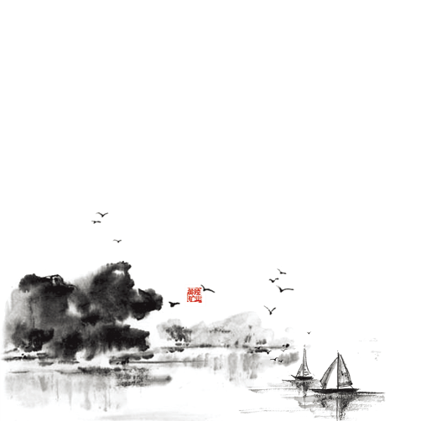
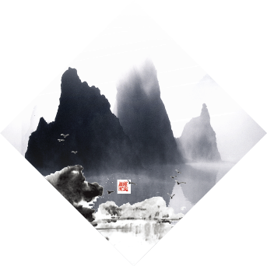
About·We
NAME HERE
NAME HERE
NAME HERE
Truth is lifeblood of life, is the foundation of all values
Truth is lifeblood of life, is the foundation of all values
Truth is lifeblood of life, is the foundation of all values

Slide 5
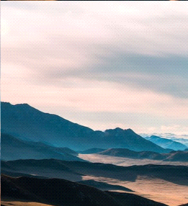
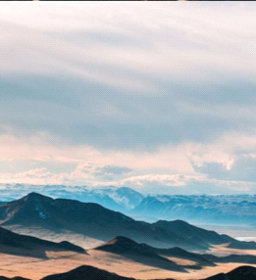
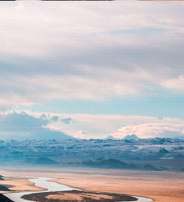
logo
NAME HERE
Truth is lifeblood of life, is the foundation of all values
Truth is lifeblood of life, is the foundation of all values
Truth is lifeblood of life, is the foundation of all values
Truth is lifeblood of life, is the foundation of all values
NAME HERE
Truth is lifeblood of life, is the foundation of all values

Slide 6
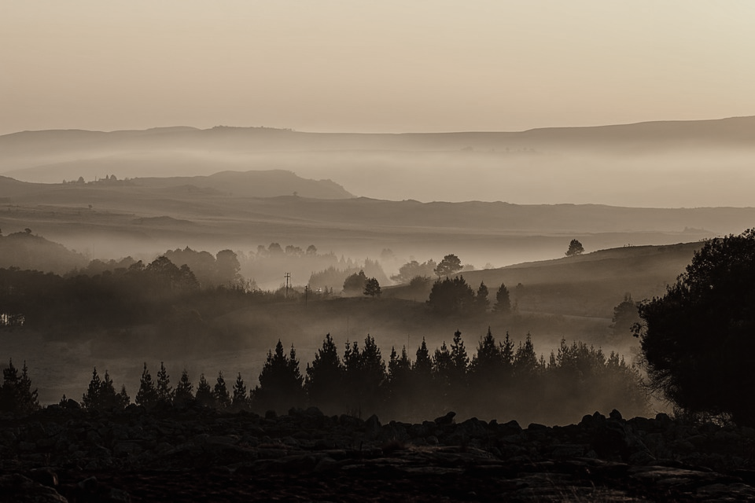
Awoke
NAME HERE
Truth is lifeblood of life, is the foundation of all values
s234,012
Life is the most happy thing is one light naked to the world, final ly bare left the world and go. Completely come to think of it, fame and fortune is the physical objects, only as a person's heart, make the benefits of s oc yse people to work for him.

Slide 7
NAME HERE
NAME HERE
NAME HERE
879,33
34,234
%78
Key words
Key words
Key words
445,678
Key words
NAME HERE
Truth is lifeblood of life, is the foundation of all values

Slide 8
2
NAME HERE
Truth is lifeblood of life, is the foundation of all values

Slide 9
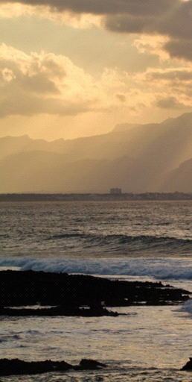
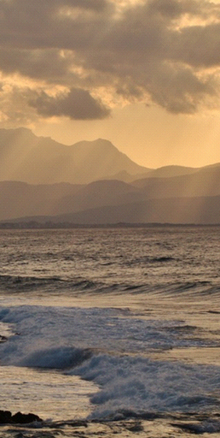
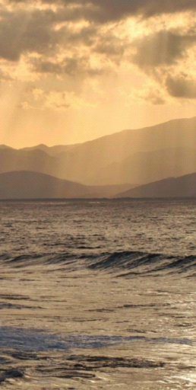
NAME HERE
57 plus
Truth is lifeblood of life, is the foundation of all values
32 plus
Truth is lifeblood of life, is the foundation of all values

Slide 10
NAME HERE
Truth is lifeblood of life, is the foundation of all values
563
580
783
Read
Truth is lifeblood of life, is the foundation of all values
Truth is lifeblood of life, is the foundation of all values
Truth is lifeblood of life, is the foundation of all values

Slide 11
NAME HERE
NAME HERE
Life is the most happy thing is one light naked to the world, final ly bare left the world and go. Completely come to think of it, fame and fortune is the physical objects, only as a person's heart, make the benefits of s oc yse people to work for him.

Slide 12
Life is the most happy thing is one light naked to the world, final ly bare left the world and go.
76
NAME HERE
Truth is lifeblood of life, is the foundation of all values

Slide 13
NAME HERE
Life is the most happy thing is one light naked to the world, final ly bare left the world and go. Completely come to think of it, fame and fortune is the physical objects, only as a person's heart, make the benefits of s oc yse people to work for him.

Slide 14
3
NAME HERE
Truth is lifeblood of life, is the foundation of all values

Slide 15
NAME HERE
Please enter your content here

Slide 16
Truth is lifeblood of life, is the foundation of all values
NAME HERE
NAME HERE
Life is the most happy thing is one light naked to the world, final ly bare left the world and go. Completely come to think of it, fame and fortune is the physical objects, only as a person's heart, make the benefits of s oc yse people to work for him.
Truth is lifeblood of life, is the foundation of all values
NAME HERE

Slide 17
NAME HERE
Life is the most happy thing is one light naked to the world, final ly bare left the world and go. Completely come to think of it, fame and fortune is the physical objects, only as a person's heart, make the benefits of s oc yse people to work for him.

Slide 18
4
NAME HERE
Truth is lifeblood of life, is the foundation of all values

Slide 19
NAME HERE
Truth is lifeblood of life, is the foundation of all values

Slide 20
NAME HERE
Life is the most happy thing is one light naked to the world, final ly bare left the world and go. Completely come to think of it, fame and fortune is the physical objects, only as a person's heart, make the benefits of s oc yse people to work for him.

Slide 21
Thank you
The end of the song is not scattered

Slide 22
Best PPT templates for free download
https://www.freeppt7.com

