Slide 1
YOUR LOGO HERE
Corporate publicity Powerpoint Template
Introduction
Production
Market
https://www.freeppt7.com
Notes:
The template title uses Huakang Jin-black font, has been embedded in this template, objectively can download and install the font.

Slide 2
00
Company Logo
Enter a slogan
ABOVE ALL
Abour Compay
01
YOUR TITLE
02
YOUR TITLE
03
YOUR TITLE
Type your coverage
Type your coverage
Type your coverage

Slide 3
SECTION ONE
→
FREEPPT7.COM

Slide 4
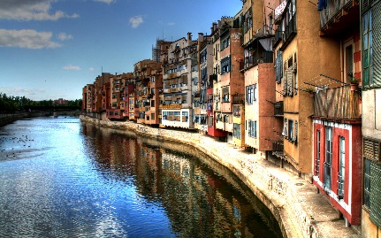
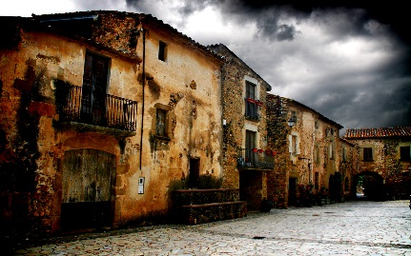
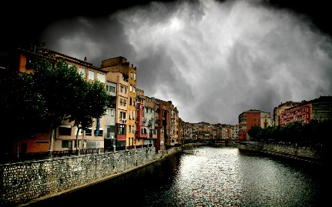
01
PART ONE
PICTURES
Picture number
Picture number
Picture number
Picture number
Picture number
Picture number

Slide 5
01
PART ONE
PICTURES
Type your coverage
Type your coverage
Type your coverage

Slide 6
01
PART ONE
THETROY HIS
THE MAIN MARKET
THE FUTURE
I looked ed in my sister's eyes and i made a decision not to go with her just yet. That I y here day and complete my journey.
I also made made the matter, i willn't just just live any life. I will life life that t i absolutely LOVE and not let less.
In-time, the clarity that descended around me was like a light shining in a dark room for the first time. As if the earth's plates hadshifted ddydd my fydy and everything suddenly looked real for the first time.

Slide 7
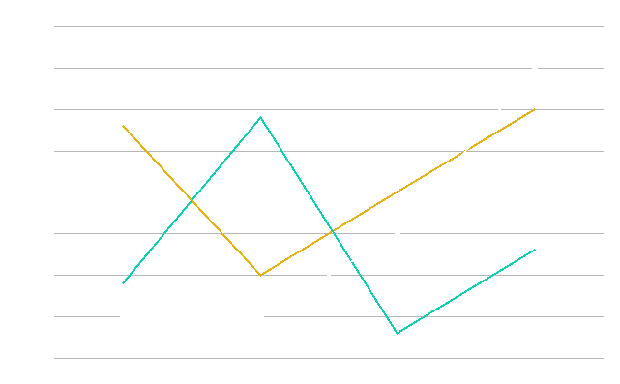
01
PART ONE
THETROY HIS
THE MAIN MARKET
THE FUTURE
I looked ed in my sister's eyes and i made a decision not to go with her just yet. That I y here day and complete my journey.

Slide 8
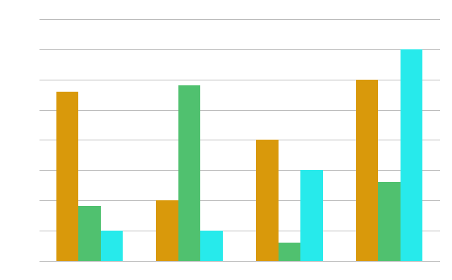
01
PART ONE
THETROY HIS
THE MAIN MARKET
THE FUTURE
I looked ed in my sister's eyes and i made a decision not to go with her just yet. That I y here day and complete my journey.

Slide 9
SECTION TWO
→
FREEPPT7.COM

Slide 10
02
PART TWO
YOUR KEY POINT
YOUR KEY POINT
YOUR KEY POINT
YOUR KEY POINT
I realised hen t-t i hadi a choice. I can choose to end my life or i can choose to live it.
I realised hen t-t i hadi a choice. I can choose to end my life or i can choose to live it.
I realised hen t-t i hadi a choice. I can choose to end my life or i can choose to live it.
I realised hen t-t i hadi a choice. I can choose to end my life or i can choose to live it.
YOUR LOGO HERE

Slide 11
02
PART TWO
35%
23%
I realised hen t-t i hadi a choice. I can choose to end my life or i can choose to live it.
I realised hen t-t i hadi a choice. I can choose to end my life or i can choose to live it.
54%
29%
I realised hen t-t i hadi a choice. I can choose to end my life or i can choose to live it.
I realised hen t-t i hadi a choice. I can choose to end my life or i can choose to live it.
YOUR LOGO HERE

Slide 12
02
PART TWO
YOUR KEY POINT
YOUR KEY POINT
I realised hen t-t i hadi a choice. I can choose to end my life or i can choose to live it.
I realised hen t-t i hadi a choice. I can choose to end my life or i can choose to live it.
YOUR KEY POINT
YOUR KEY POINT
I realised hen t-t i hadi a choice. I can choose to end my life or i can choose to live it.
I realised hen t-t i hadi a choice. I can choose to end my life or i can choose to live it.
YOUR LOGO HERE

Slide 13
02
PART TWO
YOUR KEY POINT
I realised hen t-t i hadi a choice. I can choose to end my life or i can choose to live it.
YOUR KEY POINT
I realised hen t-t i hadi a choice. I can choose to end my life or i can choose to live it.
YOUR KEY POINT
I realised hen t-t i hadi a choice. I can choose to end my life or i can choose to live it.
YOUR KEY POINT
I realised hen t-t i hadi a choice. I can choose to end my life or i can choose to live it.
YOUR KEY POINT
I realised hen t-t i hadi a choice. I can choose to end my life or i can choose to live it.
ADD YOUR TITLE
YOUR LOGO HERE

Slide 14
02
PART TWO
YOUR TITLE
ADD YOUR KEY POINT HERE
I realised hen t-t i hadi a choice. I can choose to end my life or i can choose to live it.
YOUR TITLE
ADD YOUR KEY POINT HERE
I realised hen t-t i hadi a choice. I can choose to end my life or i can choose to live it.
YOUR TITLE
ADD YOUR KEY POINT HERE
I realised hen t-t i hadi a choice. I can choose to end my life or i can choose to live it.
YOUR TITLE
ADD YOUR KEY POINT HERE
I realised hen t-t i hadi a choice. I can choose to end my life or i can choose to live it.
YOUR LOGO HERE

Slide 15
02
PART TWO
2017
2018
2019
2020
YOUR KEY POINT
YOUR KEY POINT
YOUR KEY POINT
YOUR KEY POINT
I realised hen t-t i hadi a choice. I can choose to end my life or i can choose to live it.
I realised hen t-t i hadi a choice. I can choose to end my life or i can choose to live it.
I realised hen t-t i hadi a choice. I can choose to end my life or i can choose to live it.
I realised hen t-t i hadi a choice. I can choose to end my life or i can choose to live it.
YOUR LOGO HERE

Slide 16
02
PART TWO
I realised hen t-t i hadi a choice. I can choose to end my life or i can choose to live it.
20%
I realised hen t-t i hadi a choice. I can choose to end my life or i can choose to live it.
60%
20%
I realised hen t-t i hadi a choice. I can choose to end my life or i can choose to live it.
YOUR LOGO HERE

Slide 17
THANKS FOR YOUR ATTENTION
FREEPPT7.COM

