Slide 1







Space Exploration Hand-painted
A designer can use text text to simulate what text will will look look like. A designer can use text text to simulate what text will will look look like.
Reporting time:2020 Reporter:
https://www.freeppt7.com
Notes:
Man's Material Shop Taobao Store:https://dxpu.taobao.com/

Slide 2




1.Enter a subheading
2.Enter a subheading
CONTENTS
3.Enter a subheading
4.Enter a subheading

Slide 3
(PART.1)
Add the title of this chapter here
A designer can use text text to simulate what text will will look look like. A designer can use text text to simulate what text will will look look like.

Slide 4
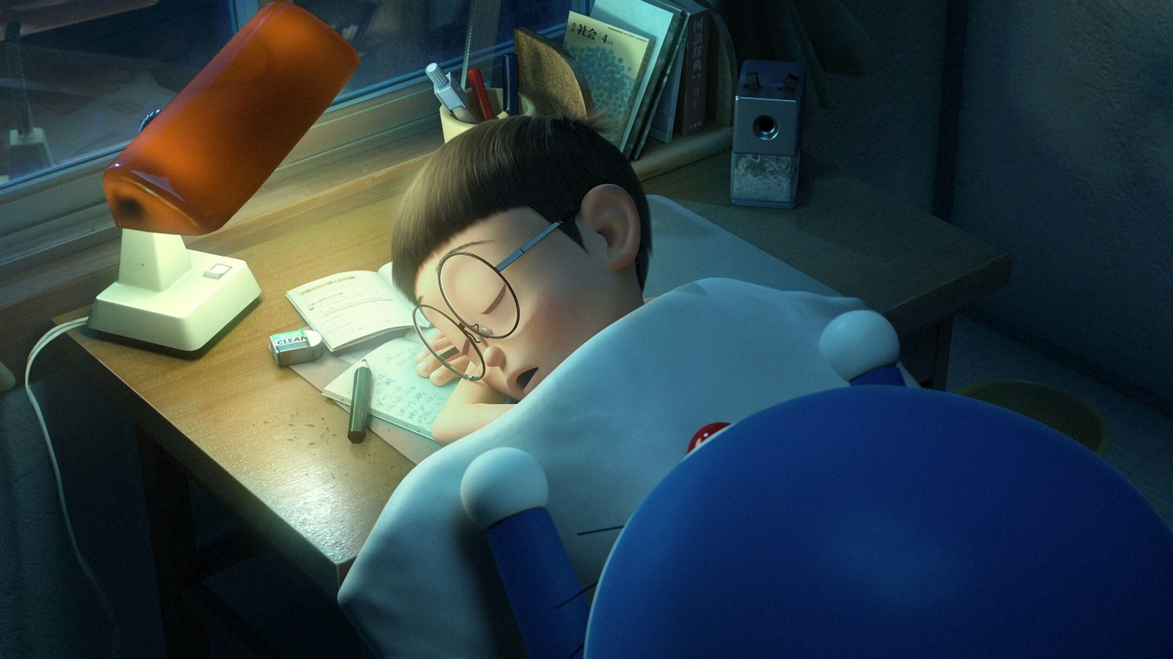
I'm a title.
A designer can use text text to simulate what text will will look look like. If it is not real text.
A designer can use text text to simulate what text will will look look like. If it is not real text. A designer can use text text to simulate what text will will look look like.

Slide 5

Add a subheading here
Subtitle
A designer can use text text to simulate what text will will look look like. If it is not real text.
Subtitle
A designer can use text text to simulate what text will will look look like. If it is not real text.
Subtitle
A designer can use text text to simulate what text will will look look like. If it is not real text.
Subtitle
A designer can use text text to simulate what text will will look look like. If it is not real text.

Slide 6

Add a subheading here
Subtitle
Subtitle
A designer can use text text to simulate what text will will look look like.
A designer can use text text to simulate what text will will look look like.
Subtitle
Subtitle
A designer can use text text to simulate what text will will look look like.
A designer can use text text to simulate what text will will look look like.

Slide 7
Add a subheading here
01
01
01
Keywords
Title
Keywords
Title
Keywords
Title
A designer can use text text to simulate what text will will look like.
A designer can use text text to simulate what text will will look like.
A designer can use text text to simulate what text will will look like.

Slide 8

Add a subheading here
Subtitle
A designer can use text text to simulate what text will will look look like.
Subtitle
Subtitle
A designer can use text text to simulate what text will will look look like.
A designer can use text text to simulate what text will will look look like.
Subtitle
Subtitle
A designer can use text text to simulate what text will will look look like.
A designer can use text text to simulate what text will will look look like.

Slide 9
(PART.2)
Add the title of this chapter here
A designer can use text text to simulate what text will will look look like. A designer can use text text to simulate what text will will look look like.

Slide 10

Add a subheading here
A designer can use text text to simulate what text will will look like. A designer can use text text to simulate what text will will look look like.
Keywords
A designer can use text text to simulate what text will will look like. A designer can use text text to simulate what text will will look look like.
Keywords
A designer can use text text to simulate what text will will look like. A designer can use text text to simulate what text will will look look like.
Keywords

Slide 11
Add a subheading here
10%
A designer can use text text to simulate what text will will look look like. If it is not real text.
25%
A designer can use text text to simulate what text will will look look like. If it is not real text.
72%
A designer can use text text to simulate what text will will look look like. If it is not real text.

Slide 12
Add a subheading here
Subtitle
A designer can use text text to simulate what text will will look look like.
Subtitle
Subtitle
A designer can use text text to simulate what text will will look look like.
A designer can use text text to simulate what text will will look look like.

Slide 13


Add a subheading here
【I'm a title.】
【I'm a title.】
【I'm a title.】
A designer can use text text to simulate what text will will look like.
A designer can use text text to simulate what text will will look look like. If it is not real text.
A designer can use text text to simulate what text will will look look like. If it is not real text.

Slide 14
Add a subheading here
Subtitle
Subtitle
Subtitle
A designer can use text text to simulate what text will will look look like. If it is not real text.
A designer can use text text to simulate what text will will look look like. If it is not real text.
A designer can use text text to simulate what text will will look look like. If it is not real text.

Slide 15
(PART.3)
Add the title of this chapter here
A designer can use text text to simulate what text will will look look like. A designer can use text text to simulate what text will will look look like.

Slide 16
Add a subheading here
01
02
03
04
Keywords1
Keywords1
Keywords1
Keywords1
Title
Title
Title
Title
A designer can use text text to simulate what text will will look like. A designer can use text text to simulate what text will will look look like.
A designer can use text text to simulate what text will will look like. A designer can use text text to simulate what text will will look look like.
A designer can use text text to simulate what text will will look like. A designer can use text text to simulate what text will will look look like.
A designer can use text text to simulate what text will will look like. A designer can use text text to simulate what text will will look look like.

Slide 17

Article Summary
A designer can use text text to simulate what text will will look look like. If it is not real text.
A designer can use text text to simulate what text will will look look like. If it is not real text. A designer can use text text to simulate what text will will look look like. If it is not real text.

Slide 18
Add a subheading here
Subtitle
Subtitle
A designer can use text text to simulate what text will will look look like.
A designer can use text text to simulate what text will will look look like.
Subtitle
Subtitle
A designer can use text text to simulate what text will will look look like.
A designer can use text text to simulate what text will will look look like.

Slide 19
Add a subheading here
Text
Text
Text
Text
A designer can use text text to simulate what text will will look look like.
A designer can use text text to simulate what text will will look look like.
A designer can use text text to simulate what text will will look look like.
A designer can use text text to simulate what text will will look look like.

Slide 20
Add a subheading here
I'm a subheading.
I'm a subheading.
A designer can use text text to simulate what text will will look like. If it is not real text.
A designer can use text text to simulate what text will will look like. If it is not real text.
I'm a subheading.
I'm a subheading.
A designer can use text text to simulate what text will will look like. If it is not real text.
A designer can use text text to simulate what text will will look like. If it is not real text.

Slide 21
(PART.4)
Add the title of this chapter here
A designer can use text text to simulate what text will will look look like. A designer can use text text to simulate what text will will look look like.

Slide 22
Add a subheading here
Subtitle
Subtitle
A designer can use text text to simulate what text will will look look like.
A designer can use text text to simulate what text will will look look like.
Subtitle
Subtitle
A designer can use text text to simulate what text will will look look like.
A designer can use text text to simulate what text will will look look like.
Subtitle
Subtitle
A designer can use text text to simulate what text will will look look like.
A designer can use text text to simulate what text will will look look like.

Slide 23
Add a subheading here
1
2
3
4
Add a subtitle
Add a subtitle
Add a subtitle
Add a subtitle
A designer can use text text to simulate what text will will look look like.
A designer can use text text to simulate what text will will look look like.
A designer can use text text to simulate what text will will look look like.
A designer can use text text to simulate what text will will look look like.

Slide 24

Add a subheading here
Subtitle
A designer can use text text to simulate what text will will look look like. If it is not real text. A designer can use text text to simulate what text will will look look like.
Subtitle
A designer can use text text to simulate what text will will look look like. If it is not real text. A designer can use text text to simulate what text will will look look like.

Slide 25
Add a subheading here
Category
4.5
Summary of this chapter
A designer can use text text to simulate what text will will look look like.
Category
4.5
A designer can use text text to simulate what text will will look look like.
Category
4.5
Category
A designer can use text text to simulate what text will will look look like.
4.5

Slide 26

Add a subheading here
【I'm a title.】
A designer can use text text to simulate what text will will look look like. If it is not real text.

Slide 27
Thank you
A designer can use text text to simulate what text will will look look like. A designer can use text text to simulate what text will will look look like.
Reporting time:2020 Reporter:
https://www.freeppt7.com

