Slide 1
HAPPY EASTER DAY
Here is where your workshop begins!
LOGO
https://www.freeppt7.com

Slide 2
01
FEATURES OF THE TOPIC
02
PRACTICAL EXERCISE
03
THEORY LESSON
04
RECOMMENDATIONS
Here you could describe the topic of the section
Here you could describe the topic of the section
Here you could describe the topic of the section
Here you could describe the topic of the section

Slide 3
INTRODUCTION
Mercury is the closest planet to the Sun and the smallest one in the Solar System—it’s only a bit larger than the Moon. The planet’s name has nothing to do with the liquid metal, since Mercury was named after the Roman messenger god

Slide 4
CONCEPT
VENUS
MERCURY
Venus has a beautiful name and is the second planet from the Sun. It’s terribly hot, even hotter than Mercury
Mercury is the closest planet to the Sun and the smallest one in the Solar System—it’s only a bit larger than the Moon

Slide 5
WHAT IS THIS TOPIC ABOUT?
JUPITER
Jupiter is the biggest planet in the Solar System and the fourth-brightest object in the sky
A.
SATURN
MARS
Neptune is the fourth-largest planet in the Solar System and the farthest one from the Sun
Despite being red, Mars is actually a cold place full of iron oxide dust
C.
B.

Slide 6
FEATURES OF THE TOPIC
VENUS
MERCURY
MARS
JUPITER
Venus has a beautiful name and is the second planet from the Sun
Mercury is the closest planet to the Sun and the smallest one in the Solar System
Despite being red, Mars is actually a cold place full of iron oxide dust
Jupiter is a gas giant and the biggest planet in the Solar System

Slide 7
EXAMPLES
01
02
03
04
Despite being red, Mars is actually a cold place
Jupiter is the biggest planet in the Solar System
Venus is the second planet from the Sun
Neptune is the farthest planet from the Sun

Slide 8
AWESOME WORDS

Slide 9
RECOMMENDED PATTERNS
Despite being red, Mars is actually a cold place
Jupiter is the biggest planet of them all
Mercury is the closest planet to the Sun
Neptune is the farthest planet from the Sun
Venus is the second planet from the Sun
Saturn is composed of hydrogen and helium

Slide 10
02
NAME OF THE SECTION
You could enter a subtitle here if you need it

Slide 11
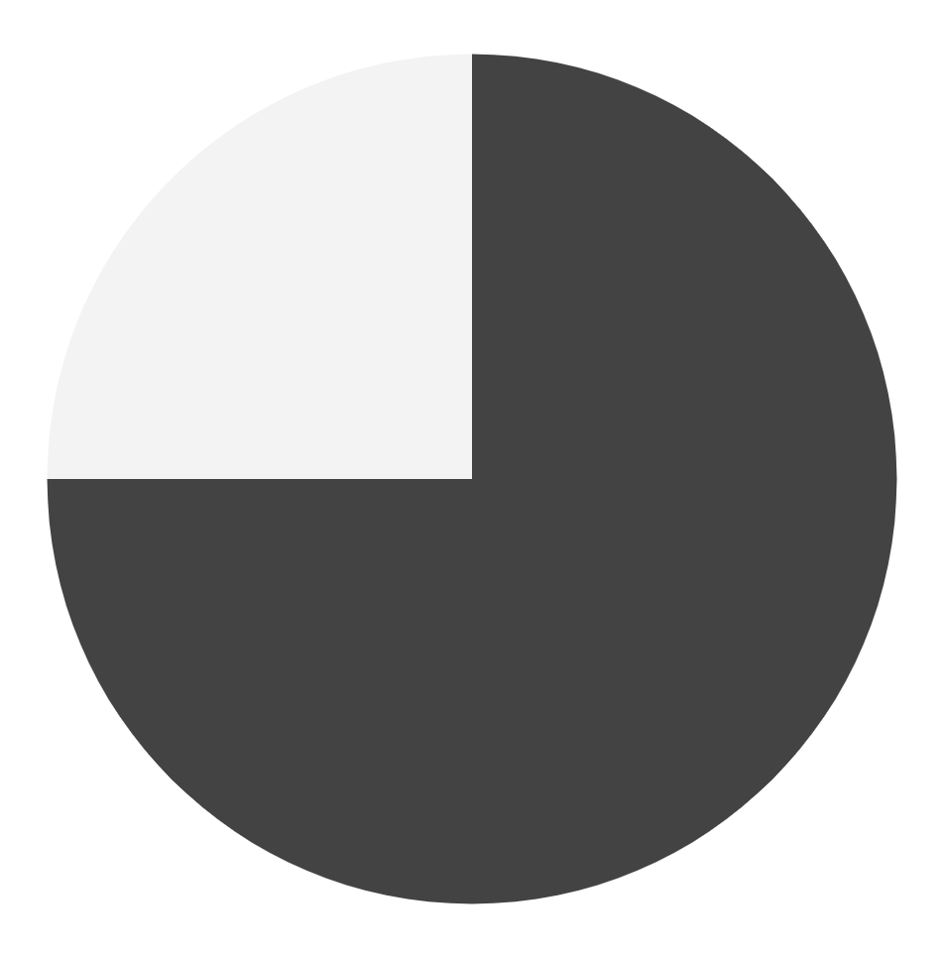
NUMBERS
2018
2019
People that celebrate Easter
People that don’t celebrate Easter
To modify these graphs, click on them, follow the link, change the data...
... and paste the resulting graphs here, replacing these ones. Go ahead and try it!

Slide 12
REQUIRED TOOLS & MATERIALS
(A DOZEN EGGS)
EGGS | COLORS | BRUSHES | SHEETS OF PAPER | CANDY
x 12 | 6 | 4 | 2 | free choice

Slide 13
PRACTICAL EXERCISE
STEP 1
STEP 2
STEP 3
Earth is the planet where we live on
Venus is the second planet from the Sun
Saturn is composed of hydrogen and helium

Slide 14
OUR TEAM
JENNA DOE
ANN WOODS
You can replace the image on the screen with your own
You can replace the image on the screen with your own

Slide 15
35 COUNTRIES
You can edit this text according to your needs

Slide 16
IMPORTANT DATA
75%
25%
Percentage of people who wrap their own gifts
Percentage of people who don’t wrap their own gifts

Slide 17
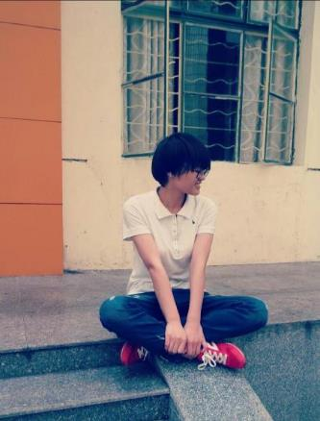
ENTER
YOUR TITLE
ENTER
YOUR TITLE
ENTER
YOUR TITLE
Your text
Enter your text
Please enter your text
Your text
Enter your text
Please enter your text
Your text
Enter your text
Please enter your text

Slide 18
SOCIAL MEDIA
Mercury is the closest planet to the Sun and the smallest one in the Solar System—it’s only a bit larger than the Moon
Venus has a beautiful name and is the second planet from the Sun. It’s terribly hot, even hotter than Mercury

Slide 19
THANKS!
LOGO
https://www.freeppt7.com

