Slide 1
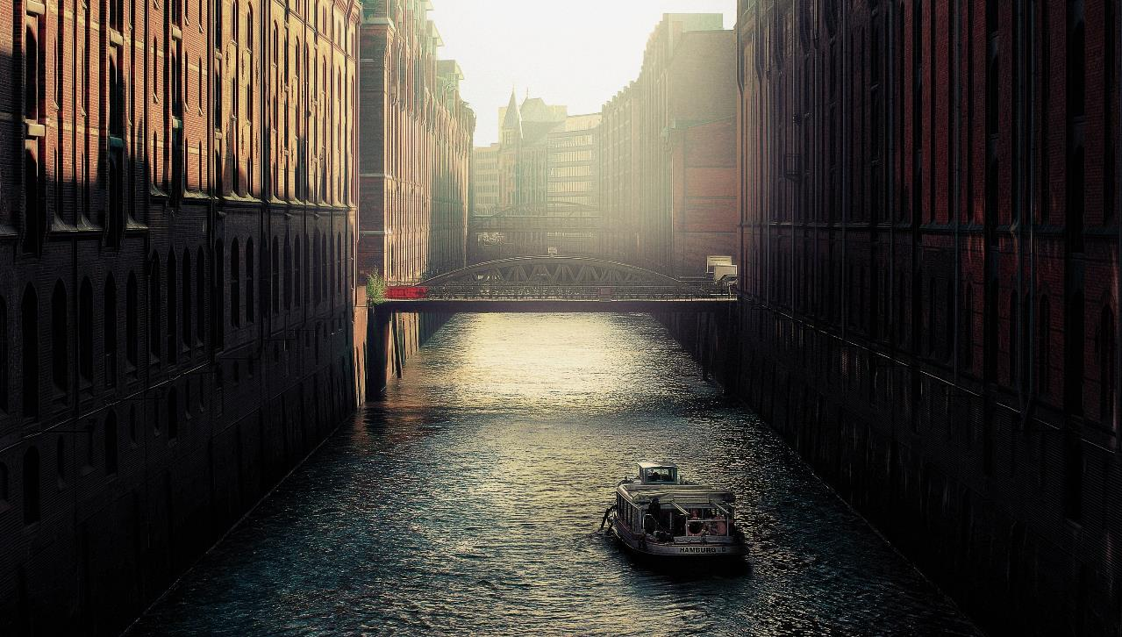
LOGO
BUSINESS
Insert the Subtitle of Your Presentation
https://www.freeppt7.com

Slide 2
About the company
Operating conditions
CONTENT
Performance Review
Development planning
The scenery is exceptionally beautiful.

Slide 3

About the company
Please enter the title of this section
THE Scenery DESIGN
The scenery is exceptionally beautiful.

Slide 4
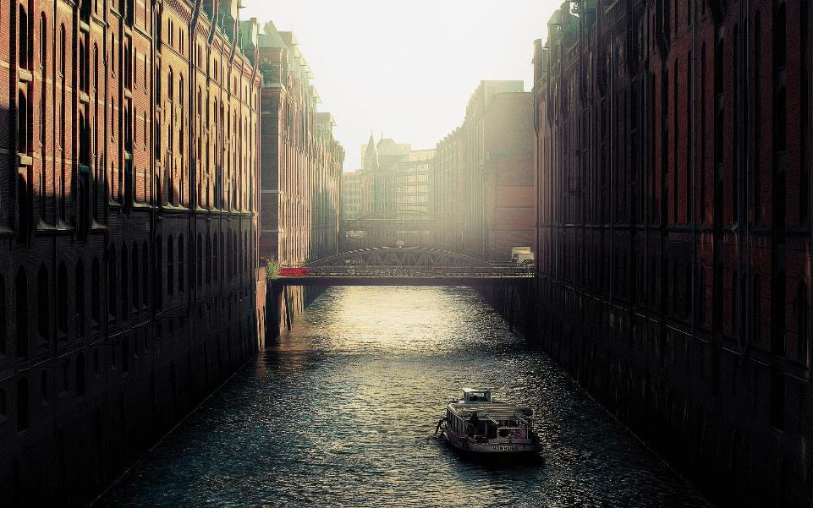
ABOUT
Add a title here
After their unremitting efforts can appreciate the scenery that others can not see, only the courage to pursue, perseverance, such a life is a really good life.
The scenery is exceptionally beautiful.

Slide 5
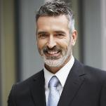
SCENERY and D
S and DESIGN
SCENERY and D
Web Developer
Web Designer
Fonts Designer
TEAM MEMBERS
The scenery is exceptionally beautiful.
The scenery is exceptionally beautiful.
The scenery is exceptionally beautiful.
The scenery is exceptionally beautiful.
The scenery is exceptionally beautiful.
The scenery is exceptionally beautiful.
The scenery is exceptionally beautiful.
The scenery is beautiful.
The scenery is exceptionally beautiful.
After their unremitting efforts can appreciate the scenery that others can not see, only the courage to pursue, perseverance, such a life is a really good life.

Slide 6
Add a title here
After their unremitting efforts can appreciate the scenery that others can not see, only the courage to pursue, perseverance, such a life is a really good life.
Add a title here
Add a title here
Add a title here
After your own unremitting efforts, you can enjoy the scenery that others can't see.
After your own unremitting efforts, you can enjoy the scenery that others can't see.
After your own unremitting efforts, you can enjoy the scenery that others can't see.

Slide 7

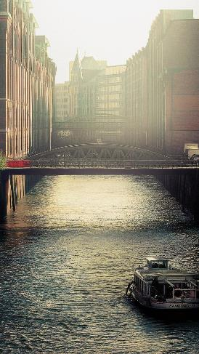
Add a title here
Add a title here
Add a title here
Enter the text here, and the language should be concise.
Enter the text here, and the language should be concise.
Add a title here
Add a title here
Enter the text here, and the language should be concise.
Enter the text here, and the language should be concise.
Add a title here
Add a title here
Enter the text here, and the language should be concise.
Enter the text here, and the language should be concise.

Slide 8
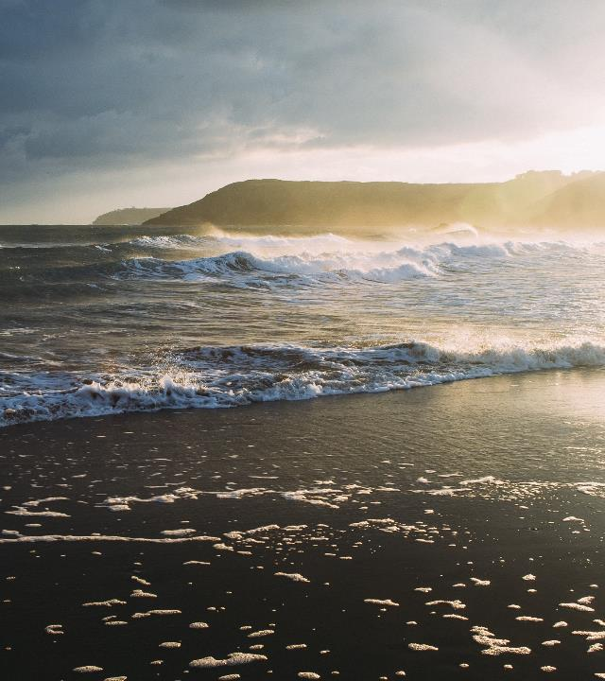
Operating conditions
Please enter the title of this section
THE Scenery DESIGN
The scenery is exceptionally beautiful.

Slide 9

Please enter the title of this section
After their unremitting efforts can appreciate the scenery that others can not see, only the courage to pursue, perseverance, such a life is a really good life. Only the courage to pursue, perseverance, such a life is a really good life
Company address
123-456-7890
E-mailname@GMAIL.COM

Slide 10
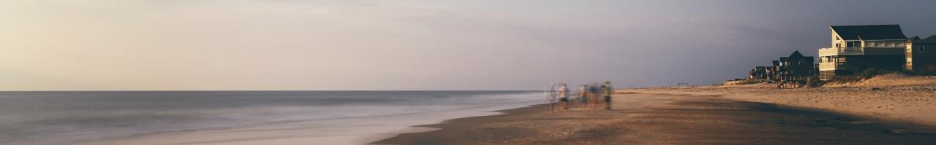
Add a title here
Add a title here
Add a title here
After your own unremitting efforts, you can enjoy the scenery that others can't see.
After your own unremitting efforts, you can enjoy the scenery that others can't see.
After your own unremitting efforts, you can enjoy the scenery that others can't see.
Add a title here
Add a title here
Add a title here
After your own unremitting efforts, you can enjoy the scenery that others can't see.
After your own unremitting efforts, you can enjoy the scenery that others can't see.
After your own unremitting efforts, you can enjoy the scenery that others can't see.

Slide 11
Our business
Beijing
Beijing
Xi'an
Xi'an
Shanghai
Shanghai
The scenery is exceptionally beautiful.

Slide 12
PublicOperating platform
Renren.com
Wechat
Weibo
http://Company's website/

Slide 13

Performance Review
Please enter the title of this section
THE Scenery DESIGN
The scenery is exceptionally beautiful.

Slide 14
Please enter the title of this section
15,562$
185$
650$
2,386$
NO.1
NO .2
NO .3
NO .4
After their unremitting efforts can appreciate the scenery that others can not see, only the courage to pursue, perseverance, such a life is a really good life. After their unremitting efforts can appreciate the scenery that others can not see, only the courage to pursue, perseverance, such a life is a really good life.

Slide 15
Please enter the title of this section
Add a title here
After their unremitting efforts can appreciate the scenery that others can not see, only the courage to pursue, perseverance, such a life is a really good life.
Add a title here
After their unremitting efforts can appreciate the scenery that others can not see, only the courage to pursue, perseverance, such a life is a really good life.
The scenery is exceptionally beautiful.

Slide 16
Add a title here
After their unremitting efforts can appreciate the scenery that others can not see, only the courage to pursue, perseverance, such a life is a really good life only the courage to pursue, perseverance, such a life is a really good life.

Slide 17
100%
80%
60%
2018
2019
2020
Enter the text here, and the language should be concise.
Enter the text here, and the language should be concise.
Enter the text here, and the language should be concise.
Enter the text here, and the language should be concise.
Enter the text here, and the language should be concise.
Enter the text here, and the language should be concise.

Slide 18

Development planning
Please enter the title of this section
THE Scenery DESIGN
The scenery is exceptionally beautiful.

Slide 19
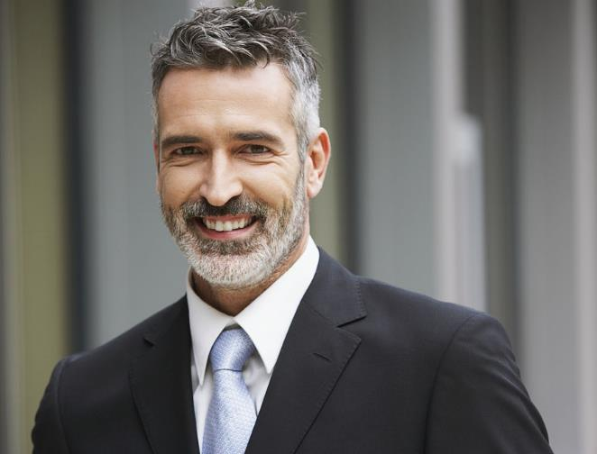
1
Add a title here
Enter the text here, and the language should be concise.
2
Add a title here
Enter the text here, and the language should be concise.
3
Add a title here
Enter the text here, and the language should be concise.

Slide 20
Please enter the title of this section
After their unremitting efforts can appreciate the scenery that others can not see, only the courage to pursue, perseverance, such a life is a really good life.

Slide 21
Please enter the title of this section
2017
2018
Enter the text here, and the language should be concise.
Enter the text here, and the language should be concise.
2019
2020
Enter the text here, and the language should be concise.
Enter the text here, and the language should be concise.
After their unremitting efforts can appreciate the scenery that others can not see, only the courage to pursue, perseverance, such a life is a really good life.

Slide 22
Please enter the title of this section
2012
After their unremitting efforts can appreciate the scenery that others can not see, only the courage to pursue, perseverance, such a life is a really good life.
2013
After their unremitting efforts can appreciate the scenery that others can not see, only the courage to pursue, perseverance, such a life is a really good life.
2014
After their unremitting efforts can appreciate the scenery that others can not see, only the courage to pursue, perseverance, such a life is a really good life.
2015
After their unremitting efforts can appreciate the scenery that others can not see, only the courage to pursue, perseverance, such a life is a really good life.

Slide 23
Thank you
Insert the Subtitle of Your Presentation
https://www.freeppt7.com

