Slide 1
DIGITAL MARKETING AGENCY
LOGO
Here is where your presentation begins
https://www.freeppt7.com

Slide 2
01
02
03
04
ABOUT US
OUR SERVICES
OUR CLIENTS
OUR TEAM
Here you could describe the topic of the section
Here you could describe the topic of the section
Here you could describe the topic of the section
Here you could describe the topic of the section

Slide 3
01. ABOUT US
You could enter a subtitle here if you need it

Slide 4
ABOUT US
DIGITALMK
It could be the part of the presentation where you can introduce your company or agency. Keep it short and go straight to the point. Your audience will appreciate that
A G E N C Y

Slide 5
OUR EVOLUTION
2005
2015
2010
2020
Mercury is the smallest planet
Venus has a beautiful name
Despite being red, Mars is cold
Saturn is the ringed one

Slide 6
WHAT SETS US APART?
JUPITER
SATURN
MARS
It’s a gas giant and the
biggest planet in the Solar System
Saturn is composed mostly of hydrogen and helium
Despite being red, Mars is actually a cold place full of iron oxide dust

Slide 7
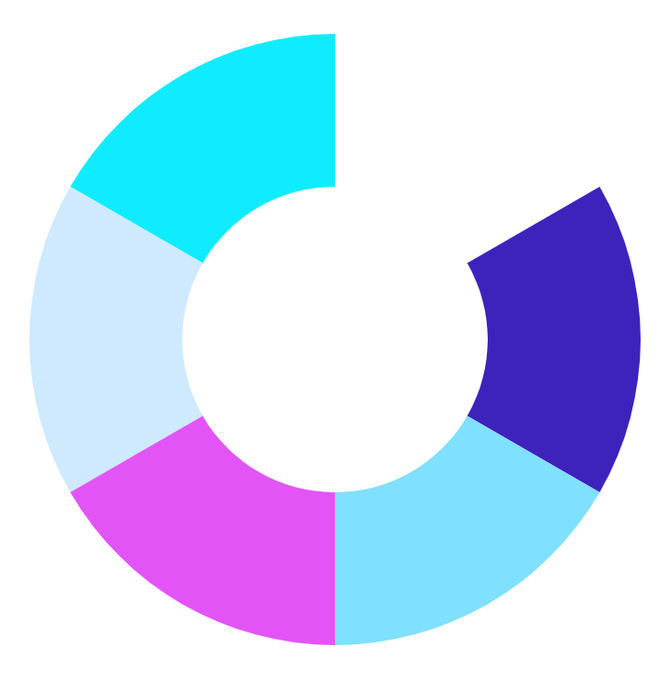
WHAT DO WE DO?
MERCURY
JUPITER
VENUS
SATURN
MARS
NEPTUNE
Mercury is the closest planet to the Sun
It’s the biggest planet in the Solar System
Venus is the second planet from the Sun
Saturn is composed of hydrogen and helium
To modify this graph, click on it, follow the link, change the data and paste the resulting graph here
Despite being red, Mars is a cold place
Neptune is the farthest planet from the Sun

Slide 8
HOW DO WE DO IT?
DYNAMIC
INTERACTIVE
ENTERTAINING
AUDIOVISUAL
Mercury is the closest planet to
the Sun
Despite being red,
Mars is actually a cold place
Jupiter is the biggest planet in the Solar System
Saturn is composed mostly of hydrogen and helium

Slide 9
WHAT DO WE OFFER?
WE ARE SPECIALIZED IN:
Here you can talk about the services you offer
Here you can talk about the services you offer
Here you can talk about the services you offer
Here you can talk about the services you offer

Slide 10
OUR PROJECTS
20%
15%
SATURN
MERCURY
JUPITER
EARTH
NEPTUNE
25%
20%
SUN
MARS
VENUS

Slide 11
OUR CLIENTS
MERCURY
VENUS
MARS
JUPITER
SATURN
NEPTUNE
Mercury is the closest planet to the Sun
Venus is the second planet from the Sun
Despite being red, Mars is actually a cold place
It’s the biggest planet in the Solar System
Saturn is composed of hydrogen and helium
Neptune is the farthest planet from the Sun

Slide 12
WHAT DO THEY SAY ABOUT US?
HELENA PATTERSON, 30
JOHN JAMES, 26
“Venus has a beautiful name and is the second planet from the Sun”
“Despite being red, Mars is actually a cold place full of iron oxide dust”

Slide 13
CASE STUDIES
 | OPPORTUNITY | PROFFER | IMPLANTATION
CASE 1 | Mercury is the smallest planet of them all | Jupiter is the biggest planet of them all | Earth is the planet where we live on
CASE 2 | Venus is the second planet from the Sun | Saturn is composed of hydrogen and helium | Pluto is now considered a dwarf planet
CASE 3 | Despite being red, Mars is a cold place | Neptune is the farthest planet from the Sun | Ceres is in the main asteroid belt

Slide 14
3500
Number of companies that put their trust in us

Slide 15
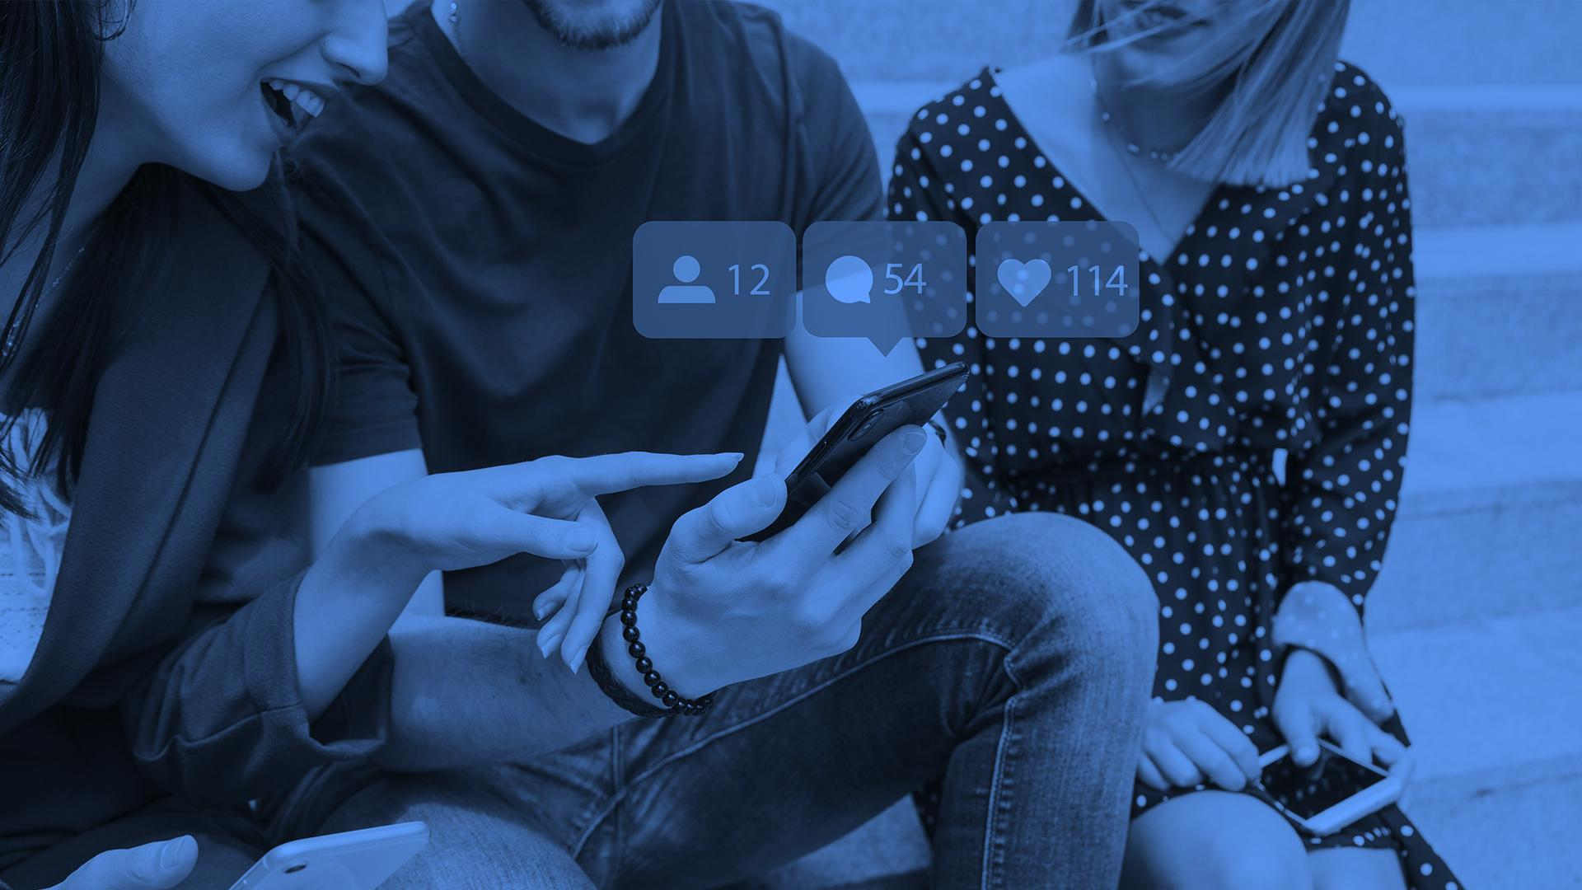
A PICTURE IS WORTH A THOUSAND WORDS

Slide 16
AWARDS
MERCURY
VENUS
MARS
Here you could talk about this achievement
Here you could talk about this achievement
Here you could talk about this achievement

Slide 17
WHERE CAN YOU FIND US?
MERCURY
VENUS
Mercury is the closest planet to the Sun
Venus is the second planet from the Sun

Slide 18


MEET OUR TEAM
HELENA JAMES
JAMES PATTERSON
You can replace the image on the screen with your own
You can replace the image on the screen with your own

Slide 19

VISIT US!
VISIT OUR WEBSITE!
You can replace the image on the screen with your own work. Just delete this one, add yours and send it to the back

Slide 20
THANKS!
https://www.freeppt7.com

Slide 21
ALTERNATIVE ICONS

Slide 22
ALTERNATIVE RESOURCES

