Slide 1
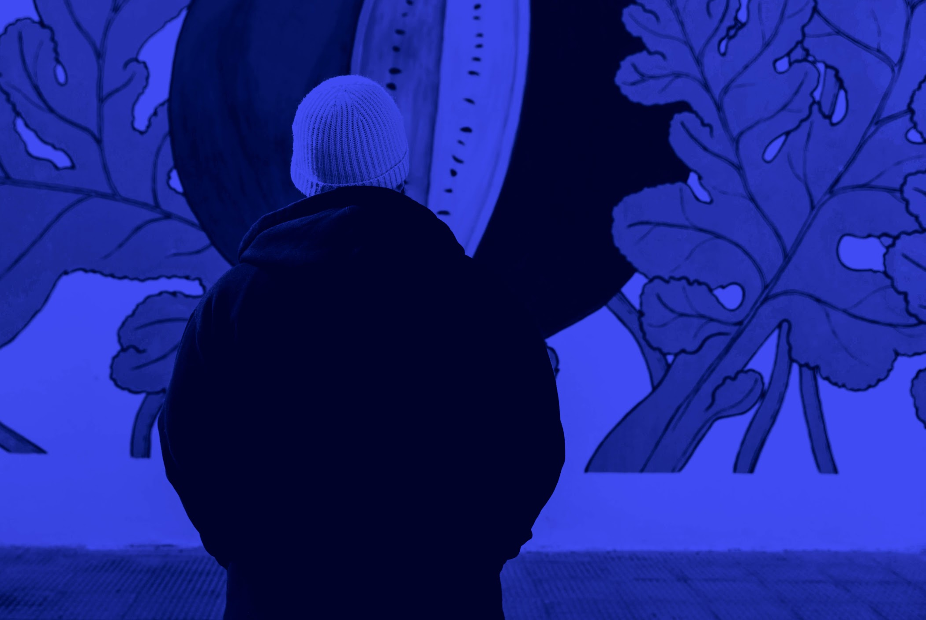
GRAPHIC DESIGN LESSON
LOGO
Here is where your presentation begins
https://www.freeppt7.com

Slide 2
TABLE OF CONTENTS
01
OVERVIEW
03
ASSIGNMENT
02
FEATURES OF THE TOPIC
04
ABOUT THE TOPIC

Slide 3
INTRODUCTION
Venus has a beautiful name and is the second planet from the Sun. It’s terribly hot—even hotter than Mercury—and its atmosphere is extremely poisonous

Slide 4
WHAT YOU WILL LEARN
Here you could give a brief description about one of the topics
Here you could give a brief description about one of the topics
Here you could give a brief description about one of the topics

Slide 5
DEFINITION OF CONCEPTS
MERCURY
VENUS
MARS
Aa
Aa
Aa
Mercury is the closest planet to the Sun
Venus is the second planet from the Sun
Despite being red, Mars is actually a cold place

Slide 6
FEATURES OF THE TOPIC
MERCURY
VENUS
MARS
JUPITER
SATURN
NEPTUNE
Mercury is the closest planet to the Sun
Venus is the second planet from the Sun
Despite being red, Mars is a cold place
It’s the biggest planet in the Solar System
It’s composed of hydrogen and helium
It’s the farthest planet from the Sun

Slide 7
PRACTICAL USES OF THIS SUBJECT
MARS
Despite being red, Mars is a cold place
VENUS
Venus is the second planet from the Sun
MERCURY
Mercury is the closest planet to the Sun

Slide 8
SECTION
01
You could enter a subtitle here if you need it

Slide 9
—SOMEONE FAMOUS
“This is a quote. Words full of wisdom that someone important said and can make the reader get inspired.”

Slide 10
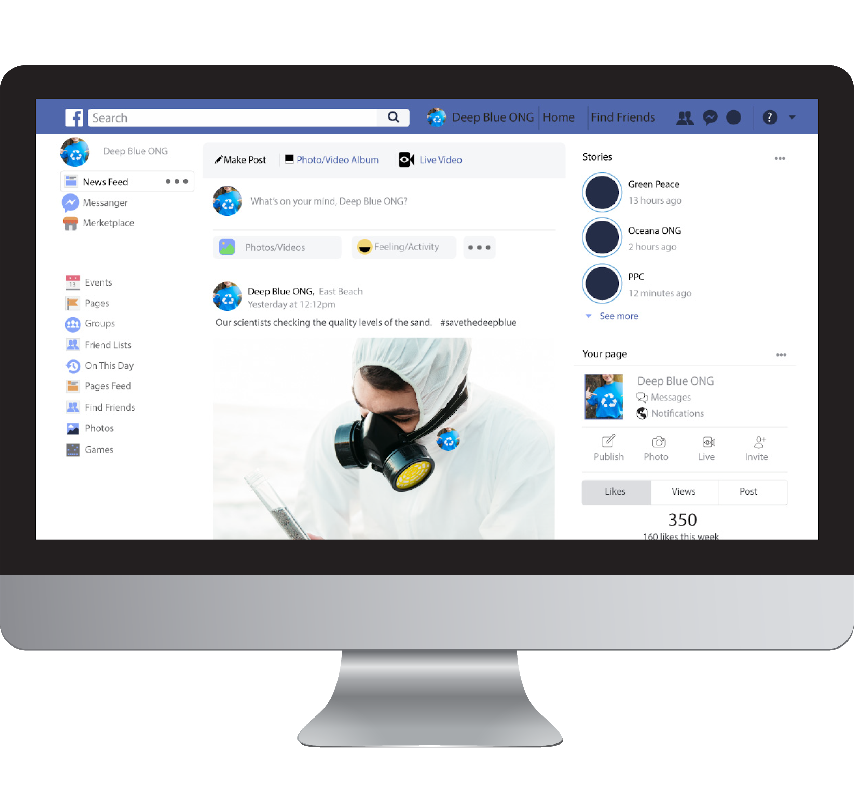
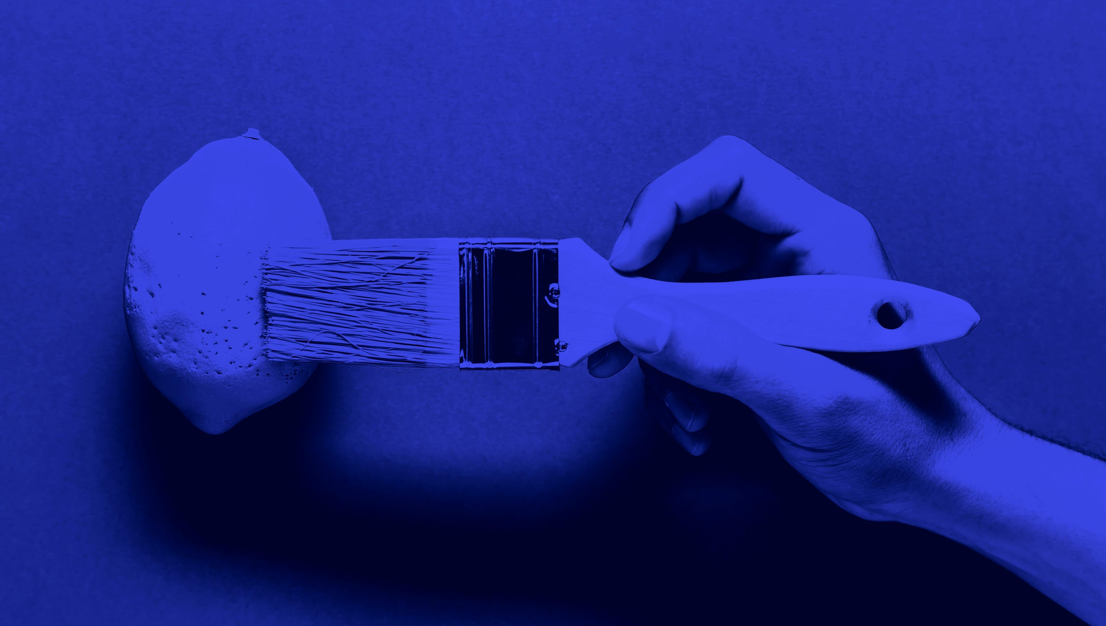
MULTIMEDIA
01
MERCURY
Mercury is the closest planet to the Sun
02
MARS
Despite being red, Mars is actually a cold place

Slide 11
333,000.00
24h 37m 23s
earths is the Sun’s mass
is Jupiter’s rotation period

Slide 12
PROCESS
MERCURY
It’s the closest planet to the Sun
01
VENUS
02
It’s the second planet from the Sun
MARS
Despite being red, Mars is a cold place
03
JUPITER
04
It’s composed of hydrogen and helium

Slide 13
A PICTURE IS WORTH A THOUSAND WORDS

Slide 14
DID YOU KNOW THIS?
MERCURY
VENUS
01
03
SATURN
NEPTUNE
02
04
Mercury is the closest planet to the Sun
Venus is the second planet from the Sun
Saturn is composed mostly of hydrogen and helium
Neptune is the farthest planet from the Sun

Slide 15
Mercury is the closest planet to the Sun
SOLUTION
PROBLEM
Venus is the second planet from the Sun

Slide 16
AWESOME WORDS

Slide 17
THIS IS A MAP
You can type relevant information here

Slide 18
THIS IS A GRAPH
20%
VENUS
Venus is the second planet from the Sun
50%
MARS
30%
Despite being red, Mars is a cold place
MERCURY
Mercury is the closest planet to the Sun
To modify this graph, click on it, follow the link, change the data and paste the new graph here

Slide 19
THIS IS A TABLE
 | Cyan | Magenta | Yellow | Black | Hex Code
MERCURY | 0 | 100 | 100 | 6 | #EF00D1
VENUS | 0 | 87 | 100 | 3 | #F72093
MARS | 0 | 75 | 100 | 0 | #FF4055

Slide 20
OVERVIEW DIAGRAM
BASE COLOR
It’s composed of hydrogen and helium
Add blue
Add red
COOL SHADE
WARM SHADE
Neptune is the farthest planet from the Sun
It’s the biggest planet in the Solar System

Slide 21
EXERCISE
Despite being red, Mars is actually a cold place. It’s full of iron oxide dust, which gives the planet its reddish cast

Slide 22
ASSIGNMENT
LET’S DESIGN!
Jupiter is a gas giant, the biggest planet in the Solar System and the fourth-brightest object in the sky

Slide 23
THANKS!
https://www.freeppt7.com

