Slide 1
SPRING SEASON
Here is where your presentation begins

Slide 2
INTRODUCTION
ANALYSIS
PRESENTATION
CONCLUSION
Here you could describe the topic of the section
Here you could describe the topic of the section
Here you could describe the topic of the section
Here you could describe the topic of the section

Slide 3
—SOMEONE FAMOUS
“This is a quote. Words full of wisdom that someone important said and can make the reader get inspired.”

Slide 4
THE SLIDE TITLE GOES HERE!
Do you know what helps you make your point clear? Lists like this one:
They’re simple
You can organize your ideas clearly
You’ll never forget to buy milk!
And the most important thing: the audience won’t miss the point of your presentation

Slide 5
WHOA!
Here you could give a brief description of the topic you want to talk about. For example, if you want to talk about Mercury, you could say that it’s the closest planet to the Sun and the smallest one in the Solar System

Slide 6
01
NAME OF THE SECTION
You could enter a subtitle here if you need it

Slide 7
YOU COULD USE THREE COLUMNS, WHY NOT?
VENUS
Venus has a beautiful name and is the second planet from the Sun
MERCURY
MARS
Mercury is the closest planet to the Sun and the smallest one
Despite being red, Mars is actually a cold place. It’s full of iron oxide dust

Slide 8
MAYBE YOU NEED TO DIVIDE THE TEXT
MERCURY
VENUS
It’s the closest planet to the Sun and the smallest one in the Solar System—it’s only a bit larger than the Moon
Venus has a beautiful name and is the second planet from the Sun. It’s terribly hot, even hotter than Mercury

Slide 9
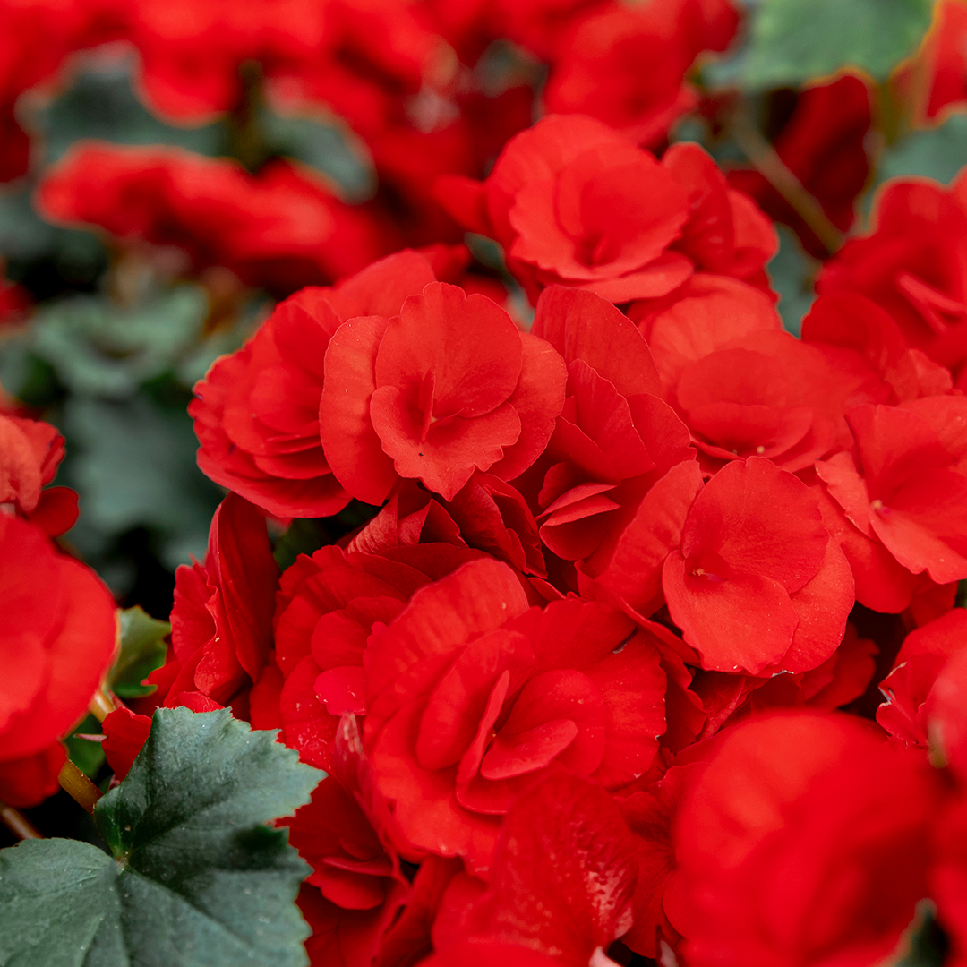
A PICTURE ALWAYS REINFORCES THE CONCEPT
To replace this picture in Google Slides, select it, right-click and choose Replace image > Upload from computer. Open the file that you want and then adjust it if needed. In PowerPoint, select the picture, right-click and choose Change Picture. Open the file and adjust it

Slide 10
02
NAME OF THE SECTION
You could enter a subtitle here if you need it

Slide 11
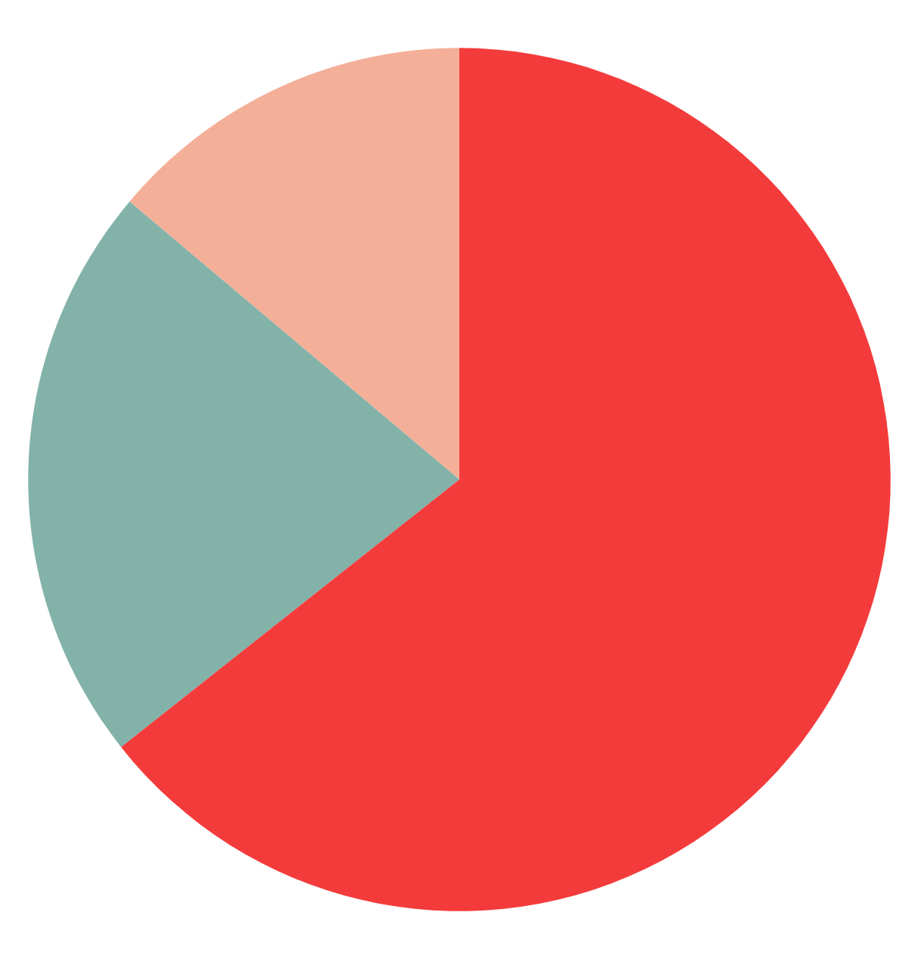
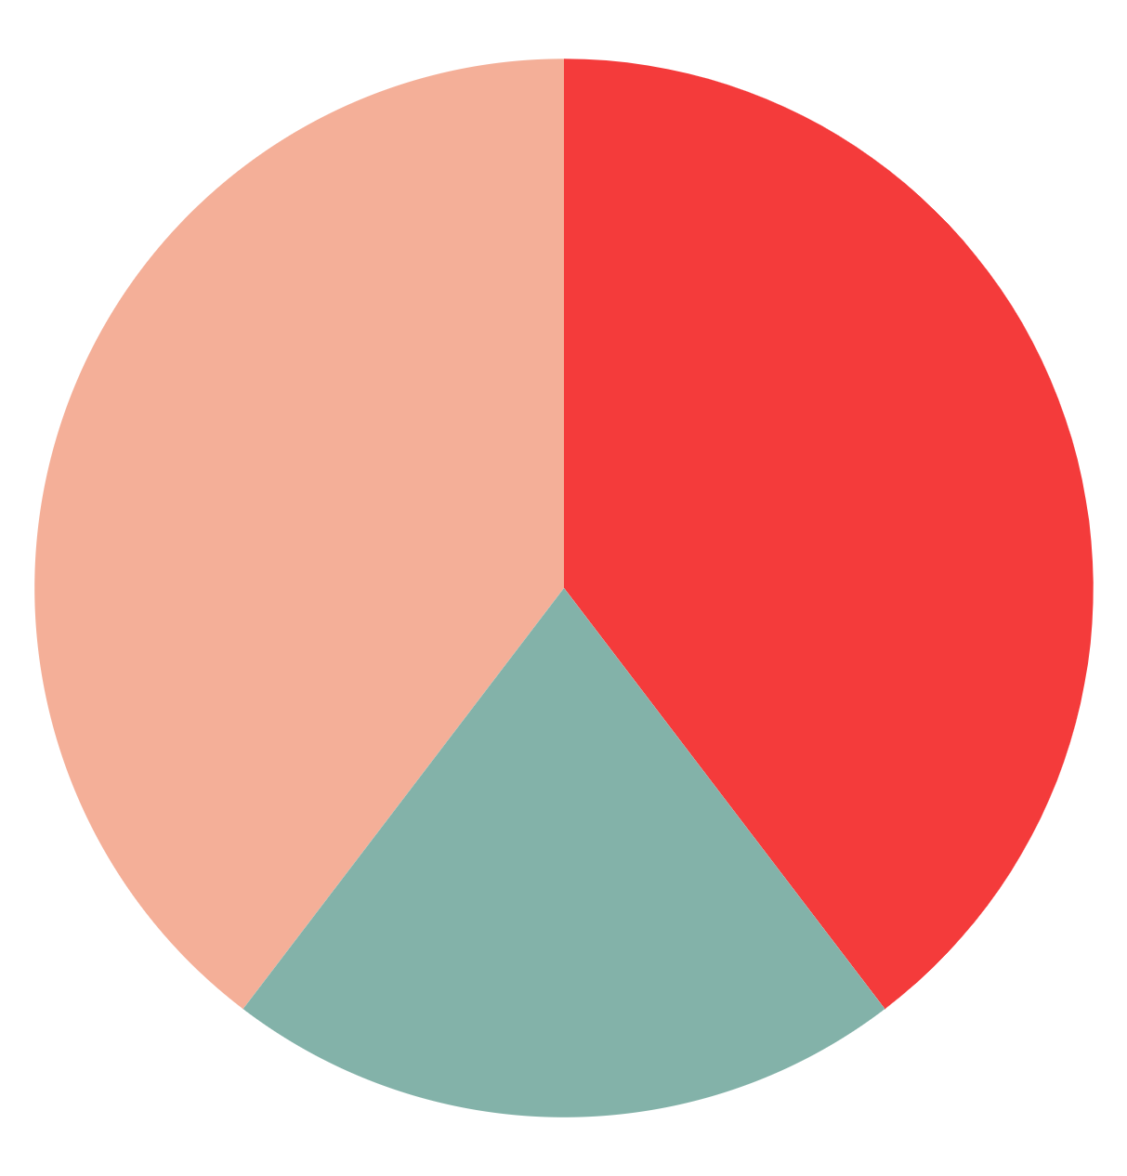
TO MODIFY THESE GRAPHS, CLICK ON THEM, FOLLOW THE LINK, CHANGE THE DATA AND PASTE THE RESULTING GRAPHS HERE
Mercury
Venus
Jupiter
2010
2020

Slide 12
A PICTURE IS WORTH A THOUSAND WORDS

Slide 13
SOMETIMES, REVIEWING CONCEPTS IS A GOOD IDEA
A.
B.
C.
Despite being red, Mars is actually a cold place
Mercury is the closest planet to the Sun
Saturn is composed of hydrogen and helium
D.
E.
F.
Venus has a beautiful name, but it’s very hot
Neptune is the farthest planet from the Sun
Jupiter is the biggest one in the Solar System

Slide 14
A TIMELINE ALWAYS WORKS WELL
01
02
03
Despite being red, Mars is actually a cold place
Neptune is the farthest planet from the Sun
Mercury is the closest planet to the Sun and the smallest one

Slide 15
AWESOME WORDS

Slide 16
THIS IS A GRAPH
01
02
Despite being red, Mars is actually a cold place
Venus is the second planet from the Sun
03
04
Jupiter is the biggest planet in the Solar System
Mercury is the smallest planet in the Solar System

Slide 17
… AND THE SAME GOES FOR TABLES
 | 2010 | 2015 | 2020
MERCURY | 3,000,000 | 4,000,000 | 5,000,000
VENUS | 1,500,000 | 2,000,000 | 2,500,000

Slide 18
HOW ABOUT THESE PERCENTAGES?
65%
Venus is the second planet from the Sun
70%
Mercury is the smallest planet in the Solar System
85%
Despite being red, Mars is actually a cold place

Slide 19
44,000,000
Mercury is the closest planet to the Sun and the smallest of them all

Slide 20
DON’T FORGET WHAT’S IMPORTANT
Write your recommendations here
Write your recommendations here
Write your recommendations here
Write your recommendations here
Write your recommendations here
Write your recommendations here
Write your recommendations here

Slide 21
03
NAME OF THE SECTION
You could enter a subtitle here if you need it

Slide 22
PERHAPS YOU COULD USE A MAP!
50,000
650,000
Despite being red, Mars is actually a cold place
Venus has a beautiful name, but it’s very hot

Slide 23
OUR SERVICES
$0
$35
You can explain here your product or your service
Characteristic
Characteristic
You can explain here your product or your service
Characteristic
Characteristic
FREE
PREMIUM

Slide 24
SOCIAL MEDIA
DESKTOP SOFTWARE
You can replace the image on the screen with your own work. Just delete this one, add yours and send it to the back

Slide 25
SOCIAL MEDIA
TABLET APP
You can replace the image on the screen with your own work. Just delete this one, add yours and send it to the back

Slide 26
SOCIAL MEDIA
MOBILE WEB
You can replace the image on the screen with your own work. Just delete this one, add yours and send it to the back

Slide 27
OUR TEAM
MARGARITA DOE, 32
VERA PATTERSON, 56
You can replace the image on the screen with your own
You can replace the image on the screen with your own

Slide 28
THANKS!

Slide 29
ALTERNATIVE RESOURCES

