Slide 1
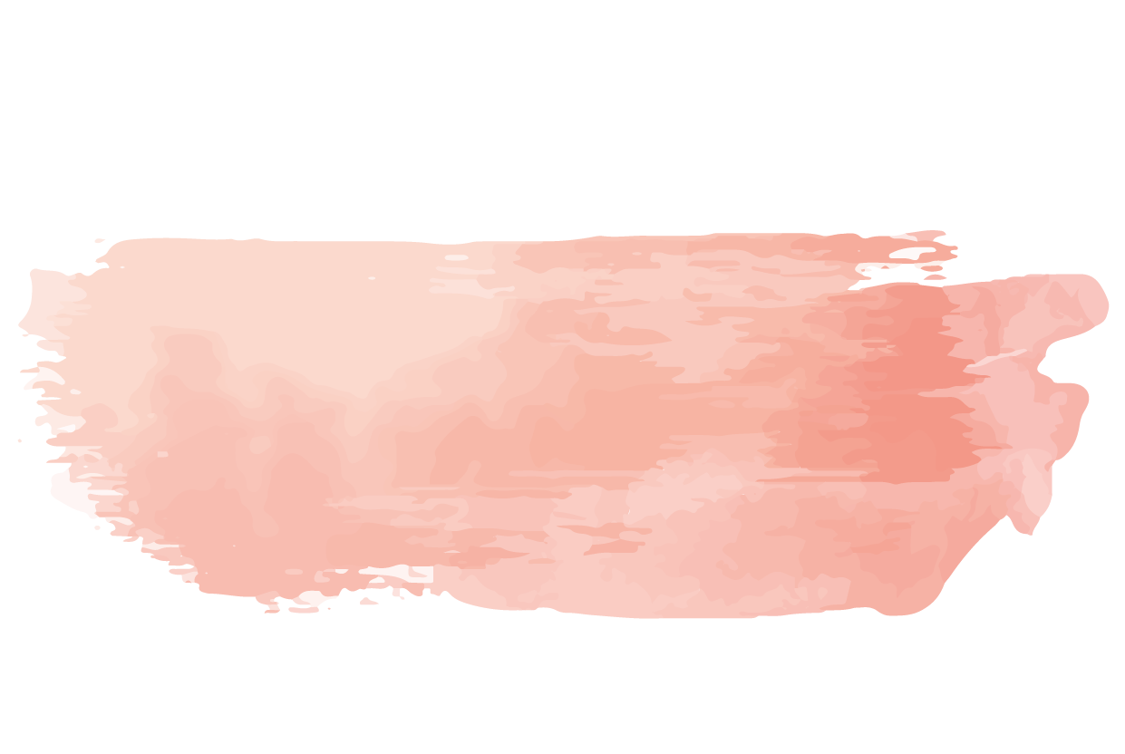
Floral Wedding
LOGO
Here is where your presentation begins
https://www.freeppt7.com

Slide 2
Whoa!
It could be the part of the presentation where you can introduce yourself, write your email...

Slide 3
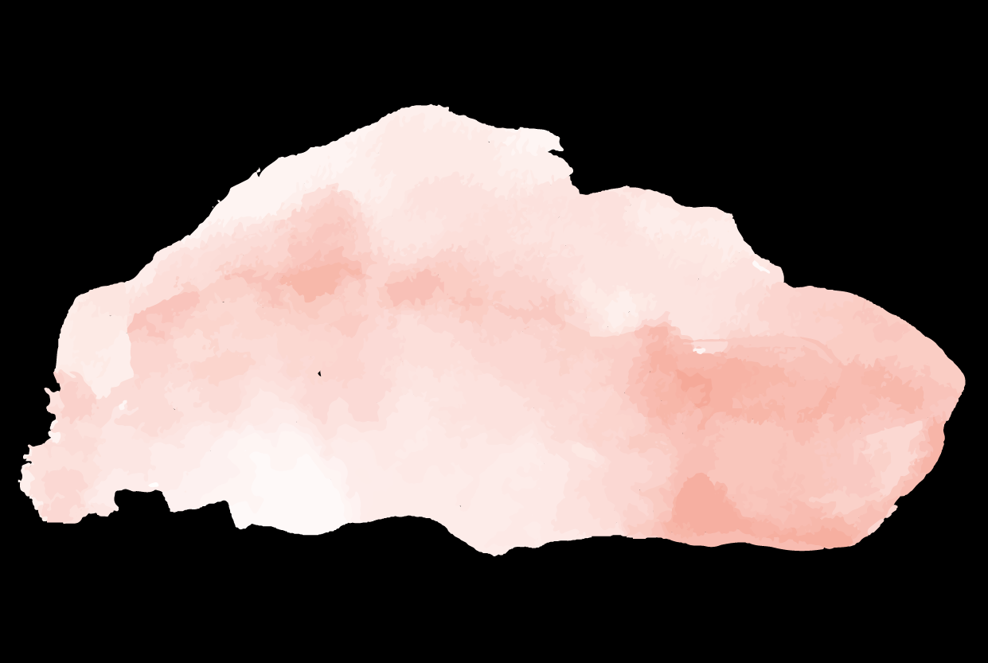
“This is a quote. Words full of wisdom that someone important said and can make the reader get inspired.”
—Someone famous

Slide 4
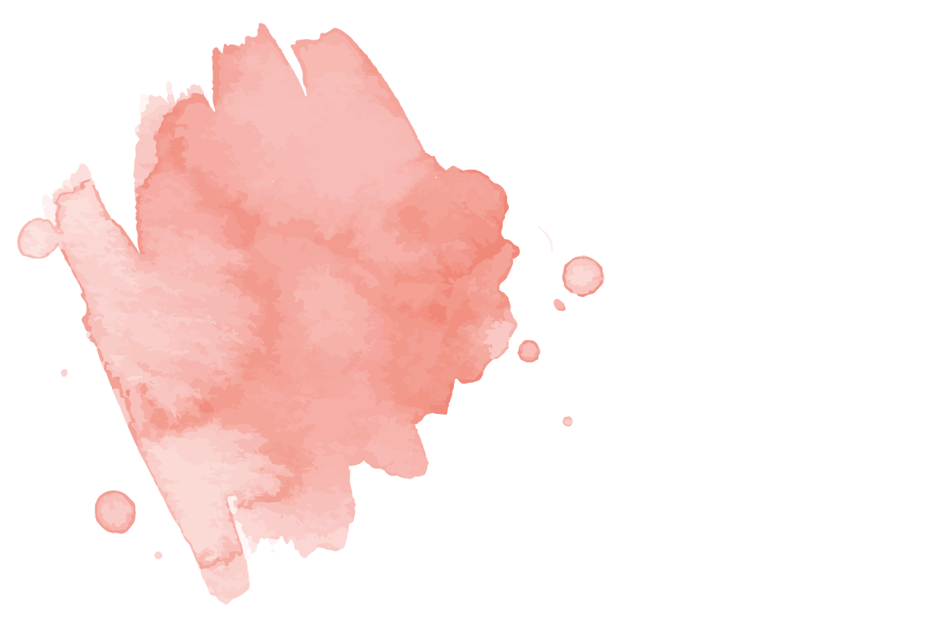
01
02
About us
Services
03
04
Organization
Design
Here you could describe the topic of the section
Here you could describe the topic of the section
Here you could describe the topic of the section
Here you could describe the topic of the section

Slide 5
01
About us
This is the subtitle that makes it comprehensible

Slide 6
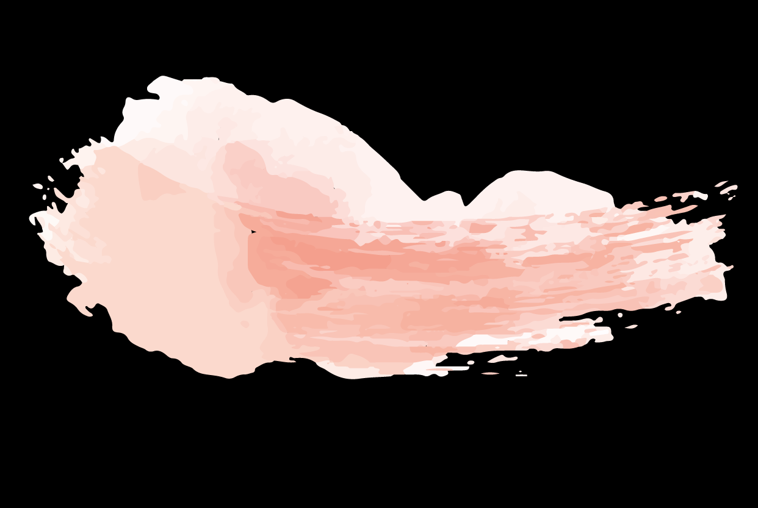
The slide title goes here!
Do you know what helps you make your point clear? Lists like this:
Because they’re simple
You can organize your ideas clearly
And because you’ll never forget to buy milk!
And the most important thing: the audience won’t miss the point of your presentation

Slide 7
This is a great
headline
This is the subtitle that makes it comprehensible

Slide 8
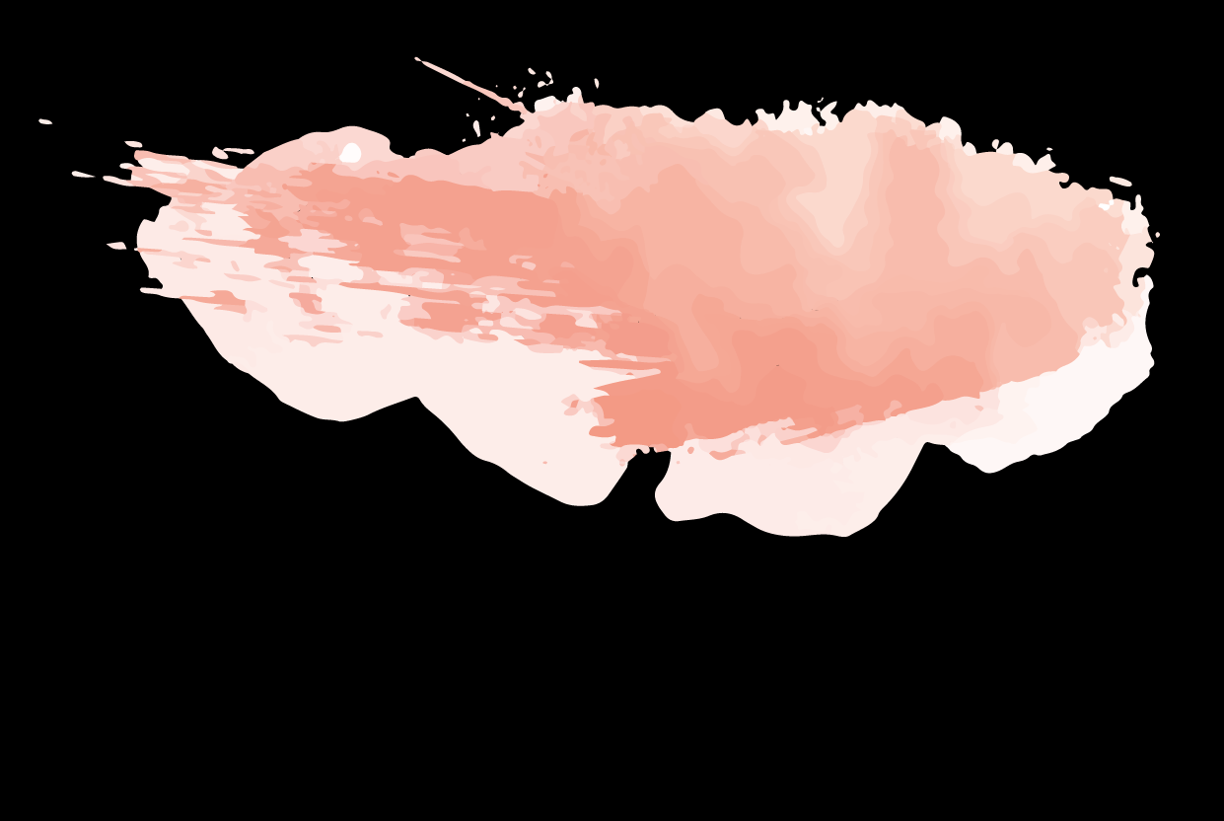
Awesome Words
Because key words are great for
catching your audience’s attention

Slide 9
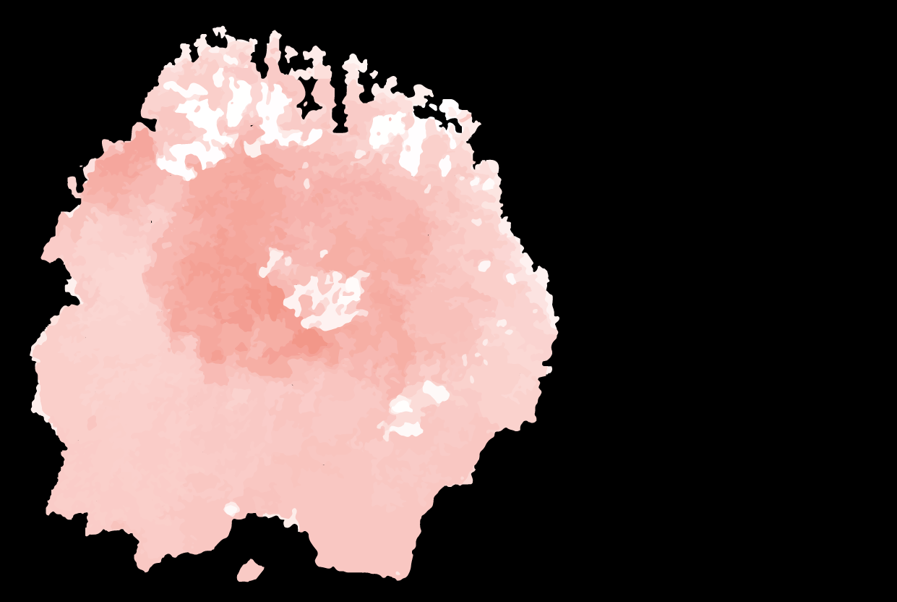
02
Services
This is the subtitle that makes it comprehensible

Slide 10
Our services
Basic
Medium
Premium
Mercury is the closest planet to the Sun and the smallest one in the Solar System—it’s only a bit larger than our Moon
Jupiter is a gas giant and the biggest planet in our Solar System. It’s the fourth-brightest object in the sky
Despite being red, Mars is a cold place, not hot. It’s full of iron oxide dust, which gives the planet its reddish cast

Slide 11
Sometimes, reviewing concepts is a good idea
Ceremony
Video
Decoration
Honeymoon
Catering
Entertainment

Slide 12
Maybe you need to divide the content
Mercury
Venus
Mercury is the closest planet to the Sun and the smallest one in the Solar System—it’s only a bit larger than our Moon. The planet’s name has nothing to do with the liquid metal since it was named after the Roman messenger god, Mercury.
Venus has a beautiful name and is the second planet from the Sun. It’s terribly hot—even hotter than Mercury—and its atmosphere is extremely poisonous. It’s the second-brightest natural object in the night sky after the Moon

Slide 13
You could use three columns, why not?
Mars
Venus
Saturn
Despite being red, Mars is a cold place, not hot. It’s full of iron oxide dust, which gives the planet its reddish cast
Venus has a beautiful name and is the second planet from the Sun. It’s terribly hot, even hotter than Mercury
Yes, this is the ringed one. It’s a gas giant, composed mostly of hydrogen and helium

Slide 14
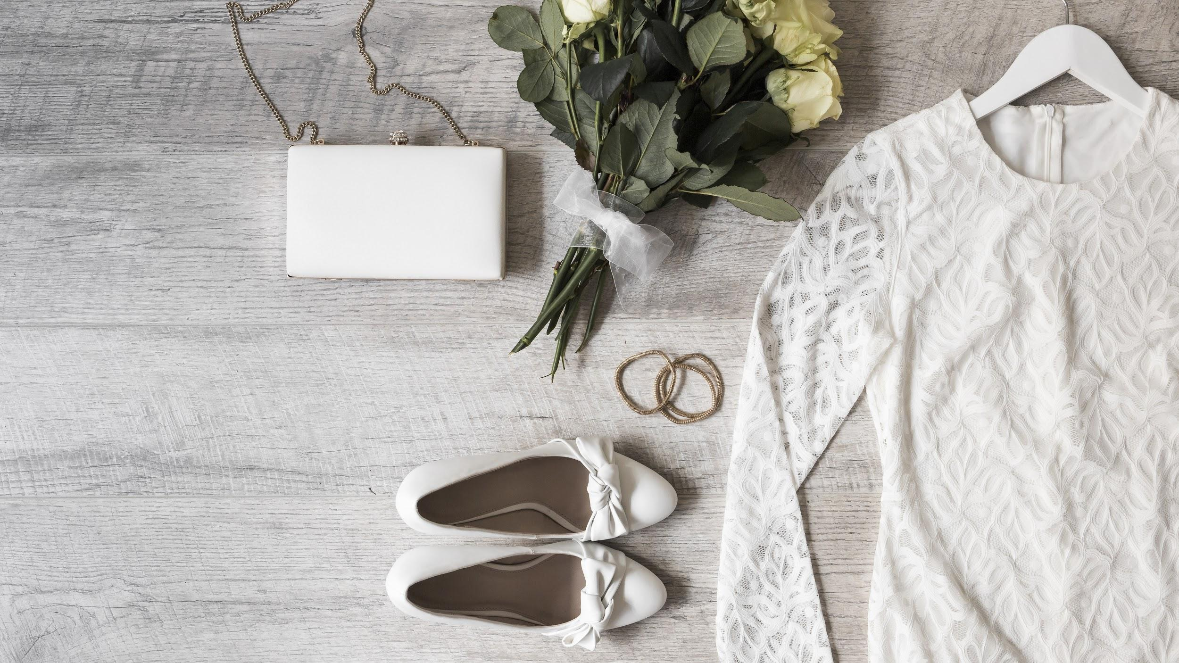
A picture always reinforces the concept
Images reveal large amounts of data, so remember: use an image instead of long texts

Slide 15
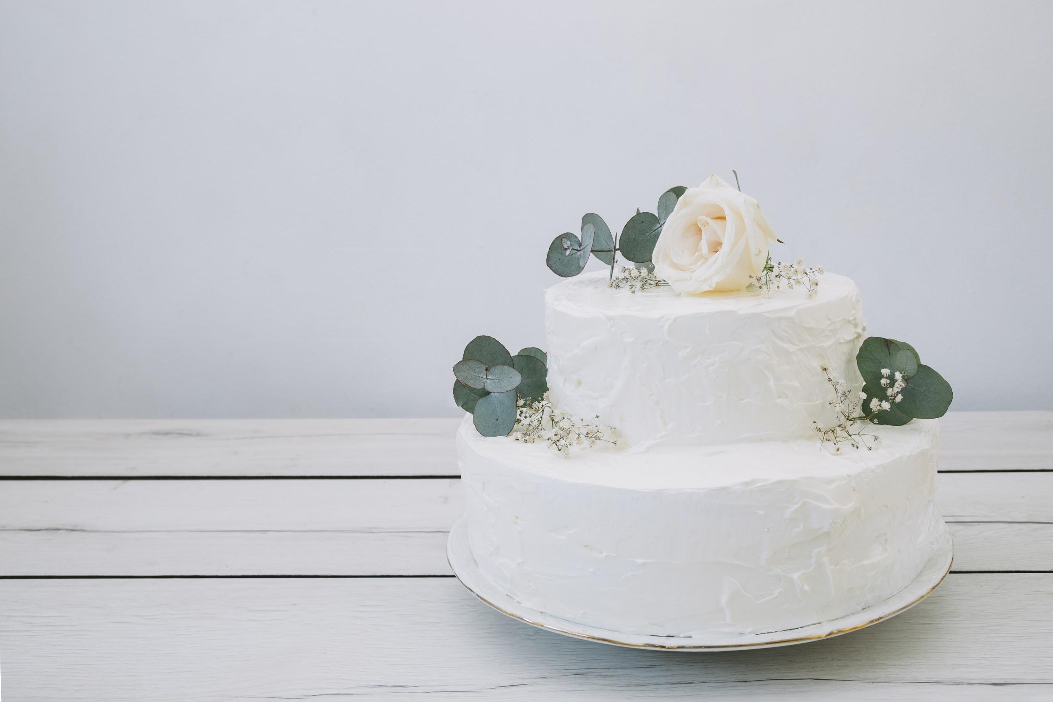
A picture is worth a thousand words

Slide 16
Option 1
Option 2
Starters
Salt & Pepper Squid
Mercury is the closest planet to the Sun and the smallest one in the Solar
Vegetarian Tart
Venus has a beautiful name, but it’s terribly hot, even hotter than Mercury
Mains
Crispy Salmon
Jupiter is a gas giant and the biggest planet in our Solar System
Vegetarian Ravioli
Saturn is the ringed one. It’s a gas giant, composed mostly of hydrogen and helium
Desserts
Despite being red, Mars is a cold place, not hot. It’s full of iron oxide dust
Starters
Salt & Pepper Squid
Mercury is the closest planet to the Sun and the smallest one in the Solar
Vegetarian Tart
Venus has a beautiful name, but it’s terribly hot, even hotter than Mercury
Mains
Crispy Salmon
Jupiter is a gas giant and the biggest planet in our Solar System
Vegetarian Ravioli
Saturn is the ringed one. It’s a gas giant, composed mostly of hydrogen and helium
Desserts
Despite being red, Mars is a cold place, not hot. It’s full of iron oxide dust

Slide 17
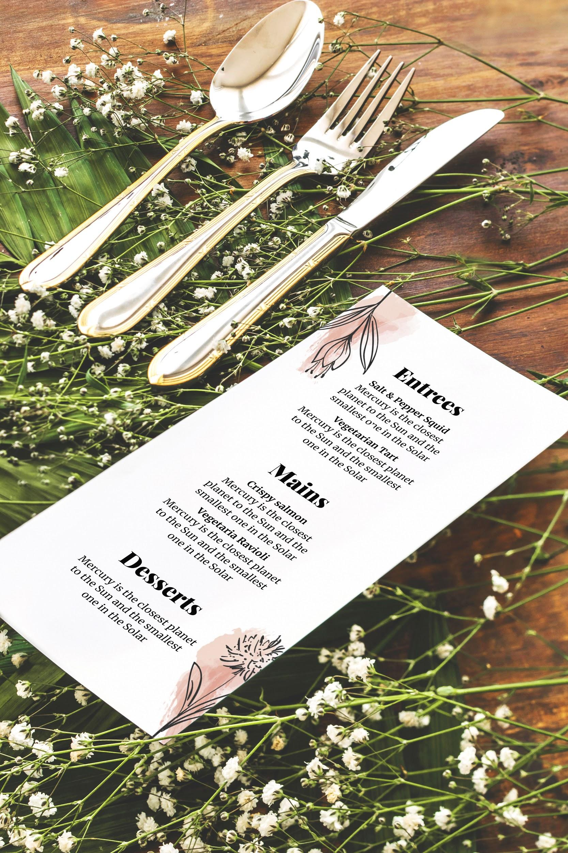
Our choice!
Describe here what you would recommend to the attendees

Slide 18
03
Organization
This is the subtitle that makes it comprehensible

Slide 19
This is a map
The honeymoon

Slide 20
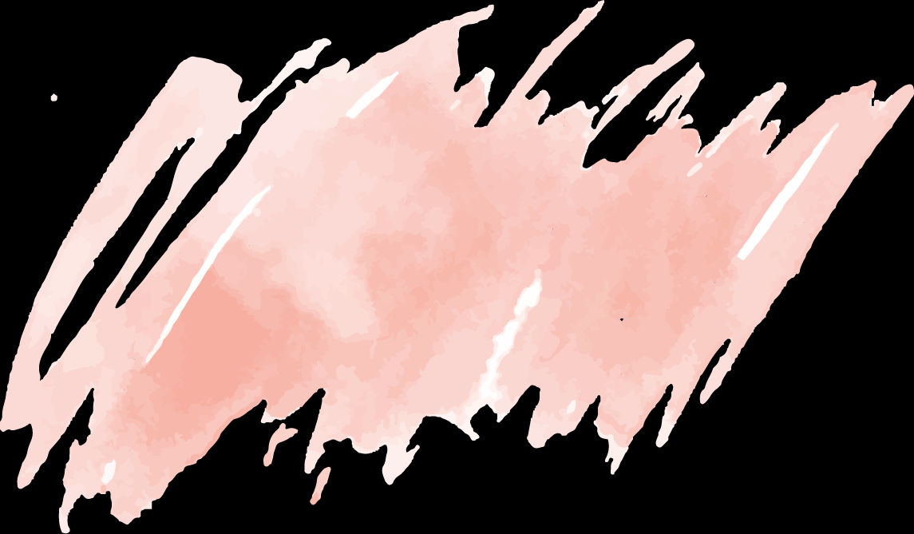
14,112
Big numbers catch your audience’s attention

Slide 21
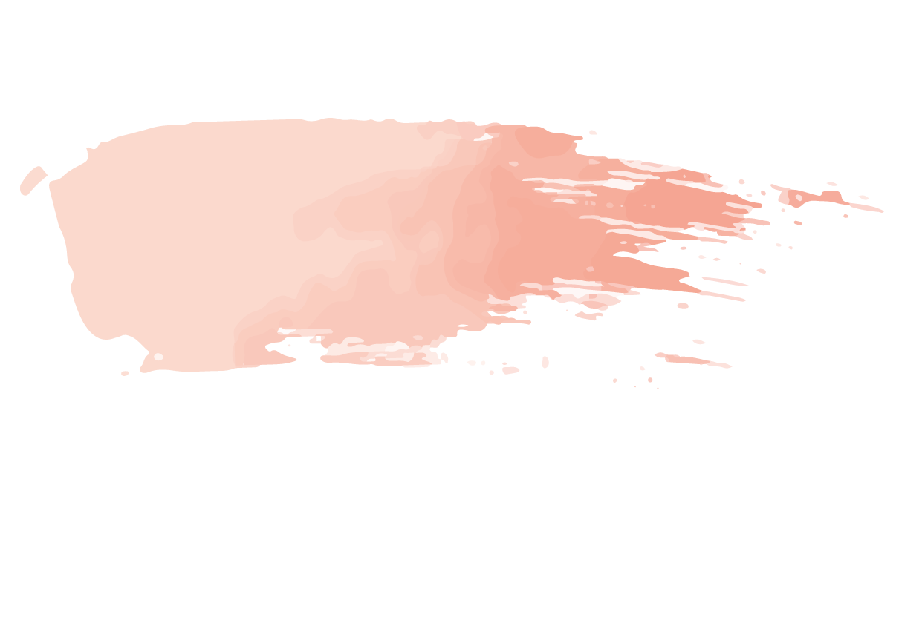
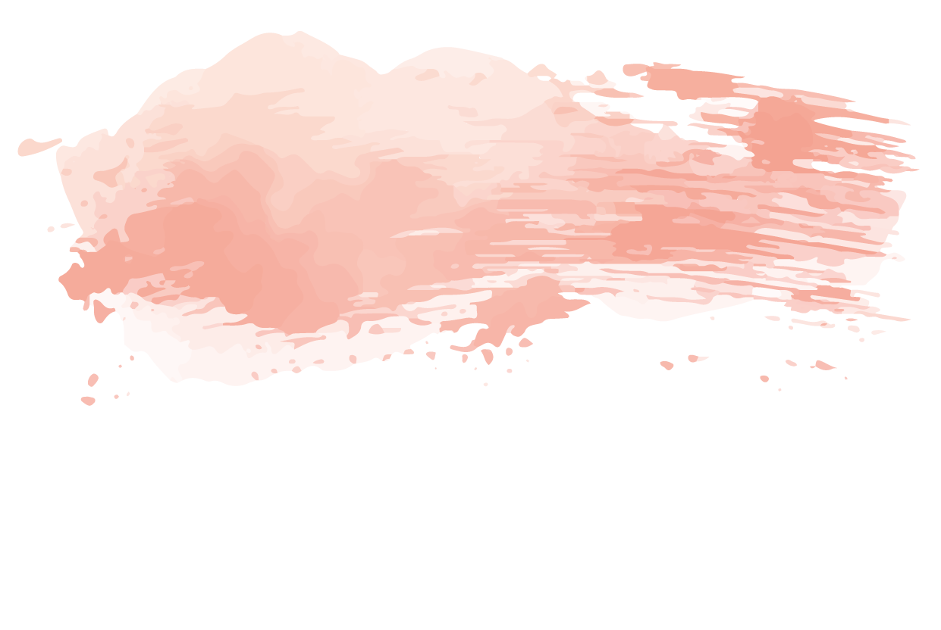
333,000.00
24h 37m 23s
386,000 km
earths is the Sun’s mass
is Jupiter’s rotation period
is the distance between the Earth and the Moon

Slide 22
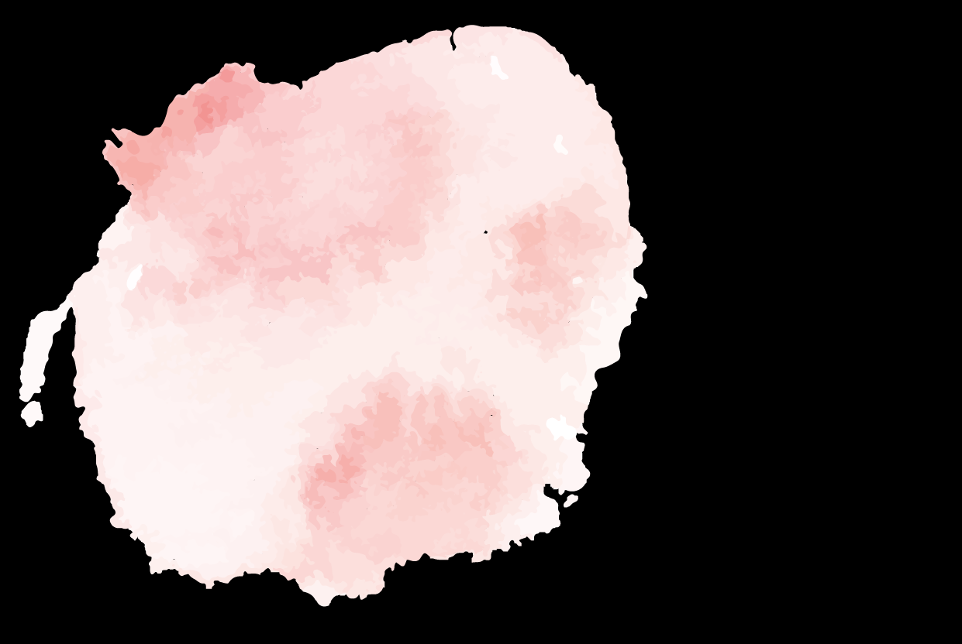
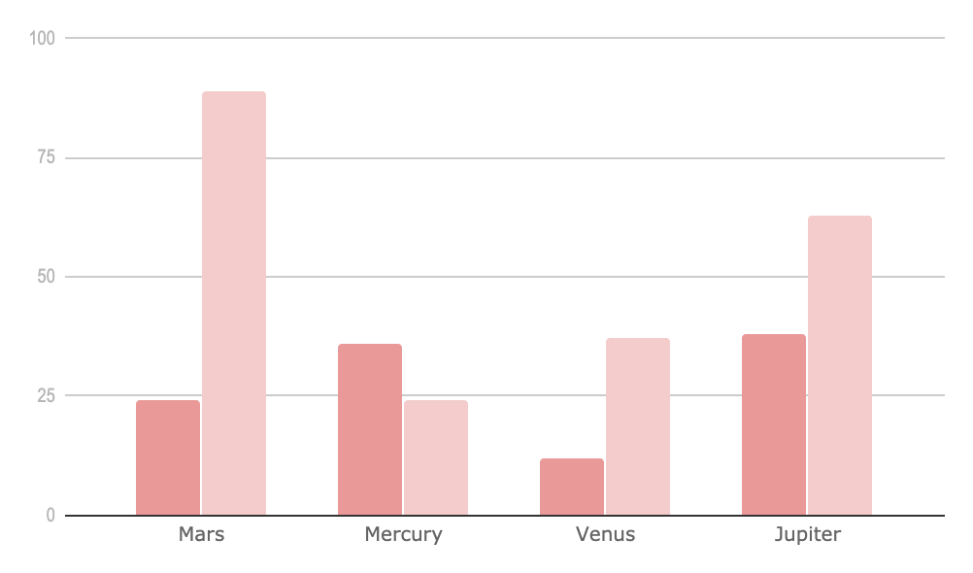
If you want to modify this graph, click on it, follow the link, change the data and replace it

Slide 23
A timeline
always works fine
16:00
18:00
19:00
20:00
21:00
23:00
00:00

Slide 24
This is the seating arrangement
This is the subtitle that makes it comprehensible
main table
Table 1
John Doe
Jess Doe
Alice Doe
Petra Doe
Table 4
John Smith
Lisa Parker
Martha Law
James Law
1
4
2
3
Table 2
Mark Jones
Tess Jones
Alice Earth
Ray Powell
Table 3
Paul Banks
Kari Banks
Anna Banks
Charles Banks

Slide 25
04
Design
This is the subtitle that makes it comprehensible

Slide 26
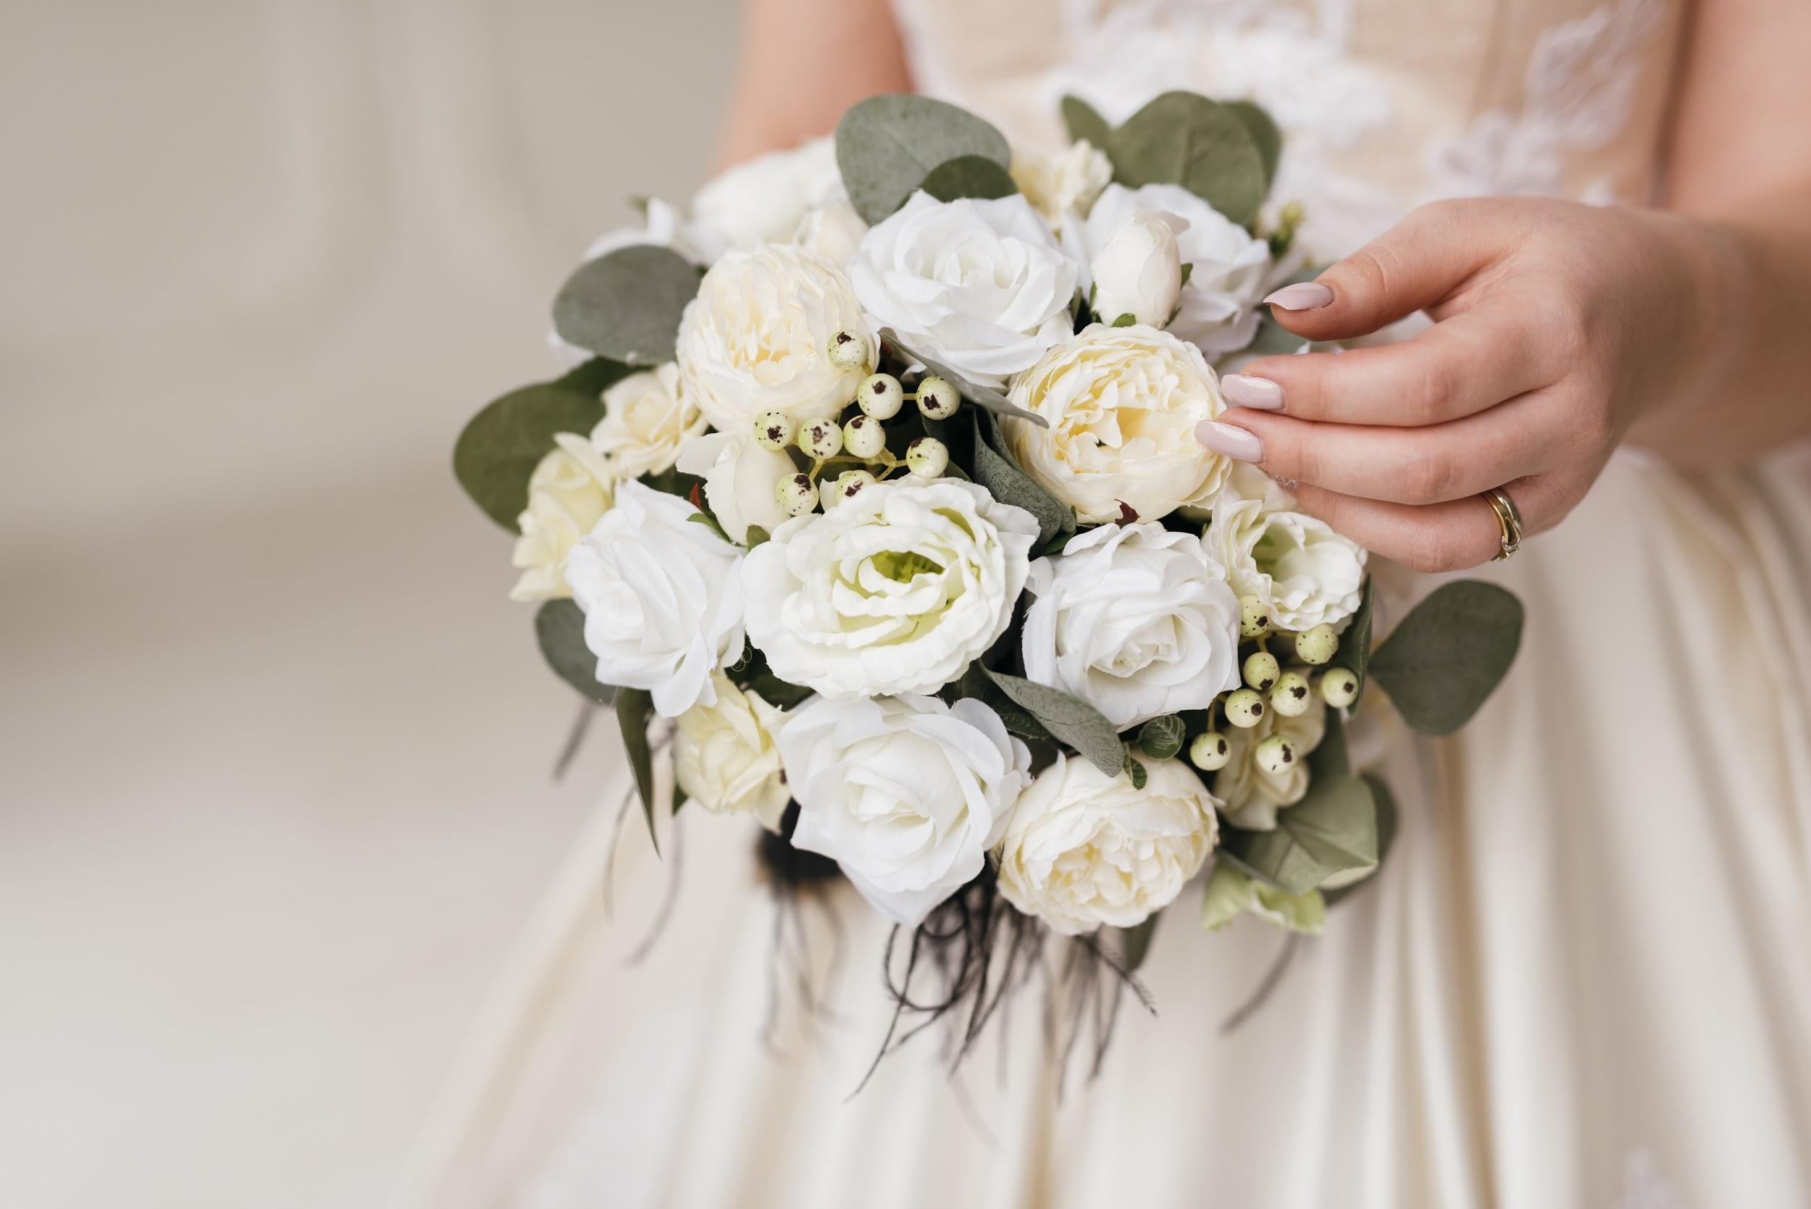
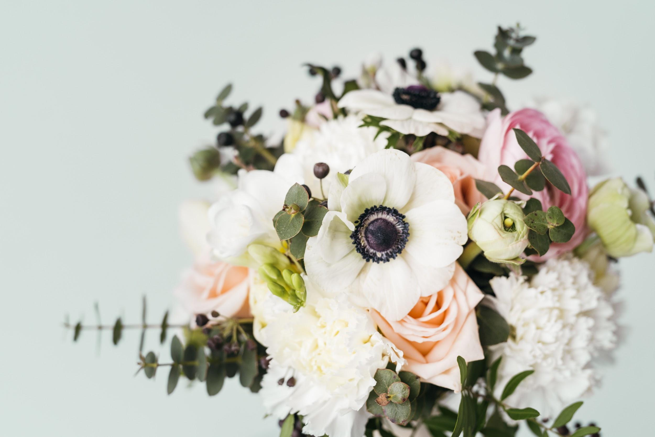
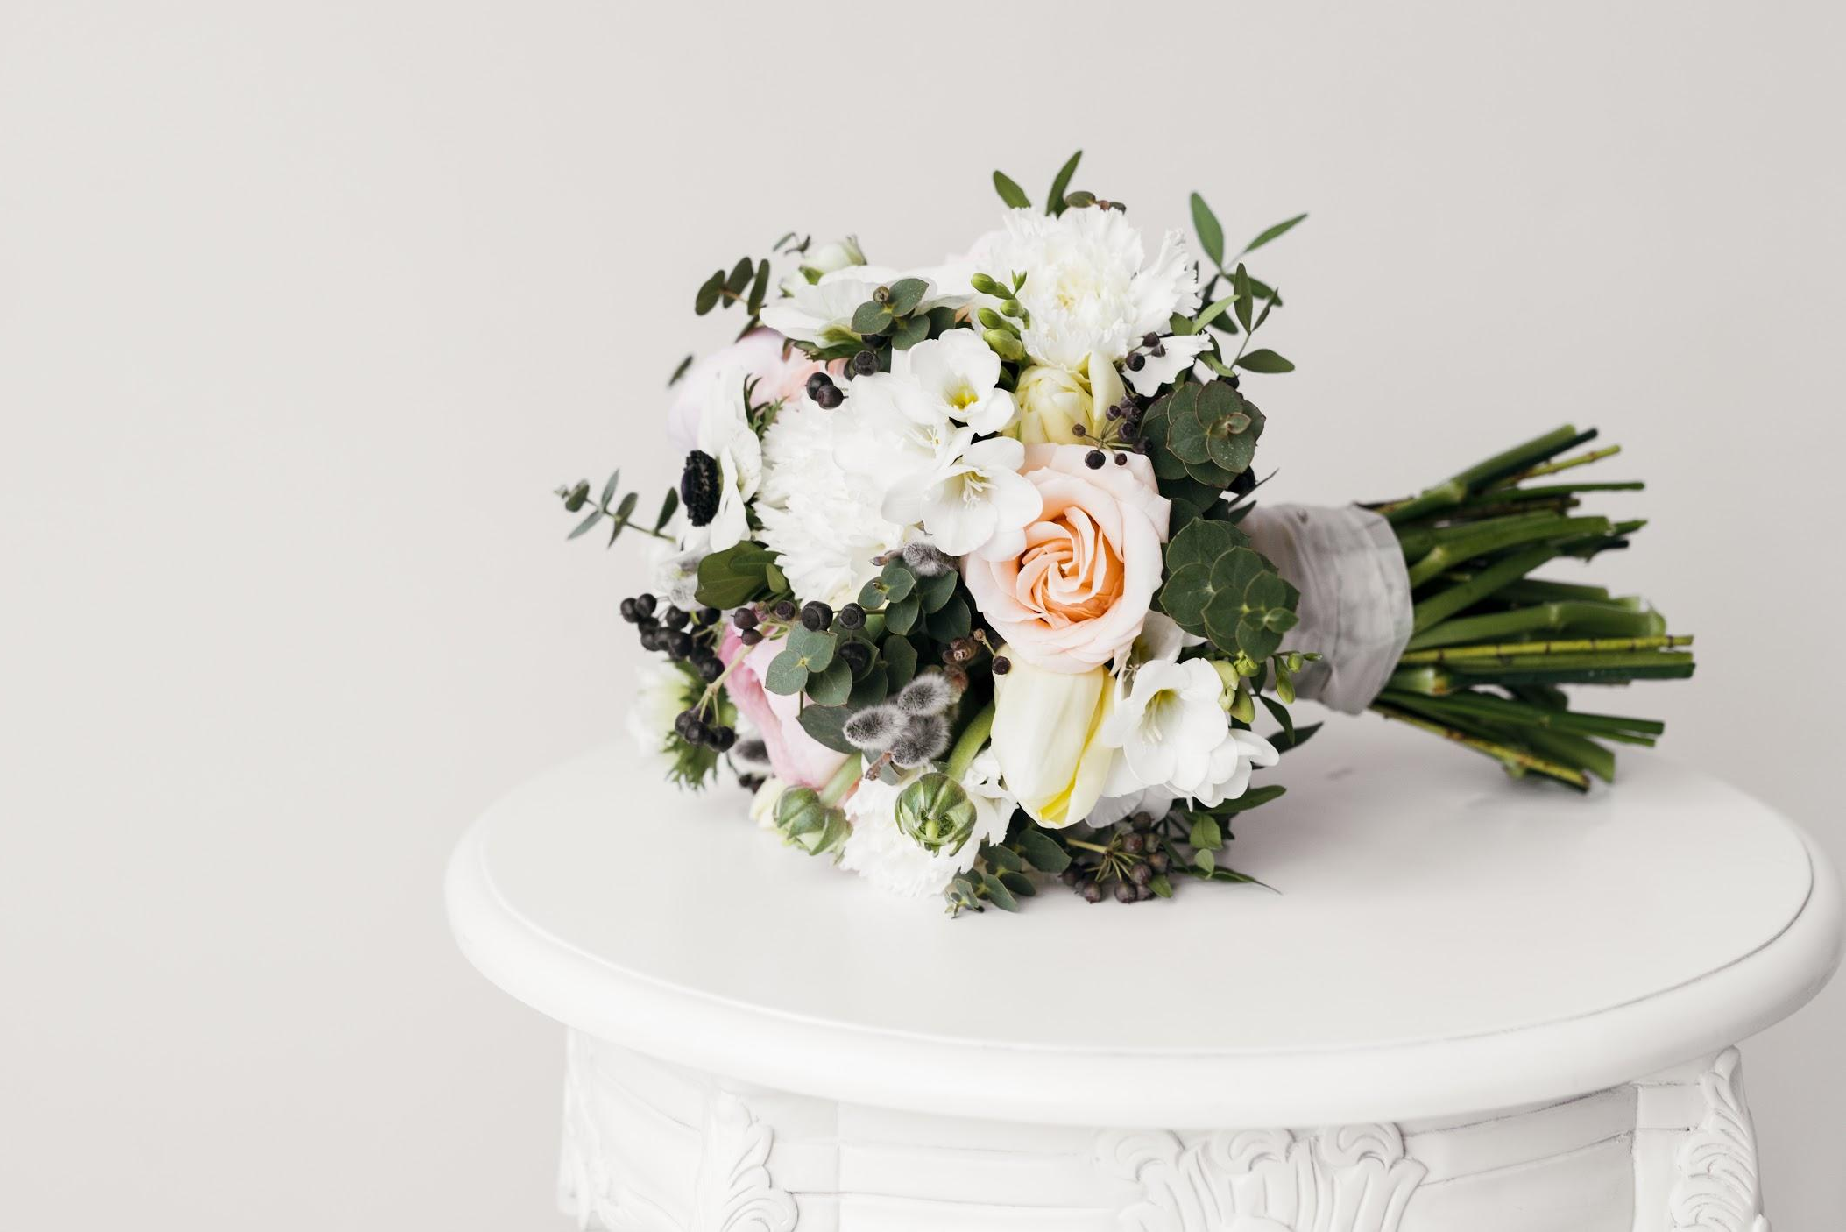
Bridal time!
Mercury
Mars
Jupiter
Mercury is the closest planet to the Sun and the smallest one in the Solar System. It’s only a bit larger than our Moon
Despite being red, Mars is a cold place, not hot. It’s full of iron oxide dust, which gives the planet its reddish
It’s a gas giant and the biggest planet in our Solar System. Jupiter is the fourth-brightest object in the sky

Slide 27
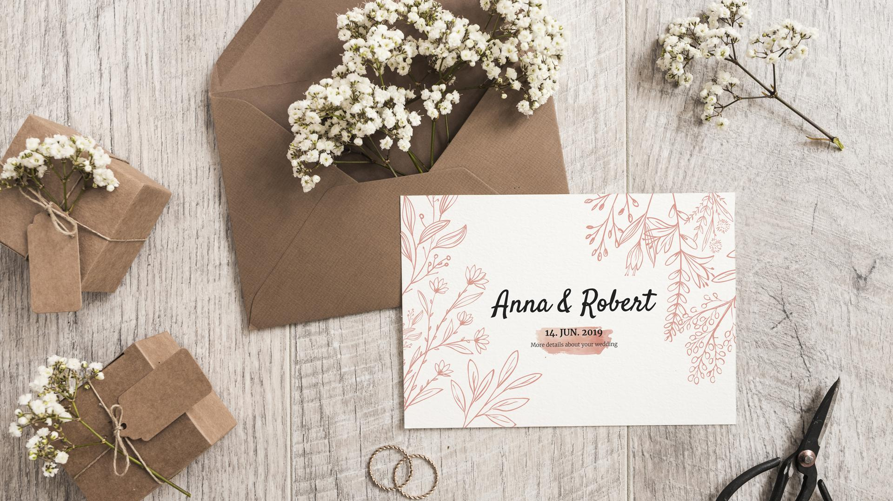

Slide 28
Budget
$8,986
$5,982
$6,888
$5,000
$7,100
$1,500
$2,988

Slide 29
Infographics make your idea understandable...
Celebration costs
Honeymoon costs
Mercury is the closest planet to the Sun and the smallest one in the Solar System
Venus has a beautiful name, but it’s terribly hot. Its atmosphere is very poisonous
Design costs
Saturn is the ringed planet. It’s a gas giant, composed mostly of hydrogen and helium

Slide 30
...and the same goes for tables
 | MASS | DIAMETER | SURFACE GRAVITY
MERCURY | 0,06 | 0,38 | 0,38
MARS | 0,11 | 0,54 | 0,66
SATURN | 95,2 | 9,4 | 1,16

Slide 31
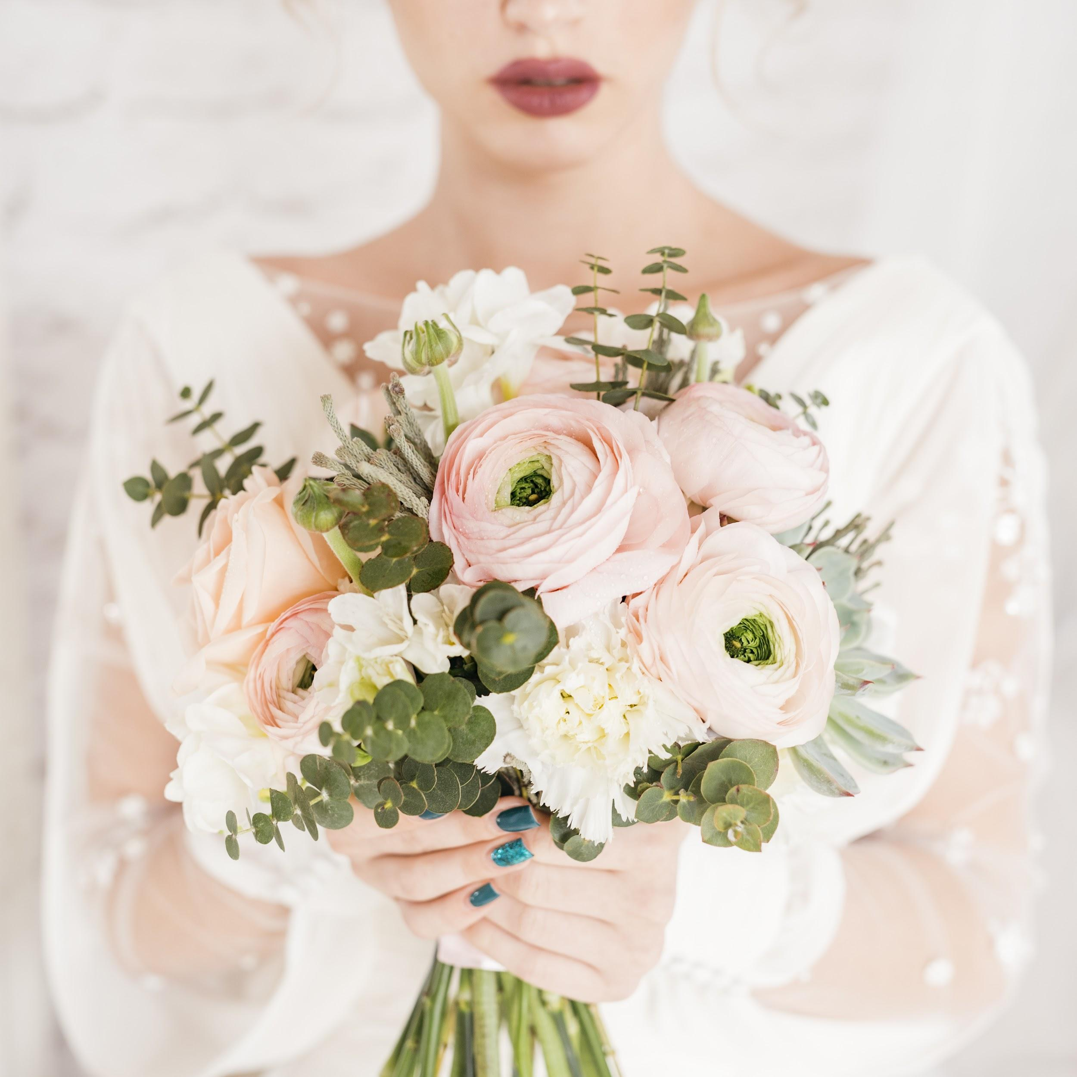
Perhaps you need
more details
Mercury is the closest planet to the Sun
Saturn is the ringed planet
Despite being red, Mars is a cold place, not hot
Venus has a beautiful name, but it’s very hot

Slide 32
Thanks!
LOGO
Does anyone have any questions?
addyouremail@freeppt7.com
+91 476 543 202
yourcompany.com
https://www.freeppt7.com

