Slide 1
economics thesis
Here is where your presentation begins

Slide 2
01 OBJECTIVES
03
RESULTS ANALYSIS
02 METHODOLOGY
04 CONCLUSIONS
Here you could describe the topic of the section
Here you could describe the topic of the section
Here you could describe the topic of the section
Here you could describe the topic of the section

Slide 3
INTRODUCTION
Mercury is the closest planet to the Sun and the smallest one in the Solar System—it’s only a bit larger than our Moon. The planet’s name has nothing to do with the liquid metal, since it was named after the Roman messenger god, Mercury

Slide 4
—SOMEONE FAMOUS
“This is a quote. Words full of wisdom that someone important said and can make the reader get inspired.”

Slide 5
01. SECTION
You could enter a subtitle here if you need it

Slide 6
STUDY OBJECTIVES
MARS
VENUS
Mercury is the closest planet to the Sun and the smallest one in the Solar System—it’s a bit larger than our Moon
Venus has a beautiful name and is the second planet from the Sun. Its atmosphere is extremely poisonous

Slide 7
LITERATURE REVIEW
01
Theory
02
Theory
03
Theory
04
Theory
Neptune is the farthest planet in our Solar System. It’s the fourth-largest by diameter and the densest
Venus has a beautiful name and is the second planet from the Sun. It’s terribly hot, even hotter than Mercury
Mercury is the closest planet to the Sun and the smallest one in the Solar System—it’s only a bit larger than our Moon
Jupiter is a gas giant and the biggest planet in our Solar System. It’s also the fourth-brightest object in the sky

Slide 8
AWESOME WORDS

Slide 9
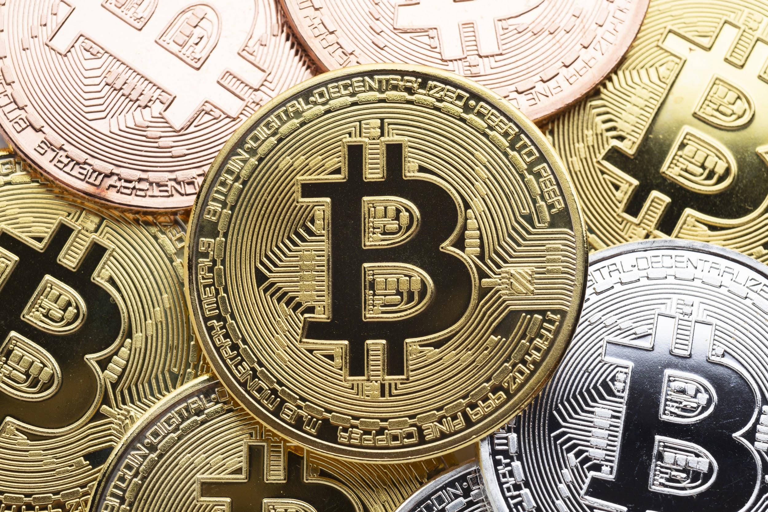
A PICTURE always reinforceS the concept

Slide 10
SCHEDULE
Week 1
26
27
28
29
30
31
1
Week 2
2
3
4
5
6
7
8
Week 3
9
10
11
12
13
14
15
Week 4
16
17
18
19
20
21
22
Week 5
23
24
25
26
27
28
29

Slide 11
METHODOLOGY
STEP 01
STEP 02
Venus has a beautiful name and is the second planet from the Sun. It’s terribly hot
Neptune is the fourth-largest planet in our Solar System and the farthest one from the Sun
STEP 04
STEP 03
Despite being red, Mars is actually a cold place. It’s full of iron oxide dust
Mercury is the closest planet to the Sun and the smallest one in the Solar System

Slide 12
TEST
TEST 1
TEST 2
TEST 3
TEST 4
TEST 5
Describe here your metrics 1
Describe here your metrics 2
Describe here your metrics 3
Describe here your metrics 4

Slide 13

RESULTS ANALYSIS
60,000
25%
75%
Mercury
mars
Sample size
If you want to modify this graph, click on it, follow the link, change the data and replace it
Despite being red, Mars is actually a cold place. It’s full of iron oxide dust

Slide 14
Reviewing concepts is a good idea
Mars
MERCURY
VENUS
JUPITER
SATURN
NEPTUNE
Despite being red, Mars is actually a cold place. It’s full of iron oxide dust
Mercury is the smallest planet in our Solar System
Venus has a beautiful name and is the second planet from the Sun
Jupiter is a gas giant and the biggest planet in our Solar System
Saturn is a gas giant, composed mostly of hydrogen and helium
Neptune is the fourth-largest planet in our Solar System

Slide 15
CONCLUSIONS
a
b
c
Venus has a beautiful name and is the second planet from the Sun. It’s terribly hot—even hotter than Mercury—and its atmosphere is extremely poisonous
Mercury is the closest planet to the Sun and the smallest one in the Solar System—it’s only a bit larger than our Moon. Its name has nothing to do with the liquid metal
Jupiter is a gas giant and the biggest planet in our Solar System. It’s also the fourth-brightest object in the sky, and its name comes from the Roman god of the sky and lightning

Slide 16
333,000.00
24h 37m 23s
386,000 km
earths is the Sun’s mass
is Jupiter’s rotation period
is the distance between the Earth and the Moon

Slide 17
BIBLIOGRAPHY
AUTHOR | Year | Title of the publication. Publisher
AUTHOR | Year | Title of the publication. Publisher
AUTHOR | Year | Title of the publication. Publisher
AUTHOR | Year | Title of the publication. Publisher
AUTHOR | Year | Title of the publication. Publisher

Slide 18
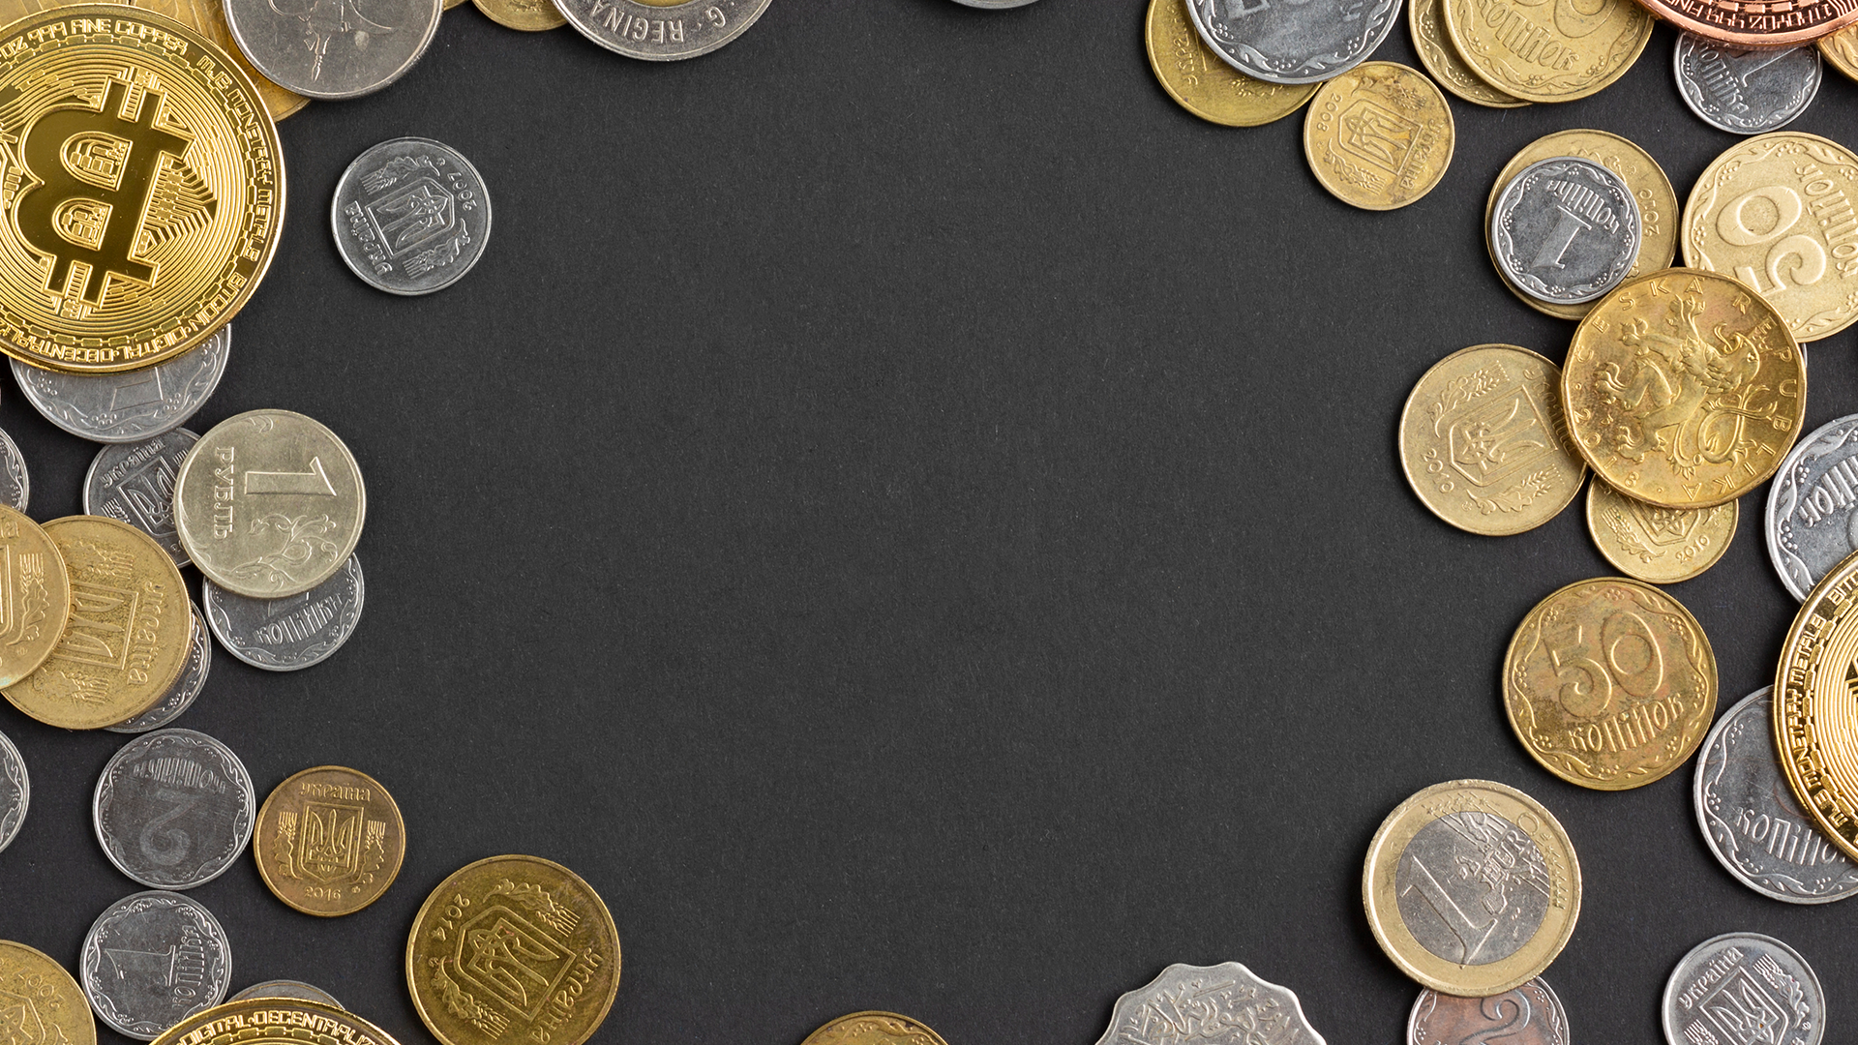
A picture is worth a thousand words

Slide 19
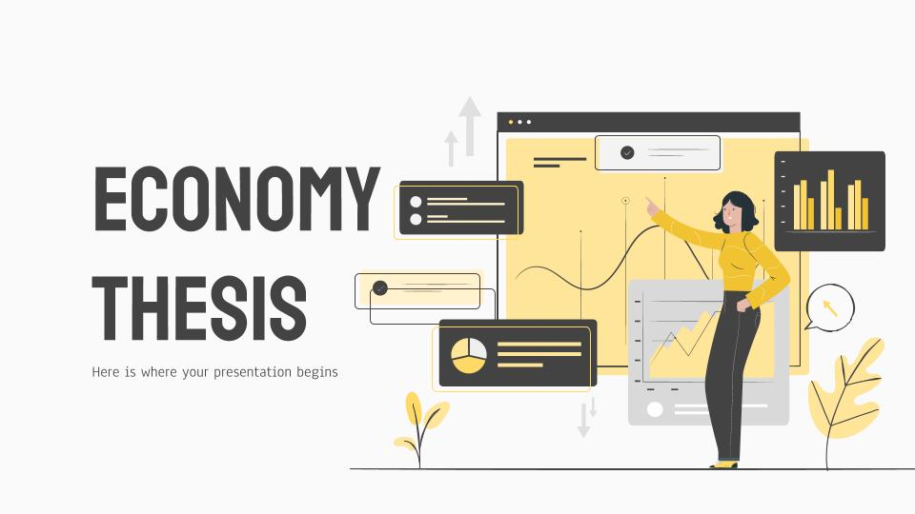

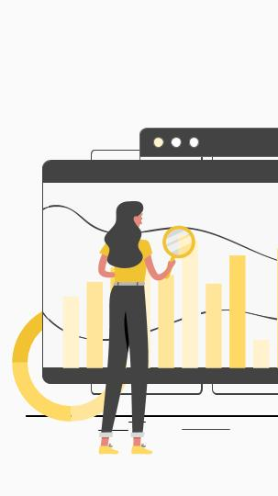
Desktop software
Tablet app
Mobile web
You can replace the image on the screen with your own work. Just delete this one, add yours and send it to the back
You can replace the image on the screen with your own work. Just delete this one, add yours and send it to the back
You can replace the image on the screen with your own work. Just delete this one, add yours and send it to the back

Slide 20
THANKS
Does anyone have any questions?
youremail@freeppt7.com
+91 723 627 983
yourcompany.com
Please keep this slide for attribution.

Slide 21
Money ICONS

Slide 22
Alternative RESOURCES

