Slide 1
Floriculture
Powerpoint Template
Think
www.freepptbackgrounds.net

Slide 2
Web design
Solutions
Check
Make
Contents

Slide 3
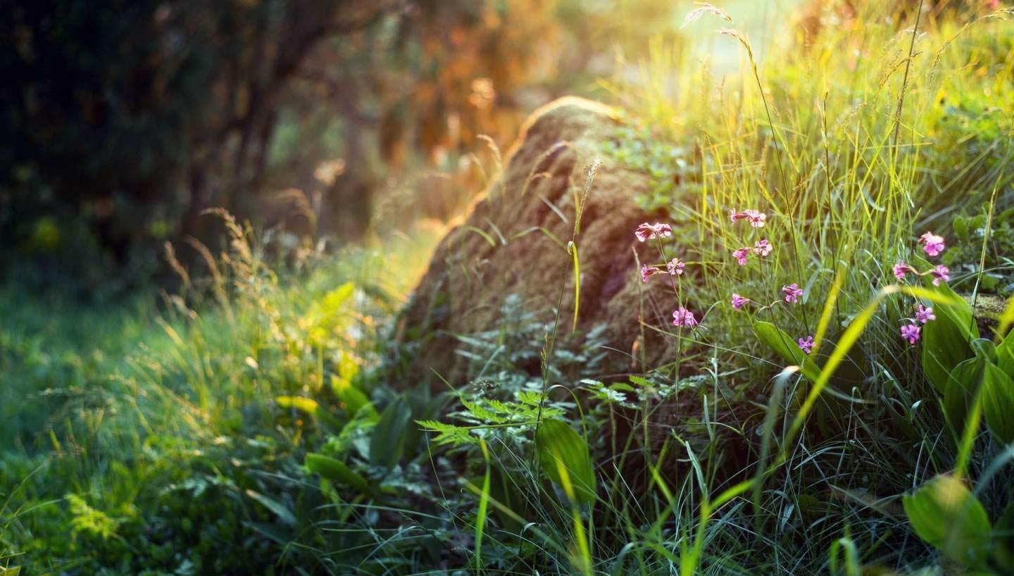
Overview
Click on the button under the presentation preview that says "Use as Google Slides Theme".You will get a copy of

Slide 4
Devices
Click on the button under the presentation preview that says "Download as PowerPoint template". You will get a .pptx file that you can edit in PowerPoint.Remember to download and install the fonts
Infographics
Is the color of gold, butter and ripe lemons. In the spectrum of visible light, yellow is found between green and orange.
Opening Cerenomy
We use well-known development methodologies to create a customized approach for each of the projects. This allows us to achieve high quality outcomes and full transparency towards.

Slide 5
Speakers Introduction
We certainly do not forget you as soon as you forget us. It is, perhaps, our fate rather than our merit. We cannot help ourselves. We live at home, quiet, confined, and our feelings prey upon us. You are forced on exertion. You have always a profession, pursuits, business of some sort or other, to take you back into the world immediately, and continual occupation and change soon weaken impressions. All the privilege I claim for my own sex (it is not a very enviable one; you need not covet it), is that of loving longest, when existence or when hope is gone.

Slide 6
Opening
Enter the comprehensive description of the above chart here, enter the comprehensive description of the above chart here, enter the comprehensive description of the above chart here, enter the comprehensive description of the above chart here, and enter the comprehensive description of the above chart here.

Slide 7
Break time
A torn jacket is soon mended; but hard words bruise the heart of a child.
Speakers
Woe be to him that reads but one book.
Woe be to him that reads but one book.
Free Time
A large income is the best recipe for happiness I ever heard of.

Slide 8
Mission & Vision
Type your content here, or by copying your text, choose Paste in this box and choose to keep only the text.

Slide 9
When you feel in your gut what you are and then dynamically pursue it - don't back down and don't give up - then you're going to mystify a lot of folks.
Our Values
The user can make a presentation on a projector or computer, or print out the presentation to make a film. The user can make a presentation on a projector or computer, or print out the presentation to make a film.

Slide 10
About us
The user can make a presentation on a projector or computer, or print out the presentation to make a film. The user can make a presentation on a projector or computer, and can also make a presentation. You can also print out the presentation to make a film
Forum

Slide 11
Services
Type your content here, or by copying your text, choose Paste in this box and choose to keep only the text. Type your content here, or by copying your text, choose Paste in this box and choose to keep only the text.
Timeline

Slide 12
Future
The user can demonstrate on a projector or computer, or print the presentation and make it into a film to be used in a wider field. Using PowerPoint

Slide 13
Annual Meeting
Add a detailed text description here. It is recommended to be related to the title and conform to the overall language style. The language description should be as concise and vivid as possible.
Conferences
We press play on your digital story. Using conceptual, digital design, we work with you to build experiences that feel 'right' for your users. We create a solid user-product relationship, one thats long and fruitful.
What we do?
Add a detailed text description here. It is recommended to be related to the title and conform to the overall language style. The language description should be as concise and vivid as possible.
Pricing
Add a detailed text description here. It is recommended to be related to the title and conform to the overall language style. The language description should be as concise and vivid as possible.

Slide 14
Tech Startup
Moving from creative ideas to solid strategy and execution, we help your target market resonate fully with your brand. When you get them, they will get you, quicker. We leverage digital tools, design and words, to become even more relevant.

Slide 15
Public & NGO
Simple & Smooth, exactly how purchasing experiences should be. We align with your users need to build and evolve a flowing shopping interface, one that slots easily into place with each step.
Please enter text please enter text please enter text please enter text
Please enter text Please enter text

Slide 16
Education
Users can make a presentation on a projector or computer, or print out the presentation to make a film for use in a wider range of fields

Slide 17
We certainly do not forget you as soon as you forget us. It is, perhaps, our fate rather than our merit. We cannot help ourselves. We live at home, quiet, confined, and our feelings prey upon us. You are forced on exertion. You have always a profession, pursuits, business of some sort or other, to take you back into the world immediately, and continual
Finance
Your audience relate and absorb information on different sensory levels. We know visual stories are amplified with the right words. Sometimes it's easier to go old school, our copywriters prefer a good ball.

Slide 18
Fashion
Type your content here, or by copying your text, choose Paste in this box and choose to keep only the text. Type your content here, or by copying your text, choose Paste in this box and choose to keep only the text.
Add a detailed text description here. It is recommended to be related to the title and conform to the overall language style. The language description should be as concise and vivid as possible.

Slide 19
Arts & Culture
Please enter text please enter text please enter text please enter text
Please enter text Please enter text
Don't worry about getting old, you must be cute when you are old. And, if you are ten years old, of course I am also ten years old, the world is ten years old, and God is ten years old, everything is the same.

Slide 20
Real Estate
Type your content here, or by copying your text, choose Paste in this box and choose to keep only the text.

Slide 21
Energy
The user can make a presentation on a projector or computer, or print out the presentation to make a film. The user can make a presentation on a projector or computer, and can also make a presentation. You can also print out the presentation to make a film
E-commerce
The user can demonstrate on a projector or computer, or print the presentation and make it into a film to be used in a wider field. Using PowerPoint
Briefing
Don't worry about getting old, you must be cute when you are old. And, if you are ten years old, of course I am also ten years old, the world is ten years old, and God is ten years old, everything is the same.

Slide 22
Evaluation
Workshops
Your audience relate and absorb information on different sensory levels. We know visual stories are amplified with the right words. Sometimes it's easier to go old school, our copywriters prefer a good ball.
Design
The user can demonstrate on a projector or computer, or print the presentation and make it into a film to be used in a wider field. Using PowerPoint
Implementation
Users can make a presentation on a projector or computer, or print out the presentation to make a film for use in a wider range of fields

Slide 23
Quality Assurance
Type your content here, or by copying your text, choose Paste in this box and choose to keep only the text. Type your content here, or by copying your text, choose Paste in this box and choose to keep only the text.
Content Direction
Simple & Smooth, exactly how purchasing experiences should be. We align with your users need to build and evolve a flowing shopping interface, one that slots easily into place with each step.

Slide 24
Visual Direction
Your audience relate and absorb information on different sensory levels. We know visual stories are amplified with the right words. Sometimes it's easier to go old school, our copywriters prefer a good ball.The user can demonstrate on a projector or computer, or print the presentation and make it into a film to be used in a wider field.

Slide 25
Floriculture
Thank you!

