Slide 1

LOGO
Free
PPT Templates
Insert the Subtitle of Your Presentation
Reporter:XXX Department:XXX
https://www.freeppt7.com

Slide 2
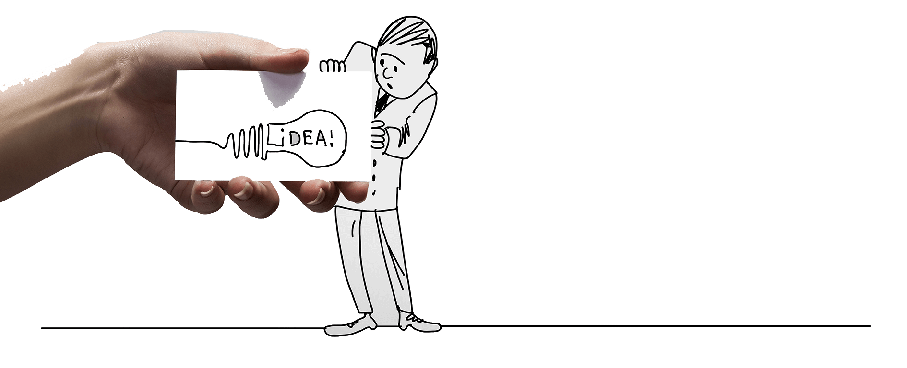
P
reface
Creative pure hand painted business
presentations Creative pure paint ed business presentations
This program is based on our understanding of your company's needs, as well as the specific requirements set out in the proposal information, combined with our knowledge of the organizers, as well as our long-standing experience and expertise.
Here, wePOWERPOINT2020Management Co. , Ltd. understanding and support to express my most sincere thanks!

Slide 3

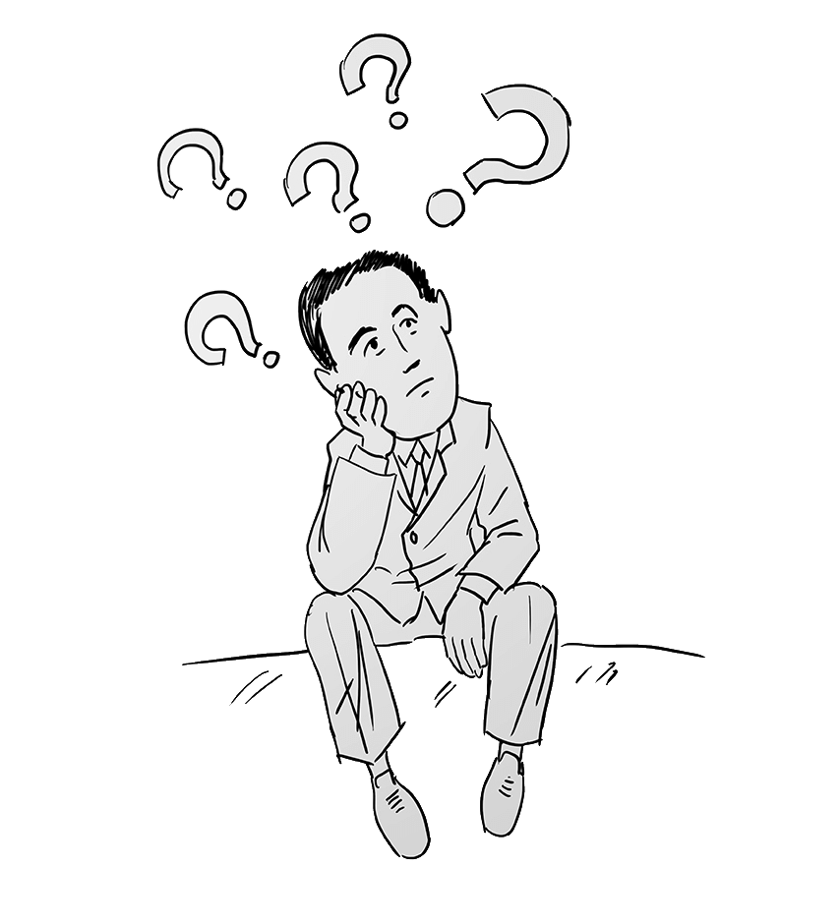
Catalog
Creative pure hand painted
business presentations Creative pure
hand painted business presentations
COMPANY PROFILE MAIN PRODUCTS SERVICE GUARANTEE COOPERATIVE PARTNER MARKET LAYOUT SUCCESS STORIES CONTACT US

Slide 4
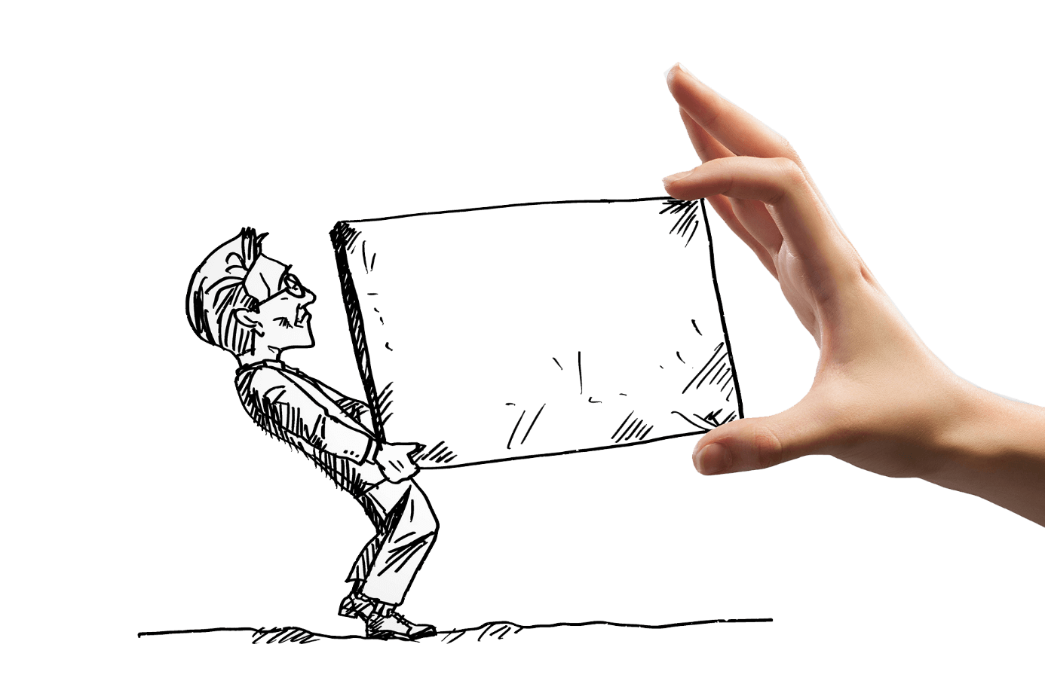
P
Art1
Creative pure hand painted business
presentations Creative
pure hand painted business presentations
Company Profile

Slide 5
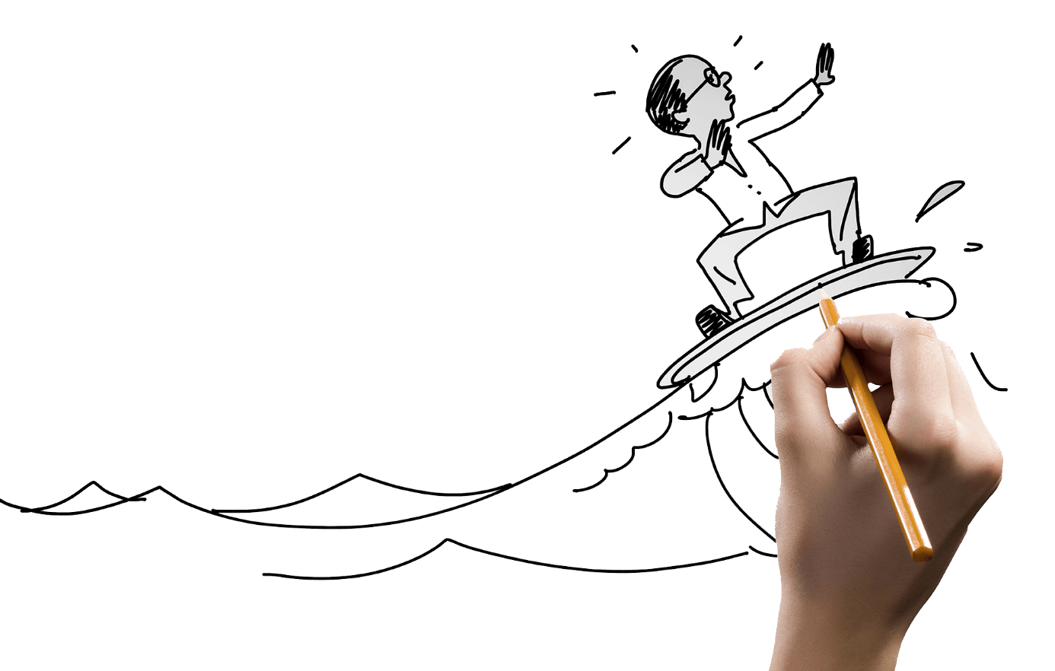
Company Profile
Creative pure hand painted business
presentations Creative
pure hand painted business presentations
The company was founded in 1999ⅩYear-end, is specialized in the production of various specifications of high-frequency straight-seam carbon steel welding pipe modernizationEnterprise。
IsAGroupBGroupCA Sino-foreign joint venture jointly invested by the company. Companies to introduce large amounts of money to the United States, Germany, Taiwan and other countries

Slide 6
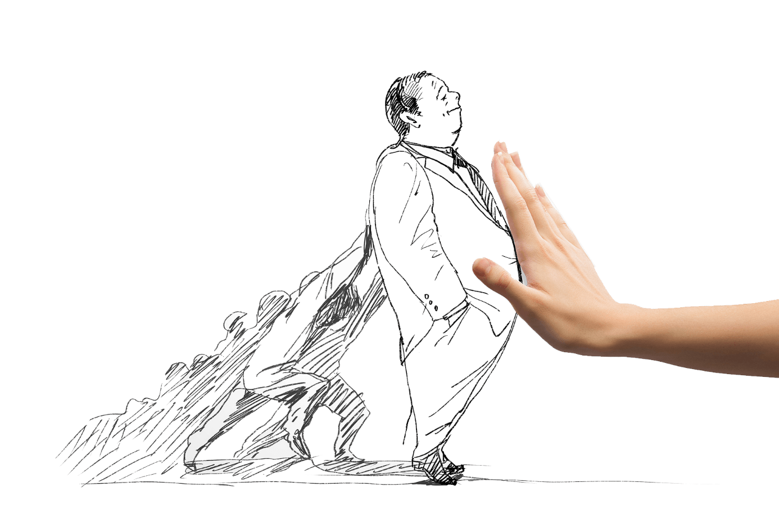
Introduction to the team
Creative pure hand painted business
presentations Creative
pure hand painted business presentations
This team members from the non-student college a number of majors, reasonable matching ability, with a certain degree of economics, management, market analysis and marketing skills, team members have won many first-class scholarships, national awards and so on. Strong sense of responsibility, with good team work ability and social practice ability.

Slide 7
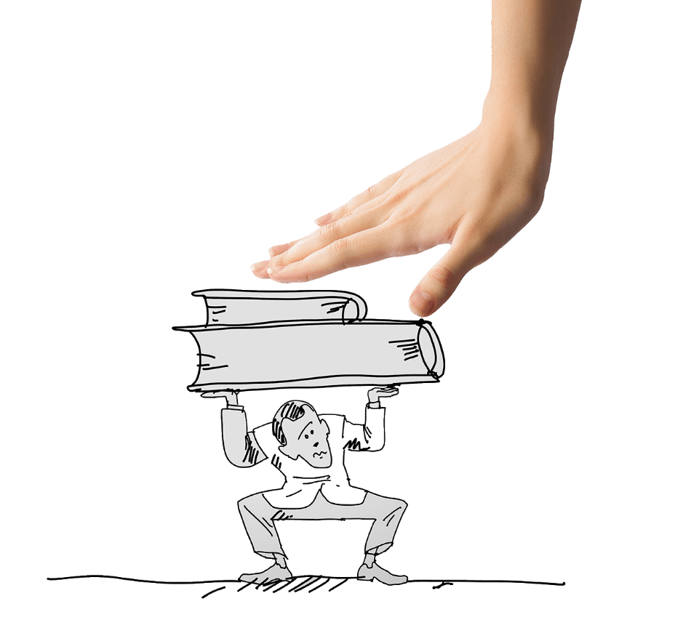
Corporate culture
Creative pure hand painted business
presentations Creative
pure hand painted business presentations
Corporate culture is a spiritual wealth and material form with the characteristics of the enterprise created in the production, operation and management activities of enterprises under certain conditions. It includes cultural concepts, values, entrepreneurship, ethics, code of conduct, historical traditions, corporate systems, cultural environment, enterprise products and so on. The values are at the heart of the corporate culture.
Corporate culture is the soul of enterprises, is to promote the development of enterprises inexhaustible power. It contains a very rich content, the core of which is the spirit and values of the enterprise. The values here do not refer to the various cultural phenomena in the management of enterprises, but the values that employees of enterprises and enterprises hold in their business activities.

Slide 8
Corporate philosophy
Creative pure hand painted business
presentations Creative
pure hand painted business presentations
The transmission of ideas is the first step in the implementation of the concept. In order to internalize the enterprise's philosophy into the employee's belief and conscious behavior, the employee must first know what the enterprise's philosophy is.
The method of concept transmission is generally a disputing method, that is, through multi-angle, multi-level, multi-channel, repeated and repeated transmission, so that the concept of enterprisedeeply in the hearts of the people.
Enterprise concept is the enterprise in the process of continuous operation and long-term development, inherit the fine tradition of enterprises, adapt to the requirements of the times, actively advocated by entrepreneurs, all staff consciously practice, thus forming a representative of the enterprise belief, stimulate the vitality of enterprises, promote the enterprise production and operation of the spirit of the group spirit and behavior norms. According to different levels are divided into spiritual and cultural type and organizational system two categories.

Slide 9
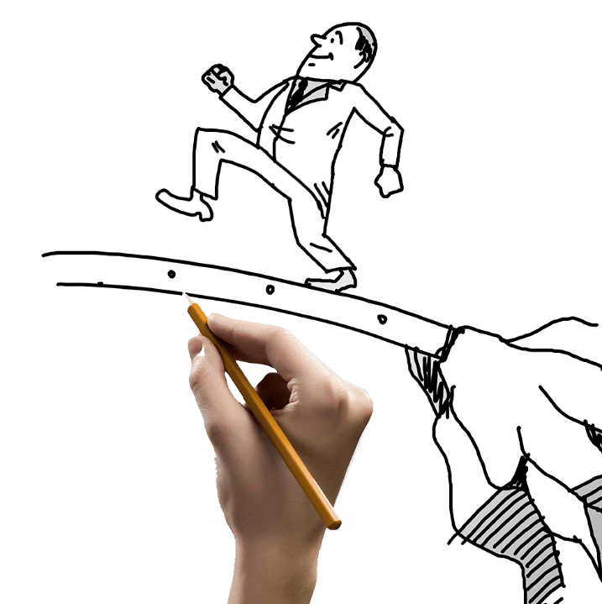
The course of development
Creative pure hand painted business
presentations Creative
pure hand painted business presentations
2014Years
The number of companies in size reached1000People
2010Years
Founded in Beijing
2020Years
Company's output value500Billion
2012Years
The company set up a branch office

Slide 10
P
Art2
Creative pure hand painted business
presentations Creative
pure hand painted business presentations
Main products

Slide 11
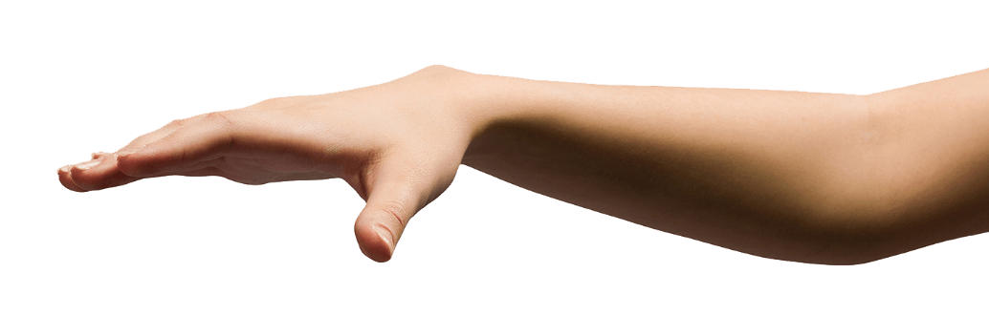

Main products
Creative pure hand painted business
presentations Creative
pure hand painted business presentations
The so-called enterprise productrefers to the purposeful labor production of an enterprise, including both the tangible products of the production enterprises and the intangible products of the service industry.
The so-called enterprise productrefers to the purposeful labor production of an enterprise, including both the tangible products of the production enterprises and the intangible products of the service industry.

Slide 12

Main products
Creative pure hand painted business
presentations Creative
pure hand painted business presentations
The so-called enterprise productrefers to the purposeful labor production of an enterprise, including both the tangible products of the production enterprises and the intangible products of the service industry.
Enterprise products include a variety of different forms, performance, use of thousands of. But they have a common characteristic, that is, people in a certain period of time production and business activities of the direct and effective results.
The so-called enterprise productrefers to the purposeful labor production of an enterprise, including both the tangible products of the production enterprises and the intangible products of the service industry.

Slide 13
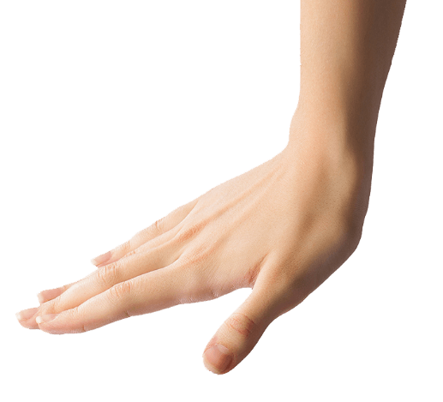
Creative pure hand painted business
presentations Creative
pure hand painted business presentations
Main products
The so-called enterprise productrefers to the purposeful labor production of an enterprise, including both the tangible products of the production enterprises and the intangible products of the service industry.
Enterprise products include a variety of different forms, performance, use of thousands of. But they have a common characteristic, that is, people in a certain period of time production and business activities of the direct and effective results.

Slide 14
Main products
Creative pure hand painted business
presentations Creative
pure hand painted business presentations
The so-called enterprise productrefers to the purposeful labor production of an enterprise, including both the tangible products of the production enterprises and the intangible products of the service industry.

Slide 15
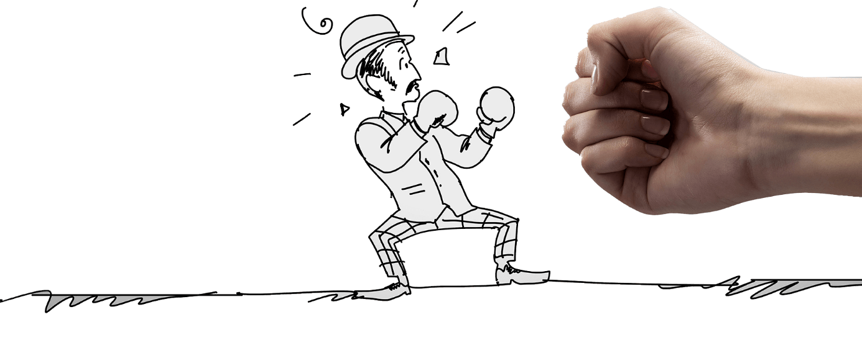
Features
Creative pure hand painted business
presentations Creative
pure hand painted business presentations
Flexible and convenient
Product characteristics are mainly to highlight the advantages of their products and different from other products.
Fast
Product characteristics are mainly to highlight the advantages of their products and different from other products.
Durable
Product characteristics are mainly to highlight the advantages of their products and different from other products.

Slide 16
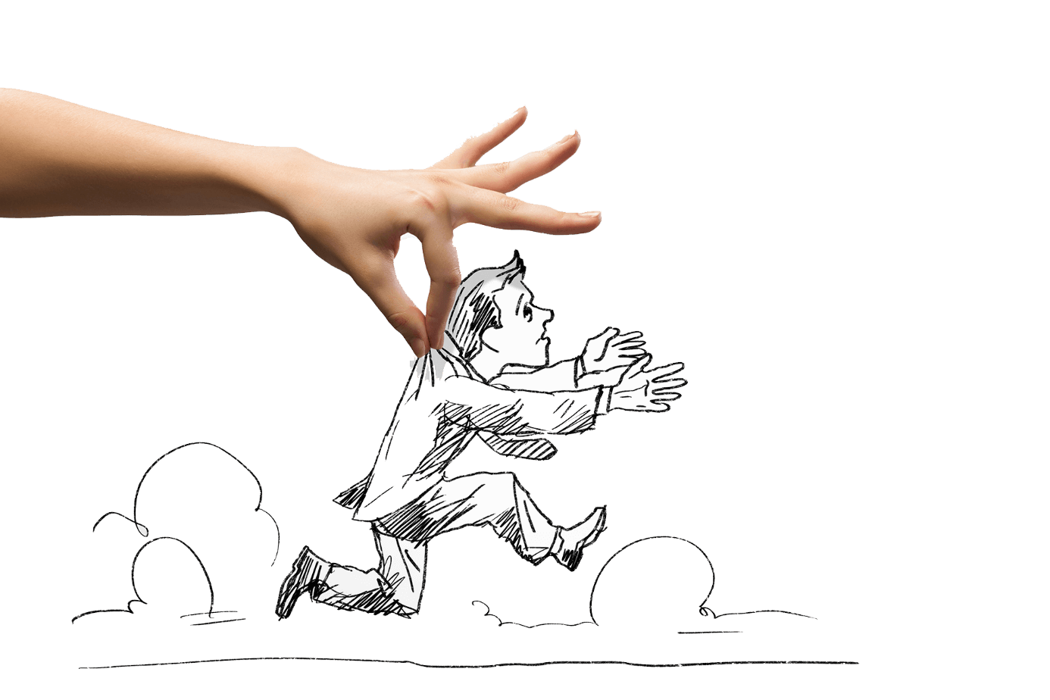
Features
Creative pure hand painted business
presentations Creative
pure hand painted business presentations
Flexible and convenient
Product characteristics are mainly to highlight the advantages of their products and different from other products. Product characteristics are mainly to highlight the advantages of their products and different from other products.
Flexible and convenient
Product characteristics are mainly to highlight the advantages of their products and different from other products. Product characteristics are mainly to highlight the advantages of their products and different from other products.

Slide 17

Forced
Features
Creative pure hand painted business
presentations Creative
pure hand painted business presentations
Product advantages are mainly to highlight the advantages of their products and different from other products Where the advantages of the product characteristics are mainly to highlight the advantages of their products and different from other products Product characteristics are mainly to highlight the advantages of their products and different from other products.
Product characteristics are mainly to highlight the advantages of their products and different from other products.
Convenient
Pretty
Economic
Simple
Practical

Slide 18
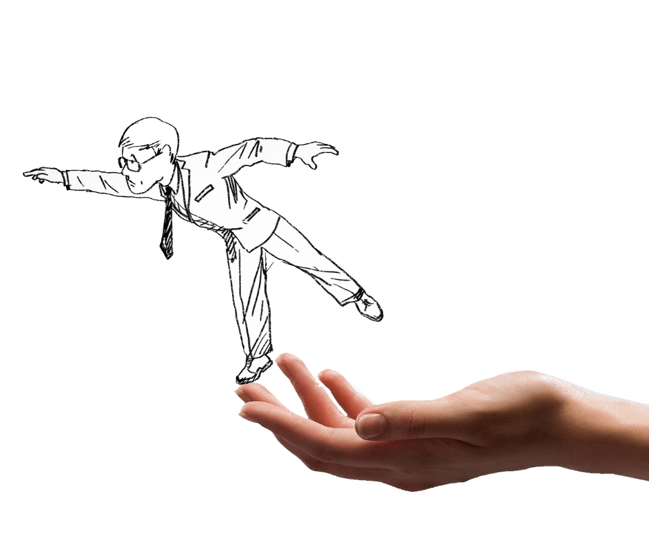
Features
Creative pure hand painted business
presentations Creative
pure hand painted business presentations
Product advantages are mainly to highlight the advantages of their products and different from other products Where the advantages of the product characteristics are mainly to highlight the advantages of their products and different from other products Product characteristics are mainly to highlight the advantages of their products and different from other products.
Product characteristics are mainly to highlight the advantages of their products and different from other products are mainly to highlight the advantages of their products and different from other products, the advantages of the product characteristics are mainly to highlight the advantages of their products and different from other products.

Slide 19
P
Art3
Creative pure hand painted business
presentations Creative
pure hand painted business presentations
Service protection
Notes:
PptTemplate: www.1ppt.com/moban/ IndustryPptTemplate:www.1ppt.com/hangye/
FestivalPptTemplate:www.1ppt.com/jieri/ PptMaterial: www.1ppt.com/sucai/
PptBackground:www.1ppt.com/beijing/ PptChart: www.1ppt.com/tubiao/
ExcellentPptDownload:www.1ppt.com/xiazai/ PptTutorial: www.1ppt.com/powerpoint/
WordTutorial: www.1ppt.com/word/ ExcelTutorial: www.1ppt.com/excel/
Resume: www.1ppt.com/jianli/ PptCourseware: www.1ppt.com/kejian/
Transcript for: www.1ppt.com/shouchaobao/ Question download: www.1ppt.com/shiti/
Lesson plan download: www.1ppt.com/jiaoan/ Font download: www.1ppt.com/ziti/

Slide 20
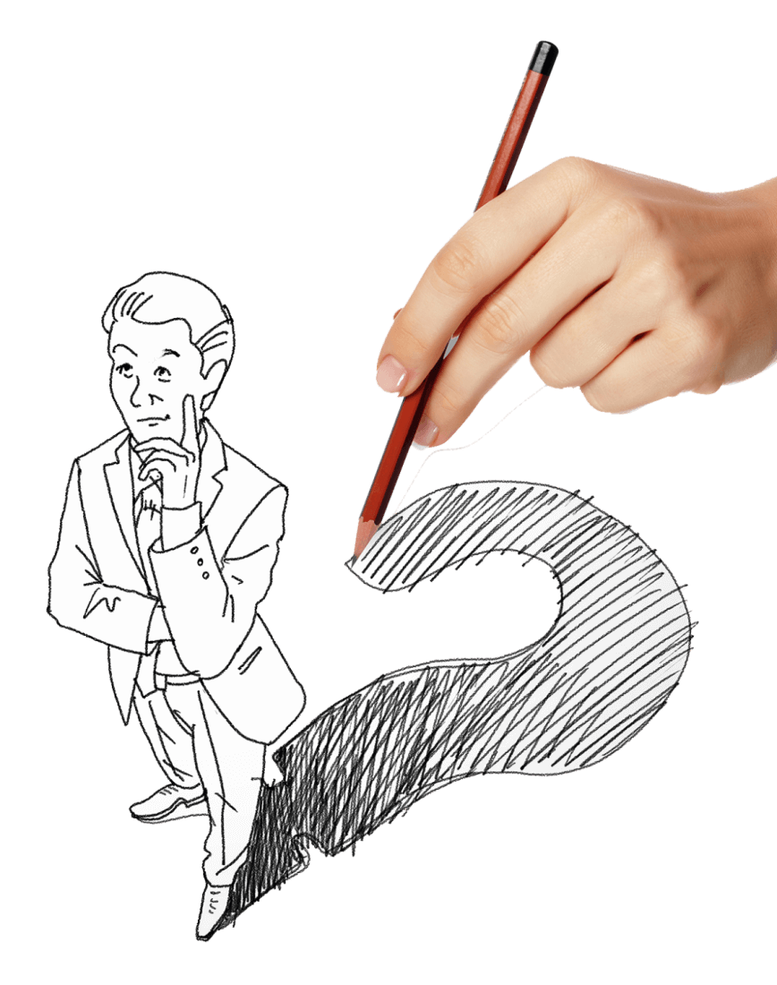
Services
Creative pure hand painted business
presentations Creative
pure hand painted business presentations
One-on-one service
Our service standards are the first in the country, to solve any customer problems, one-on-one intimate service. , solve any customer's problems, one-on-one intimate service.
Professional maintenance
Our service standards are the first in the country, to solve any customer problems, one-on-one intimate service.

Slide 21
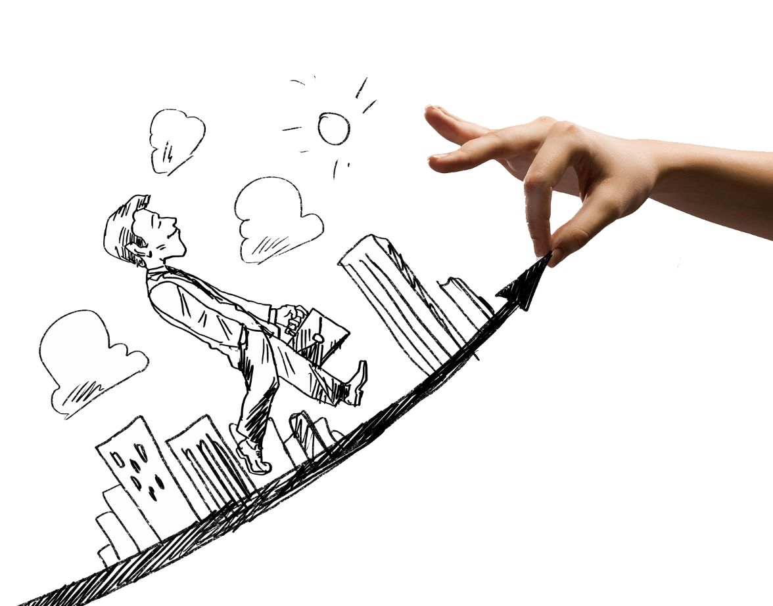
Services
Creative pure hand painted business
presentations Creative
pure hand painted business presentations
Gold Service frees you from any stress
Our service standards are the first in the country, to solve any customer problems, one-on-one intimate service. Is the first in the country, to solve any customer's problems, one-on-one intimate service to solve any customer's problems, one-on-one intimate service.
Our service standards are the first in the country, to solve any customer problems, one-on-one intimate service.
Our service standards are the first in the country, to solve any customer problems, one-on-one intimate service. Is the first in the country, to solve any customer's problems, one-on-one intimate service to solve any customer's problems, one-on-one intimate service.

Slide 22
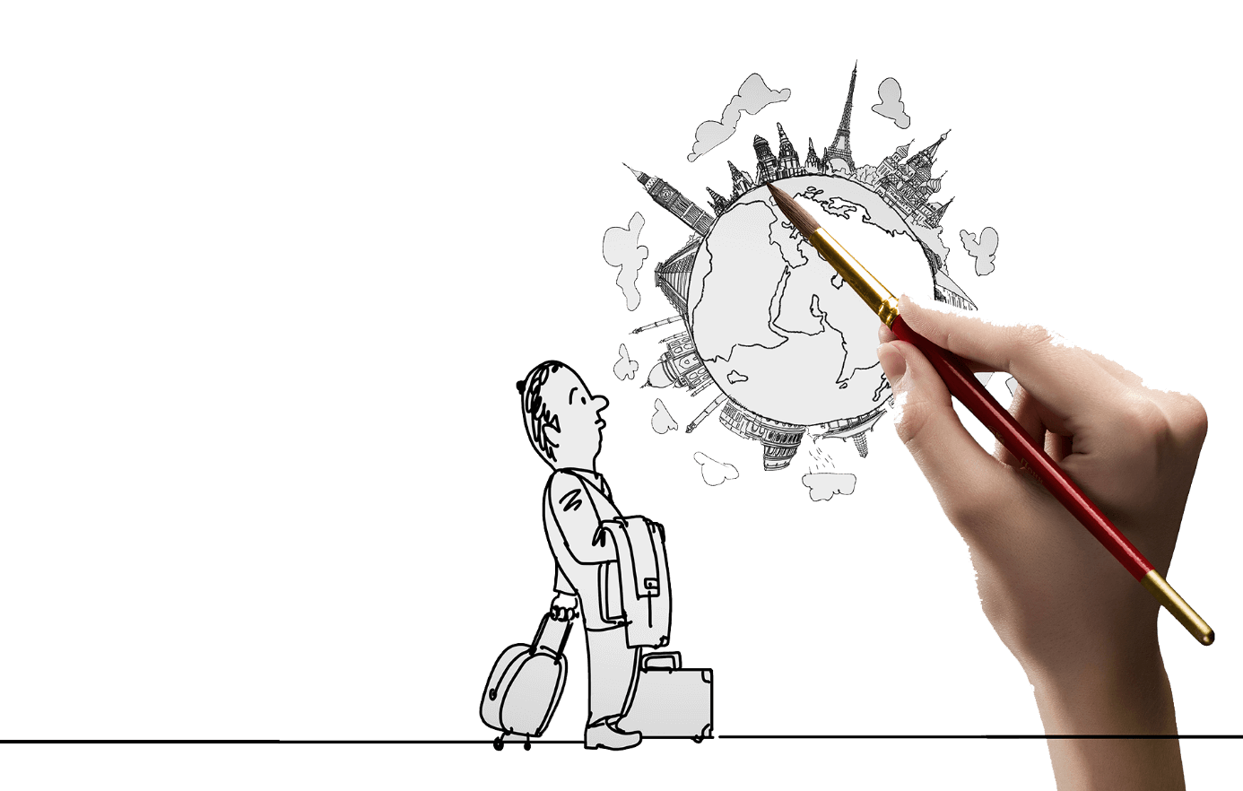
Services
Creative pure hand painted business
presentations Creative
pure hand painted business presentations
Solve all your worries
Our service standards are the first in the country, to solve any customer problems, one-on-one intimate service. Is the first in the country, to solve any customer problems, one-on-one intimate service.
Is the first in the country, to solve any customer problems, one-on-one intimate service. Is the first in the country, to solve any customer problems, one-on-one intimate service. Is the first in the country, to solve any customer problems, one-on-one intimate service. Is the first in the country, to solve any customer problems, one-on-one intimate service. Is the first in the country, to solve any customer problems, one-on-one intimate service. Is the first in the country, to solve any customer problems, one-on-one intimate service.

Slide 23
P
Art4
Creative pure hand painted business
presentations Creative
pure hand painted business presentations
Partners

Slide 24

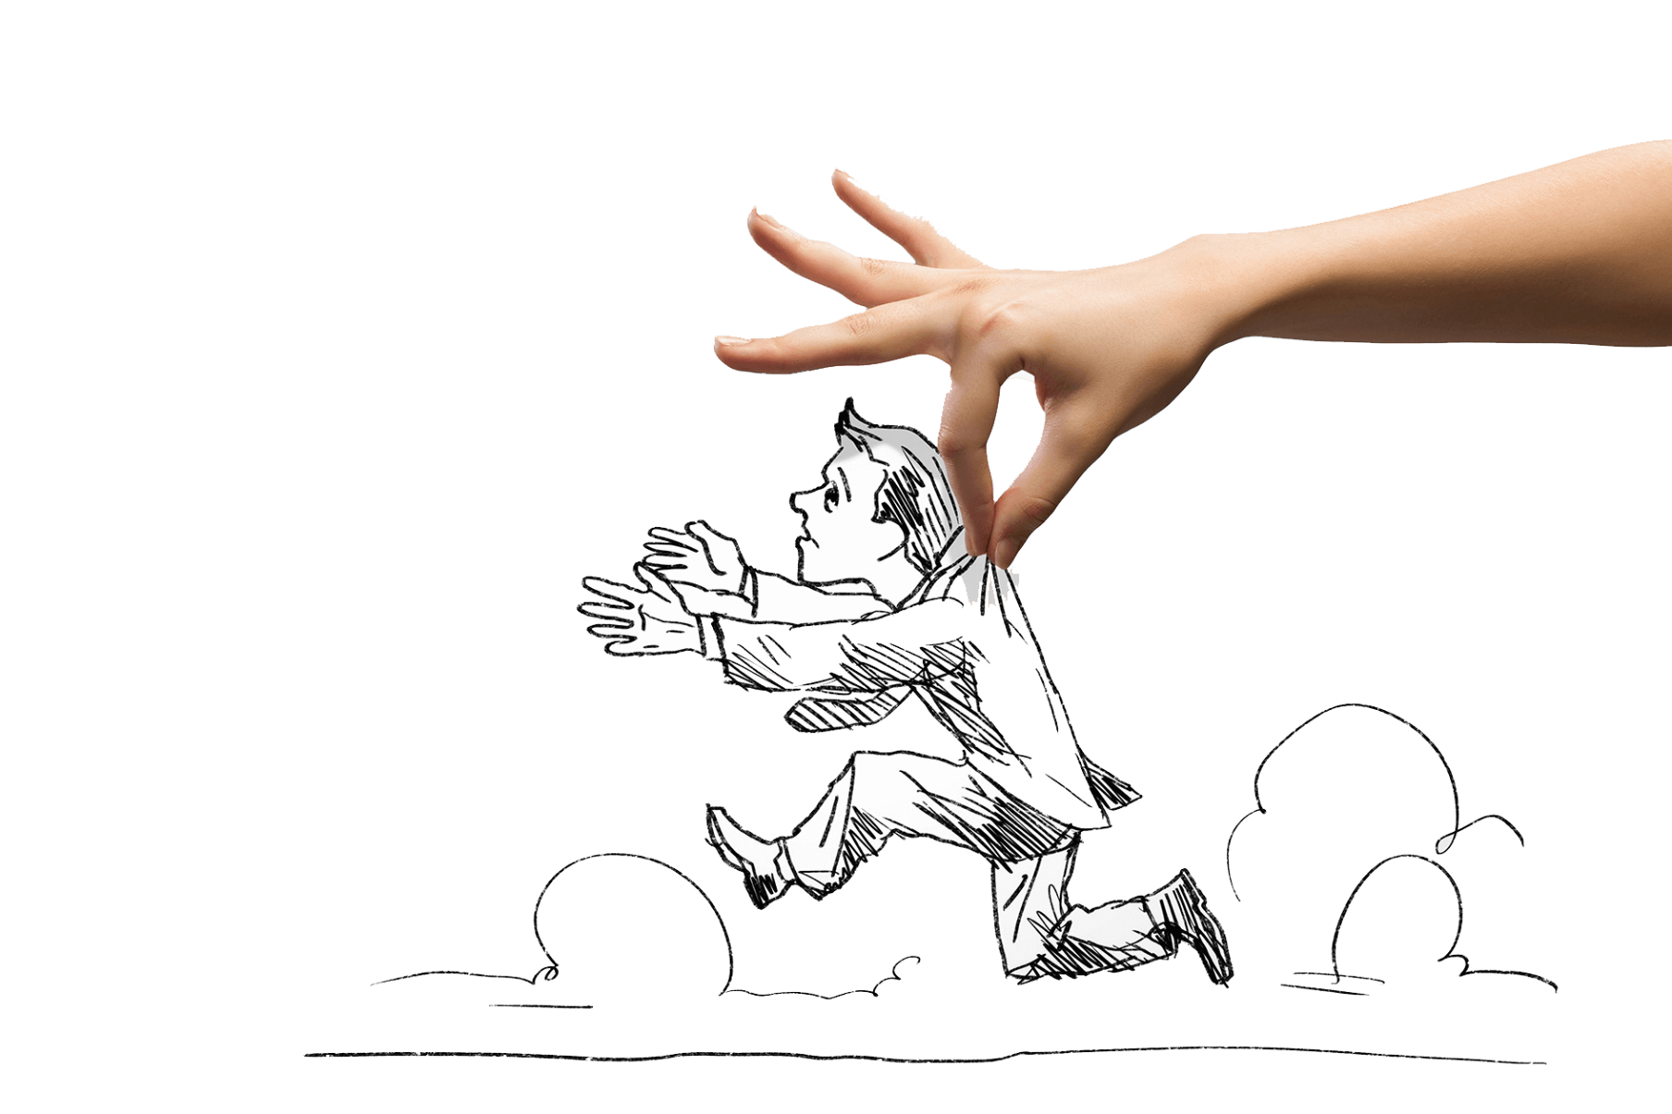
Partners
Creative pure hand painted business
presentations Creative
pure hand painted business presentations
Our service standards are the first in the country, to solve any customer problems, one-on-one intimate service.

Slide 25
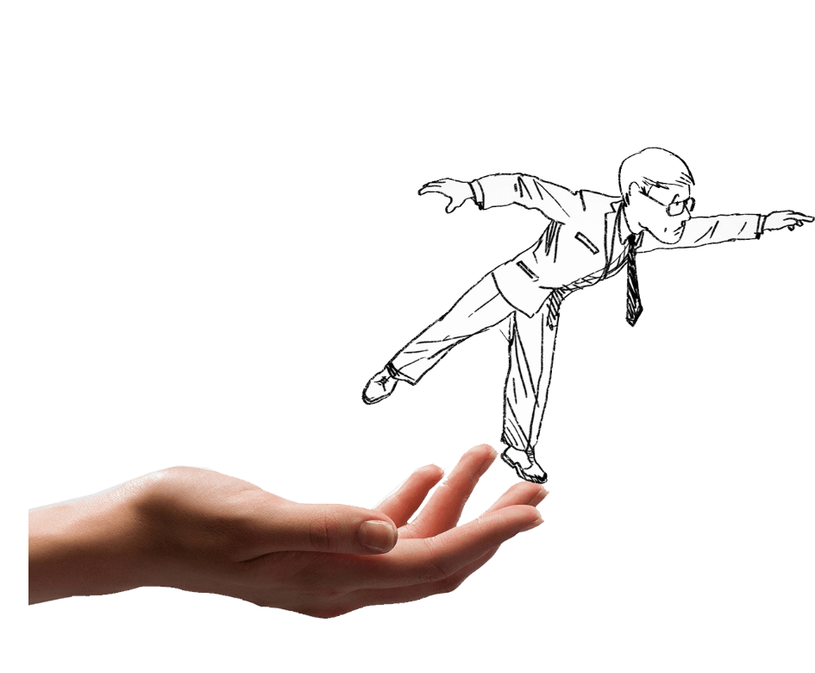
Partners
Creative pure hand painted business
presentations Creative
pure hand painted business presentations
Our service standards are the first in the country, to solve any customer problems, one-on-one intimate service.
Our service standards are the first in the country, to solve any customer problems, one-on-one intimate service.

Slide 26
P
Art5
Creative pure hand painted business
presentations Creative
pure hand painted business presentations
Market layout

Slide 27
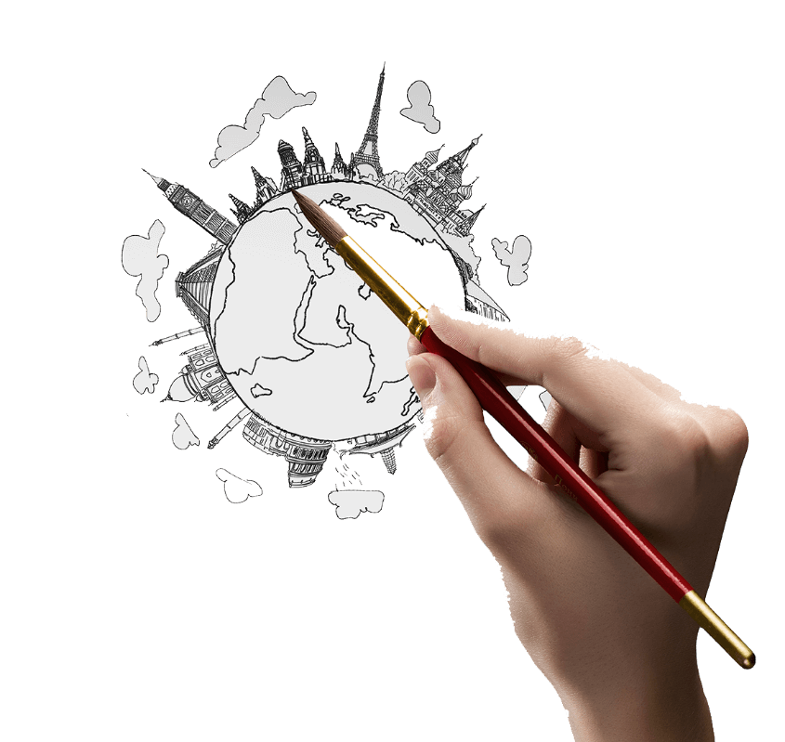
Our market
Creative pure hand painted business
presentations Creative
pure hand painted business presentations
Product advantages are mainly to highlight the advantages of their products and different from other products Where the advantages of the product characteristics are mainly to highlight the advantages of their products and different from other products Product characteristics are mainly to highlight the advantages of their products and different from other products.

Slide 28
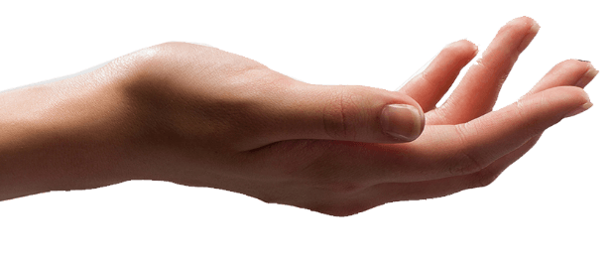
Domestic market
Creative pure hand painted business
presentations Creative
pure hand painted business presentations
National layout one
Our service standards are the first in the country, to solve any customer problems, one-on-one intimate service. Solve any customer's problems, one-on-one intimate service.
National layout one
Our service standards are the first in the country, to solve any customer problems, one-on-one intimate service. Solve any customer's problems, one-on-one intimate service.
National layout one
Our service standards are the first in the country, to solve any customer problems, one-on-one intimate service. Solve any customer's problems, one-on-one intimate service.

Slide 29
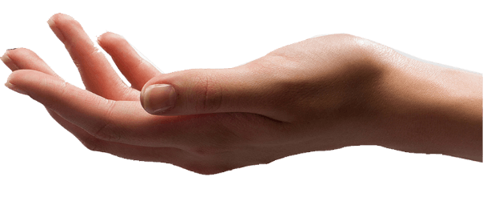
Overseas markets
Creative pure hand painted business
presentations Creative
pure hand painted business presentations
Overseas Layout One
Our service standards are the first in the country, to solve any customer problems, one-on-one intimate service. Solve any customer's problems, one-on-one intimate service.
Overseas Layout II
Our service standards are the first in the country, to solve any customer problems, one-on-one intimate service. Solve any customer's problems, one-on-one intimate service.

Slide 30
P
Art6
Creative pure hand painted business
presentations Creative
pure hand painted business presentations
Case Show

Slide 31
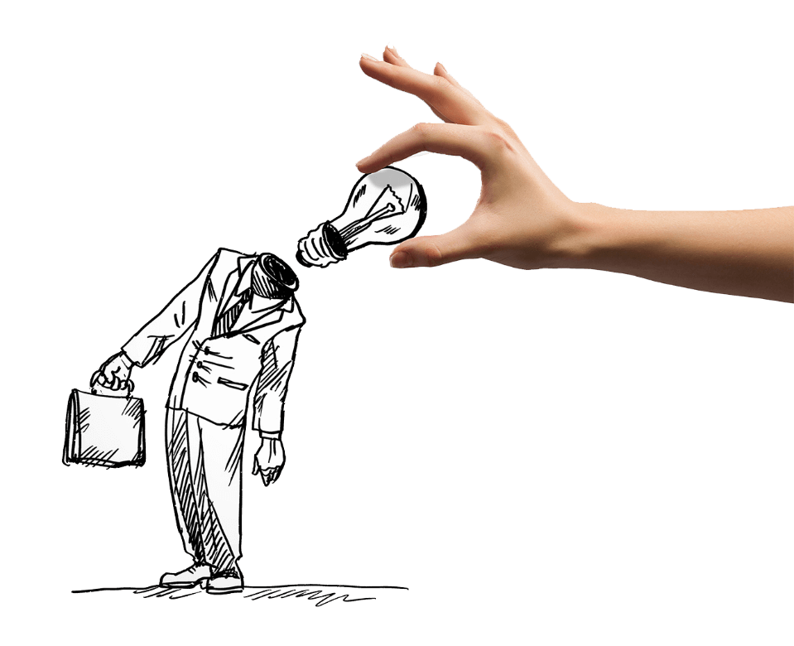
Our customers
Creative pure hand painted business
presentations Creative
pure hand painted business presentations
NBCustomer one
Our standards are the first in the country, to solve any customer problems, one-on-one intimate service. Our service standards are the first in the country, to solve any customer problems, one-on-one intimate service.
NBCustomer two
NBCustomer three
Our standards are the first in the country, to solve any customer problems, one-on-one intimate service. Our service standards are the first in the country, to solve any customer problems, one-on-one intimate service.
Our standards are the first in the country, to solve any customer problems, one-on-one intimate service. Our service standards are the first in the country, to solve any customer problems, one-on-one intimate service.

Slide 32
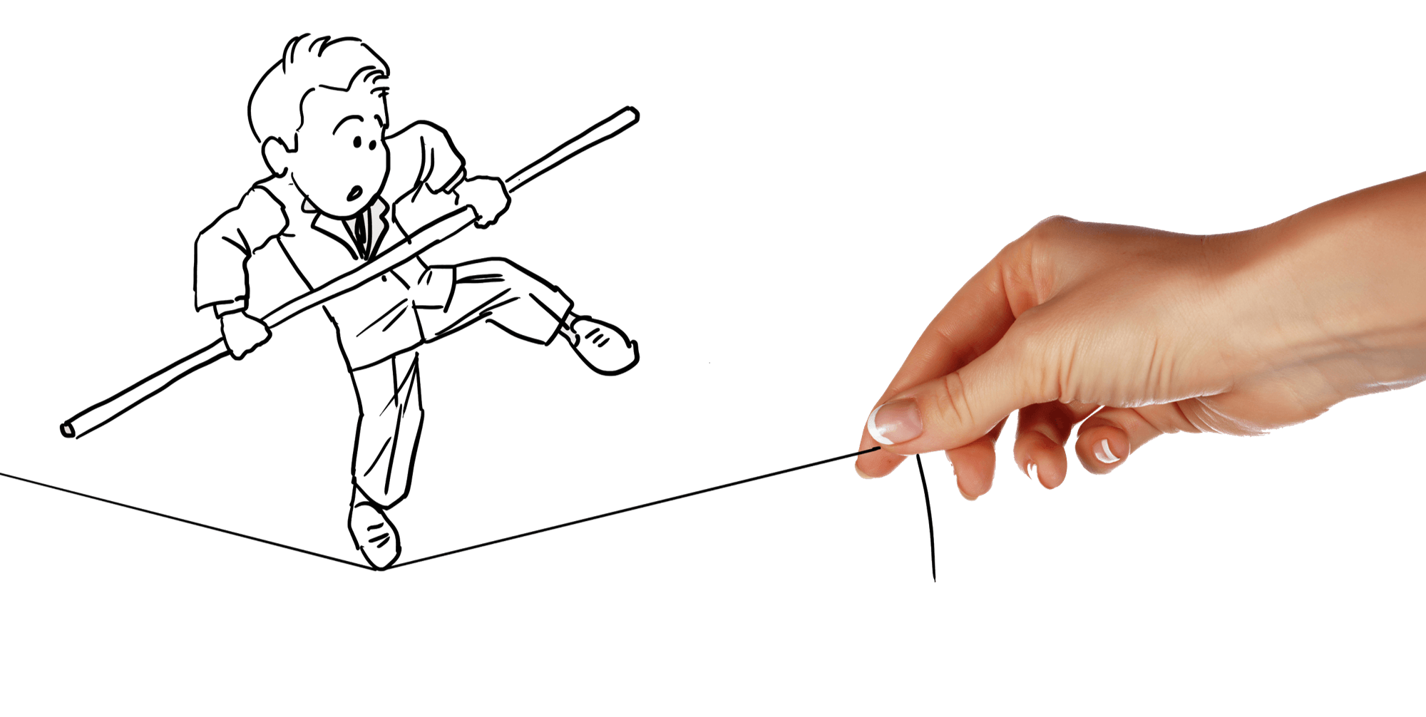
Case Show
Creative pure hand painted business
presentations Creative
pure hand painted business presentations
Our standards are the first in the country, to solve any customer problems, one-on-one intimate service. Our service standards are the first in the country, to solve any customer problems, one-on-one intimate service.

Slide 33
Case Show
Creative pure hand painted business
presentations Creative
pure hand painted business presentations
The so-called enterprise productrefers to the purposeful labor production of an enterprise, including both the tangible products of the production enterprises and the intangible products of the service industry.
Enterprise products include a variety of different forms, performance, use of thousands of. But they have a common characteristic, that is, people in a certain period of time production and business activities of the direct and effective results.

Slide 34
P
Art7
Creative pure hand painted business
presentations Creative
pure hand painted business presentations
Contact us

Slide 35
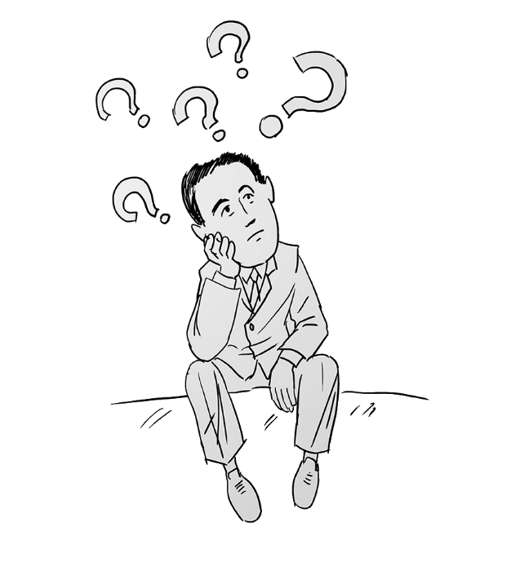
Contact us
Creative pure hand painted business
presentations Creative
pure hand painted business presentations
Address: Please enter the company office address Tel:021-88888888 021-88888888
Fax:021-88888888 021-88888888 Url:www.freeppt7.com

Slide 36
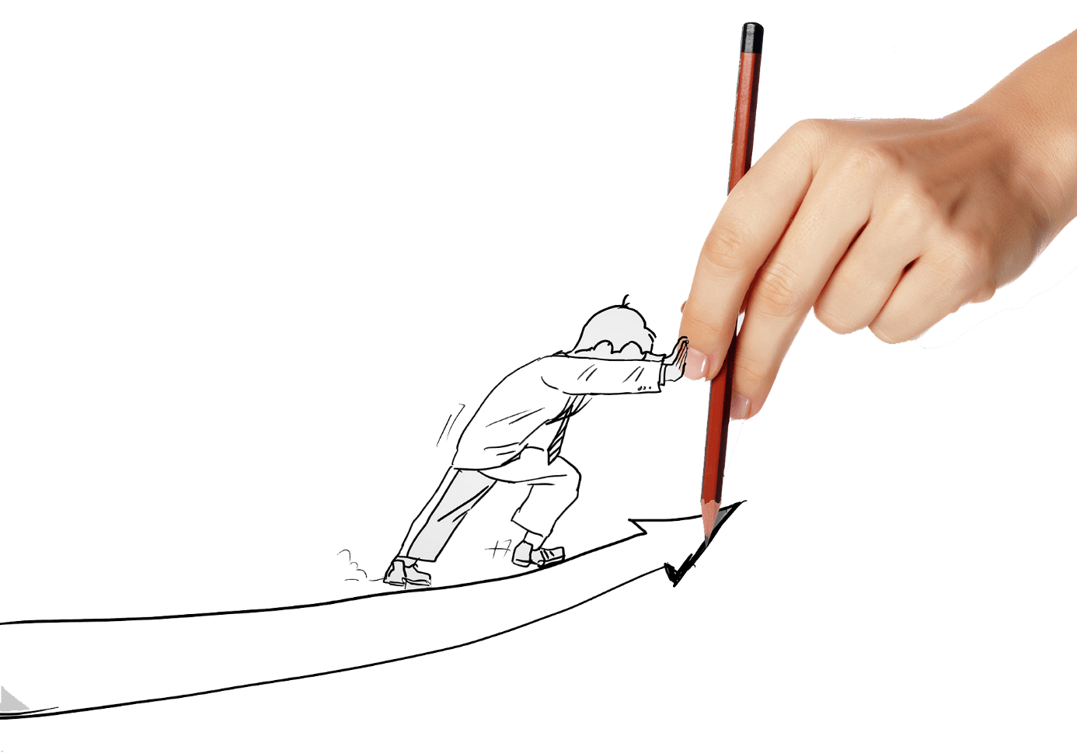
T
HANKS!
Creative hand painted business

Slide 37
Fully Editable Icon Set: A

Slide 38
Fully Editable Icon Set: B

Slide 39
Fully Editable Icon Set: C

