Slide 1
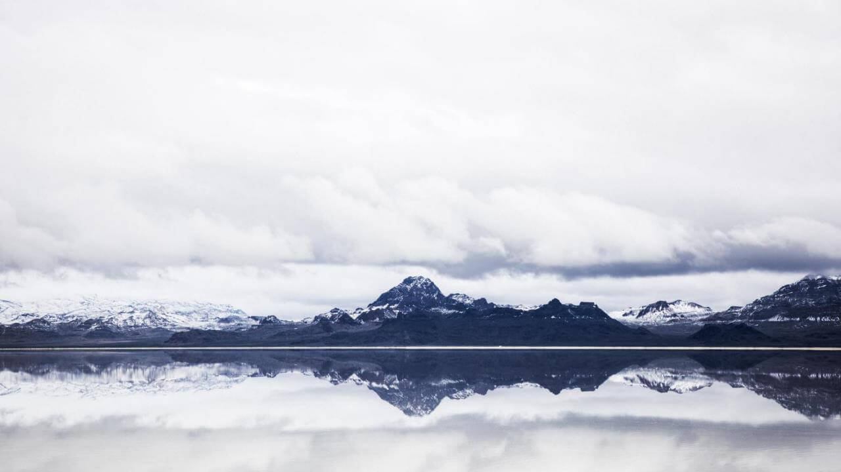
RANPINTANG
Minimalist album template
Ran pin tang，Focus on PPT optimization and substitution
template customization, ingenuity production
satisfy your needs
LOGO
https://www.freeppt7.com

Slide 2
01
Click here to add your title
And I've waited longer for you than I've waited for any woman.
02
Click here to add your title
And I've waited longer for you than I've waited for any woman.
03
Click here to add your title
And I've waited longer for you than I've waited for any woman.
04
Click here to add your title
And I've waited longer for you than I've waited for any woman.

Slide 3
PART ONE
Click here to add your title
I love you more than I've ever loved any woman. And I've waited longer for you than I've waited for any woman.
I love you more than I've ever loved any woman. And I've waited longer for you than I've waited for any woman.I love you more than I've ever loved any woman. And I've waited longer for you than I've waited for any woman.

Slide 4
I love you more than I've ever loved any woman. And I've waited longer for you than I've waited for any woman.
I love you more than I've ever loved any woman. And I've waited longer for you than I've waited for any woman.
DESTINY FREEDOM
DESTINY FREEDOM
I love you more than I've ever loved any woman. And I've waited longer for you than I've waited for any woman.
I love you more than I've ever loved any woman. And I've waited longer for you than I've waited for any woman.

Slide 5
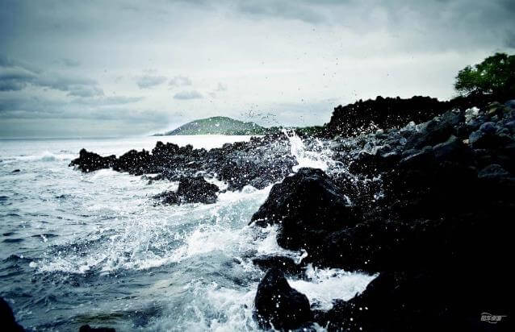
ALL OR NOTHING
NOW OR NEVER
I love you more than I've ever loved any woman. And I've waited longer for you than I've waited for any woman.
I love you more than I've ever loved any woman. And I've waited longer for you than I've waited for any woman.I love you more than I've ever loved any woman. And I've waited longer for you than I've waited for any woman.

Slide 6
ALL OR NOTHING
NOW OR NEVER
I love you more than I've ever loved any woman. And I've waited longer for you than I've waited for any woman.
I love you more than I've ever loved any woman. And I've waited longer for you than I've waited for any woman.I love you more than I've ever loved any woman. And I've waited longer for you than I've waited for any woman.
DESTINY FREEDOM
I love you more than I've ever loved any woman. And I've waited longer for you than I've waited for any woman.

Slide 7
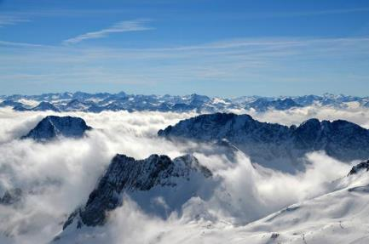
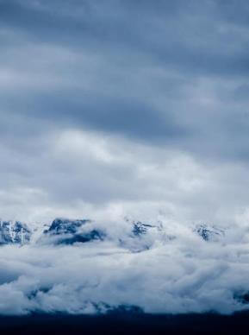
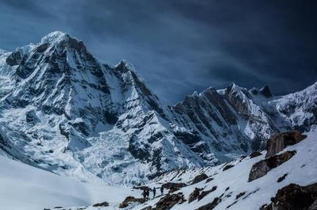
ALL OR
NOTHING
NOW OR
NEVER
I love you more than I've ever loved any woman. And I've waited longer for you than I've waited for any woman.
I love you more than I've ever loved any woman. And I've waited longer for you than I've waited for any woman.I love you more than I've ever loved any woman. And I've waited longer for you than I've waited for any woman.

Slide 8
PART TWO
Click here to add your title
I love you more than I've ever loved any woman. And I've waited longer for you than I've waited for any woman.
I love you more than I've ever loved any woman. And I've waited longer for you than I've waited for any woman.I love you more than I've ever loved any woman. And I've waited longer for you than I've waited for any woman.

Slide 9
ALL OR NOTHING
NOW OR NEVER
I love you more than I've ever loved any woman. And I've waited longer for you than I've waited for any woman.
I love you more than I've ever loved any woman. And I've waited longer for you than I've waited for any woman.I love you more than I've ever loved any woman. And I've waited longer for you than I've waited for any woman.
I love you more than I've ever loved any woman. And I've waited longer for you than I've waited for any woman.

Slide 10
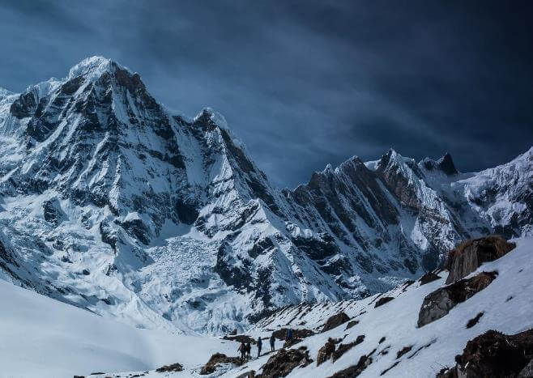
ALL OR NOTHING
NOW OR NEVER
I love you more than I've ever loved any woman. And I've waited longer for you than I've waited for any woman.
I love you more than I've ever loved any woman. And I've waited longer for you than I've waited for any woman.
DESTINY FREEDOM
I love you more than I've ever loved any woman. And I've waited longer for you than I've waited for any woman.I love you more than I've ever loved any woman. And I've waited longer for you than I've waited for any woman.

Slide 11
DESTINY
DESTINY
DESTINY
DESTINY
DESTINY
And I've waited longer for you than I've waited for any woman.
And I've waited longer for you than I've waited for any woman.
And I've waited longer for you than I've waited for any woman.
And I've waited longer for you than I've waited for any woman.
And I've waited longer for you than I've waited for any woman.
DESTINY FREEDOM

Slide 12
ALL OR NOTHING
NOW OR NEVER
DESTINY FREEDOM
I love you more than I've ever loved any woman. And I've waited longer for you than I've waited for any woman.
I love you more than I've ever loved any woman. And I've waited longer for you than I've waited for any woman.I love you more than I've ever loved any woman. And I've waited longer for you than I've waited for any woman.
I love you more than I've ever loved any woman. And I've waited longer for you than I've waited for any woman.

Slide 13
DESTINY FREEDOM
DESTINY FREEDOM
I love you more than I've ever loved any woman. And I've waited longer for you than I've waited for any woman.
I love you more than I've ever loved any woman. And I've waited longer for you than I've waited for any woman.I love you more than I've ever loved any woman. And I've waited longer for you than I've waited for any woman.
I love you more than I've ever loved any woman. And I've waited longer for you than I've waited for any woman.
I love you more than I've ever loved any woman. And I've waited longer for you than I've waited for any woman.I love you more than I've ever loved any woman. And I've waited longer for you than I've waited for any woman.

Slide 14
PART THREE
Click here to add your title
I love you more than I've ever loved any woman. And I've waited longer for you than I've waited for any woman.
I love you more than I've ever loved any woman. And I've waited longer for you than I've waited for any woman.I love you more than I've ever loved any woman. And I've waited longer for you than I've waited for any woman.

Slide 15
DESTINY FREEDOM
I love you more than I've ever loved any woman. And I've waited longer for you than I've waited for any woman.
I love you more than I've ever loved any woman. And I've waited longer for you than I've waited for any woman.I love you more than I've ever loved any woman. And I've waited longer for you than I've waited for any woman.
DESTINY FREEDOM
I love you more than I've ever loved any woman. And I've waited longer for you than I've waited for any woman.
I love you more than I've ever loved any woman. And I've waited longer for you than I've waited for any woman.I love you more than I've ever loved any woman. And I've waited longer for you than I've waited for any woman.

Slide 16
S
DESTINY FREEDOM
I love you more than I've ever loved any woman. And I've waited longer for you than I've waited for any woman.
I love you more than I've ever loved any woman. And I've waited longer for you than I've waited for any woman.I love you more than I've ever loved any woman. And I've waited longer for you than I've waited for any woman.

Slide 17
W
DESTINY FREEDOM
I love you more than I've ever loved any woman. And I've waited longer for you than I've waited for any woman.
I love you more than I've ever loved any woman. And I've waited longer for you than I've waited for any woman.I love you more than I've ever loved any woman. And I've waited longer for you than I've waited for any woman.

Slide 18
O
DESTINY FREEDOM
I love you more than I've ever loved any woman. And I've waited longer for you than I've waited for any woman.
I love you more than I've ever loved any woman. And I've waited longer for you than I've waited for any woman.I love you more than I've ever loved any woman. And I've waited longer for you than I've waited for any woman.

Slide 19
T
DESTINY FREEDOM
I love you more than I've ever loved any woman. And I've waited longer for you than I've waited for any woman.
I love you more than I've ever loved any woman. And I've waited longer for you than I've waited for any woman.I love you more than I've ever loved any woman. And I've waited longer for you than I've waited for any woman.

Slide 20
PART FOUR
Click here to add your title
I love you more than I've ever loved any woman. And I've waited longer for you than I've waited for any woman.
I love you more than I've ever loved any woman. And I've waited longer for you than I've waited for any woman.I love you more than I've ever loved any woman. And I've waited longer for you than I've waited for any woman.

Slide 21
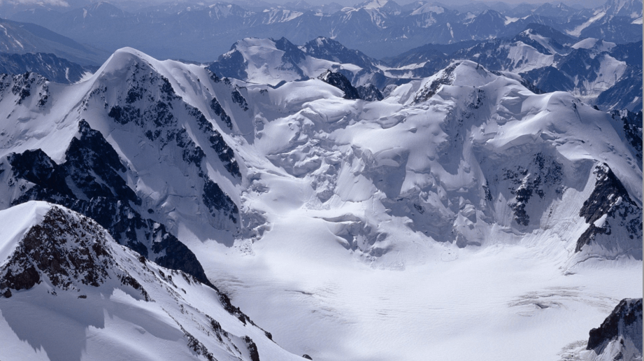
ALL OR NOTHING
NOW OR NEVER
I love you more than I've ever loved any woman. And I've waited longer for you than I've waited for any woman.
I love you more than I've ever loved any woman. And I've waited longer for you than I've waited for any woman.I love you more than I've ever loved any woman. And I've waited longer for you than I've waited for any woman.
I love you more than I've ever loved any woman. And I've waited longer for you than I've waited for any woman.

Slide 22
Click here to add your title
I love you more than I've ever loved any woman. And I've waited longer for you than I've waited for any woman.
DESTINY FREEDOM
I love you more than I've ever loved any woman. And I've waited longer for you than I've waited for any woman.
I love you more than I've ever loved any woman. And I've waited longer for you than I've waited for any woman.

Slide 23
DESTINY FREEDOM
I love you more than I've ever loved any woman. And I've waited longer for you than I've waited for any woman.
I love you more than I've ever loved any woman. And I've waited longer for you than I've waited for any woman.I love you more than I've ever loved any woman. And I've waited longer for you than I've waited for any woman.

Slide 24
ALL OR NOTHING
NOW OR NEVER
I love you more than I've ever loved any woman. And I've waited longer for you than I've waited for any woman.
I love you more than I've ever loved any woman. And I've waited longer for you than I've waited for any woman.I love you more than I've ever loved any woman. And I've waited longer for you than I've waited for any woman.
I love you more than I've ever loved any woman. And I've waited longer for you than I've waited for any woman.

Slide 25
RANPINTANG
Thank you
I love you more than I've ever loved any woman
LOGO
https://www.freeppt7.com

