Slide 1
LOGO
Insert the Subtitle of Your Presentation.
Colored circle PPT Template
Reporter:freeppt7.com. Time:2030.12.12
https://www.freeppt7.com.

Slide 2
1
2
3
Title text presets.
Title text presets.
Title text presets.
This section.
Displayed as a literal layout.
This section.
Displayed as a literal layout.
This section.
Displayed as a literal layout.
4
5
6
Title text presets.
Title text presets.
Title text presets.
This section.
Displayed as a literal layout.
This section.
Displayed as a literal layout.
This section.
Displayed as a literal layout.

Slide 3

Click to enter the title text
01
02
03
Keywords.
Title text presets.
Title text presets.
Title text presets.
Keywords.
Keywords.
Keywords.
Title text presets.
This section is displayed as a typography location (subject fonts are recommended)
If you want to change, adjust it under the (format shape) menu (text options).

Slide 4

Click to enter the title text
"
Today is very short, but today is very important, beautiful today, not only can turn yesterday's glory into tomorrow's glory, but also can turn yesterday's failure into tomorrow's success.
Title text presets.
Title text presets.

Slide 5
Click to enter the title text.
Please enter text text text, please enter text text please enter text text please enter text text please enter text text text. Please enter text text text, please enter text text please enter text text please enter text text please enter text text text.
01。
02。
03。
04。
The title text.
The title text.
The title text.
The title text.
Please enter the text text, please enter the text text.
Please enter the text text, please enter the text text.
Please enter the text text, please enter the text text.
Please enter the text text, please enter the text text.

Slide 6
Click to enter the title text.
01
02
03
Keywords.
Title text presets.
Title text presets.
Title text presets.
Keywords.
Keywords.
Keywords.
Title text presets.
This section is displayed as a typography location (subject fonts are recommended)
If you want to change, adjust it under the (format shape) menu (text options).

Slide 7




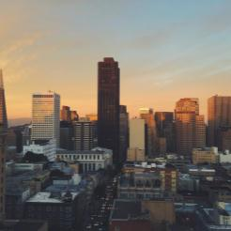




Click to enter the title text.
Title text presets.
This section is displayed as a text layout.
(It is recommended to use theme font)
Title text presets.
This section is displayed as a text layout.
(It is recommended to use theme font)
"
Please enter the title text.
Please enter text text please enter text text please enter text text please enter text text please enter text text please enter the text text please enter the text text.
Please enter the text text of this text.
Title text presets.
This section is displayed as a text layout.
(It is recommended to use theme font)

Slide 8



Click to enter the title text.
Please enter the title text.
Please enter the title text.
Please enter the title text.
Please enter text text please enter text text please enter text text please enter text please enter text text please enter text text.
Please enter text text please enter text text please enter text text please enter text please enter text text please enter text text.
Please enter text text please enter text text please enter text text please enter text please enter text text please enter text text.

Slide 9



Click to enter the title text.
The title text is added.
Users can present on a projector or computer, or they can print a presentation and make it into film for application to a wider range of areas. Use.Microsoft Office PowerPoint.Not only can you create presentations, you can also hold face-to-face meetings, remote meetings, or present presentations to your audience on the Internet.

Slide 10




Click to enter the title text.
The title text is added.
Users can present on a projector or computer, or they can print a presentation and make it into film for application to a wider range of areas.
The title text is added.
The title text is added.
The title text is added.
The title text is added.
The title text is added.
The title text is added.
The title text is added.
The title text is added.
The title text is added.
The title text is added.
The title text is added.
The title text is added.

Slide 11
Click to enter the title text.
The title text is added.
The title text is added.
Users can present on a projector or computer or print a presentation into film for application to a wider range of areas.
Users can present on a projector or computer or print a presentation into film for application to a wider range of areas.
PART 01.
PART 02.
The title text is added.
The title text is added.
PART 04.
PART 03.
Users can present on a projector or computer or print a presentation into film for application to a wider range of areas.
Users can present on a projector or computer or print a presentation into film for application to a wider range of areas.

Slide 12
Click to enter the title text
Text is added.
Text is added.
Text is added.
Users can present on a projector or computer.
Users can present on a projector or computer.
Users can present on a projector or computer.

Slide 13

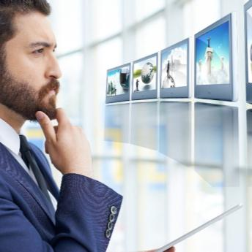

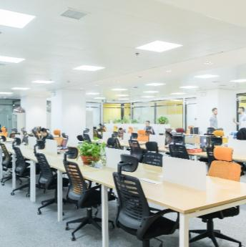
Click to enter the title text.
The title text is added.
Users can present on a projector or computer, or they can print a presentation and make it into film for application to a wider range of areas. Use.Microsoft Office PowerPoint.Not only can you create presentations, you can also hold face-to-face meetings, remote meetings, or present presentations to your audience on the Internet.
PART 01.
PART 02.
PART 03.
PART 04.

Slide 14
Click to enter the title text
PART 01
PART 02
PART 03
PART 04
Text is added.
Text is added.
Text is added.
Text is added.
Users can present on a projector or computer or print out a presentation.
Users can present on a projector or computer or print out a presentation.
Users can present on a projector or computer or print out a presentation.
Users can present on a projector or computer or print out a presentation.

Slide 15
Click to enter the title text.
Keywords.
Keywords.
Keywords.
Keywords.
Keywords.
The title text is added.
Users can present on a projector or computer, or they can print a presentation and make it into film for application to a wider range of areas. Use.Microsoft Office PowerPoint.Not only can you create presentations, you can also hold face-to-face meetings, remote meetings, or present presentations to your audience on the Internet.

Slide 16
Click to enter the title text.
PART01.
Users can present on a projector or computer or print a presentation into film.
PART03.
Users can present on a projector or computer or print a presentation into film.
OUR BEGINNINGS.
OUR BEGINNINGS.
Users can present on a projector or computer or print a presentation into film.
PART02.
Users can present on a projector or computer or print a presentation into film.
PART04.
OUR BEGINNINGS.
OUR BEGINNINGS.

Slide 17
Click to enter the title text.
PART05.
Users can present on a projector or computer or print a presentation into film.
PART07.
OUR BEGINNINGS.
OUR BEGINNINGS.
Users can present on a projector or computer or print a presentation into film.
PART06.
Users can present on a projector or computer or print a presentation into film.
OUR BEGINNINGS.

Slide 18
Click to enter the title text.
The title text is added.
The title text is added.
Users can present on a projector or computer or print a presentation into film for application to a wider range of areas.
Users can present on a projector or computer or print a presentation into film for application to a wider range of areas.
The title text is added.
The title text is added.
Users can present on a projector or computer or print a presentation into film for application to a wider range of areas.
Users can present on a projector or computer or print a presentation into film for application to a wider range of areas.

Slide 19
Click to enter the title text.
The title text is added.
Users can present on a projector or computer, or they can print out the presentation.
The title text is added.
Users can present on a projector or computer, or they can print out the presentation.
The title text is added.
Users can present on a projector or computer, or they can print out the presentation.

Slide 20
Click to enter the title text
The title text is added.
Users can present on a projector or computer, or they can print out the presentation.
The title text is added.
Users can present on a projector or computer, or they can print out the presentation.
The title text is added.
Users can present on a projector or computer, or they can print out the presentation.

Slide 21
Click to enter the title text.
The title text is added.
The title text is added.
70
90
Users can present on a projector or computer or print a presentation into film for application to a wider range of areas.
Users can present on a projector or computer or print a presentation into film for application to a wider range of areas.
The title text is added.
The title text is added.
50
30
Users can present on a projector or computer or print a presentation into film for application to a wider range of areas.
Users can present on a projector or computer or print a presentation into film for application to a wider range of areas.

Slide 22


Click to enter the title text.
The title text is added.
Users can present on a projector or computer, or they can print a presentation and make it into film for application to a wider range of areas.
The title text.
65%
The title text.
85%
The title text.
74%

Slide 23
THANKS

