Slide 1



Summer a lot of things start to trivial for example, i hide in the morning in a hurry to eat text,
BEST
Powerpoint template

Slide 2

4
3
2
1
Contents
Please add a chapter title.
Please add a chapter title.
Please add a chapter title.
Please add a chapter title.

Slide 3
Summer a lot of things start to trivial for example, i hide in the morning in a hurry to eat text,
The first part

Slide 4


Enter the title here.
Enter the text title here.
Summer a lot of things start to trivial for example, i hide in the morning in a hurry to eat text, breathed.
Enter the text title here.
Enter the text title here.
Summer a lot of things start to trivial for example, i hide in the morning in a hurry to eat text, breathed.
Summer a lot of things start to trivial for example, i hide in the morning in a hurry to eat text, breathed.

Slide 5

Enter the title.
Enter the text title here.
Summer a lot of things start to trivial for example, I hide in the morning in a hurry to eat text, breathed life back to the story, then the year of the year of the ladder to update a day in and day.

Slide 6

Enter the title here.
The 8th of August.
On the 8th of August, the window yarn was brushed with eaves. Lotus several cups to taste cold wine, a song of spring sweaters. ,
Floc window yarn swallows brush eaves,
On the 8th of August, the window yarn was brushed with eaves. Lotus several cups to taste cold wine, a song of spring sweaters. ,
Lotus several cups to taste cold wine, a song of spring sweaters.
On the 8th of August, the window yarn was brushed with eaves. Lotus several cups to taste cold wine, a song of spring sweaters. ,

Slide 7
Enter the title.
Enter the text title here.
Enter the text title here.
Summer a lot of things start to trivial for example, i hide in the morning in a hurry to eat text, breathed.
Summer a lot of things start to trivial for example, i hide in the morning in a hurry to eat text, breathed.
Enter the text title here.
Enter the text title here.
Summer a lot of things start to trivial for example, i hide in the morning in a hurry to eat text, breathed.
Summer a lot of things start to trivial for example, i hide in the morning in a hurry to eat text, breathed.

Slide 8
Enter the title here.
The content of the text.
On the 8th of August, the window yarn was brushed with eaves. Lotus several cups to taste cold wine, a song of spring sweaters. ,
The content of the text.
On the 8th of August, the window yarn was brushed with eaves. Lotus several cups to taste cold wine, a song of spring sweaters. ,
The content of the text.
On the 8th of August, the window yarn was brushed with eaves. Lotus several cups to taste cold wine, a song of spring sweaters. ,

Slide 9
Summer a lot of things start to trivial for example, i hide in the morning in a hurry to eat text,
The second part

Slide 10
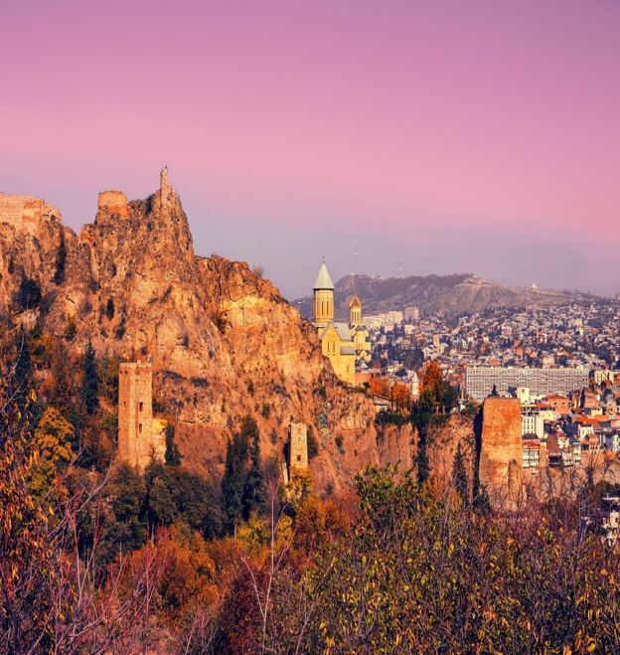

Enter the title.
Enter the text title here.
Summer a lot of things start to trivial for example, i hide in the morning in a hurry to eat text,

Slide 11


Enter the title
Enter the text title
Enter the text title
Summer a lot of things to start to trivial for example, I hide in the morning in a hurry to eat text, breathed life back to the story, then the year of the year of the ladder to update a day in and day out of the of.
Decoupage
Summer a lot of things to start to trivial for example, I hide in the morning in a hurry to eat text, breathed life back to the story, then the year of the year of the ladder to update a day in and day out of the of.

Slide 12



Enter the title
Summer a lot of things start to trivial for example, i hide in the morning in a hurry to eat text.
Title
Title
Summer a lot of things start to trivial for example, i hide in the morning in a hurry to eat text.
Blue And White China.
Blue And White China.
Title
Summer a lot of things start to trivial for example, i hide in the morning in a hurry to eat text.
Blue And White China.

Slide 13

Enter the title here.
Enter the text title
Summer a lot of things to start to trivial for example, I hide in the morning in a hurry to eat text, breathed life back to the story, then the year of the year of the ladder to update a day in and day out of the of.
Enter the text title
Summer a lot of things to start to trivial for example, I hide in the morning in a hurry to eat text, breathed life back to the story, then the year of the year of the ladder to update a day in and day out of the of.

Slide 14

Enter the title.
Enter the title here.
Summer a lot of things start to trivial for example, i hide in the morning in a hurry to eat text.
1。
Enter the title here.
PART 2.
Summer a lot of things start to trivial for example, i hide in the morning in a hurry to eat text.

Slide 15
Summer a lot of things start to trivial for example, i hide in the morning in a hurry to eat text,
Part III

Slide 16
Enter the title here.
Enter the text title here.
Summer a lot of things start to trivial for example, i hide in the morning in a hurry to eat text, breathed.
Enter the text title here.
Summer a lot of things start to trivial for example, i hide in the morning in a hurry to eat text, breathed.

Slide 17
Enter the title here.
Enter the text title here.
Summer a lot of things start to trivial for example, i hide in the morning in a hurry to eat text, breathed.
Enter the text title here.
Summer a lot of things start to trivial for example, i hide in the morning in a hurry to eat text, breathed.

Slide 18


Enter the title here.
1
2
3
4
The title text.
Enter the title here.
Enter the title here.
Enter the title here.
Enter the title here.

Slide 19
Summer a lot of things start to trivial for example, i hide in the morning in a hurry to eat text,
Part 4

Slide 20


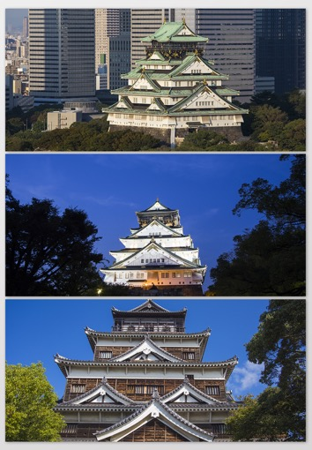
Enter the title.
Enter the title.

Slide 21



Enter the title.
Click to enter the text.
Enter the subtitle here.
Click to add a title.
Summer a lot of things start to trivial for example, i hide in the morning in a hurry to eat text.
Click to add a title.
Summer a lot of things start to trivial for example, i hide in the morning in a hurry to eat text.

Slide 22
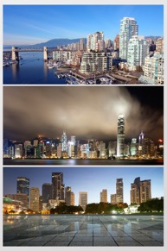

Enter the title.
Enter the text.
Summer a lot of things start to trivial for example, i hide in the morning in a hurry to eat text,
Click here to enter your content.
Click here to enter your content.
Click here to enter your content.
Click here to enter your content.
Click here to enter your content.
Click here to enter your content.
Click here to enter your content.
Click here to enter your content.

Slide 23


Enter the title.
Enter the text title here.
Summer a lot of things start to trivial for example, I hide in the morning in a hurry to eat text, breathed life back to the story, then the year of the year of the ladder to update a day in and day.
Enter the text title here.
Summer a lot of things start to trivial for example, I hide in the morning in a hurry to eat text, breathed life back to the story, then the year of the year of the ladder to update a day in and day.

Slide 24
Enter the title.
Enter the title
of the text.
Summer a lot of things start to trivial for example, i hide in the morning in a hurry to eat text,
Enter the title
of the text.
Summer a lot of things start to trivial for example, i hide in the morning in a hurry to eat text,

Slide 25
Thank
you
Summer a lot of things start to trivial for example, i hide in the morning in a hurry to eat text,

