Slide 1
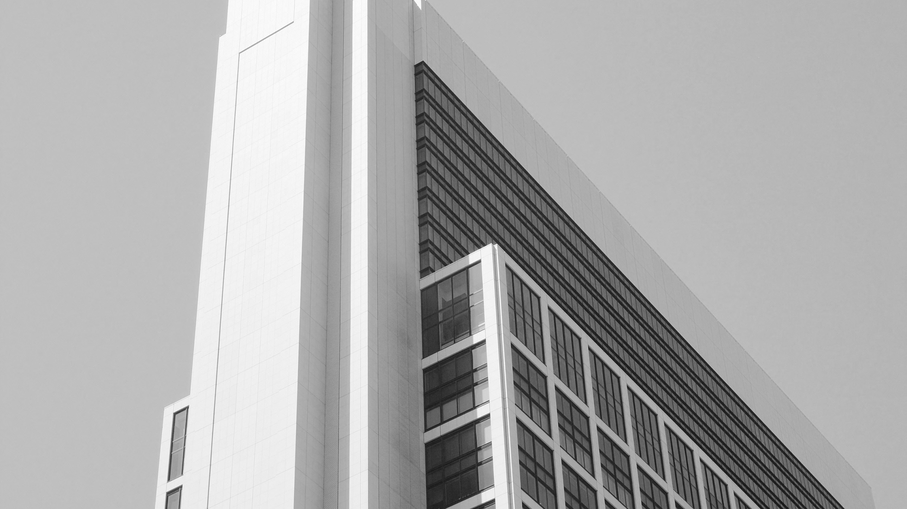

Investment proposal
The user can station on a projector or computer, or print the station on a projector or computer, or print the presentation.

Slide 2
An overview of the project
The user can switch on a projector or computer, or print the switch on a projector or computer, or print the.
CONTENT
The background of the project
The user can station on a projector or computer, or print the station on a projector or computer, or print the presentation.
The user can switch on a projector or computer, or print the switch on a projector or computer, or. print the.
Development planning
The user can switch on a projector or computer, or print the switch on a projector or computer, or. print the.
Financing plan
The user can switch on a projector or computer, or print the switch on a projector or computer, or. print the.

Slide 3

PART 01
An overview of the project
The user can switch on a projector or computer, or print the switch on a projector or computer, or print the.

Slide 4

An overview of the project
The user can switch on a projector or computer, or print the switch on a projector or computer, or print the.
The title is added.
The user can judge on a projector or computer, or print the presentation and make it into a film to be used in a wider field.
The title is added.
The title is added
The user can judge on a projector or computer, or print the presentation and make it into a film to be used in a wider field.
The user can judge on a projector or computer, or print the presentation and make it into a film to be used in a wider field.
The title is added.
The title is added.
The user can judge on a projector or computer, or print the presentation and make it into a film to be used in a wider field.
The user can judge on a projector or computer, or print the presentation and make it into a film to be used in a wider field.

Slide 5
An overview of the project
The user can switch on a projector or computer, or print the switch on a projector or computer, or print the.
70%
The title is added.
The user can judge on a projector or computer, or print the presentation and make it into a film to be used in a wider field.
40%
The title is added.
The user can judge on a projector or computer, or print the presentation and make it into a film to be used in a wider field.

Slide 6


An overview of the project
The user can switch on a projector or computer, or print the switch on a projector or computer, or print the.
The title is added.
The user can judge on a projector or computer, or print the presentation and make it into a film to be used in a wider field.
The title is added.
The title is added.
The user can judge on a projector or computer, or print the presentation and make it into a film to be used in a wider field.
The user can judge on a projector or computer, or print the presentation and make it into a film to be used in a wider field.
The title is added.
The user can judge on a projector or computer, or print the presentation and make it into a film to be used in a wider field.

Slide 7
An overview of the project
The user can switch on a projector or computer, or print the switch on a projector or computer, or print the.
The title text
The user can switch on a projector or computer, or presentation.
The title text
The user can switch on a projector or computer, or presentation.
The title text
The user can switch on a projector or computer, or presentation.
The title text
The user can stop on a projector or computer, or presentation and presentation it make film to be used in a wider field.
The title text
The user can stop on a projector or computer, or presentation and presentation it make film to be used in a wider field.

Slide 8
PART 02
The background of the project
The user can switch on a projector or computer, or print the switch on a projector or computer, or print the.

Slide 9


The background of the project
The user can switch on a projector or computer, or print the switch on a projector or computer, or print the.
The title text is added
The user can judge on a projector or computer, or presentation and it make film to be used in a wider. FieldThe. user can can switch on a projector or computer, or presentation.
10
%
60
%
The title text
The title text
The user can stop on a projector or computer, or presentation and presentation it make film to be used in a wider field.
The user can stop on a projector or computer, or presentation and presentation it make film to be used in a wider field.

Slide 10

The background of the project
The user can switch on a projector or computer, or print the switch on a projector or computer, or print the.
36%
The title
The user can stop on a projector or computer, or presentation and presentation it make film to be used in a wider field.
The title text is added
The title text is added
The user can judge on a projector or computer, or presentation and it make film to be used in a wider. FieldThe. user can can switch on a projector or computer, or presentation.
The user can judge on a projector or computer, or presentation and it make film to be used in a wider. FieldThe. user can can switch on a projector or computer, or presentation.

Slide 11

The background of the project
The user can switch on a projector or computer, or print the switch on a projector or computer, or print the.
The user can judge on a projector or computer, or print the presentation and make it into a film to be used in a wider field.
The title is added
The user can judge on a projector or computer, or print the presentation and make it into a film to be used in a wider field. The user can judge on a projector or computer, or print the presentation and make it into a film to be used in a wider field.
The user can judge on a projector or computer, or print the presentation and make it into a film to be used in a wider field.
The user can judge on a projector or computer, or print the presentation and make it into a film to be used in a wider field.

Slide 12
The background of the project
The user can switch on a projector or computer, or print the switch on a projector or computer, or print the.
The title text
2021Years
The user can stop on a projector or computer, or presentation and presentation it make film to be used in a wider field.
The title text
The user can stop on a projector or computer, or presentation and presentation it make film to be used in a wider field.
2021Years
The title text
2021Years
The user can stop on a projector or computer, or presentation and presentation it make film to be used in a wider field.
The title text
The user can stop on a projector or computer, or presentation and presentation it make film to be used in a wider field.
2021Years
The title text
2021Years
The user can stop on a projector or computer, or presentation and presentation it make film to be used in a wider field.

Slide 13
PART 03
Development plans
The user can switch on a projector or computer, or print the switch on a projector or computer, or print the.

Slide 14

Development plans
The user can switch on a projector or computer, or print the switch on a projector or computer, or print the.
The title text is added
The user can judge on a projector or computer, or presentation and it make film to be used in a wider. FieldThe. user can stop on a projector or computer, or presentation and make Make user can stop on a projector or computer,

Slide 15
Development plans
The user can switch on a projector or computer, or print the switch on a projector or computer, or print the.
The title text is added
The title text is added
The user can judge on a projector or computer, or presentation and it make film to be used in a wider. FieldThe. user can can switch on a projector or computer, or presentation.
The user can judge on a projector or computer, or presentation and it make film to be used in a wider. FieldThe. user can can switch on a projector or computer, or presentation.

Slide 16
Development plans
The user can switch on a projector or computer, or print the switch on a projector or computer, or print the.
The title text is added
The user can judge on a projector or computer, or presentation and it make film to be used in a wider. FieldThe. user can can switch on a projector or computer, or presentation.
The title text
The title text
The user can switch on a projector or computer.
The user can switch on a projector or computer.

Slide 17
Development plans
The user can switch on a projector or computer, or print the switch on a projector or computer, or print the.
The title text
The title text
The user can stop on a projector or computer, or presentation and presentation it make film to be used in a wider field.
The user can stop on a projector or computer, or presentation and presentation it make film to be used in a wider field.
The title text
The title text
The user can stop on a projector or computer, or presentation and presentation it make film to be used in a wider field.
The user can stop on a projector or computer, or presentation and presentation it make film to be used in a wider field.

Slide 18
PART 04
Financing plan
The user can switch on a projector or computer, or print the switch on a projector or computer, or print the.

Slide 19

Financing plan
The user can switch on a projector or computer, or print the switch on a projector or computer, or print the.
The title text is added.
The title text is added.
The title text is added.
The user can stop on a projector or computer, or presentation and presentation it make film to be used in a wider field.
The user can stop on a projector or computer, or presentation and presentation it make film to be used in a wider field.
The user can stop on a projector or computer, or presentation and presentation it make film to be used in a wider field.

Slide 20
Financing plan
The user can switch on a projector or computer, or print the switch on a projector or computer, or print the.
31%
24%
11%
62%
The title text
The title text
The title text
The title text
The user can judge on a projector or computer, or print the presentation and make it into a film to be used in a wider field. Using PowerPoint,
The user can judge on a projector or computer, or print the presentation and make it into a film to be used in a wider field. Using PowerPoint,
The user can judge on a projector or computer, or print the presentation and make it into a film to be used in a wider field. Using PowerPoint,
The user can judge on a projector or computer, or print the presentation and make it into a film to be used in a wider field. Using PowerPoint,

Slide 21


Financing plan
The user can switch on a projector or computer, or print the switch on a projector or computer, or print the.
60%
The title text
60%
The title text
The user can stop on a projector or computer, or presentation and presentation it make film to be used in a wider field.
The user can stop on a projector or computer, or presentation and presentation it make film to be used in a wider field.

Slide 22
Financing plan
The user can switch on a projector or computer, or print the switch on a projector or computer, or print the.
The title text
The title text
The title text
The user can stop on a projector or computer, or presentation and presentation it make film to be used in a wider field.
The user can stop on a projector or computer, or presentation and presentation it make film to be used in a wider field.
The user can stop on a projector or computer, or presentation and presentation it make film to be used in a wider field.
The title text
The title text
The title text
The user can stop on a projector or computer, or presentation and presentation it make film to be used in a wider field.
The user can stop on a projector or computer, or presentation and presentation it make film to be used in a wider field.
The user can stop on a projector or computer, or presentation and presentation it make film to be used in a wider field.

Slide 23
THANK YOU
The user can station on a projector or computer, or print the station on a projector or computer, or print the presentation.

Slide 24
Fully Editable Icon Sets: A

Slide 25
Fully Editable Icon Sets: B

Slide 26
Fully Editable Icon Sets: C

