Slide 1
Happy childhood

Slide 2


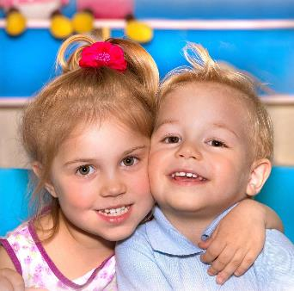
May my baby always swim in the sea of love, soar in the happy sky, peace and happiness forever!

Slide 3




Slide 4

Not every wave for the beach, not every star for the night, not every drizzle for the wheat seedlings, but, your lovely baby for your happiness, congratulations!

Slide 5

Thank you, baby. Because of you, the flowers are open, the fruit is fragrant,
The hope that comes with you!

Slide 6

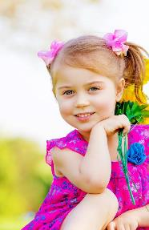

Boy, may you quickly take off your childishness and tenderness, raise the sails of creation, sail to maturity, and sail to the gold coast.

Slide 7





Slide 8



Boy, may you quickly take off your childishness and tenderness, raise the sails of creation, sail to maturity, and sail to the gold coast.

Slide 9


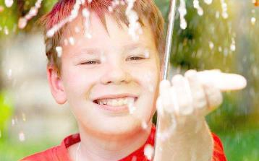

Slide 10

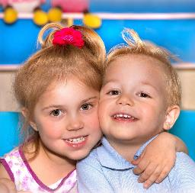
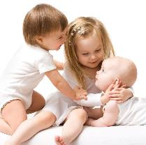
I wish the baby, healthy growth, people love, smart and lively, the future to test a famous university,
Promising!

Slide 11

The constant strong love, into your motivation to seek knowledge, to help you achieve the ideal of the other side. I wish you health forever, love forever!

Slide 12

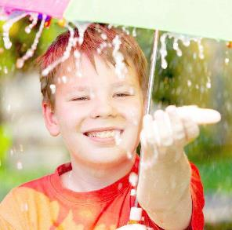


Slide 13
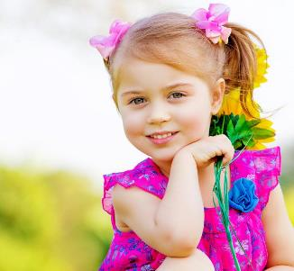


The silver light in the air is surrounded by colorful dreams, bless you, hands together ten wishes, all come true in front of you!

Slide 14

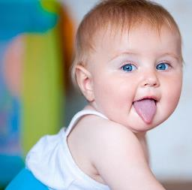


Slide 15


Slide 16


Write to the baby's blessing: I wish the baby healthy growth, happiness, the future must be successful!

Slide 17


Dear baby: Because of you, everything becomes better, lovely baby, welcome to this beautiful world, in this long road of life wish you healthy growth, happiness!

Slide 18



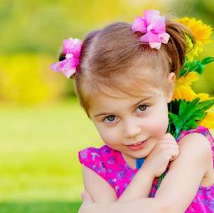

Slide 19


May you, like a seed, bravely break through the silt and stick the green buds out to the ground and point to the sky.

Slide 20
Happiness

