Slide 1

Some things do not do now, will not do a lifetime.
Beautiful youth
Travel album PPT Template
https://www.freeppt7.com

Slide 2
TRAVEL
Some things do not do now, will not do a lifetime.

Slide 3



TRAVEL
July 10, 2030

Slide 4


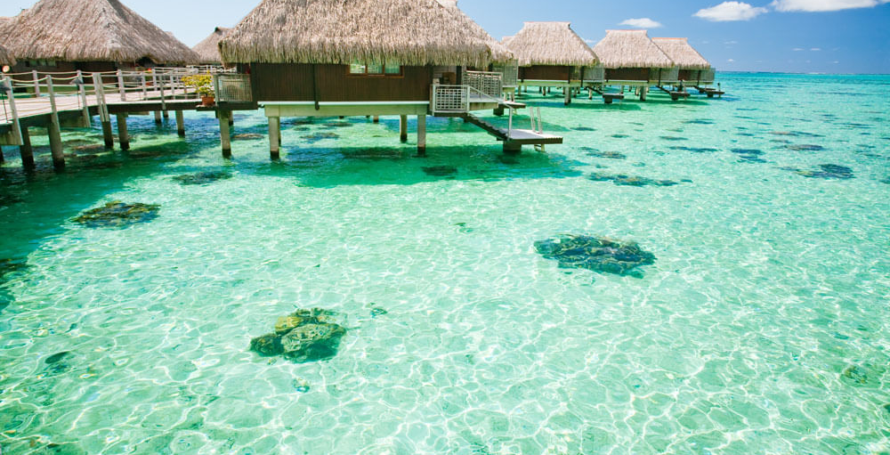
TRAVEL NOTES

Slide 5



TRAVEL NOTES

Slide 6

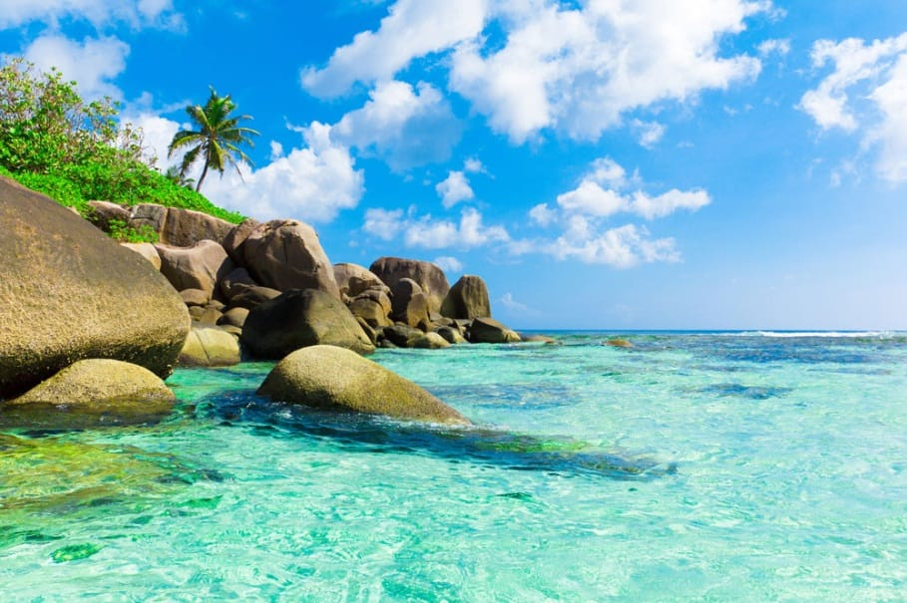

TRAVEL NOTES

Slide 7



TRAVEL NOTES

Slide 8

TRAVEL NOTES

Slide 9
TRAVEL

Slide 10


TRAVEL
July 10, 2030

Slide 11
TRAVEL
Life is a wonderful journey, it's on the back of the train. With the new and old people together to experience it! Perhaps this is a person can not resist the fate, have you, have me, also have him.

Slide 12

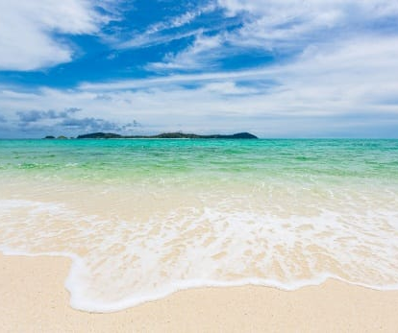

TRAVEL
July 10, 2030

Slide 13




TRAVEL
Life is a wonderful journey, it's on the back of the train. With the new and old people together to experience it! Perhaps this is a person can not resist the fate, have you, have me, also have him.

Slide 14



Slide 15

TRAVEL
July 10, 2030

Slide 16

TRAVEL

Slide 17

July 10, 2030
TRAVEL NOTES

Slide 18
July 10, 2030
TRAVEL NOTES

Slide 19
TRAVEL NOTES
July 10, 2030

Slide 20



TRAVEL
July 10, 2030

Slide 21
INSTRUCTIONS FOR USE:
1.select the photo and press the delete key
2.click the icon to replace your picture
(Auto crop picture, animation effect unchanged)

