Slide 1




LOGO
Free
PPT Templates
Insert the Subtitle of Your Presentation
Report:jpppt.com
https://www.freeppt7.com。

Slide 2
CONTENT
01
02
03
04
Early
Work review
Problem
formal analysis
Made
Experience scores
The next paragraph
Work planning
Never forget what you are, for surely the world will not.
Never forget what you are, for surely the world will not.
Never forget what you are, for surely the world will not.
Never forget what you are, for surely the world will not.

Slide 3




01
Early
Work review
Never forget what you are, for surely the world will not. Make it your strength.

Slide 4




Enter the title
Never forget what you are, for surely the world will not. Make it your strength. Then it can never be your weakness. Armor yourself in it, and it will never be used to hurt you.
Title
Title
Title
Title
Never forget what you are, for surely the world.
Never forget what you are, for surely the world.
Never forget what you are, for surely the world.
Never forget what you are, for surely the world.
01
02
03
04

Slide 5

WORK PLAN
Enter the title
Never forget what you are, for surely the world will not. Make it your strength. Then it can never be your weakness. Armor yourself in it, and it will never be used to hurt you. Never forget what you are, for surely the world will not. Make it your strength. Then it can never be your weakness. Armor yourself in it, and it will never be used to hurt you.
Armor yourself in it, and it will never be used to hurt you. Never forget what you are, for surely the world will not. Make it your strength.

Slide 6
WORK PLAN
Enter the title here
75%
Enter the title here
Enter the title here
60%
50%
Never forget what you are, for surely the world will not. Make it your strength.
Never forget what you are, for surely the world will not. Make it your strength.
Never forget what you are, for surely the world will not. Make it your strength.

Slide 7



Third quarter
WORK PLAN
Title
Title
Title
Never forget what you are, for surely the world will not. Make it your strength.
Never forget what you are, for surely the world will not. Make it your strength.
Never forget what you are, for surely the world will not. Make it your strength.

Slide 8

02
Made
Experience scores
Never forget what you are, for surely the world will not. Make it your strength.

Slide 9





WORK PLAN
Never forget what you are, for surely the world will not. Make it your strength. Then it can never be your weakness. Then it can never be your weakness..
Never forget what you are, for surely the world will not. Make it your strength. Then it can never be your weakness. Then it can never be your weakness..

Slide 10
WORK PLAN
Enter the title
Enter the title
Enter the title
FIRST QUARTER
SECOND QUARTER
THIRD QUARTER
Never forget what you are, for surely the world will not. Make it your strength. Then it can never be your weakness..
Never forget what you are, for surely the world will not. Make it your strength. Then it can never be your weakness..
Never forget what you are, for surely the world will not. Make it your strength. Then it can never be your weakness..

Slide 11
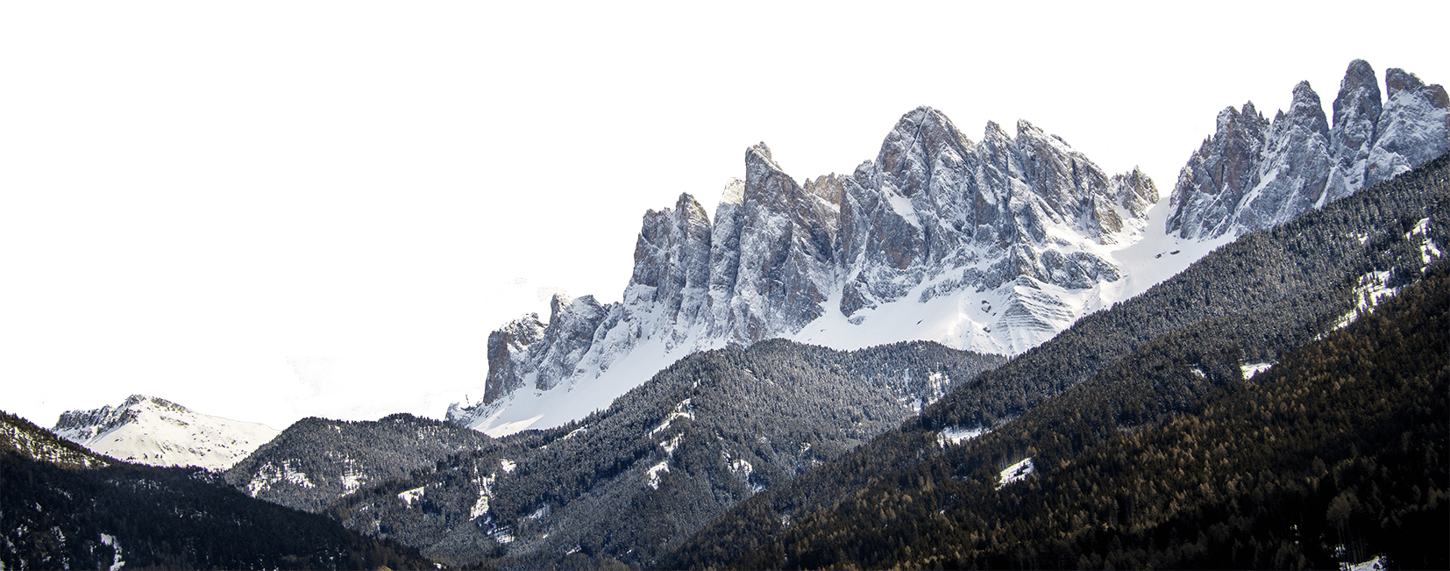
WORK
PLAN
FIRST QUARTER
Never forget what you are, for surely the world will not. Make it your strength. Then it can never be your weakness.
SECOND QUARTER
Never forget what you are, for surely the world will not. Make it your strength. Then it can never be your weakness.

Slide 12

WORK PLAN
Never forget what you are, for surely the world will not. Make it your strength.
Title
Title
Title
Title
Never forget what you are, for surely the world will not. Make it your strength.
Never forget what you are, for surely the world will not. Make it your strength.
Never forget what you are, for surely the world will not. Make it your strength.
Never forget what you are, for surely the world will not. Make it your strength.

Slide 13

03
Problem
formal analysis
Never forget what you are, for surely the world will not. Make it your strength.

Slide 14

WORK PLAN
Never forget what you are, for surely the world will not. Make it your strength.
2020
Never forget what you are, for surely the world will not. Make it your strength.
Never forget what you are, for surely the world will not. Make it your strength.

Slide 15
WORK PLAN
FIRST QUARTER
Never forget what you are, for surely the world will not.
one
SECOND QUARTER
The things we love destroy us every time.
two
T.HIRD QUARTER
Some people feel the rain. Others just get wet.
three
FOURTH QUARTER
Never forget what you are, for surely the world will not.
four
FIFTH QUARTER
The things we love destroy us every time.
five

Slide 16
WORK PLAN
Never forget what you are, for surely the world will not. Make it your strength.
2020
01.
Never forget what you are, for surely the world will not. Make it your strength.
Never forget what you are, for surely the world will not. Make it your strength.
02.
1
2
3
4
Never forget what you are, for surely the world will not. Make it your strength.
03.

Slide 17



WORK PLAN
Never forget what you are, for surely the world will not. Make it your strength. Then it can never be your weakness.
Never forget what you are, for surely the world will not. Make it your strength. Then it can never be your weakness.
Never forget what you are, for surely the world will not.
Never forget what you are, for surely the world will not.
Make it your strength. Then it can never be your weakness. I'm selfish, impatient and a little insecure.
I make mistakes, I am out of control and at times hard to handle. But if you can't handle me at my worst.

Slide 18

04
The next paragraph
Work planning
Never forget what you are, for surely the world will not. Make it your strength.

Slide 19
WORK PLAN
Never forget what you are, for surely the world will not. Make it your strength. Then it can never be your weakness.
02
03
01
Never forget what you are, for surely the world will not. Make it your strength.
Never forget what you are, for surely the world will not. Make it your strength.
Never forget what you are, for surely the world will not. Make it your strength.
Third quarter

Slide 20


WORK
PLAN
The title
Never forget what you are, for surely the world will not. Make it your strength.
Never forget what you are, for surely the world will not. Make it your strength. Then it can never be your weakness..
I am out of control and at times hard to handle.
I am out of control and at times hard to handle. But if you can't handle me at my worst, then you sure as hell don't deserve me at my best.

Slide 21

WORK PLAN
Never forget what you are, for surely the world will not. Make it your strength. Then it can never be your weakness. I'm selfish, impatient and a little insecure. I make mistakes, I am out of control and at times hard to handle. But if you can't handle me at my worst, then you sure as hell don't deserve me at my best.
Part One
Part Two
Part Three
Part Four
Part Five
Part Six

Slide 22
WORK PLAN
Enter the title
Enter the title
Enter the title
Never forget what you are, for surely the world will not. Make it your strength. Then it can never be your weakness..
Never forget what you are, for surely the world will not. Make it your strength. Then it can never be your weakness..
Never forget what you are, for surely the world will not. Make it your strength. Then it can never be your weakness..

Slide 23


WORK PLAN
Never forget what you are, for surely the world will not. Make it your strength. Then it can never be your weakness..
Never forget what you are, for surely the world will not. Make it your strength. Then it can never be your weakness..

Slide 24
WORK
LIAN
Enter the title
Never forget what you are, for surely the world will not. Make it your strength.
12
01
04
06
03
08
11
02
05
07
09
10

Slide 25
LOGO
THANK YOU!
https://www.freeppt7.com。

