Slide 1
Synergistically utilize technically sound portals with frictionless chainsSynergistically
LOGO
BUSINESS REPORT
Synergistically utilize technically sound portals with, Synergistically utilize technically sound, , Synergistically
Jpppt.com
https://www.freeppt7.com
Notes:
Photos by Freepik

Slide 2
Synergistically utilize technically sound portals with, Synergistically utilize technically sound, , Synergistically
Synergistically utilize technically sound portals with, Synergistically utilize technically sound, , Synergistically
Contents
Synergistically utilize technically sound portals with, Synergistically utilize technically sound, , Synergistically
Synergistically utilize technically sound portals with, Synergistically utilize technically sound, , Synergistically
Synergistically utilize technically sound portals with, Synergistically utilize technically sound, , Synergistically
Synergistically utilize technically sound portals with, Synergistically utilize technically sound, , Synergistically
Notes:
Photos by rawpixel.com / Freepik

Slide 3
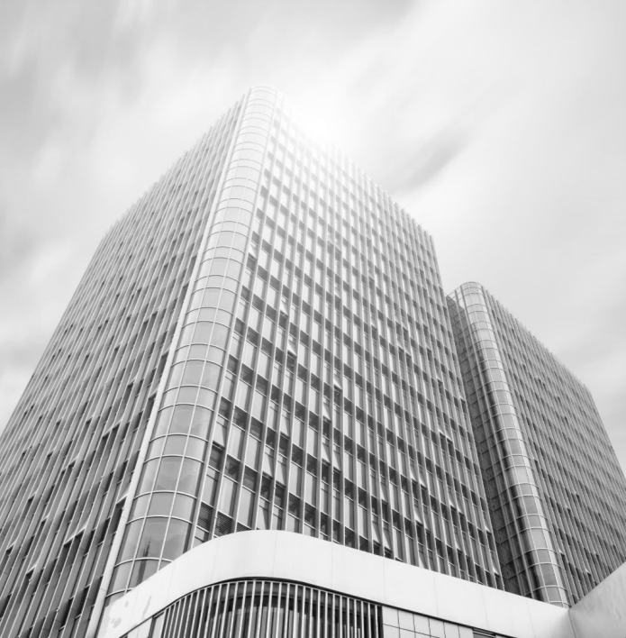
Part one
Synergistically utilize technically sound portals with, Synergistically utilize technically sound, , Synergistically
jpppt.com
Notes:
Photos by Evening_tao / Freepik

Slide 4
JPPPT.COM
Synergistically utilize technically sound portals with, Synergistically utilize technically sound, Synergistically
Synergistically utilize technically sound portals with, Synergistically utilize technically sound, Synergistically
Synergistically utilize technically sound portals with, Synergistically utilize technically sound, Synergistically
Synergistically utilize technically sound portals with, Synergistically utilize technically sound, Synergistically/Synergistically utilize technically sound portals with, Synergistically utilize technically sound,
Notes:
Photos by rawpixel.com / Freepik

Slide 5
JPPPT.COM
Synergistically utilize technically sound portals with, Synergistically utilize technically sound, Synergistically/Synergistically utilize technically sound portals with, Synergistically utilize technically sound,
Synergistically utilize technically sound portals with frictionless chainsSynergistically，Synergistically utilize
Synergistically utilize technically sound portals with frictionless chainsSynergistically，Synergistically utilize
Synergistically utilize technically sound portals with frictionless chainsSynergistically，Synergistically utilize
Notes:
Photos by Freepik

Slide 6
5
Synergistically utilize technically sound portals with, Synergistically utilize technically sound, Synergistically。Synergistically utilize technically sound portals with
JPPPT.COM
1
Synergistically utilize technically sound portals with, Synergistically utilize technically sound, Synergistically。Synergistically utilize technically sound portals with
Synergistically utilize technically sound portals with, Synergistically utilize technically sound, Synergistically。Synergistically utilize technically sound portals with
4
Synergistically utilize technically sound portals with, Synergistically utilize technically sound, Synergistically。Synergistically utilize technically sound portals with
Synergistically utilize technically sound portals with, Synergistically utilize technically sound, Synergistically。Synergistically utilize technically sound portals with

Slide 7
Part two
Synergistically utilize technically sound portals with, Synergistically utilize technically sound, , Synergistically
JPPPT.COM
Notes:
Photos by Evening_tao / Freepik

Slide 8
JPPPT.COM
Synergistically utilize technically sound portals with frictionless chainsSynergistically，Synergistically utilize
Synergistically utilize technically sound portals with frictionless chainsSynergistically，Synergistically utilize
Synergistically utilize technically sound portals with frictionless chainsSynergistically，Synergistically utilize
Synergistically utilize technically sound portals with frictionless chainsSynergistically，Synergistically utilize
Synergistically utilize technically sound portals with frictionless chainsSynergistically，Synergistically utilize
Synergistically utilize technically sound portals with frictionless chainsSynergistically，Synergistically utilize
Notes:
Photos by creativeart / Freepik

Slide 9
JPPPT.COM
01
Synergistically utilize technically sound portals with, Synergistically utilize technically sound, Synergistically。Synergistically utilize technically sound portals with
04
02
Synergistically utilize technically sound portals with, Synergistically utilize technically sound, Synergistically。Synergistically utilize technically sound portals with
03
01
03
Synergistically utilize technically sound portals with, Synergistically utilize technically sound, Synergistically。Synergistically utilize technically sound portals with
02
04
Synergistically utilize technically sound portals with, Synergistically utilize technically sound, Synergistically。Synergistically utilize technically sound portals with

Slide 10
JPPPT.COM
Synergistically utilize technically sound portals with, Synergistically utilize technically sound, Synergistically
2
Synergistically utilize technically sound portals with, Synergistically utilize technically sound, Synergistically
6
Synergistically utilize technically sound portals with, Synergistically utilize technically sound, Synergistically
3
1
5
Synergistically utilize technically sound portals with, Synergistically utilize technically sound, Synergistically
Synergistically utilize technically sound portals with, Synergistically utilize technically sound, Synergistically
4

Slide 11
Part three
Synergistically utilize technically sound portals with, Synergistically utilize technically sound, , Synergistically
JPPPT.COM
Notes:
Photos by Evening_tao / Freepik

Slide 12
JPPPT.COM
Synergistically utilize technically sound portals with, Synergistically utilize technically sound, Synergistically
Synergistically utilize technically sound portals with, Synergistically utilize technically sound, Synergistically
S
W
Synergistically utilize technically sound portals with, Synergistically utilize technically sound, Synergistically
Synergistically utilize technically sound portals with, Synergistically utilize technically sound, Synergistically
T
O
Notes:
Photos by rawpixel.com / Freepik

Slide 13
JPPPT.COM
Synergistically utilize technically sound portals with, Synergistically utilize technically sound, Synergistically。Synergistically utilize technically sound portals with, Synergistically utilize technically sound,
Synergistically utilize technically sound portals with, Synergistically utilize technically sound, Synergistically。Synergistically utilize technically sound portals with, Synergistically utilize technically sound,
Synergistically utilize technically sound portals with, Synergistically utilize technically sound, Synergistically。Synergistically utilize technically sound portals with, Synergistically utilize technically sound,

Slide 14
JPPPT.COM
JPPPT.COM
JPPPT.COM
JPPPT.COM
Synergistically utilize technically sound portals with frictionless chainsSynergistically，Synergistically utilize
Synergistically utilize technically sound portals with frictionless chainsSynergistically，Synergistically utilize
Synergistically utilize technically sound portals with frictionless chainsSynergistically，Synergistically utilize
Synergistically utilize technically sound portals with frictionless chainsSynergistically，Synergistically utilize
1
2
3
4

Slide 15
Part four
Synergistically utilize technically sound portals with, Synergistically utilize technically sound, , Synergistically
JPPPT.COM
Notes:
Photos by Evening_tao / Freepik

Slide 16
JPPPT.COM
Synergistically utilize technically sound portals with, Synergistically utilize technically sound, Synergistically。Synergistically utilize
Synergistically utilize technically sound portals with, Synergistically utilize technically sound, Synergistically。Synergistically utilize
Synergistically utilize technically sound portals with, Synergistically utilize technically sound, Synergistically。Synergistically utilize
Synergistically utilize technically sound portals with, Synergistically utilize technically sound, Synergistically。Synergistically utilize

Slide 17
JPPPT.COM
Synergistically utilize technically sound portals with, Synergistically utilize technically sound, Synergistically。Synergistically utilize technically sound portals with, Synergistically utilize technically sound,
Synergistically utilize technically sound portals with, Synergistically utilize technically sound, Synergistically。Synergistically utilize technically sound portals with, Synergistically utilize technically sound,
Notes:
Photos by Freepik

Slide 18
JPPPT.COM
Synergistically utilize technically sound portals with, Synergistically utilize technically sound, Synergistically。Synergistically utilize
Synergistically utilize technically sound portals with, Synergistically utilize technically sound, Synergistically。Synergistically utilize
Synergistically utilize technically sound portals with, Synergistically utilize technically sound, Synergistically。Synergistically utilize
Synergistically utilize technically sound portals with, Synergistically utilize technically sound, Synergistically。Synergistically utilize

Slide 19
JPPPT.COM
Synergistically utilize technically sound portals with, Synergistically utilize technically sound, Synergistically。Synergistically utilize
Synergistically utilize technically sound portals with, Synergistically utilize technically sound, Synergistically。Synergistically utilize
Synergistically utilize technically sound portals with, Synergistically utilize technically sound, Synergistically。Synergistically utilize
Synergistically utilize technically sound portals with, Synergistically utilize technically sound, Synergistically。Synergistically utilize
Synergistically utilize technically sound portals with, Synergistically utilize technically sound, Synergistically。Synergistically utilize
Synergistically utilize technically sound portals with, Synergistically utilize technically sound, Synergistically。Synergistically utilize

Slide 20
Part five
Synergistically utilize technically sound portals with, Synergistically utilize technically sound, , Synergistically
JPPPT.COM
Notes:
Photos by Evening_tao / Freepik

Slide 21
JPPPT.COM
Synergistically utilize technically sound portals with, Synergistically utilize technically sound, Synergistically。Synergistically utilize
Synergistically utilize technically sound portals with, Synergistically utilize technically sound, Synergistically。Synergistically utilize
Synergistically utilize technically sound portals with, Synergistically utilize technically sound, Synergistically。Synergistically utilize
Synergistically utilize technically sound portals with, Synergistically utilize technically sound, Synergistically。Synergistically utilize

Slide 22
20%
15%
10%
JPPPT.COM
JPPPT.COM
Synergistically utilize technically sound portals with, Synergistically utilize technically sound,
Synergistically utilize technically sound portals with, Synergistically utilize technically sound,
20%
5%
JPPPT.COM
JPPPT.COM
Synergistically utilize technically sound portals with, Synergistically utilize technically sound,
Synergistically utilize technically sound portals with, Synergistically utilize technically sound,
30%
JPPPT.COM
JPPPT.COM
Synergistically utilize technically sound portals with, Synergistically utilize technically sound,
Synergistically utilize technically sound portals with, Synergistically utilize technically sound,

Slide 23
JPPPT.COM
Synergistically utilize technically sound portals with, Synergistically utilize technically sound, Synergistically
Synergistically utilize technically sound portals with, Synergistically utilize technically sound, Synergistically
Synergistically utilize technically sound portals with, Synergistically utilize technically sound, Synergistically
1
2
3
4
5
6
7
Synergistically utilize technically sound portals with, Synergistically utilize technically sound, Synergistically
Synergistically utilize technically sound portals with, Synergistically utilize technically sound, Synergistically
Synergistically utilize technically sound portals with, Synergistically utilize technically sound, Synergistically
Synergistically utilize technically sound portals with, Synergistically utilize technically sound, Synergistically
Notes:
Photos by Jcomp / Freepik

Slide 24
JPPPT.COM
Synergistically utilize technically sound portals with, Synergistically utilize technically sound, Synergistically。Synergistically utilize technically sound
Synergistically utilize technically sound portals with, Synergistically utilize technically sound, Synergistically。Synergistically utilize technically sound
1
3
Synergistically utilize technically sound portals with, Synergistically utilize technically sound, Synergistically。Synergistically utilize technically sound
Synergistically utilize technically sound portals with, Synergistically utilize technically sound, Synergistically。Synergistically utilize technically sound
2
4

Slide 25
Synergistically utilize technically sound portals with frictionless chainsSynergistically
LOGO
THANK YOU
Synergistically utilize technically sound portals with, Synergistically utilize technically sound, , Synergistically
Jpppt.com
https://www.freeppt7.com
Notes:
Photos by Freepik

