Slide 1
LOGO
Best PPT templates
The user can demonstrate on a projector or computer, or print the presentation and make it into a film to be used in a wider field
JPPPT.COM
https://www.freeppt7.com

Slide 2
The first part
The user can demonstrate on a projector or computer, or print the presentation and make it into a film to be used in a wider field
The second part
The user can demonstrate on a projector or computer, or print the presentation and make it into a film to be used in a wider field
Part III
CONTENT
The user can demonstrate on a projector or computer, or print the presentation and make it into a film to be used in a wider field
Part FOUR
The user can demonstrate on a projector or computer, or print the presentation and make it into a film to be used in a wider field

Slide 3
The first part
PART ONE
Enter your text description Enter your text description Enter your text description Enter your text description Enter your text description enter your text description
The user can demonstrate on a projector or computer.or presentation and make it film to be used in a wider field.

Slide 4
The title text is added
The user can demonstrate on a projector or computer, or print the presentation and make it into a filmThe user can demonstrate on a projector or computer, or print the presentation and make it into a filmThe user can demonstrate on a projector or computer, or print the presentation and make it into a film
Text added
Text added
Text added

Slide 5
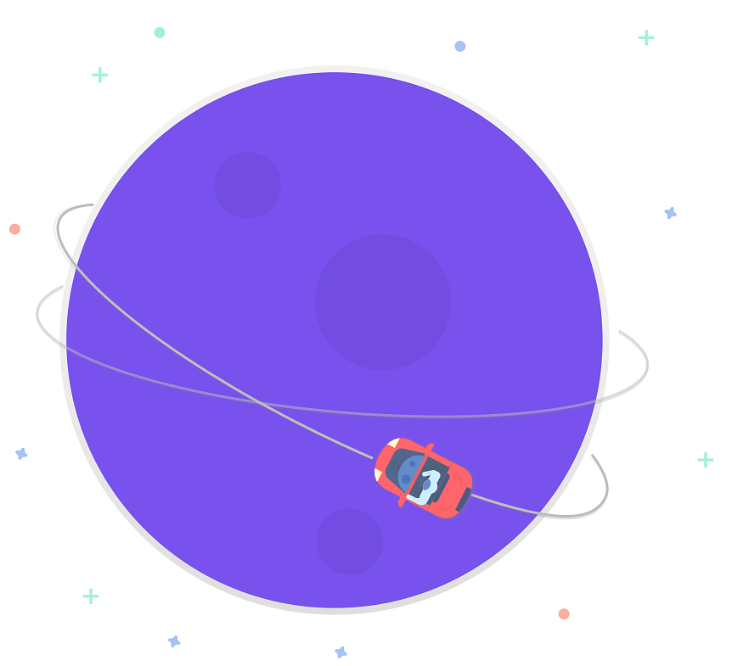
Enter the title
print the presentation and make it into a film a wider field
The title text is added
The title text is added
The user can demonstrate on a projector or computer, or presentation and make it film to be used in a wider field
The user can demonstrate on a projector or computer, or presentation and make it film to be used in a wider field
The title text is added
The title text is added
The user can demonstrate on a projector or computer, or presentation and make it film to be used in a wider field
The user can demonstrate on a projector or computer, or presentation and make it film to be used in a wider field

Slide 6
Enter the title
print the presentation and make it into a film a wider field
The title text is added
The title text is added
The title text is added
The title text is added
The user can demonstrate on a projector or computer, or presentation and make it film to be used in a wider field
The user can demonstrate on a projector or computer, or presentation and make it film to be used in a wider field
The user can demonstrate on a projector or computer, or presentation and make it film to be used in a wider field
The user can demonstrate on a projector or computer, or presentation and make it film to be used in a wider field

Slide 7
The second part
PART TWO
Enter your text description Enter your text description Enter your text description Enter your text description Enter your text description enter your text description
The user can demonstrate on a projector or computer.or presentation and make it film to be used in a wider field.

Slide 8
Click to add a title
After you've typed your content here, or by copying your text, select Paste in this box and choose to keep only the text
Click to add a title
After you've typed your content here, or by copying your text, select Paste in this box and choose to keep only the text
Click to add a title
After you've typed your content here, or by copying your text, select Paste in this box and choose to keep only the text
Click to add a title
After you've typed your content here, or by copying your text, select Paste in this box and choose to keep only the text

Slide 9
Enter the title
print the presentation and make it into a film a wider field
The title text is added
The title text is added
print the presentation and make it film to be used in a wider field
print the presentation and make it film to be used in a wider field
The title text is added
The title text is added
print the presentation and make it film to be used in a wider field
print the presentation and make it film to be used in a wider field

Slide 10
52
%
The title text is added
print the presentation and make it film to be used in a wider field
38
%
The title text is added
print the presentation and make it film to be used in a wider field

Slide 11
Enter the title
print the presentation and make it into a film a wider field
The title text
The title text
The title text
The user can demonstrate on a projector or computer, or presentation and make it film to be used in a wider field
The user can demonstrate on a projector or computer, or presentation and make it film to be used in a wider field
The user can demonstrate on a projector or computer, or presentation and make it film to be used in a wider field

Slide 12
Part III
PART THREE
Enter your text description Enter your text description Enter your text description Enter your text description Enter your text description enter your text description
The user can demonstrate on a projector or computer.or presentation and make it film to be used in a wider field.

Slide 13
Enter the title
print the presentation and make it into a film a wider field
Click to add a title
Click to add a title
After you've typed your content here, or by copying your text, select Paste in this box and choose to keep only the text
After you've typed your content here, or by copying your text, select Paste in this box and choose to keep only the text
Click to add a title
Click to add a title
After you've typed your content here, or by copying your text, select Paste in this box and choose to keep only the text
After you've typed your content here, or by copying your text, select Paste in this box and choose to keep only the text
Click to add a title
Click to add a title
After you've typed your content here, or by copying your text, select Paste in this box and choose to keep only the text
After you've typed your content here, or by copying your text, select Paste in this box and choose to keep only the text

Slide 14
Enter the title
print the presentation and make it into a film a wider field
Enter your text description Enter your text description Enter your text description Enter your text description
Enter your text description Enter your text description Enter your text description Enter your text description
Enter your text description Enter your text description Enter your text description Enter your text description
Enter your text description Enter your text description Enter your text description Enter your text description
design
design
design
design

Slide 15
The title text is added
After you've typed your content here, or by copying your text, select Paste in this box and choose to keep only the text
The user can demonstrate on a projector or computer, or print the presentation and make it into a filmThe user can demonstrate on a projector or computer, or print the presentation and make it into a filmThe user can demonstrate on a projector or computer, or print the presentation and make it into a film
design

Slide 16
Enter the title
print the presentation and make it into a film a wider field
The title text is added
The title text is added
Your content is typed here, or by copying your text later
Your content is typed here, or by copying your text later
The user can demonstrate on a projector or computer, or presentation and make it film to be used in a wider field
The user can demonstrate on a projector or computer, or presentation and make it film to be used in a wider field

Slide 17
Part FOUR
PART FOUR
Enter your text description Enter your text description
The user can demonstrate on a projector or computer.or presentation and make it film to be used in a wider field.

Slide 18
Enter the title
print the presentation and make it into a film a wider field

Slide 19
Enter the title
print the presentation and make it into a film a wider field
40%
30%
85%
65%
35%
The title text
The title text
The title text
The title text
The title text

Slide 20
Thank you
The user can demonstrate on a projector or computer, or print the presentation and make it into a film to be used in a wider field
www.jpppt.com

