Slide 1
LOGO
BUSINESS
Synergistically utilize technically sound portals with, Synergistically utilize technically sound, , Synergistically
www.jpppt.com
https://www.jpppt.com
Notes:
https://unsplash.com/

Slide 2
01
Synergistically utilize technically sound portals with, Synergistically utilize technically sound
02
Synergistically utilize technically sound portals with, Synergistically utilize technically sound
03
Synergistically utilize technically sound portals with, Synergistically utilize technically sound
04
Synergistically utilize technically sound portals with, Synergistically utilize technically sound
05
Synergistically utilize technically sound portals with, Synergistically utilize technically sound
Contents
06
Synergistically utilize technically sound portals with, Synergistically utilize technically sound

Slide 3
Synergistically utilize technically sound portals with, Synergistically utilize technically sound。Synergistically utilize technically sound portals with, Synergistically utilize technically sound。Synergistically utilize technically sound portals with,
01.
Notes:
https://unsplash.com/

Slide 4
www.jpppt.com
1
Synergistically utilize technically sound portals with frictionless chainsSynergistically，Synergistically utilize，Synergistically utilize technically sound portals with frictionless chainsSynergistically，Synergistically utilize, Synergistically utilize technically sound portals with frictionless chainsSynergistically，Synergistically
2
Synergistically utilize technically sound portals with frictionless chainsSynergistically，Synergistically utilize，Synergistically utilize technically sound portals with frictionless chainsSynergistically，Synergistically utilize, Synergistically utilize technically sound portals with frictionless chainsSynergistically，Synergistically
Notes:
https://unsplash.com/

Slide 5
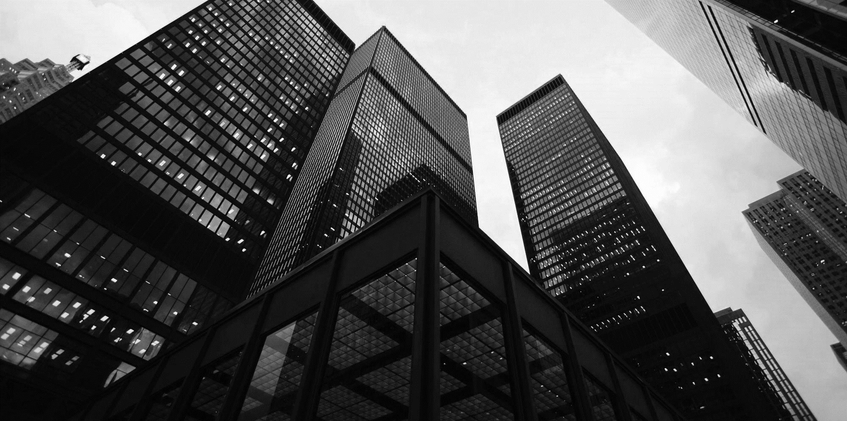
www.jpppt.com
Synergistically utilize technically sound portals with, Synergistically utilize technically sound, Synergistically,
01
03
05
Synergistically utilize technically sound portals with, Synergistically utilize technically sound, Synergistically, Synergistically
Synergistically utilize technically sound portals with, Synergistically utilize technically sound, Synergistically, Synergistically
02
04
Synergistically utilize technically sound portals with, Synergistically utilize technically sound, Synergistically,
Synergistically utilize technically sound portals with, Synergistically utilize technically sound, Synergistically,
Notes:
https://unsplash.com/

Slide 6
www.jpppt.com
Synergistically utilize technically sound portals with, Synergistically utilize technically sound, Synergistically utilize technically sound portals with, Synergistically
+
Synergistically utilize technically sound portals with, Synergistically utilize technically sound, Synergistically utilize technically sound portals with, Synergistically
+
Synergistically utilize technically sound portals with, Synergistically utilize technically sound, Synergistically utilize technically sound portals with, Synergistically
+
Notes:
https://unsplash.com/

Slide 7
Synergistically utilize technically sound portals with, Synergistically utilize technically sound。Synergistically utilize technically sound portals with, Synergistically utilize technically sound。Synergistically utilize technically sound portals with,
02.
Notes:
https://unsplash.com/

Slide 8
www.jpppt.com
01.
02.
03.
04.
Synergistically utilize technically sound portals with, Synergistically utilize technically sound, Synergistically utilize，Synergistically utilize technically sound portals with, Synergistically
Synergistically utilize technically sound portals with, Synergistically utilize technically sound, Synergistically utilize，Synergistically utilize technically sound portals with, Synergistically
Synergistically utilize technically sound portals with, Synergistically utilize technically sound, Synergistically utilize，Synergistically utilize technically sound portals with, Synergistically
Synergistically utilize technically sound portals with, Synergistically utilize technically sound, Synergistically utilize，Synergistically utilize technically sound portals with, Synergistically
Notes:
https://unsplash.com/

Slide 9
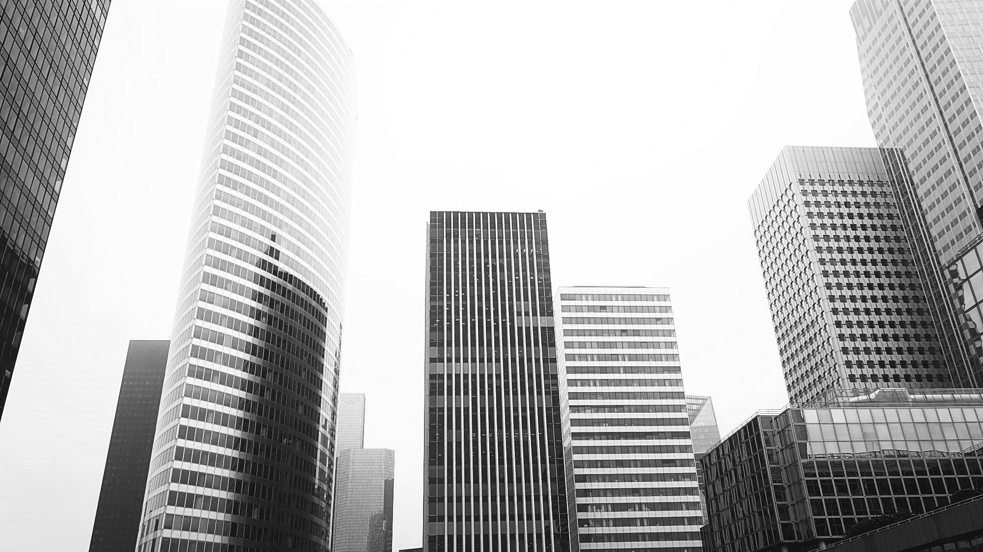
Jpppt.com
65%
Synergistically utilize technically sound portals with, Synergistically utilize technically sound，Synergistically utilize technically sound portals with, Synergistically utilize technically sound，Synergistically utilize technically sound portals with, Synergistically utilize technically sound，Synergistically utilize technically
Notes:
https://unsplash.com/

Slide 10
www.jpppt.com
25%
75%
15%
50%
Synergistically utilize technically sound portals with, Synergistically utilize technically sound, Synergistically utilize
Synergistically utilize technically sound portals with, Synergistically utilize technically sound, Synergistically utilize
Synergistically utilize technically sound portals with, Synergistically utilize technically sound, Synergistically utilize
Synergistically utilize technically sound portals with, Synergistically utilize technically sound, Synergistically utilize

Slide 11
www.jpppt.com
Synergistically utilize technically sound portals with, Synergistically utilize technically sound, Synergistically utilize technically sound portals with, Synergistically
Synergistically utilize technically sound portals with, Synergistically utilize technically sound, Synergistically utilize technically sound portals with, Synergistically
Synergistically utilize technically sound portals with, Synergistically utilize technically sound, Synergistically utilize technically sound portals with, Synergistically
50%
75%
25%

Slide 12
Synergistically utilize technically sound portals with, Synergistically utilize technically sound。Synergistically utilize technically sound portals with, Synergistically utilize technically sound。Synergistically utilize technically sound portals with,
03.
Notes:
https://unsplash.com/

Slide 13
www.jpppt.com
Synergistically utilize technically sound portals with, Synergistically utilize technically sound, Synergistically, Synergistically utilize technically sound portals with, Synergistically utilize technically sound
01
Synergistically utilize technically sound portals with, Synergistically utilize technically sound, Synergistically, Synergistically utilize technically sound portals with, Synergistically utilize technically sound
02
Notes:
https://unsplash.com/

Slide 14
www.jpppt.com
Synergistically utilize technically sound portals with, Synergistically utilize technically sound, Synergistically
Synergistically utilize technically sound portals with, Synergistically utilize technically sound, Synergistically
Synergistically utilize technically sound portals with, Synergistically utilize technically sound, Synergistically
Synergistically utilize technically sound portals with, Synergistically utilize technically sound, Synergistically
Synergistically utilize technically sound portals with, Synergistically utilize technically sound, Synergistically
Synergistically utilize technically sound portals with, Synergistically utilize technically sound, Synergistically
Synergistically utilize technically sound portals with, Synergistically, Synergistically utilize
Jpppt.com

Slide 15
Synergistically utilize technically sound portals with, Synergistically utilize technically sound。Synergistically utilize technically sound portals with, Synergistically utilize technically sound。Synergistically utilize technically sound portals with,
04.
Notes:
https://unsplash.com/

Slide 16
www.jpppt.com
8 0%
www.jpppt.com
Synergistically utilize technically sound portals with, Synergistically utilize technically sound, Synergistically utilize technically sound
www.jpppt.com
Synergistically utilize technically sound portals with, Synergistically utilize technically sound, Synergistically utilize，Synergistically utilize technically sound portals with, Synergistically utilize technically
www.jpppt.com

Slide 17
www.jpppt.com
Synergistically utilize technically sound portals with, Synergistically, Synergistically utilize , Synergistically utilize technically sound
Synergistically utilize technically sound portals with, Synergistically, Synergistically utilize , Synergistically utilize technically sound
100
75
50
Synergistically utilize technically sound portals with, Synergistically, Synergistically utilize , Synergistically utilize technically sound
Synergistically utilize technically sound portals with, Synergistically, Synergistically utilize , Synergistically utilize technically sound
25

Slide 18
Synergistically utilize technically sound portals with, Synergistically utilize technically sound。Synergistically utilize technically sound portals with, Synergistically utilize technically sound。Synergistically utilize technically sound portals with,
05.
PPT模板 http://www.1ppt.com/moban/
Notes:
https://unsplash.com/

Slide 19
www.jpppt.com
75%
25%
Synergistically utilize technically sound portals with, Synergistically utilize technically sound, Synergistically utilize technically sound portals with, Synergistically
Synergistically utilize technically sound portals with, Synergistically utilize technically sound, Synergistically utilize technically sound portals with, Synergistically
50%
15%
Synergistically utilize technically sound portals with, Synergistically utilize technically sound, Synergistically utilize technically sound portals with, Synergistically
Synergistically utilize technically sound portals with, Synergistically utilize technically sound, Synergistically utilize technically sound portals with, Synergistically

Slide 20
www.jpppt.com
Synergistically utilize technically sound portals with, Synergistically utilize technically sound, Synergistically utilize technically sound portals with
Synergistically utilize technically sound portals with, Synergistically utilize technically sound, Synergistically utilize technically sound portals with
Synergistically utilize technically sound portals with, Synergistically utilize technically sound, Synergistically utilize technically sound portals with
Synergistically utilize technically sound portals with, Synergistically utilize technically sound, Synergistically utilize technically sound portals with
Synergistically utilize technically sound portals with, Synergistically utilize technically sound, Synergistically utilize technically sound portals with

Slide 21
Synergistically utilize technically sound portals with, Synergistically utilize technically sound。Synergistically utilize technically sound portals with, Synergistically utilize technically sound。Synergistically utilize technically sound portals with,
06.
Notes:
https://unsplash.com/

Slide 22
www.jpppt.com
Synergistically utilize technically sound portals with, Synergistically utilize technically sound
2
3
Synergistically utilize technically sound portals with, Synergistically utilize technically sound
Synergistically utilize technically sound portals with, Synergistically utilize technically sound
1
4
Synergistically utilize technically sound portals with, Synergistically utilize technically sound

Slide 23
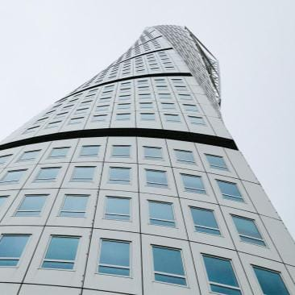
1
2
Synergistically utilize technically sound portals with, Synergistically utilize technically sound, Synergistically, Synergistically utilize technically sound portals with,
Synergistically utilize technically sound portals with, Synergistically utilize technically sound, Synergistically, Synergistically utilize technically sound portals with,
Synergistically utilize technically sound portals with, Synergistically utilize technically sound, Synergistically, Synergistically utilize technically sound portals with,
Synergistically utilize technically sound portals with, Synergistically utilize technically sound, Synergistically, Synergistically utilize technically sound portals with,
3
4

Slide 24
www.jpppt.com
1
Synergistically utilize technically sound portals with, Synergistically utilize technically sound
2
Synergistically utilize technically sound portals with, Synergistically utilize technically sound
3
Synergistically utilize technically sound portals with, Synergistically utilize technically sound
Notes:
https://unsplash.com/

Slide 25
LOGO
THANK YOU
Synergistically utilize technically sound portals with, Synergistically utilize technically sound, , Synergistically
www.jpppt.com
https://www.jpppt.com
Notes:
https://unsplash.com/

