Slide 1

LOGO
Business
1PPT.COM
-Insert the Subtitle of Your Presentation-
Synergistically utilize technically sound portals with frictionless chainsSynergistically，Synergistically utilize technically sound portals with frictionless chainsSynergistically
https://www.jpppt.com

Slide 2
0 1
Click here to add a title
0 2
Click here to add a title
1PPT.COM
0 3
Click here to add a title
CONTE Nt
0 4
Click here to add a title
0 5
Click here to add a title

Slide 3

Part one
01.Click here to add a title
Synergistically utilize technically sound portals with frictionless chainsSynergistically，Synergistically utilize technically sound portals with frictionless chainsSynergistically

Slide 4
Business
S
W
O
T
Synergistically utilize technically sound portals with, Synergistically utilize technically sound portals with，Synergistically utilize technically sound portals with
Synergistically utilize technically sound portals with, Synergistically utilize technically sound portals with，Synergistically utilize technically sound portals with
Synergistically utilize technically sound portals with, Synergistically utilize technically sound portals with，Synergistically utilize technically sound portals with
Synergistically utilize technically sound portals with, Synergistically utilize technically sound portals with，Synergistically utilize technically sound portals with

Slide 5

Synergistically utilize technically sound portals with, Synergistically utilize technically sound portals with，Synergistically
Synergistically utilize technically sound portals with, Synergistically utilize technically sound portals with，Synergistically
Synergistically utilize technically sound portals with, Synergistically utilize technically sound portals with，Synergistically

Slide 6
JPPPT.COM
JPPPT.COM
JPPPT.COM
JPPPT.COM
Synergistically utilize technically sound portals with, Synergistically utilize technically sound portals with，Synergistically
Synergistically utilize technically sound portals with, Synergistically utilize technically sound portals with，Synergistically
Synergistically utilize technically sound portals with, Synergistically utilize technically sound portals with，Synergistically
Synergistically utilize technically sound portals with, Synergistically utilize technically sound portals with，Synergistically

Slide 7
Part two
02.Click here to add a title
Synergistically utilize technically sound portals with frictionless chainsSynergistically，Synergistically utilize technically sound portals with frictionless chainsSynergistically

Slide 8
Synergistically utilize technically sound portals with, Synergistically utilize technically sound portals with，Synergistically utilize technically sound portals with
Synergistically utilize technically sound portals with, Synergistically utilize technically sound portals with，Synergistically utilize technically sound portals with
Business
Synergistically utilize technically sound portals with, Synergistically utilize technically sound portals with，Synergistically utilize technically sound portals with
Synergistically utilize technically sound portals with, Synergistically utilize technically sound portals with，Synergistically utilize technically sound portals with

Slide 9
Business
Synergistically utilize technically sound portals with, Synergistically utilize technically sound portals with，Synergistically, Synergistically utilize technically
Synergistically utilize technically sound portals with, Synergistically utilize technically sound portals with，Synergistically
Synergistically utilize technically sound portals with, Synergistically utilize technically sound portals with，Synergistically

Slide 10


Business
JPPPT.COM
Synergistically utilize technically sound portals with, Synergistically utilize technically sound portals with，Synergistically utilize technically sound portals with
Synergistically utilize technically sound portals with, Synergistically utilize technically sound portals with，Synergistically utilize technically sound portals with, Synergistically utilize technically sound portals with, Synergistically utilize technically sound portals with，Synergistically utilize technically sound portals with

Slide 11
Part three
03.Click here to add a title
Synergistically utilize technically sound portals with frictionless chainsSynergistically，Synergistically utilize technically sound portals with frictionless chainsSynergistically

Slide 12

1PPT.COM
Business
Synergistically utilize technically sound portals with, Synergistically utilize technically sound portals with，Synergistically, Synergistically utilize technically sound portals with, Synergistically utilize technically sound portals with

Slide 13
Business
Synergistically utilize technically sound portals with, Synergistically utilize technically sound portals with，Synergistically utilize technically sound portals with
Synergistically utilize technically sound portals with, Synergistically utilize technically sound portals with，Synergistically utilize technically sound portals with
Synergistically utilize technically sound portals with, Synergistically utilize technically sound portals with，Synergistically utilize technically sound portals with

Slide 14
01
02
Business
Synergistically utilize technically sound portals with, Synergistically utilize technically sound portals with
Synergistically utilize technically sound portals with, Synergistically utilize technically sound portals with
Synergistically utilize technically sound portals with, Synergistically utilize technically sound portals with

Slide 15
Part four
04.Click here to add a title
Synergistically utilize technically sound portals with frictionless chainsSynergistically，Synergistically utilize technically sound portals with frictionless chainsSynergistically

Slide 16
Synergistically utilize technically sound portals with, Synergistically utilize technically sound portals with
Synergistically utilize technically sound portals with, Synergistically utilize technically sound portals with
Synergistically utilize technically sound portals with, Synergistically utilize technically sound portals with
Synergistically utilize technically sound portals with, Synergistically utilize technically sound portals with

Slide 17

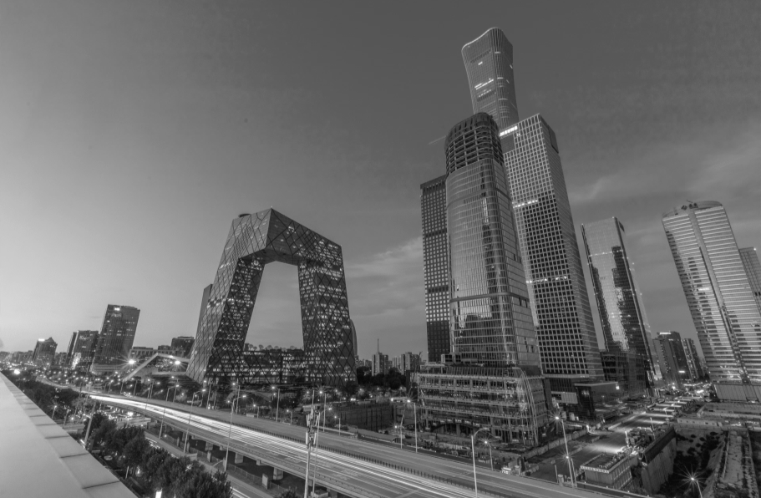
Business
Synergistically utilize technically sound portals with, Synergistically utilize technically sound portals with，Synergistically utilize technically sound portals with

Slide 18
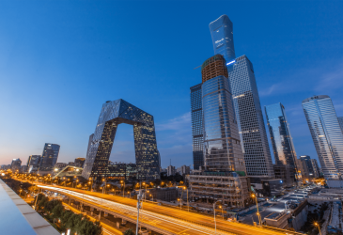
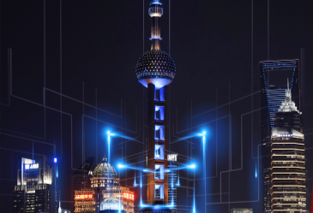




JPPPT.COM
JPPPT.COM
JPPPT.COM
Synergistically utilize technically sound portals with, Synergistically utilize technically sound portals with，Synergistically utilize technically sound portals with, Synergistically utilize technically sound portals with，Synergistically utilize technically sound portals with, Synergistically utilize technically sound portals with
PptTemplate http://www.1ppt.com/moban/
JPPPT.COM
JPPPT.COM
JPPPT.COM

Slide 19
Part five
05.Click here to add a title
Synergistically utilize technically sound portals with frictionless chainsSynergistically，Synergistically utilize technically sound portals with frictionless chainsSynergistically

Slide 20
JPPPT.COM
JPPPT.COM
JPPPT.COM
...
...
...
Synergistically utilize technically sound portals with,
...
...
Synergistically utilize technically sound portals with,
...
...
...
...
...
Synergistically utilize technically sound portals with,
...
...
Synergistically utilize technically sound portals with,
...
...
...
...
...
Synergistically utilize technically sound portals with,
...
...
...
...

Slide 21
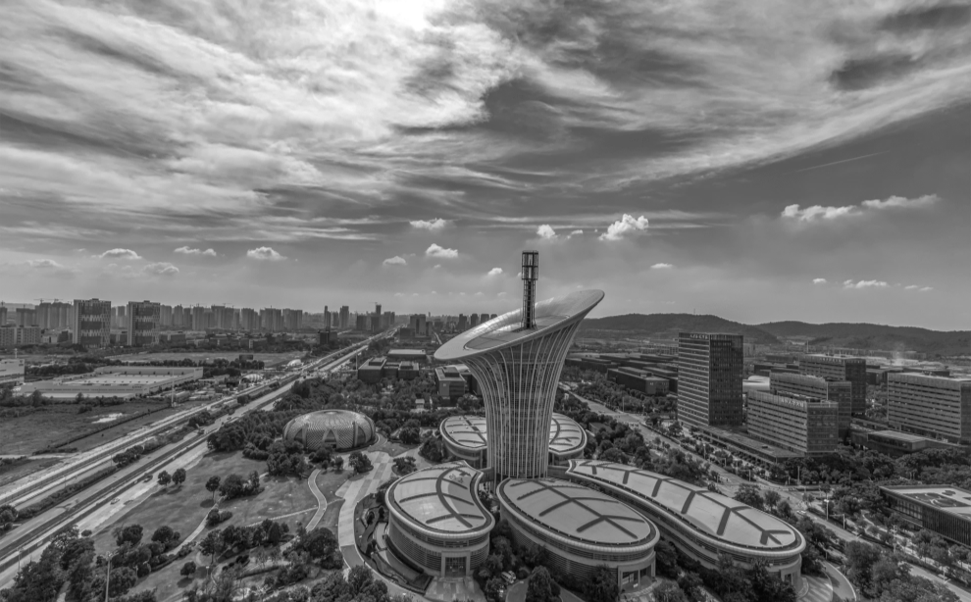
Business
Synergistically utilize technically sound portals with, Synergistically utilize technically sound portals with，Synergistically utilize technically sound portals with,
Synergistically utilize technically sound portals with, Synergistically utilize technically sound portals with，Synergistically utilize technically sound portals with

Slide 22
Part six
06.Click here to add a title
Synergistically utilize technically sound portals with frictionless chainsSynergistically，Synergistically utilize technically sound portals with frictionless chainsSynergistically

Slide 23
JPPPT.COM
JPPPT.COM
JPPPT.COM
Synergistically utilize technically sound portals with, Synergistically utilize technically sound portals with，Synergistically, Synergistically utilize technically sound portals with, Synergistically utilize technically sound portals with
Synergistically utilize technically sound portals with, Synergistically utilize technically sound portals with，Synergistically, Synergistically utilize technically sound portals with, Synergistically utilize technically sound portals with
Synergistically utilize technically sound portals with, Synergistically utilize technically sound portals with，Synergistically, Synergistically utilize technically sound portals with, Synergistically utilize technically sound portals with

Slide 24
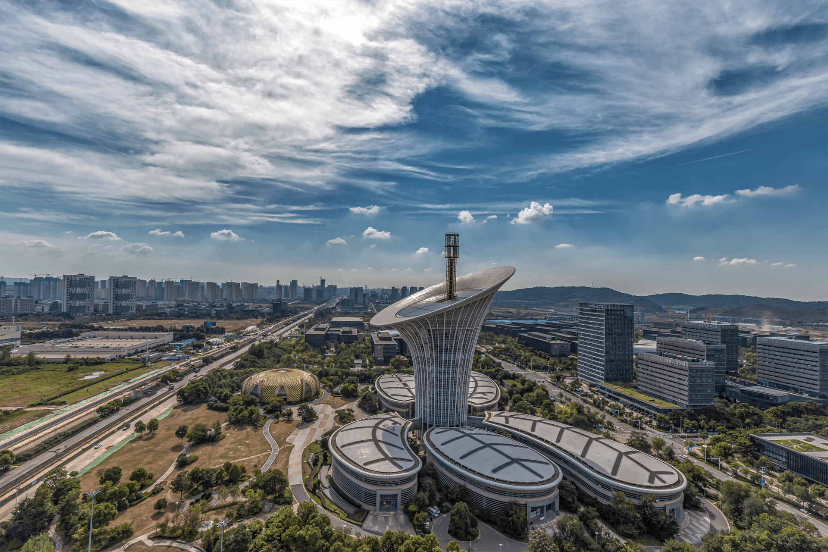
Synergistically utilize technically sound portals with, Synergistically utilize technically sound portals with，Synergistically utilize technically sound portals with
0 1
0 2
Synergistically utilize technically sound portals with, Synergistically utilize technically sound portals with，Synergistically utilize technically sound portals with
Synergistically utilize technically sound portals with, Synergistically utilize technically sound portals with，Synergistically utilize technically sound portals with
Synergistically utilize technically sound portals with, Synergistically utilize technically sound portals with，Synergistically utilize technically sound portals with
0 4
0 3

Slide 25
LOGO
Thanks
JPPPT.COM
Synergistically utilize technically sound portals with frictionless chainsSynergistically，Synergistically utilize technically sound portals with frictionless chainsSynergistically
https://www.jpppt.com

