Slide 1


Business proposal

Slide 2

CONTENT
Who we are
A peep at some distant orb has power to raise and purify our thoughts like a strain of sacred music, or a noble picture, or a passage from the grander poets. It always does one good.
What we Offer
A peep at some distant orb has power to raise and purify our thoughts like a strain of sacred music, or a noble picture, or a passage from the grander poets. It always does one good.
What we do
A peep at some distant orb has power to raise and purify our thoughts like a strain of sacred music, or a noble picture, or a passage from the grander poets. It always does one good.
Where are we Going
A peep at some distant orb has power to raise and purify our thoughts like a strain of sacred music, or a noble picture, or a passage from the grander poets. It always does one good.

Slide 3

PART 01
Copy paste fonts. Choose the only option to retain text.
……

Slide 4





Meet the Team
Victor Hugo
Graphic Designer
Victor Hugo
Graphic Designer
Victor Hugo
Graphic Designer
Victor Hugo
Graphic Designer

Slide 5


Welcome
Message
A peep at some distant orb has power to raise and purify our thoughts like a strain of sacred music, or a noble picture, or a passage from the grander poets. It always does one good.
Victor Hugo
Graphic Designer

Slide 6





Tittle text
MEET THE
TEAM
A peep at some distant orb has power to raise and purify our thoughts like a strain of sacred music.
75%
Powerpoint
50%
Sketch
90%
Photoshop

Slide 7

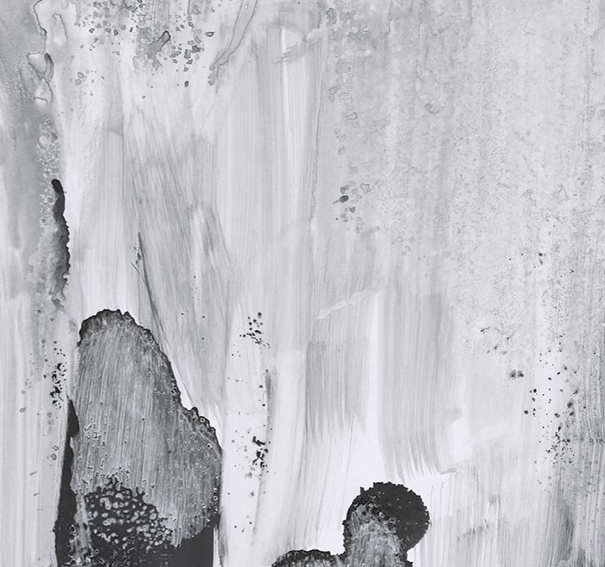

The
Best
Presentation
Summit
20XX
Subtitle here
A peep at some distant orb has power to raise and purify our thoughts like a strain of sacred music, or a noble picture, or a passage from the grander poets. It always does one good.
A peep at some distant orb has power to raise and purify our thoughts like a strain of sacred music, or a noble picture, or a passage from the grander poets.

Slide 8
PART 02
Copy paste fonts. Choose the only option to retain text.
……

Slide 9

Message
A peep at some distant orb has power to raise and purify our thoughts like a strain of sacred music, or a noble picture, or a passage from the grander poets. It always does one good. A peep at some distant orb has power to raise and purify our thoughts like a strain of sacred music, or a noble picture, or a passage from the grander poets. It always does one good.
A peep at some distant orb has power to raise and purify our thoughts like a strain of sacred music, or a noble picture, or a passage from the grander poets. It always does one good.
It always does one good. A peep at some distant orb has power to raise and purify our thoughts like a strain of sacred music, or a noble picture, or a passage from the grander poets. It always does one good.

Slide 10


Headquarters
It always does one good. A peep at some distant orb has power to raise and purify our thoughts like a strain of sacred music, or a noble picture, or a passage from the grander poets. It always does one good.
Title One
A peep at some distant orb has power to raise and purify our thoughts like a strain of sacred music, or a noble picture.
Title One
A peep at some distant orb has power to raise and purify our thoughts like a strain of sacred music, or a noble picture.

Slide 11



Portfolio
Images
Layout
A peep at some distant orb has power to raise and purify our thoughts like a strain of sacred music, or a noble picture, or a passage from the grander poets.
Photo Subtitle
A peep at some distant orb has power to raise and purify our thoughts like a strain of sacred music, or a noble picture.

Slide 12


Value title here
A peep at some distant orb has power to raise and purify our thoughts like a strain of sacred music, or a noble picture, or a passage from the grander poets.
It always does one good. A peep at some distant orb has power to raise and purify our thoughts like a strain of sacred music, or a noble picture, or a passage from the grander poets.
It always does one good.
Value title here
A peep at some distant orb has power to raise and purify our thoughts like a strain of sacred music, or a noble picture, or a passage from the grander poets. It always does one good. A peep at some distant orb has power to raise and purify our thoughts like a strain of sacred music, or a noble picture, or a passage from the grander poets. It always does one good.
Subtitle
A peep at some distant orb has power to raise and purify our thoughts like a strain of sacred music, or a noble picture.

Slide 13
PART 03
Copy paste fonts. Choose the only option to retain text.
……

Slide 14


Title One
Title Two
A peep at some distant orb has power to raise and purify our thoughts like a strain of sacred music, or a noble picture, or a passage from the grander poets.
It always does one good. A peep at some distant orb has power to raise and purify our thoughts like a strain of sacred music, or a noble picture, or a passage from the grander poets.
It always does one good.
Title One
A peep at some distant orb has power to raise and purify our thoughts like a strain of sacred music, or a noble picture, or a passage from the grander poets. It always does one good.
A peep at some distant orb has power to raise and purify our thoughts like a strain of sacred music, or a noble picture, or a passage from the grander poets. It always does one good. like a strain of sacred music, or a noble picture, or a passage from the grander poets. It always does one good.

Slide 15

Emma Harper
”
A peep at some distant orb has power to raise and purify our thoughts like a strain of sacred music, or a noble picture, or a passage from the grander poets.
A peep at some distant orb has power to raise and purify our thoughts like a strain of sacred music, or a noble picture, or a passage from the grander poets. It always does one good.
75%
Powerpoint
50%
Sketch
90%
Photoshop
PPT模板 http://www.1ppt.com/moban/

Slide 16



Portfolio
Three
Layout
Subtitle
A peep at some distant orb has power to raise and purify our thoughts like a strain of sacred music, or a noble picture, or a passage from the grander poets. It always does one good.
A peep at some distant orb has power to raise and purify our thoughts like a strain of sacred music, or a noble picture, or a passage from the grander poets. It always does one good.

Slide 17


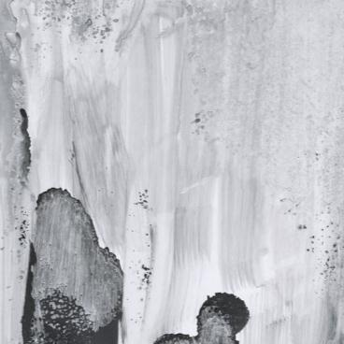






Creat
Members
A peep at some distant orb has power to raise and purify our thoughts like a strain of sacred music, or a noble picture, or a passage from the grander poets. It always does one good. A peep at some distant orb has power to raise and purify our thoughts like a strain of sacred music, or a noble picture, or a passage from the grander poets.
Victor Hugo
Graphic Designer

Slide 18


Products Layout
Title here
A peep at some distant orb has power to raise and purify our thoughts like a strain of sacred music, or a noble picture, or a passage from the grander poets. It always does one good.
Products Layout
Title here
A peep at some distant orb has power to raise and purify our thoughts like a strain of sacred music, or a noble picture, or a passage from the grander poets. It always does one good.

Slide 19
PART 04
Copy paste fonts. Choose the only option to retain text.
……

Slide 20


Devices Mockup

Slide 21

Application
Devices
A peep at some distant orb has power to raise and purify our thoughts like a strain of sacred music, or a noble picture, or a passage from the grander poets. It always does one good.
75%
UI
50%
Program
90%
User interface

Slide 22

Application
Devices
Subtitle
A peep at some distant orb has power to raise and purify our thoughts like a strain of sacred music, or a noble picture, or a passage from the grander poets. It always does one good.
A peep at some distant orb has power to raise and purify our thoughts like a strain of sacred music, or a noble picture, or a passage from the grander poets. It always does one good.

Slide 23

Application
Devices
A peep at some distant orb has power to raise and purify our thoughts like a strain of sacred music, or a noble picture, or a passage from the grander poets. It always does one good.
75%
UI
50%
Program
90%
User interface

Slide 24
Thank
you

